Slide 1
Section 12.1
Rules for Exponents

Slide 2
Properties: The Product Rule for Exponents
If a is a nonzero real number and m and n are integers, then
In words, to multiply powers with the same base, keep the base and add the exponents.

Slide 3
Note
Reminder about the exponent 1: if a variable or constant has no exponent written, the exponent is understood to be 1.
For example,
In general, for any real number a,

Slide 4
Example 1: Using the Product Rule for Exponents
Use the product rule for exponents to simplify the following expressions.
Solution
d.
e.
Keep the base and add the exponents.
This expression cannot be simplified.
The bases are not the same.

Slide 5
Example 1: Using the Product Rule for Exponents (cont.)
Note that the base stays 4.
That is, the bases are not multiplied.
Note that the base stays 2.
That is, the bases are not multiplied.

Slide 6
Example 2: Using the Product Rule for Exponents
Use the product rule for exponents when simplifying the following expressions.
Solution
Apply the commutative property of multiplication. Then, multiply the coefficients 2 and 3 and add the exponents 2 and 9.

Slide 7
Example 2: Using the Product Rule for Exponents (cont.)
Coefficients −3 and −4 are multiplied and exponents 3 and 3 are added.
Coefficients −6 and 8 are multiplied and exponents on each variable are added.

Slide 8
Properties: The Exponent 0
If a is a nonzero real number, then
a⁰ = 1.
The expression 0⁰ is undefined.

Slide 9
Attention!
Throughout this text, unless specifically stated otherwise, we will assume that the bases of exponents are nonzero.

Slide 10
Example 3: Evaluating The Exponent 0
Simplify the following expressions using the rule for 0 as an exponent.
b. c.
Solution

Slide 11
Properties: Quotient Rule for Exponents
If a is a nonzero real number and m and n are integers, then
In words, to divide two powers with the same base, keep the base and subtract the exponents. (Subtract the denominator exponent from the numerator exponent.)

Slide 12
Example 4: Using the Quotient Rule for Exponents
Use the quotient rule for exponents to simplify the following expressions.
b. c.
Solution
Keep the base and subtract the exponents.

Slide 13
Example 4: Using the Quotient Rule for Exponents (cont.)
Note how this example shows another way to justify the idea that a⁰ = 1. Since the numerator and denominator are the same and not 0, it makes sense that the fraction is equal to 1.

Slide 14
Example 5: Dividing Terms with Coefficients
Use the quotient rule for exponents when simplifying the following expressions.
b.
Solution
Coefficients 15 and 3 are divided and exponents 15 and 3 are subtracted.

Slide 15
Example 5: Dividing Terms with Coefficients (cont.)
b.
Coefficients 20 and 2 are divided and exponents on each variable are subtracted.

Slide 16
Properties: Rule for Negative Exponents
If a is a nonzero real number and n is an integer, then

Slide 17
Example 6: Negative Exponents
Use the rule for negative exponents to simplify each expression so that it contains only positive exponents.
b. c.
Solution

Slide 18
Example 6: Negative Exponents (cont.)
Here we use the product rule first and then the rule for negative exponents.

Slide 19
Note
There is nothing wrong with negative exponents. In fact, negative exponents are preferred in some courses in mathematics and science. However, so that all answers are the same, in this course we will consider expressions to be simplified if
all exponents are positive and
each base appears only once.

Slide 20
Example 7: Combining Rules for Exponents
Simplify each expression so that it contains only positive exponents.
Solution
b.
c.
d.
e.
Use the product rule with positive and negative exponents.

Slide 21
Example 7: Combining Rules for Exponents (cont.)
Use the quotient rule with positive and negative exponents.
Use the quotient rule with negative exponents.
Add the exponents.
Use the rule for negative exponents.

Slide 22
Example 7: Combining Rules for Exponents (cont.)

Slide 23
Example 7: Combining Rules for Exponents (cont.)
Use the rule for negative exponents.
(Note: Notice that the negative exponent relates only to the variable x, not to the number 10.)

Slide 24
Attention!
Using the Quotient Rule
Regardless of the size of the exponents or whether they are positive or negative, the following single subtraction rule can be used with the quotient rule.
(numerator exponent − denominator exponent)
This subtraction will always lead to the correct answer.

Slide 25
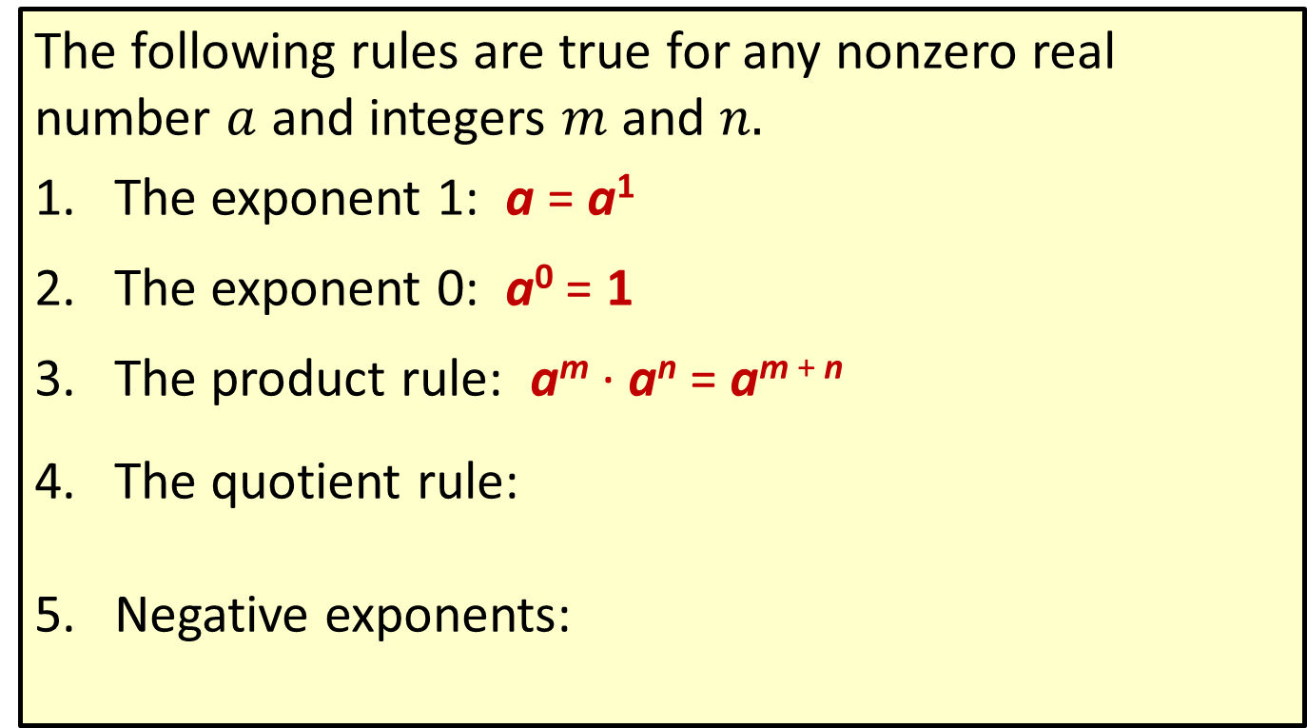
Properties: Summary of the Rules for Exponents
The following rules are true for any nonzero real number $a$ and integers $m$ and $n.$
The exponent 1: a = a¹
The exponent 0: a⁰ = 1
The product rule: a^{m} · a^{n} = a^{m + n}
The quotient rule:
Negative exponents:

Slide 26

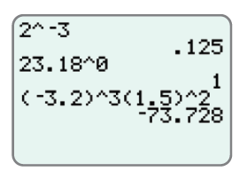
Example 8: Evaluating Exponential Expressions
Use a graphing calculator to evaluate each expression.
Solution
The following solutions show how the caret key is used to indicate exponents.
b.
c.

Slide 27

Example 8: Evaluating Exponential Expressions (cont.)
Be careful to use the negative sign key (and not the minus sign key) for negative numbers and negative exponents. Use parentheses as they are given in the expression being evaluated.

