Slide 1
Section 12.3
Applications: Scientific Notation

Slide 2
Definition: Scientific Notation
If N is a decimal number, then in scientific notation
N = a × 10 ^{n} where 1 ≤ |a| < 10 and n is an integer.

Slide 3

Example 1: Writing Decimals in Scientific Notation
Write the following decimal numbers in scientific notation.
Solution
b.
To check, move the decimal point 6 places to the
right and get the original number:
$$8.72×{10}^{6}=8.720000.=$$
1 2 3 4 5 6

Slide 4
Example 1: Writing Decimals in Scientific Notation (cont.)
To check, move the decimal point 7 places to the
left and get the original number:
7 6 5 4 3 2 1

Slide 5
Example 2: Using Scientific Notation while Simplifying
Simplify the following expressions by first writing the decimal numbers in scientific notation and then using the properties of exponents.
Solution
b.
Write each number in
scientific
notation.

Slide 6
Example 2: Using Scientific Notation while Simplifying (cont.)
Reduce and simplify by
using the appropriate
rules for exponents.

Slide 7
Example 2: Using Scientific Notation while Simplifying (cont.)
Write each
b.
number in
scientific
notation.
0.3
0.8
Reduce and
simplify by
using the appropriate rules for exponents.

Slide 8
Example 3: Application: Scientific Notation
Light travels approximately meters per second. How many meters per minute does light travel?
Solution
Since there are 60 seconds in one minute, multiply by 60.
Thus, light travels meters per minute.

Slide 9
Example 3: Application: Scientific Notation (cont.)
(Note: In decimal form, this is 18,000,000,000 meters
per minute. So, you can see why scientists prefer
scientific notation.)

Slide 10
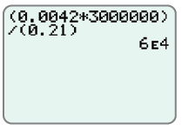
Example 4: Scientific Notation and Calculators
Use a graphing calculator to evaluate each expression. Leave the answer in scientific notation.
b.
Solution
With a graphing calculator
(set in scientific notation mode) the
display should appear as shown here.
Note that the E in the display
indicates an exponent with base 10.

Slide 11
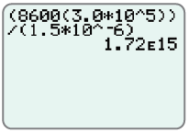

Example 4: Scientific Notation and Calculators (cont.)
With a graphing calculator (set in
scientific notation mode) the display
should appear as shown here.
Note: Remember, the caret key
is used to indicate an exponent
and that the numerator and
denominator must be set in parentheses.

Slide 12

Note
You can press the key and select SCI to have all calculations in scientific notation.

Slide 13
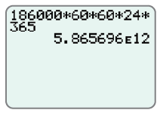
Example 5: Application: Scientific Notation and Calculators
A light-year is the distance light travels in one year. Use a graphing calculator to find the length of a light-year in scientific notation if light travels 186,000 miles per second.
Solution
60 seconds = 1 minute
60 minutes = 1 hour
24 hours = 1 day
365 days = 1 year
Multiplication gives the following
display on your calculator.

Slide 14
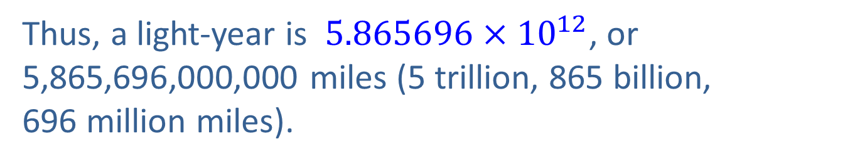
Example 5: Application: Scientific Notation and Calculators (cont.)
Thus, a light-year is $5.865696×{10}^{12}$, or 5,865,696,000,000 miles (5 trillion, 865 billion,
696 million miles).

