Slide 1
Section 15.3
Rational Exponents

Slide 2
n^{th} Roots
Type of Root | Radical Notation and Exponential Notation | Example
Square roots
Cube roots
Fourth roots
n^{th} roots
Table 1

Slide 3
Definition: Radical Notation
If n is an integer greater than 1, then (assuming is a real number).
The expression is called a radical.
The symbol is called a radical sign.
n is called the index.
a is called the radicand.
Note: If no index is given, it is understood to be 2. For
example,

Slide 4
Note: Special Notes about the Index n
For the expression (or ) to be a real number (assuming n is an integer greater than 1):
when a is nonnegative, n can be any index, and
when a is negative, n must be odd. (If a is negative and n is even, then is not a real number.)

Slide 5
Example 1: Evaluating n^{th} Roots
because 7² = 49.
because 3⁴ = 81.
is not a real number.
Any even root of a negative number is not a real number.

Slide 6
Properties: Summary of the Rules for Exponents
For nonzero real numbers a and b and rational numbers m and n,
The exponent 1: a¹ = a (a is any real number.)
The exponent 0: a⁰ = 1 (a ≠ 0)
The product rule: a^{m} ∙ a^{n} = a^{m + n}
The quotient rule:

Slide 7
Properties: Summary of the Rules for Exponents (cont.)
Negative exponents:
Power rule:
Power of a product:
Power of a quotient:

Slide 8

Definition: The General Form $a^{\frac{m}{n}}$
If n is an integer greater than 1, m is any integer, and is a real number, then
In radical notation:

Slide 9
Example 2: Converting from Exponential Notation to Radical Notation
Assume that each variable represents a positive real number. Each expression is changed to an equivalent expression in either radical or exponential notation.
The index, 3, is the denominator in the rational exponent.
The coefficient, 3, is not affected by the exponent.
−1 is the understood coefficient.

Slide 10
Example 2: Converting from Exponential Notation to Radical Notation (cont.)
The index, 6, is the denominator of the rational exponent.
In a square root, the index is understood to be 2.
The coefficient, −1, is not affected by the exponent. We could also write

Slide 11
Attention!
For the remainder of this chapter, we will assume that all variables represent positive real numbers, unless otherwise stated.

Slide 12
Example 3: Simplifying Expressions with Rational Exponents
Simplify each expression using one or more of the rules for exponents.

Slide 13
Example 3: Simplifying Expressions with Rational Exponents (cont.)
Add the exponents.
Subtract the exponents.

Slide 14
Example 3: Simplifying Expressions with Rational Exponents (cont.)
Multiply the exponents of y and reduce.
This is not a real number.
is not real.

Slide 15
Example 3: Simplifying Expressions with Rational Exponents (cont.)
The exponent can be reduced as long as the expression is real.
Use the power rule four times.
Simplify the exponents.
Use the properties of negative exponents.

Slide 16
Example 4: Simplifying Radical Notation by Changing to Exponential Notation
Simplify each expression by first changing it into an equivalent expression with rational exponents. Then rewrite the answer in simplified radical form. Assume that all variables represent positive real numbers.

Slide 17
Example 4: Simplifying Radical Notation by Changing to Exponential Notation (cont.)

Slide 18
Example 4: Simplifying Radical Notation by Changing to Exponential Notation (cont.)

Slide 19
Example 4: Simplifying Radical Notation by Changing to Exponential Notation (cont.)

Slide 20

Example 5: Evaluating Rational Exponents using a Calculator
Evaluate the following expressions using a TI-84 Plus graphing calculator.
b.
Solution
a. To find proceed as follows.
Step 1: Enter the base, 125.
Step 2: Press the caret key .

Slide 21

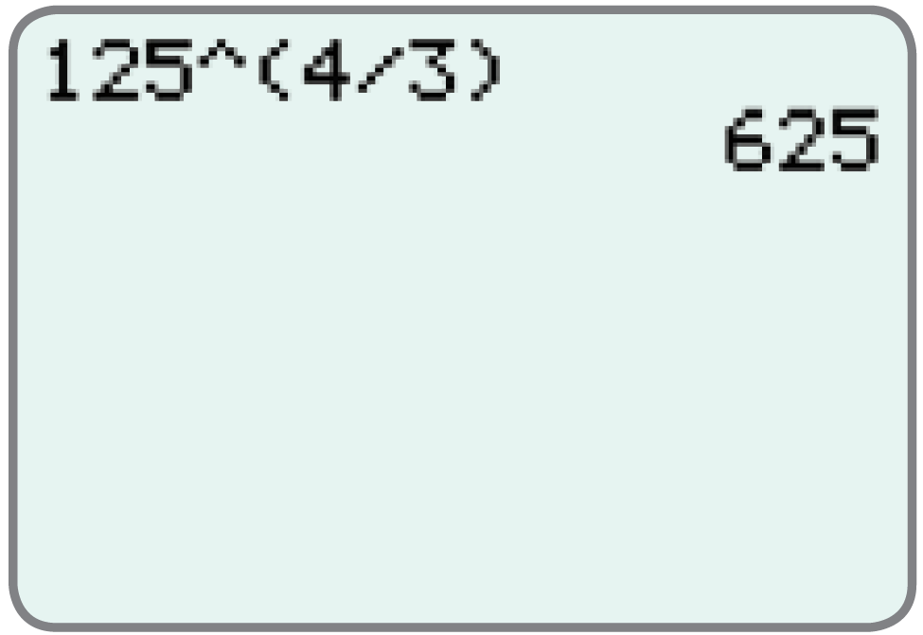
Example 5: Evaluating Rational Exponents using a Calculator (cont.)
Step 3: Enter the exponent in parentheses,
Step 4: Press .
The display should appear as follows.

Slide 22
Example 5: Evaluating Rational Exponents using a Calculator (cont.)
To find proceed as follows.
Step 1: Enter the base, 36.
Step 2: Press the caret key .
Step 3: Enter the exponent in parentheses,
Step 4: Press .

Slide 23
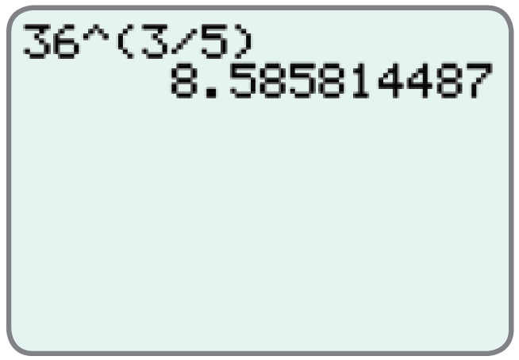
Example 5: Evaluating Rational Exponents using a Calculator (cont.)
The display should appear as follows.

