Slide 1
Section 15.7
Functions with Radicals

Slide 2
Definition: Relation, Domain, and Range
A relation is a set of ordered pairs of real numbers.
The domain D of a relation is the set of all first coordinates in the relation.
The range R of a relation is the set of all second coordinates in the relation.

Slide 3
Definition: Function
A function is a relation in which each domain element has exactly one corresponding range element.

Slide 4
Definition: Vertical Line Test
If any vertical line intersects the graph of a relation at more than one point, then the relation is not a function.

Slide 5
Definition: Radical Function
A radical function is a function of the form in which the radicand contains a variable expression.
The domain of such a function depends on the index, n.
If n is an even number, the domain is the set of all x such that
If n is an odd number, the domain is the set of all real numbers,

Slide 6
Definition: Radical Function (cont.)
The range of the function also depends on the index n.
If n is an even number, the range is the set of all real numbers greater than or equal to 0,
If n is an odd number, the range is the set of all real numbers,

Slide 7
Example 1: Finding the Domain of a Radical Function
Determine the domain of each radical function.
a. b.
Solution
Because the index is 2, the radicand must be nonnegative. (That is, the expression under the radical sign cannot be negative.)

Slide 8
Example 1: Finding the Domain of a Radical Function (cont.)
Thus, we must have
and the domain is the interval of real numbers

Slide 9
Example 1: Finding the Domain of a Radical Function (cont.)
b. Because the index is 3, an odd number, the radicand may be any real number.
Thus, the domain is the set of all real numbers

Slide 10
Example 2: Evaluating Radical Functions
Complete each table by finding the corresponding f(x) values for the given values of x.
b.
x | f (x)
7 | ?
6 | ?
−1 | ?
x | f (x)
0 | ?
4 | ?
6 | ?

Slide 11
Example 2: Evaluating Radical Functions (cont.)
Solution
a. b.
x | f (x)
7
6
−1
x | f (x)
0
4
6

Slide 12
Example 3: Graphing a Radical Function
Graph the function
Solution
For the domain, we have x + 5 ≥ 0, so x ≥ −5.
To see the nature of the graph, we select a few values for x in the domain and find the corresponding values of y. Then we plot the points on a graph.

Slide 13
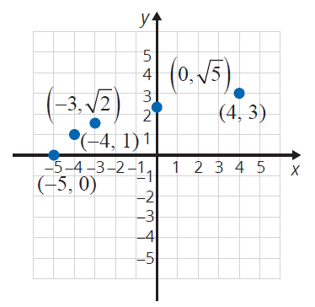
Example 3: Graphing a Radical Function (cont.)
x | y
−5
0
−4
1
−3
0
4
3

Slide 14
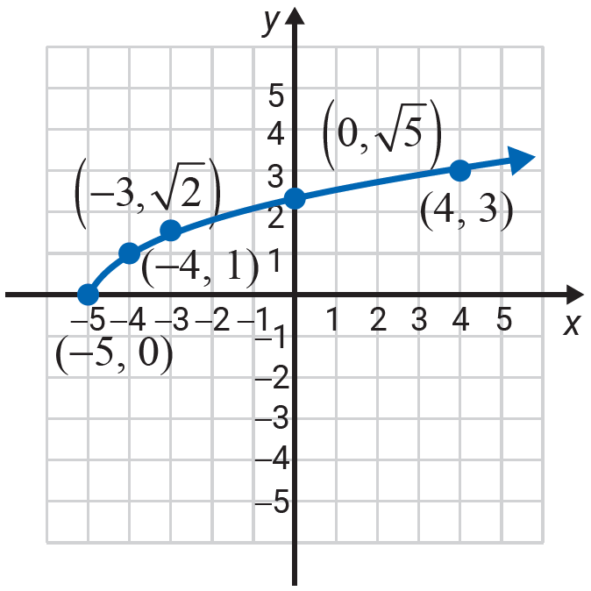
Example 3: Graphing a Radical Function (cont.)
Note that is the principal square root. This means that y ≥ 0. Thus, the point (−5, 0) is on the x-­axis and is a zero of the function. The remaining points on the graph are above the x-axis. So, we can complete the graph by drawing a smooth curve that passes through the selected points. The graph of the function is shown here.
We see that the domain is and the range is

Slide 15



Example 4: Using a TI-84 Plus to Graph a
Radical Function
Use the TABLE feature of a TI-84 Plus graphing calculator to locate seven points on the graph of the function
Solution
Use the TABLE feature of a TI-84 Plus graphing
calculator.
Step 1: Press and enter the function as follows:
Press .
Choose 4:
Enter 2x − 3) and press .

Slide 16


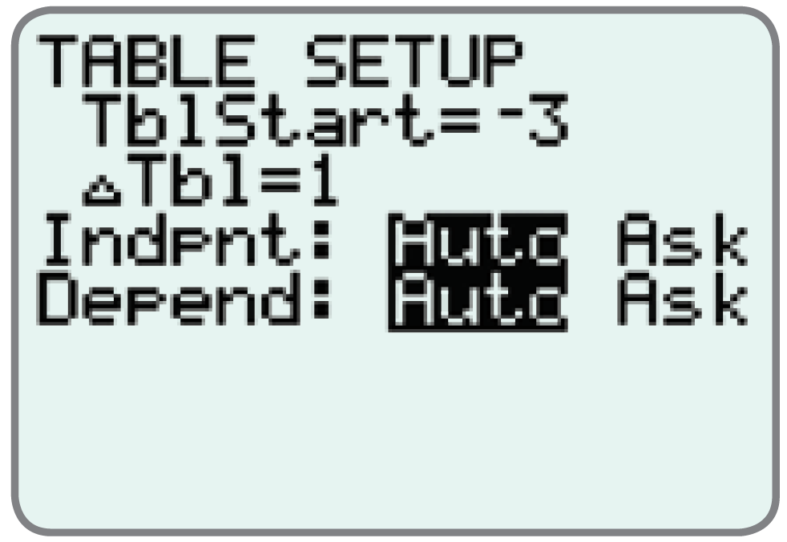
Example 4: Using a TI-84 Plus to Graph a
Radical Functions (cont.)
Step 2: Press TBLSET, (which is ) and set the display as shown here.

Slide 17

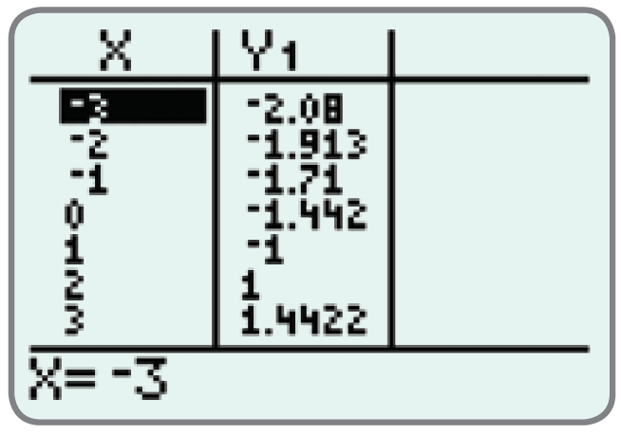
Example 4: Using a TI-84 Plus to Graph a
Radical Functions (cont.)
Step 3: Press TABLE (which is ) and the display will appear as follows.

Slide 18
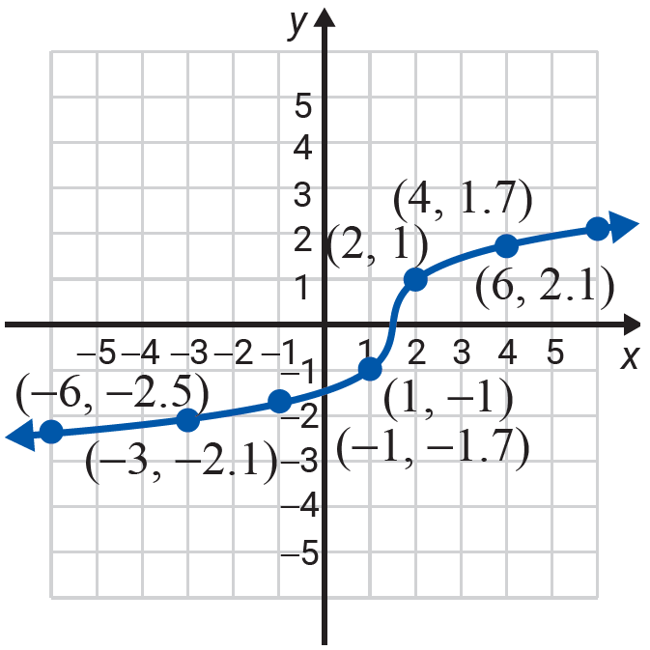
Example 4: Using a TI-84 Plus to Graph a
Radical Functions (cont.)
Plot seven points (approximately) on a graph and then connect them with a smooth curve.
Solution
b. Once your calculator is displaying the table, you may scroll up and down the display to find as many points as you like. Seven are shown here to see the nature of the graph.

Slide 19
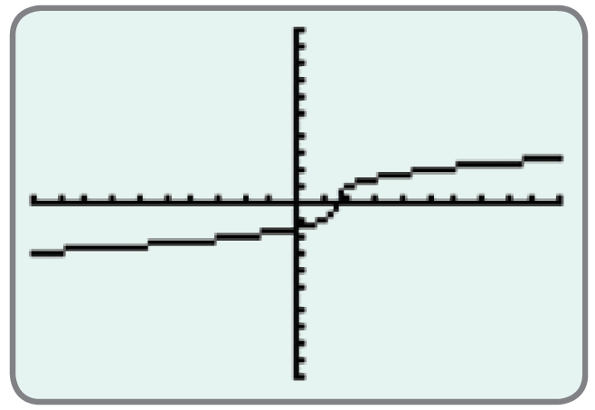
Example 4: Using a TI-84 Plus to Graph a
Radical Functions (cont.)
c. Use a TI-84 Plus graphing calculator to graph the function.
Solution
c. Press and the display will appear with the following curve.

