Slide 1
Section 18.3
Distance Formula, Midpoint Formula, and Circles

Slide 2
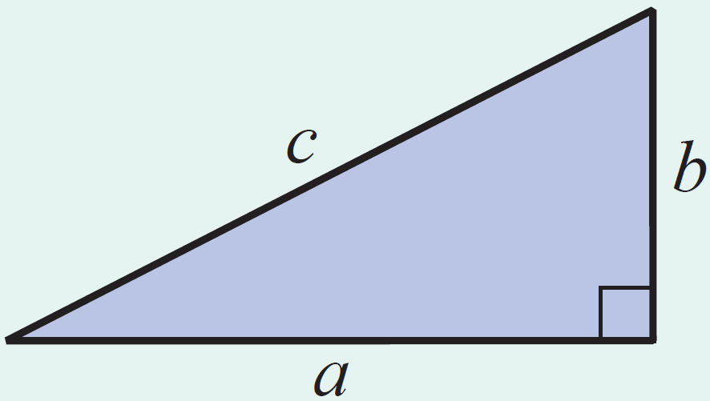
Theorem: The Pythagorean Theorem
In a right triangle, if c is the length of the hypotenuse and a and b are the lengths of the legs, then
c² = a² + b².

Slide 3
Formula: The Distance Formula
For two points P(x₁, y₁) and Q(x₂, y₂) in a plane, the distance between the points is

Slide 4
Example 1: Using the Distance Formula
Find the distance between the two points (3, 4) and (−2, 7).
Solution

Slide 5
Example 2: Determining If a Triangle is a Right Triangle
Use the distance formula (3 times) and the Pythagorean Theorem to determine whether the triangle with vertices at is a right triangle.
Solution
Find the lengths of the three line segments and decide whether the Pythagorean Theorem is satisfied.

Slide 6
Example 2: Determining If a Triangle is a Right Triangle (cont.)

Slide 7
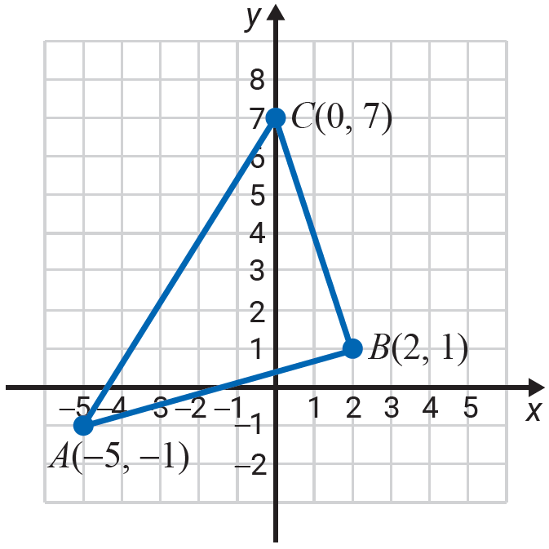
Example 2: Determining If a Triangle is a Right Triangle (cont.)
The longest side is
The triangle is not a right triangle since
as 89 ≠ 53 + 40.

Slide 8
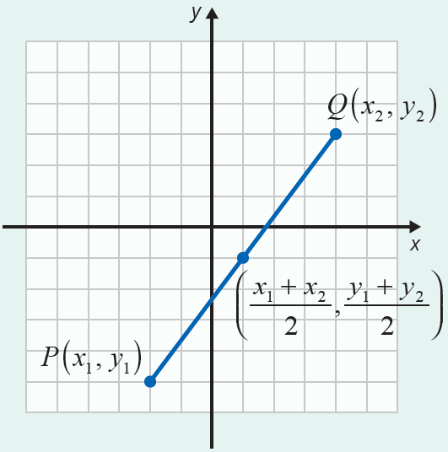
Formula: Midpoint Formula
The formula for the midpoint between two points P(x₁, y₁) and Q(x₂, y₂) is

Slide 9
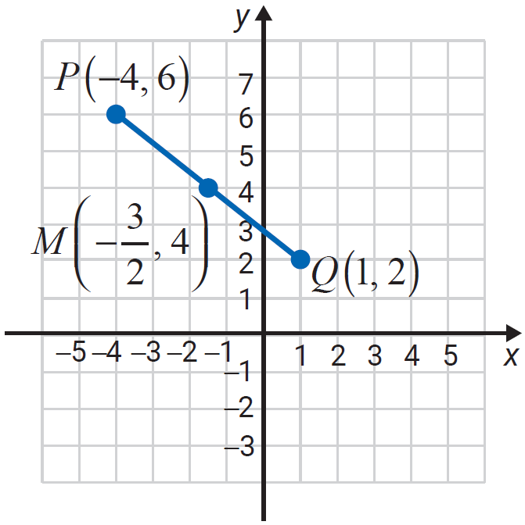
Example 3: Finding the Midpoint
Find the coordinates of the midpoint of the line segment joining the two points P(−4,6) and Q(1,2).
Solution
The midpoint is

Slide 10
Definition: Circle, Center, Radius, and Diameter
A circle is the set of all points in a plane that are a fixed distance from a fixed point.
The fixed point is called the center of the circle.
The distance from the center to any point on the circle is called the radius of the circle.
The distance from one point on the circle to another point on the circle measured through the center is called the diameter of the circle.
Note: The diameter is twice the length of the radius.

Slide 11
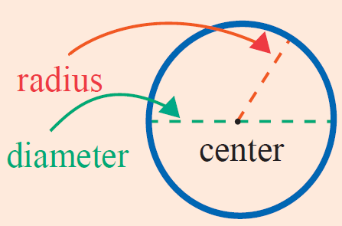
Definition: Circle, Center, Radius, and Diameter (cont.)

Slide 12
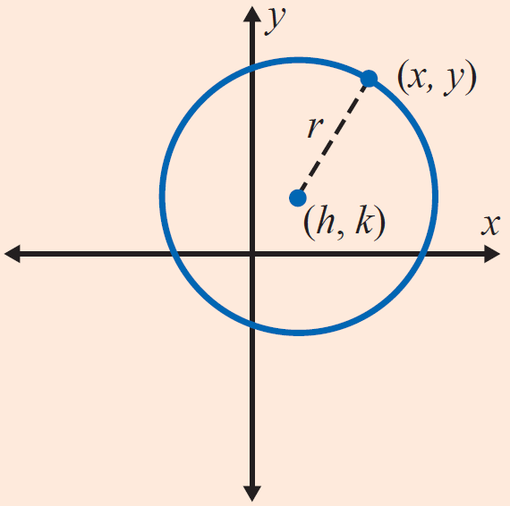
Definition: Equation of a Circle
The equation of a circle with radius r and center at (h, k) is
If the center is at the origin, (0, 0), the equation simplifies to

Slide 13
Example 4: Finding the Equation of a Circle
Find the equation of the circle with its center at the origin and radius Are the points and (1,2) on the circle?
Solution
The equation of the circle is
To determine whether or not the points and (1,2) are on the circle, substitute each of these points into the equation.

Slide 14
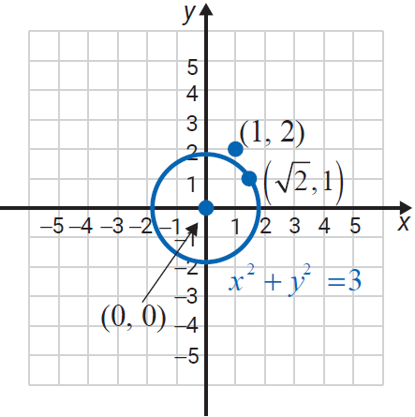
Example 4: Finding the Equation of a Circle (cont.)
Substituting gives
Substituting (1,2) gives
Therefore, is on the circle, but (1,2) is not on the circle.

Slide 15
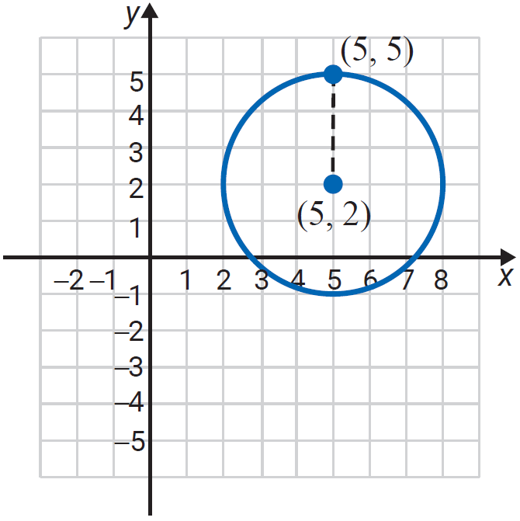
Example 5: Finding the Equation of a Circle
Find the equation of the circle with center at (5, 2) and radius 3. Is the point (5, 5) on the circle?
Solution
The equation of the circle is
Substituting (5, 5) gives
Therefore, (5, 5) is on the circle.

Slide 16
Example 6: Graphing a Circle
Show that represents a circle. Find its center and radius. Then graph the circle.
Solution
Rearrange the terms and complete the square for and

Slide 17
Example 6: Graphing a Circle (cont.)
Add 16 and 1 to both sides.
Complete the squares
Standard form for the equation of a circle
Center is at and

Slide 18
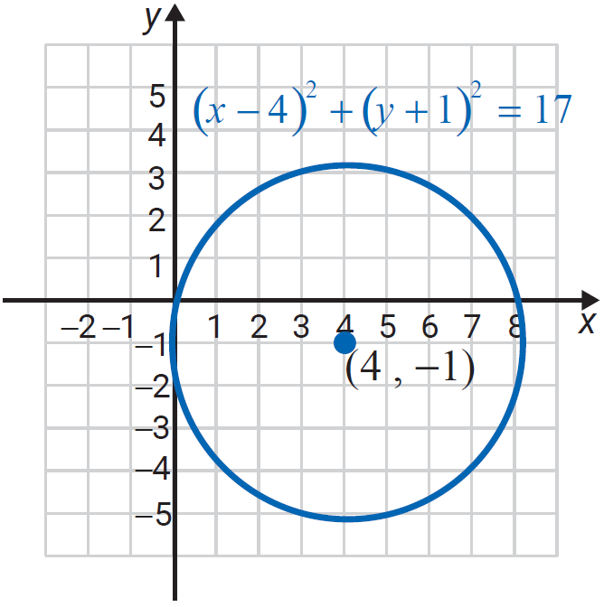
Example 6: Graphing a Circle (cont.)

Slide 19

Example 7: Using a Graphing Calculator to Graph Circles
Use a TI-84 Plus graphing calculator to graph the circle x² + y² = 9.
Solution
Press the key and set the values to −6 and 6 for Xmin and Xmax and −4 and 4 for Ymin and Ymax, respectively.
Solving for y² gives:
Solving for y₁ and y₂ gives:

Slide 20
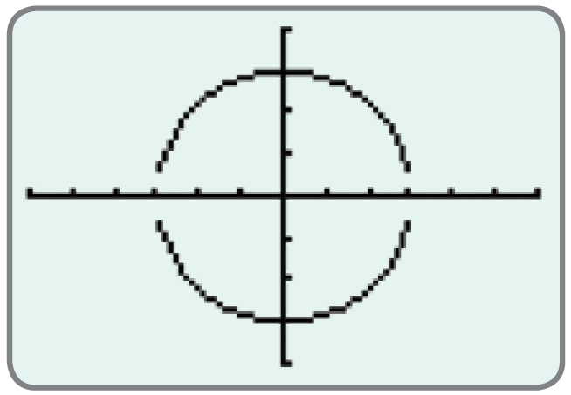
Example 7: Using a Graphing Calculator to Graph Circles (cont.)
Graphing both y₁ and y₂ gives the following graph of the circle.

