Slide 1
Section 2.1
Introduction to Fractions and Mixed Numbers

Slide 2
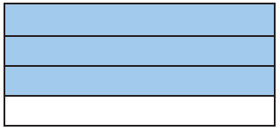
Example 1: Understanding Fractions
Write a fraction indicating
the shaded part of the rectangle and
the unshaded part of the rectangle.
Solution
In the rectangle, 3 of the 4 equal parts are shaded.
Thus, of the rectangle is shaded.
b. is not shaded.

Slide 3
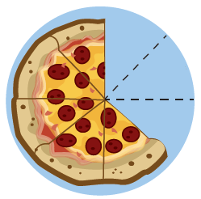
Example 2: Understanding Fractions
Write a fraction indicating
the remaining portion of the pizza and
the missing portion of the pizza.
Solution
The pizza was cut into 8 equal pieces. The 5 pieces
remaining represent of the pizza.
The missing portion of the pizza represents of the
pizza.

Slide 4
Definition: Proper Fractions and Improper Fractions
A proper fraction is a fraction in which the numerator
is less than the denominator. (Proper fractions have
values less than 1.)
Examples of proper fractions:

Slide 5
Definition: Proper Fractions and Improper Fractions (cont.)
An improper fraction is a fraction in which the
numerator is greater than or equal to the
denominator. (Improper fractions have values greater
than or equal to 1.)
Examples of improper fractions:

Slide 6
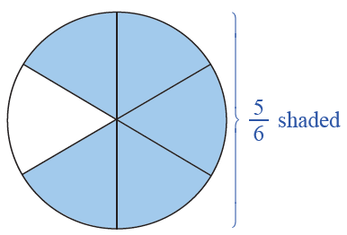
Example 3: Understanding Proper Fractions
Draw a figure to represent the fraction
Solution
indicates 5 of 6 equal parts. Drawing a figure to
represent this fraction, we divide a circle into 6 equal sections and shade 5 of them. (Note: Figures other than circles can be used.)

Slide 7
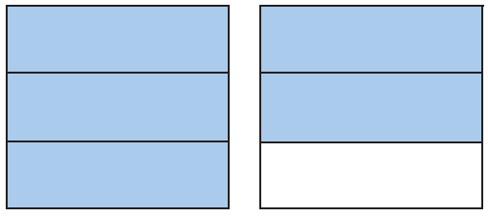
Example 4: Understanding Improper Fractions
Write a fraction that indicates the shaded parts of the figure.
Solution
There are two squares, each
separated into 3 equal parts.
This means that the denominator is 3. The shading here indicates 5 of these equal parts, which means the numerator is 5. Thus, the shaded part of the figure can
be represented by the improper fraction

Slide 8
Definition: Variable
A variable is a symbol (generally a letter of the alphabet) that is used to represent an unknown number.

Slide 9
Definition: The Number 0 in Fractions
For any nonzero value of
For any value of is undefined.

Slide 10
Example 5: Evaluating Fractions Involving 0
Find the value of each expression.
Solution

Slide 11
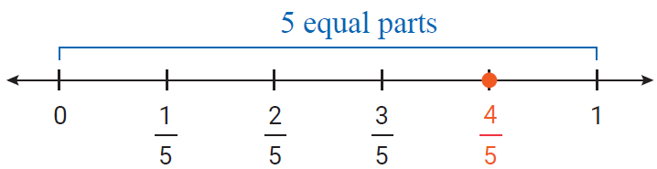
Example 6: Graphing Proper Fractions
Graph each proper fraction on a number line.
Solution
a.

Slide 12
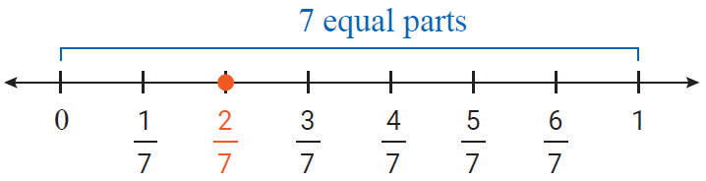
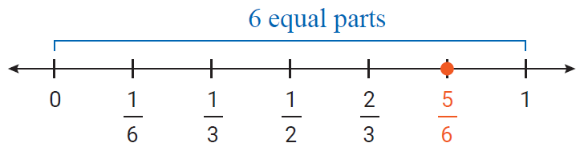
Example 6: Graphing Proper Fractions (cont.)

Slide 13
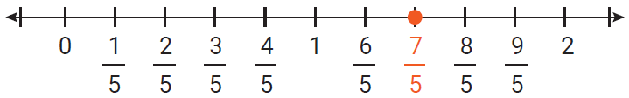
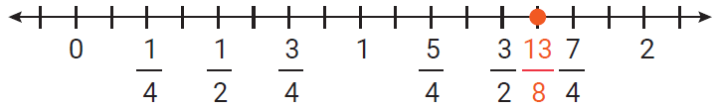
Example 7: Graphing improper Fractions
Graph each of the following improper fractions on a number line.
Solution
a.
b.

Slide 14
Example 8: Identifying Types of Fractions and Mixed Numbers
Identify each number as a proper fraction, an improper fraction, or a mixed number.
Solution
a. improper fraction
b. mixed number
c. proper fraction

Slide 15
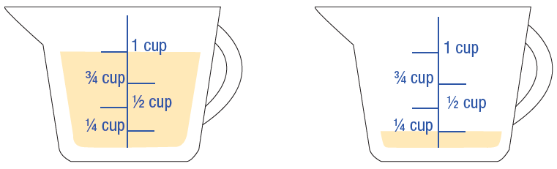
Example 9: Application: Understanding Mixed Numbers
A recipe calls for the amount of oil indicated in the figure.
Write a mixed number indicating the amount of oil in the measuring cups.
Write this amount as an improper fraction.

Slide 16
Example 9: Application: Understanding Mixed Numbers (cont.)
Solution
a. Each cup is marked in fourths and we see that there
is a total of cups.
b. As an improper fraction, cups = cups.

Slide 17
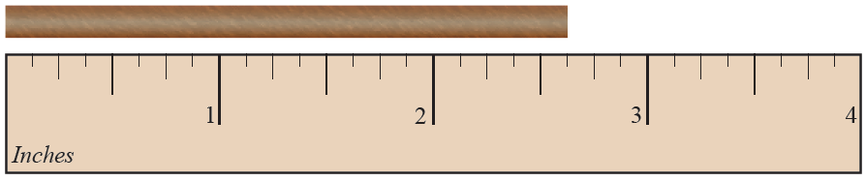
Example 10: Application: Understanding Mixed Numbers
A wooden rod is cut to the length indicated in the figure. Write the length of the rod as a mixed number.
Solution
The ruler is marked in eighths of an inch. The rod
measures in.

Slide 18
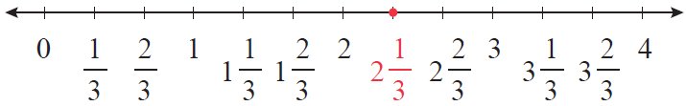
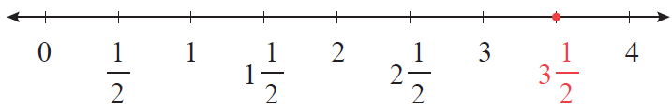
Example 11: Graphing Mixed Numbers
Graph each of the following mixed numbers on a number line.
Solution
a.
b.

Slide 19
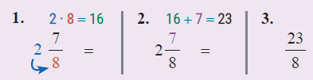
Procedure: Changing a Mixed Number to an Improper Fraction
Multiply the whole number by the denominator of the proper fraction.
Add the numerator of the proper fraction to this product.
Write this sum over the denominator of the fraction.

Slide 20
Example 12: Changing Mixed Numbers to Improper Fractions
Change to an improper fraction.
Solution
Step 1: Multiply the whole number by the denominator: 8 ∙ 10 = 80
Step 2: Add the numerator: 80 + 9 = 89
Step 3: Write this sum over the denominator:

Slide 21
Completion Example 13: Changing Mixed Numbers to Improper Fractions
Change to an improper fraction.
Solution
Step 1: Multiply the whole number by the denominator: 11 ∙ 3 = ____
Step 2: Add the numerator: _____ + _____ = ____
Step 3: Write this sum over the denominator:
______

Slide 22
Procedure: Changing an Improper Fraction to a Mixed Number
Divide the numerator by the denominator. The quotient is the whole number part of the mixed number.
Write the remainder over the denominator as the fraction part of the mixed number.

Slide 23
Example 14: Changing Improper Fractions to Mixed Numbers
Change to a mixed number.
Solution
Step 1:
Divide the numerator by the
denominator. The quotient
is the whole number part
of the mixed number.
Whole number part
Remainder

Slide 24
Example 14: Changing Improper Fractions to Mixed Numbers (cont.)
Step 2:
Write the remainder over the denominator as the fraction part of the mixed number:

Slide 25
Example 15: Changing Improper Fractions to Mixed Numbers
Change to a mixed number.
Solution
Step 1: Divide the numerator by
the denominator. The quotient
is the whole number part of the
mixed number.
Whole number part
Remainder

Slide 26
Example 15: Changing Improper Fractions to Mixed Numbers (cont.)
Step 2:
Write the remainder over the denominator as the fraction part of the mixed number:

