Slide 1
Section 6.1
Angles and Triangles

Slide 2
Definition: Point, Line, Plane
Undefined Term | Representation | Discussion
Point | A Point A | A point is represented by a dot. Points are labeled with capital letters.
·

Slide 3
Definition: Point, Line, Plane (cont.)
Undefined Term | Representation | Discussion
Line |  | A line has no beginning or end. Lines are labeled with lowercase letters or by two points on the line.
l
A
B
Line l or line AB

Slide 4
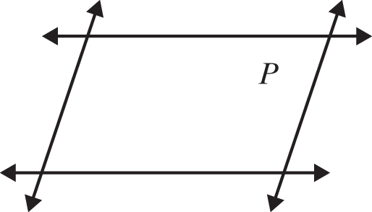
Definition: Point, Line, Plane (cont.)
Undefined Term | Representation | Discussion
Plane | Plane P | Flat surfaces, such as a table top or wall, represent portions of planes. Planes are labeled with capital letters.

Slide 5
Definition: Ray and Angle
Term | Definition | Illustrations with Notation
Ray | A ray consists of a point (called the endpoint) and all the points on a line on one side of that point.
Q
P
Ray PQ with endpoint P

Slide 6
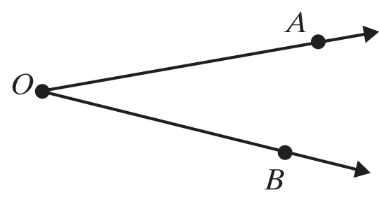
Definition: Ray and Angle (cont.)
Term | Definition | Illustrations with Notation
Angle | An angle consists of two rays with a common endpoint. (The two rays are called the sides of the angle and the endpoint is called the vertex.)

Slide 7
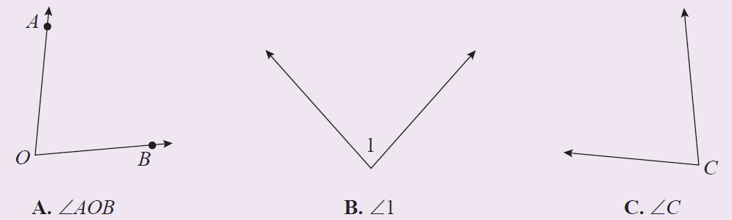
Procedure: Labeling Angles
There are three common ways of labeling angles:
Using three capital letters with the vertex as the middle letter.
Using single numbers such as 1, 2, 3.
Using the single capital letter at the vertex when the meaning is clear.

Slide 8
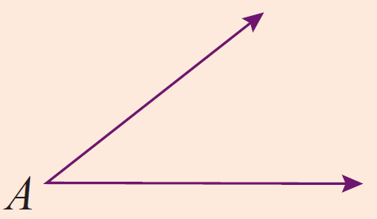
Definition: Angles Classified by Measure
Name | Measure | Illustrations with Notation
Acute |  | is an acute angle.

Slide 9
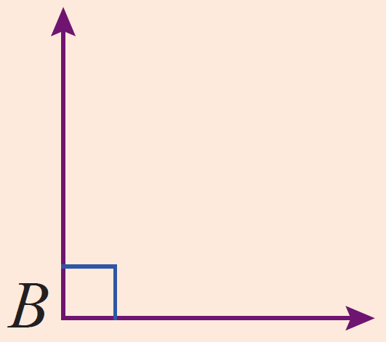
Definition: Angles Classified by Measure (cont.)
Name | Measure | Illustrations with Notation
Right |  | is a right angle.

Slide 10
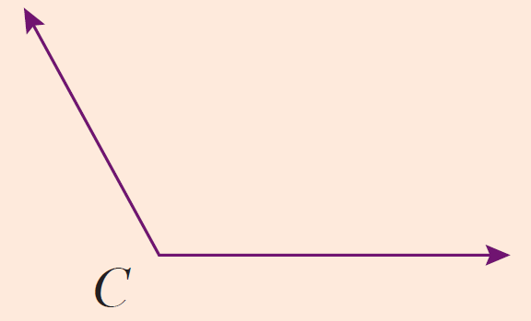
Definition: Angles Classified by Measure (cont.)
Name | Measure | Illustrations with Notation
Obtuse |  | is an obtuse angle.

Slide 11
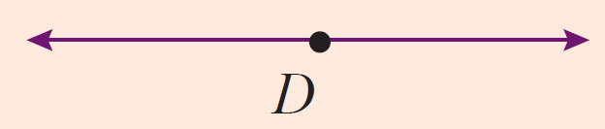
Definition: Angles Classified by Measure (cont.)
Name | Measure | Illustrations with Notation
Straight |  | is a straight angle. (The rays are in opposite directions.)

Slide 12
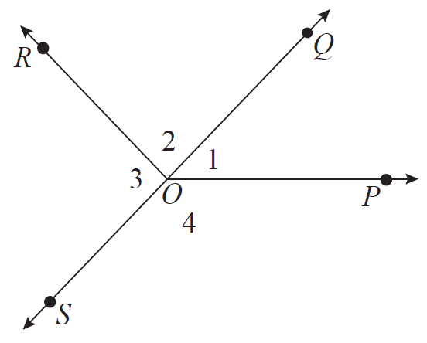
Introduction to Geometry
Figure 3 is used for Examples 1 and 2.
Figure 1

Slide 13
Example 1: Measuring Angles
Check the measures of (from Figure 3) using a protractor. (You may need to extend the rays to be able to read the numbers on your protractor.)
Solutions

Slide 14
Example 2: Classifying Angles by Their Measure
Classify each angle (from Figure 3) as acute, right, obtuse, or straight.
Solutions
∠1
∠2
∠POR

Slide 15
Definition: Complementary and Supplementary Angles
Two angles are complementary if the sum of their measures is 90˚.
Two angles are supplementary if the sum of their measures is 180˚.

Slide 16
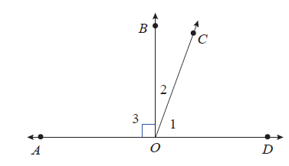
Example 3: Identifying Complementary and Supplementary Angles
In the figure shown, is a straight line. Identify all pairs of complementary, supplementary, and straight angles.

Slide 17
Example 3: Identifying Complementary and Supplementary Angles (cont.)
Solution
∠1 and ∠2 are complementary since
∠COD and ∠COA are supplementary.
∠AOD is a straight angle since
∠BOA and ∠BOD are supplementary; and in this case

Slide 18
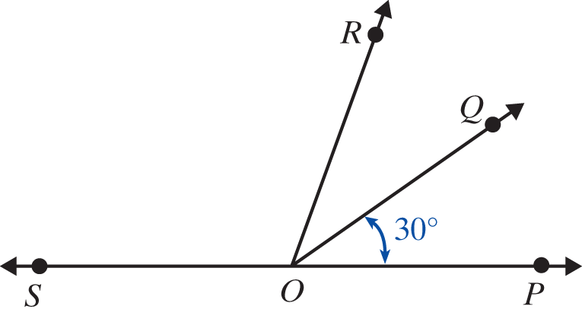
Example 4: Calculating Measures of Angles
In the figure shown, is a straight line and
Find the measure of ∠QOS.
Find the measure of ∠SOP.
c. Are any pairs of angles supplementary?

Slide 19
Example 4: Calculating Measures of Angles (cont.)
Solution
Yes, ∠QOP and ∠QOS are supplementary and ∠ROP and ∠ROS are supplementary.

Slide 20
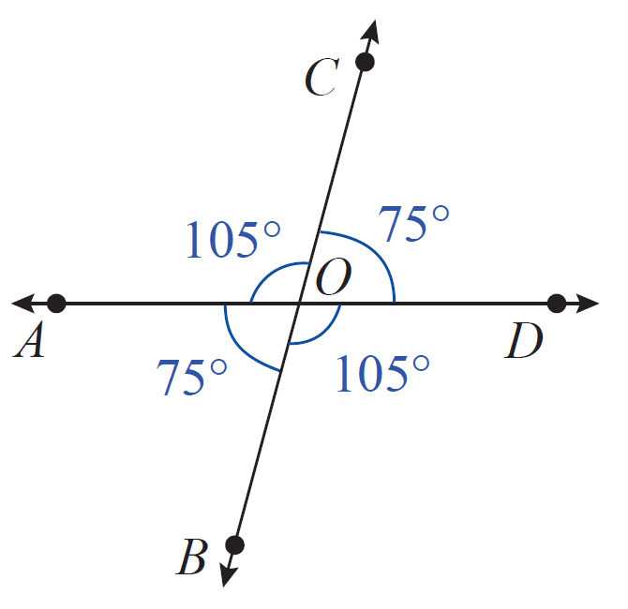
Example 5: Identifying Congruent Angles
Identify the congruent angles in the figure.
Solution

Slide 21
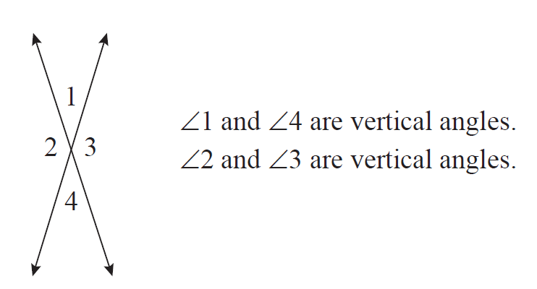
Congruent, Vertical, and Adjacent Angles
Two lines intersect if they have exactly one point in common. If two lines intersect, then two pairs of vertical angles are formed. Vertical angles are opposite each other. (See Figure 5.)
Figure 5

Slide 22
Definition: Vertical Angles
Vertical angles are congruent. That is, vertical angles have the same measure.
(Note: In Figure 5, ∠1 ≅ ∠4 and ∠2 ≅ ∠3.)

Slide 23
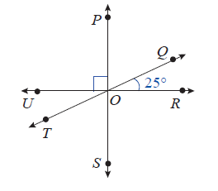
Example 6: Calculating Measures of Angles
In the given figure, three lines intersect at the point O.
Find the measure of each angle.
a. ∠TOU b. ∠ROS c. ∠POQ d. ∠SOT

Slide 24
Example 6: Calculating Measures of Angles (cont.)
Solution
are vertical angles and have the same measure. This means that
are vertical angles and have the same measure. This means that

Slide 25
Example 6: Calculating Measures of Angles (cont.)
Because is a straight line, we have
are vertical angles and have the same measure. This means

Slide 26
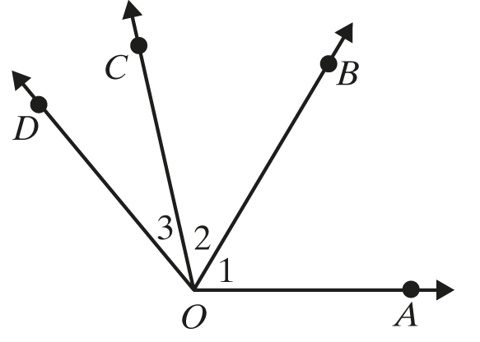
Definition: Adjacent Angles
Two angles are adjacent if they share a common vertex and a common side but do not overlap. (See Figure 6.)
∠1 and ∠2 are adjacent angles.
They have the common side
∠2 and ∠DOB are not adjacent even
though they share vertex and
common side
Figure 6

Slide 27
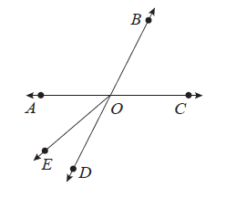
Example 7: Finding Adjacent Angles
In the figure shown, are straight lines.
Name an angle adjacent to
Solution
One angle adjacent to is Two other angles adjacent to are and

Slide 28
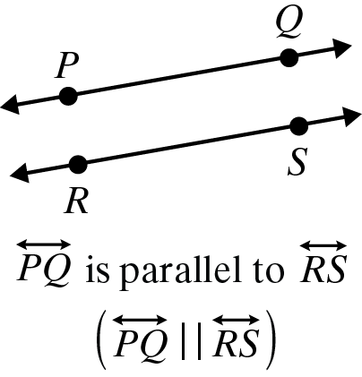
Definition: Parallel Lines and Perpendicular Lines
Term | Definition | Illustrations with Notation
Parallel Lines | Two lines are parallel (symbolized ) if they are in the same plane and do not intersect.

Slide 29
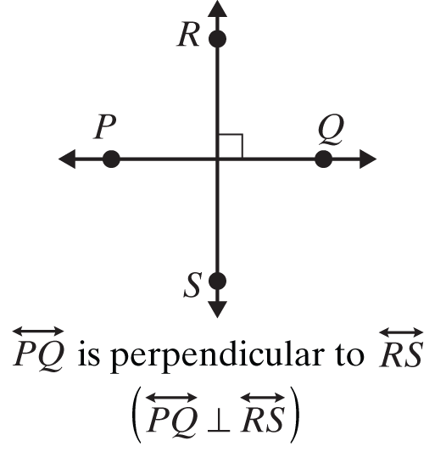
Definition: Parallel Lines and Perpendicular Lines (cont.)
Term | Definition | Illustrations with Notation
Perpendicular Lines | Two lines are perpendicular (symbolized ⊥ ) if they intersect to form right angles.

Slide 30
Properties: Parallel Lines and a Transversal
If two parallel lines are cut by a transversal, then the following two statements are true.
1. Corresponding angles are congruent.
2. Alternate interior angles are congruent.

Slide 31
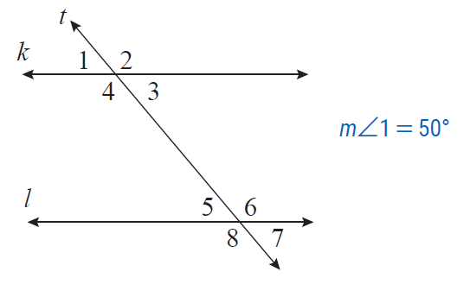
Example 8: Calculating Measures of Angles
In the figure shown, lines k and l are parallel, t is a transversal, and Find the measures of the other 7 angles.

Slide 32
Example 8: Calculating Measures of Angles (cont.)
Solution
One way of reasoning (among several) is as follows.
∠1 and ∠3 are vertical angles so
∠1 and ∠2 are supplementary angles so
∠2 and ∠4 are vertical angles so

Slide 33
Example 8: Calculating Measures of Angles (cont.)
Now, because ∠1 and ∠5 are corresponding angles, they have the same measures which means
Because ∠4 and ∠6 are alternate interior angles, they have the same measures which means
Again, using vertical angles, and

Slide 34
Note
The line segment with endpoints A and B is indicated by placing a bar over the letters, as in The length of the segment is indicated by writing only the letters, as in AB.

Slide 35

Definition: Triangles Classified by Sides
(Note: In the figures, sides with equal length are indicated by the same number of tic marks.)
Name | Property | Example
Scalene | No two sides have equal lengths. | ∆ABC is scalene since no two sides have equal lengths.

Slide 36
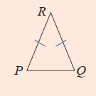
Definition: Triangles Classified by Sides (cont.)
Isosceles | At least two sides have equal lengths. | ∆PQR is isosceles since PR = QR.

Slide 37
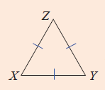
Definition: Triangles Classified by Sides (cont.)
Equilateral | All three sides have equal lengths. | ∆XYZ is equilateral since XY = XZ = YZ

Slide 38
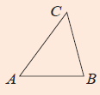
Definition: Triangles Classified by Angles
Name | Property | Example
Acute | All three angles are acute. | are all acute so ∆ABC is acute.

Slide 39
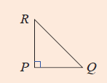
Definition: Triangles Classified by Angles (cont.)
Right | One angle is a right angle. | so ∆PRQ is a right triangle.

Slide 40
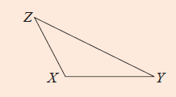
Definition: Triangles Classified by Angles (cont.)
Obtuse | One angle is obtuse. | is obtuse, so ∆XYZ is an obtuse triangle.

Slide 41
Properties: Three Properties of Triangles
In a triangle, the following statements are true:
The sum of the measures of the angles is 180°.
The sum of the lengths of any two sides must be greater than the length of the third side.
Longer sides are opposite angles with larger measures.

Slide 42
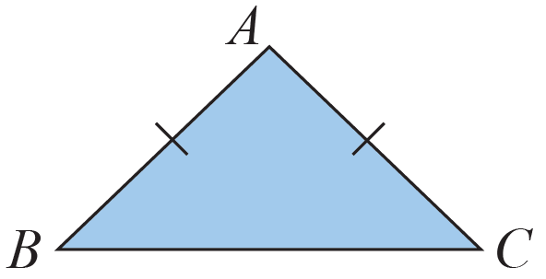
Example 9: Classifying a Triangle by Its Sides
In ΔABC, AB = AC. What kind of triangle is ΔABC?
Solution
∆ABC is isosceles because two sides have equal lengths.

Slide 43
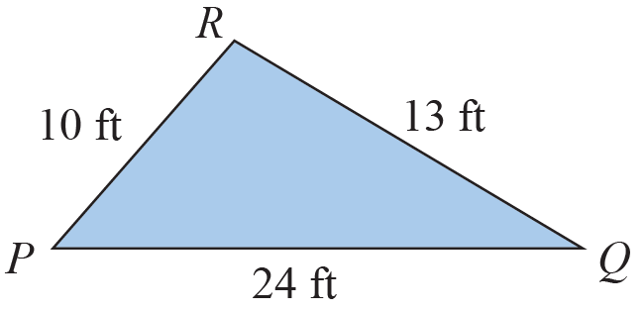
Example 10: Determining Whether a Triangle Exists
∆PQR was drawn and then the lengths of the sides were labeled as shown in the figure. Explain why the labels cannot be correct.

Slide 44
Example 10: Determining Whether a Triangle Exists (cont.)
Solution
The labels cannot be correct because
PR + QR = 10 ft + 13 ft = 23 ft and PQ = 24 ft, which is greater than the sum of the other two sides. In a triangle, the sum of the lengths of any two sides must be greater than the length of the third side.

Slide 45
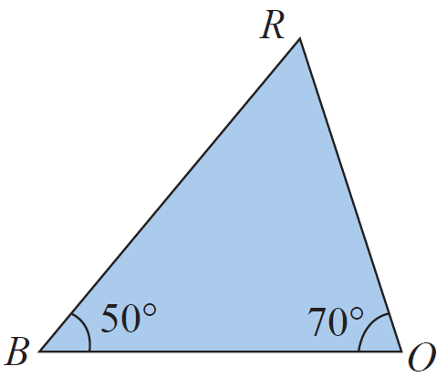
Example 11: Analyzing Triangles
In ∆BOR, and
What is
Which side is opposite
Which sides include
Is ∆BOR a right triangle? Why or why not?

Slide 46
Example 11: Analyzing Triangles (cont.)
Solution
The sum of the measures of the angles must be 180°.
Since
is opposite
and include
∆BOR is not a right triangle because none of the angles is a right angle.

