Slide 1
Section 6.5
Volume and Surface Area

Slide 2
Volume
From the Metric System | From the US Customary System
cubic millimeters (mm³) | cubic inches (in.³)
cubic centimeters (cm³) | cubic feet (ft³)
cubic meters (m³) | cubic yards (yd³)
Table 1

Slide 3
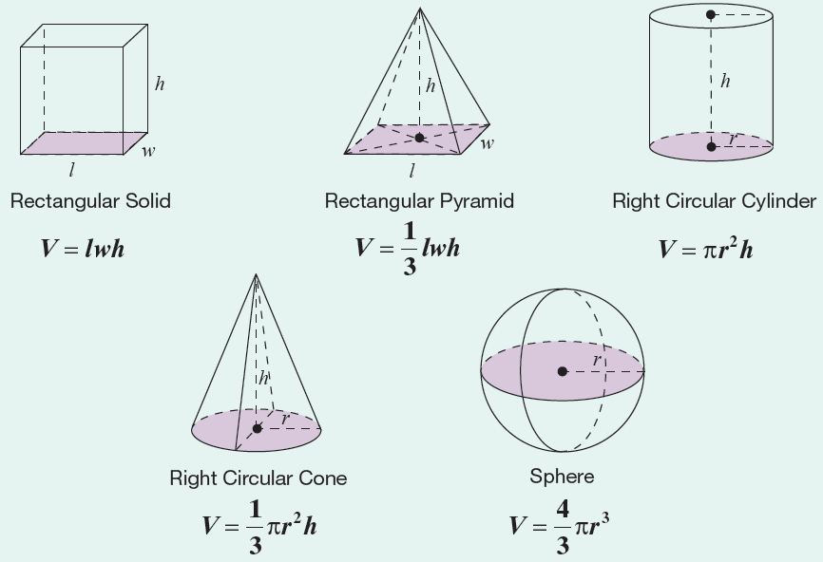
Formula: Volume Formulas for Five Geometric Solids

Slide 4
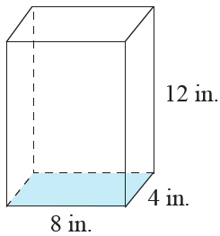
Example 1: Calculating the Volume of a Rectangular Solid
Calculate the volume of a rectangular solid with length 8 in., width 4 in., and height 12 in.
Solution
Using the formula for the volume of a
rectangular solid, we have the following.
The volume of the rectangular solid is

Slide 5
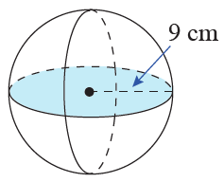
Example 2: Calculating the Volume of a Sphere
Calculate the volume of a sphere with radius 9 cm.
Use π = 3.14.
Solution
Using the formula for the volume of
a sphere, we have the following.
The volume of the sphere is .

Slide 6
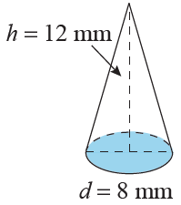
Example 3: Calculating the Volume of a Cone
What is the volume of a cone with a height of 12 mm and a circular base with a diameter of 8 mm?
Solution
We know the diameter of 8 mm, but we
need the radius.
The radius is half of the diameter.

Slide 7
Example 3: Calculating the Volume of a Cone (cont.)
So, applying the formula for the volume of a cone, we have the following.
The volume of the cone is

Slide 8
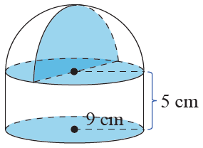
Example 4: Calculating the Volume of a Solid
Calculate the volume of a solid with the
indicated dimensions.
Solution
From the figure, we see that the
bottom portion of the solid is a
cylinder and on top of the cylinder is a hemisphere (one-half of a sphere). Thus, the volume of the solid will be the sum of the volumes of the cylinder and the hemisphere.

Slide 9
Example 4: Calculating the Volume of a Solid (cont.)

Slide 10
Example 4: Calculating the Volume of a Solid (cont.)
The volume of the solid is

Slide 11
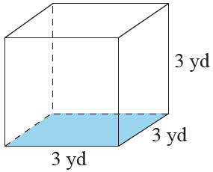
Example 5: Calculating the Volume of a Cube
Calculate the volume of the cube in both cubic yards and cubic feet. (Remember, 1 yd = 3 ft.)

Slide 12
Example 5: Calculating the Volume of a Cube (cont.)
Solution
We apply the formula V = s³ twice; once by using s = 3 yards and once by using s = 9 feet.
The volume of the cube is
Notice that because feet are smaller than yards, there are many more cubic feet than cubic yards in the cube.

Slide 13
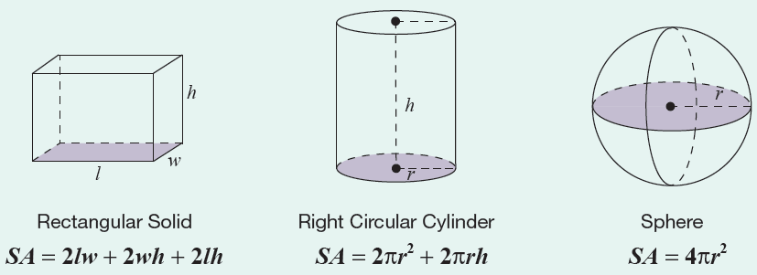
Formula: Surface Area Formulas for Three Geometric Solids

Slide 14
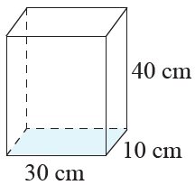
Example 6: Calculating the Surface Area of a Rectangular Solid
Calculate the surface area of a rectangular solid with length 30 cm, width 10 cm, and height 40 cm.
Solution
Using the formula for the surface area
of a rectangular solid, we have the following.
The surface area of the rectangular solid is

Slide 15
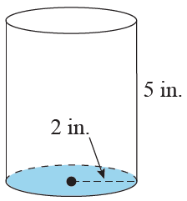
Example 7: Calculating the Surface Area of a Cylinder
Calculate the surface area of a coffee can in the shape of a cylinder with a height of 5 in. and a circular base with a radius of 2 in.

Slide 16
Example 7: Calculating the Surface Area of a Cylinder (cont.)
Solution
Using the formula for the surface area of a
cylinder, we have the following.
The surface area of the cylinder is

