Slide 1
Section 7.2
Reading Graphs

Slide 2
Definition: Four Types of Graphs and Their Purposes
Bar Graphs: To emphasize comparative amounts
Circle Graphs: To help in understanding percents or parts of a whole. (Circle graphs are also called pie charts.)
Line Graphs: To indicate tendencies or trends over a period of time.
Histograms: To indicate data in classes (a range or interval of numbers)

Slide 3
Properties: Properties of Graphs
Every graph should
be clearly labeled,
be easy to read, and
have an appropriate title.

Slide 4
Example 1: Reading a Bar Graph
Examine the bar graph and answer the questions given.
Note that the scale on the left (sales) and the categories at the bottom (months) are clearly labeled
and the graph itself has a title.

Slide 5
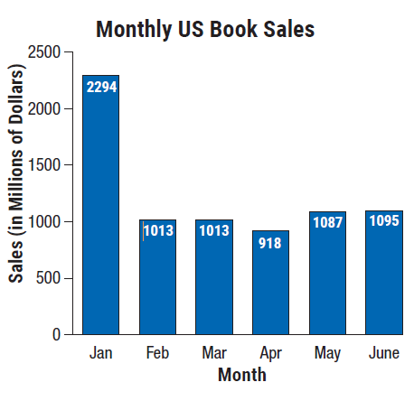
Example 1: Reading a Bar Graph (cont.)

Slide 6
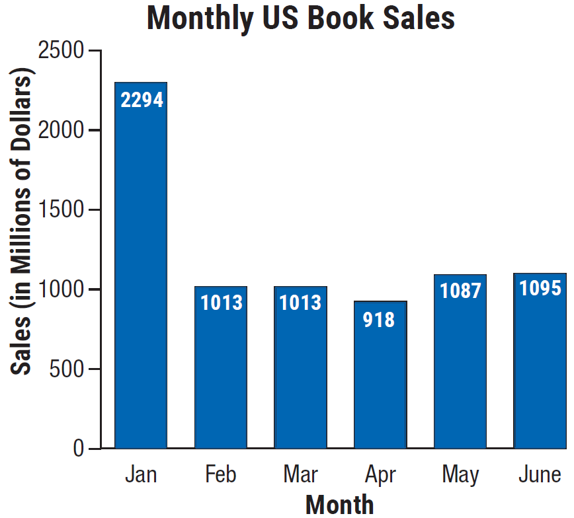
Example 1: Reading a Bar Graph (cont.)
What were the sales in February?
Solution
Look at the bar for February and read to the left to find the amount in sales (or read the
number at the top of the bar).
Note that the scale on the left of
the graph says that sales are in
millions of dollars. This gives an
answer of $1013 million.

Slide 7
Example 1: Reading a Bar Graph (cont.)
During what month were sales lowest?
Solution
To determine which month had the lowest amount of sales, look for the shortest bar. The month that sales were lowest
is April.

Slide 8
Example 1: Reading a Bar Graph (cont.)
During what month were sales highest?
Solution
To determine which month had the highest amount of sales, look for the tallest bar. The month that sales were highest is January.

Slide 9
Example 1: Reading a Bar Graph (cont.)
What were the sales during the highest-sales month?
Solution
Sales were highest in January. Looking at the top of the bar and reading to the left gives sales of
$2294 million.

Slide 10
Example 1: Reading a Bar Graph (cont.)
What were the sales in June?
Solution
To find the sales in June, look at the bar for June and read over to the left. Doing this gives an answer of $1095 million.

Slide 11
Example 1: Reading a Bar Graph (cont.)
What was the amount of increase in sales between April and May?
Solution
To determine the amount of increase in sales from April to May, first read the sales for
April ($918 million). Then read the
sales for May ($1087 million).
Subtracting April sales from May
sales gives a difference of
$169 million.

Slide 12
Example 1: Reading a Bar Graph (cont.)

Slide 13
Example 1: Reading a Bar Graph (cont.)
What was the percent increase in sales from April to May (to the nearest tenth of a percent)?
Solution
To find the percent of increase in sales from April to May take the amount of increase in
sales (found in part f. above) and
divide by the sales in April.

Slide 14

Example 1: Reading a Bar Graph (cont.)
$$\frac{\text{Increase} \text{in} \text{April} \text{sales}}{April sales}$$

Slide 15
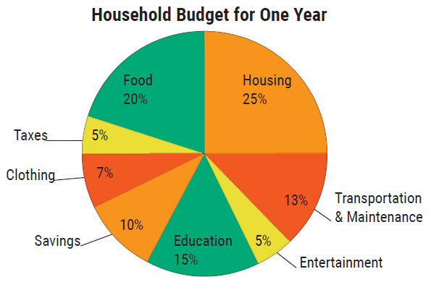
Example 2: Reading a Circle Graph
Examine the circle graph. This graph shows the percent of a household's annual income they plan to budget for various expenses. Suppose the household has an annual income of $45,000. Use the information in the graph to calculate how much
money will be budgeted for
each expense.

Slide 16
Example 2: Reading a Circle Graph (cont.)
Solution
To calculate the budget amount for each item multiply the corresponding percent by the total household income.

Slide 17
Example 2: Reading a Circle Graph (cont.)
Item Amount
Housing | 0.25 X $45,000 =
Food | 0.20 X $45,000 =
Taxes | 0.05 X $45,000 =
Clothing | 0.07 X $45,000 =
Savings | 0.10 X $45,000 =
Education | 0.15 X $45,000 =
Entertainment | 0.05 X $45,000 =
Transportation & Maintenance | 0.13 X $45,000 =
What is the total of all amounts?
$11,250
$9000
$2250
$3150
$4500
$6750
$2250
$5850
$45,000

Slide 18
Example 3: Reading a Line Graph
Examine the line graph. This graph shows the relationships between daily high and low temperatures. You can see that temperatures tended to rise during the week but fell sharply on Saturday.

Slide 19
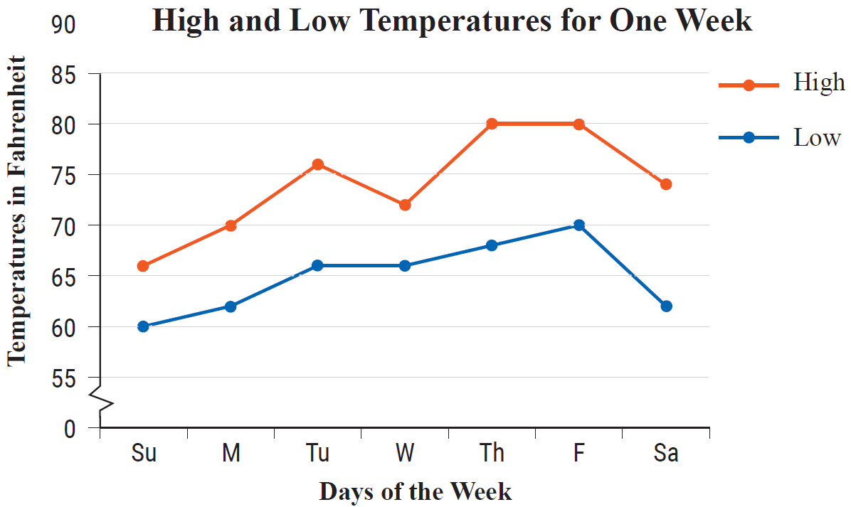
Example 3: Reading a Line Graph (cont.)

Slide 20
Note
In the line graph, notice that the temperature scale on the left does not start at 0 °F. There is a break indicated in that scale.

Slide 21
Example 3: Reading a Line Graph (cont.)
What was the lowest high temperature?
Solution
To find the lowest high temperature, look at the line labeled “High” and find the lowest point on that line graph. This shows that the lowest high temperature is 66 °F.

Slide 22
Example 3: Reading a Line Graph (cont.)
On what day did this occur?
Solution
Looking directly down from the point located in Part a., we see that the lowest high temperature occurred on Sunday.

Slide 23
Example 3: Reading a Line Graph (cont.)
What was the highest low temperature?
Solution
To find the highest low temperature, look at the line labeled “Low” and find the highest point on that line graph. This shows that the highest low temperature is 70 °F.

Slide 24
Example 3: Reading a Line Graph (cont.)
On what day did this occur?
Solution
Looking directly down from the point located in Part c., we see that the highest low temperature occurred on Friday.

Slide 25
Example 3: Reading a Line Graph (cont.)
Find the mean difference between the daily high and low temperatures for the week shown (to the nearest hundredth).
Solution

Slide 26
Example 3: Reading a Line Graph (cont.)
First, find the sum of the differences:
Sunday: | 66 − 60 = 6 °F
Monday: | 70 − 62 = 8 °F
Tuesday: | 76 − 66 = 10 °F
Wednesday: | 72 − 66 = 6 °F
Thursday: | 80 − 68 = 12 °F
Friday: | 80 − 70 = 10 °F
Saturday: | 74 − 62 = 12 °F
64 °F |  | Sum of differences

Slide 27
Example 3: Reading a Line Graph (cont.)
Then divide the sum of the differences by the number of days to find the mean of these differences.
64 ÷ 7 = 9.142... ≈ 9.14
Thus, the mean difference between the daily high and low temperatures is approximately 9.14 °F.

Slide 28
Definition: Terms Related to Histograms
Class: A range (or interval) of numbers that contains data items.
Lower class limit: The smallest number that belongs to a class.
Upper class limit: The largest number that belongs to a class.
Class boundaries: Numbers that are halfway between the upper limit of one class and the lower limit of the next class.

Slide 29
Definition: Terms Related to Histograms (cont.)
Class width: The difference between the class boundaries of a class (the width of each bar).
Frequency: The number of data items in a class.

Slide 30
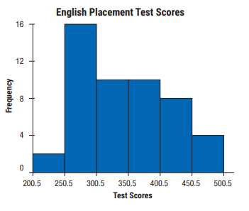
Example 4: Reading a Histogram
Examine the following histogram. This histogram summarizes the scores of 50 students on an English placement test. Refer to the graph to answer the given questions. Assume the scores are whole numbers.

Slide 31
Example 4: Reading a Histogram (cont.)
How many classes are represented?
Solution
Each bar on the histogram represents a class. Thus, in this histogram, there are 6 classes.

Slide 32
Example 4: Reading a Histogram (cont.)
What are the class limits of the first class?
Solution
The class limits consist of the smallest number and the largest number that belong to a class. The first class has a lower class limit of 201 and an
upper class limit of 250.

Slide 33
Example 4: Reading a Histogram (cont.)
What are the class boundaries of the second class?
Solution
The class boundaries are listed on the horizontal axis of the graph. Looking at the second class, or second bar, we see that the lower class
boundary is 250.5 and the upper
class boundary is 300.5.

Slide 34
Example 4: Reading a Histogram (cont.)
What is the width of each class?
Solution
Each class has the same width and this is found by subtracting the lower class boundary from the upper class boundary of any class. Using
the class boundaries just found for
the second class gives
300.5 − 250.5 = 50. Thus,
the class width of each class is 50.

Slide 35
Example 4: Reading a Histogram (cont.)
Which class has the greatest frequency?
Solution
To find the class with the greatest frequency, look for the tallest bar. We see that the second class has the greatest frequency.

Slide 36
Example 4: Reading a Histogram (cont.)
What is this frequency?
Solution
Looking at the bar for the second class and then to the left, we see that the frequency of the second class is 16.

Slide 37
Example 4: Reading a Histogram (cont.)
What percent of the scores are between 200.5 and 250.5?
Solution
The graph shows that there are 2 scores between 200.5 and 250.5. We want to divide this
number by the total number of
scores: 2 + 16 + 10 + 10 + 8 + 4 = 50.
Now dividing 2 by 50 gives

Slide 38
Example 4: Reading a Histogram (cont.)
What percent of the scores are above 400.5?
Solution
Looking at the graph we see that the fifth and sixth classes represent scores above 400.5. The frequencies of these classes are 8 and 4. Now
dividing the total of these classes
by the total number of scores gives
the percent of scores greater than
400.5:

