Slide 1
Section 7.3
Constructing Graphs from Databases

Slide 2
Note
All of the graphs discussed here can be created with a computer and a spreadsheet program such as Microsoft Excel. If you have access to a computer, your instructor may choose to have you work the problems in this section with a spreadsheet program.

Slide 3
Procedure: Steps to Follow in Constructing a Vertical Bar Graph
Draw a vertical axis and a horizontal axis. Label these axes appropriately.
Mark an appropriate scale on the vertical axis to represent the frequency of each category. (The scale must be uniform. That is, the distance between consecutive marks must represent the same amount.)

Slide 4
Procedure: Steps to Follow in Constructing a Vertical Bar Graph (cont.)
Mark the categories of data along the horizontal axis.
Draw the vertical bar for each category so that the height of the bar reaches the frequency of the data in that category. (Note: Make sure the bars have the same width.)
Give the graph a title.

Slide 5
Example 1: Constructing a Bar Graph
Construct a bar graph that represents the following population data.

Slide 6
Example 1: Constructing a Bar Graph (cont.)
Population of the 8 Largest US Cities in the US 2020 Census (to the nearest thousand)
 | City | Population
1. | New York, NY | 8,253,000
2. | Los Angeles, CA | 3,970,000
3. | Chicago, IL | 2,678,000
4. | Houston, TX | 2,316,000
5. | Phoenix, AZ | 1,708,000
6. | Philadelphia, PA | 1,578,000
7. | San Antonio, TX | 1,567,000
8. | San Diego, CA | 1,422,000
Source: www.census.gov

Slide 7
Example 1: Constructing a Bar Graph (cont.)
Solution
Steps 1 and 2: Draw the vertical axis and horizontal axis and mark a scale on the vertical axis that will encompass the numbers from 0 to 8.253 million people. (On this graph, we have chosen to mark the numbers from 0 to 9.0 in a scale of 1 unit.)

Slide 8
Example 1: Constructing a Bar Graph (cont.)
Steps 3 and 4: The horizontal axis marks are labeled with the names of the cities represented in alphabetical order. The height of each vertical bar corresponds to the population (in millions) of each city as given.

Slide 9
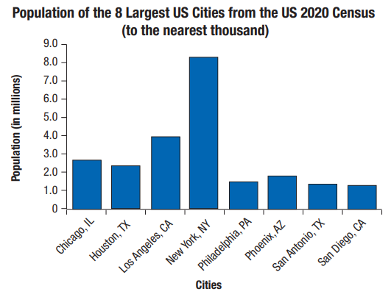
Example 1: Constructing a Bar Graph (cont.)
Step 5: Give the graph a title.

Slide 10
Procedure: Steps to Follow in Constructing a Circle Graph
Find the central angle (angle at the center of the circle) for each category by multiplying the corresponding percent (in decimal form) by 360°.
Draw a circle.
Draw each central angle (use a protractor).
Label each sector with the name and corresponding percent of each category.
Give the graph a title.

Slide 11
Example 2: Constructing a Circle Graph
Construct a circle graph that represents the following data.
Ethnic Breakdown of Students Who Took the SAT (Scholastic Assessment Test), Nationwide, 2010
Ethnicity | % SAT Taken
African-American | 13%
Asian-American | 11%
Hispanic | 14%
Native American | 1%
White | 54%
Other | 3%
No Response | 4%
Source: CollegeBoard.com

Slide 12
Example 2: Constructing a Circle Graph (cont.)
Solution
Step 1: Find the central angle for each category by multiplying the corresponding percent (in decimal form) by 360°.
African-American:
Asian-American:
Hispanic:
Native American:
White:
Other:
No Response:

Slide 13
Example 2: Constructing a Circle Graph (cont.)
Steps 2, 3, and 4: Draw a circle, mark the central angles as close to the actual degrees as is practical, and label each sector. Note that the order of the sectors (pie slices) is not important.
Step 5: Give the graph a title.

Slide 14
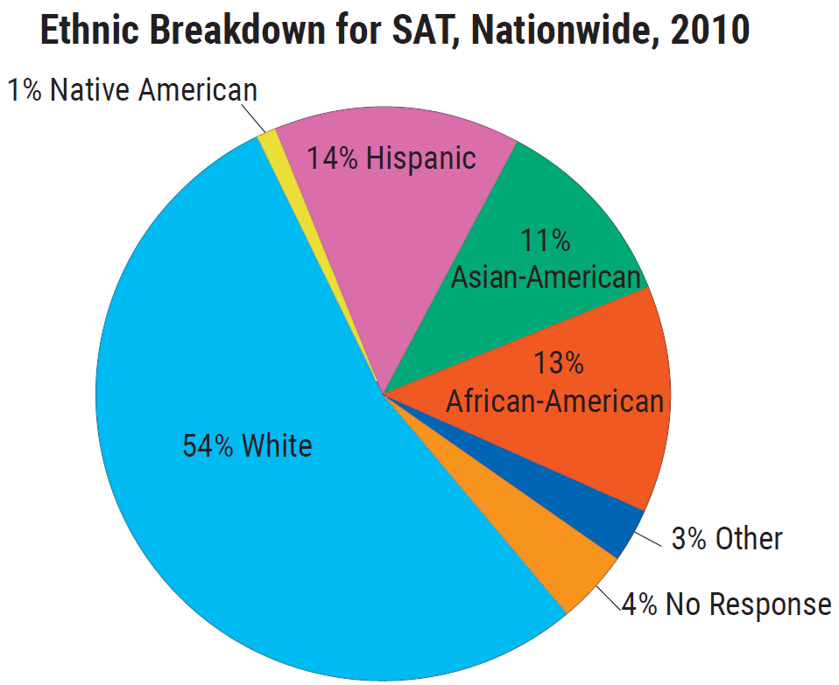
Example 2: Constructing a Circle Graph (cont.)

