Slide 1
Section 7.4
Probability

Slide 2
Definition: Terms Related to Probability
Outcome: An individual result of an experiment.
Sample Space: The set of all possible outcomes of an experiment.
Event: Some (or all) of the outcomes from the sample space.

Slide 3
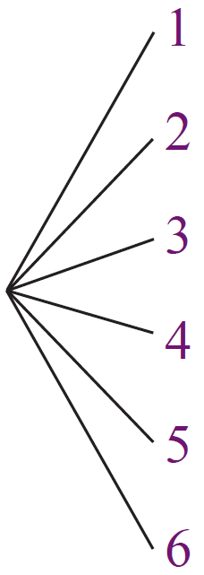
Example 1: Finding All Outcomes Using a Tree Diagram
A 6-sided die is rolled. Draw a tree diagram illustrating the possible outcomes of this experiment.
Solution
Since the die has 6 sides, we will label
the possible outcomes as 1, 2, 3, 4, 5,
and 6.

Slide 4
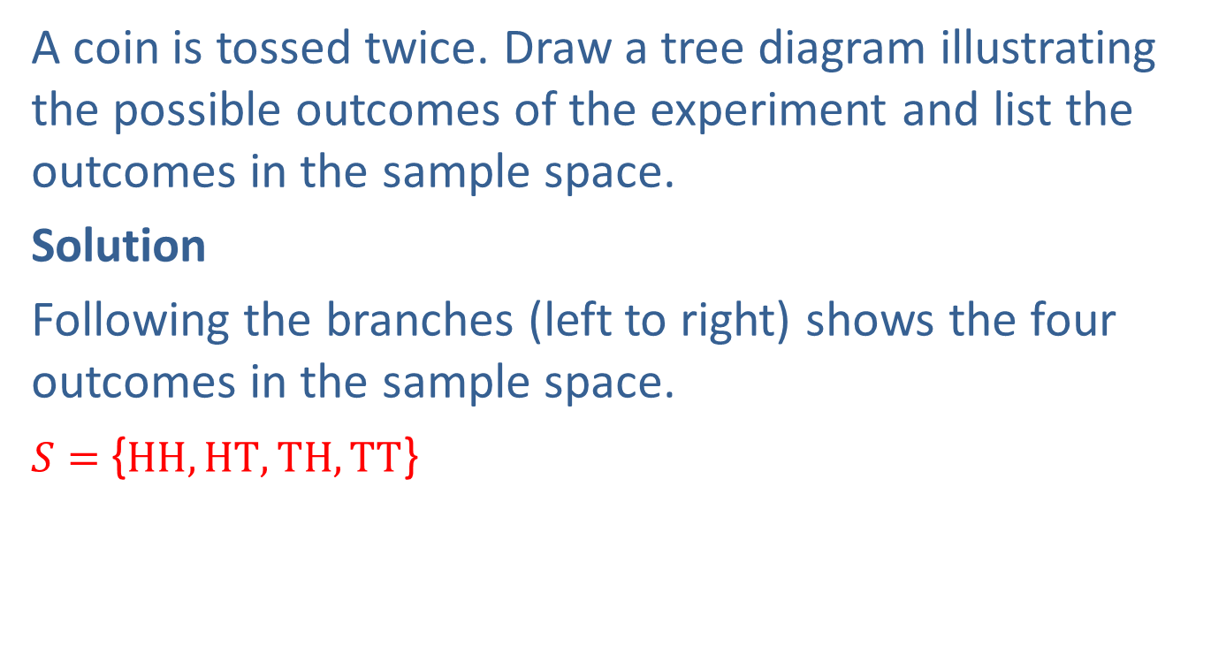
Example 2: Finding the Sample Space Using a Tree Diagram
A coin is tossed twice. Draw a tree diagram illustrating the possible outcomes of the experiment and list the outcomes in the sample space.
Solution
Following the branches (left to right) shows the four outcomes in the sample space.
$S=${$HH,HT,TH,TT$}

Slide 5
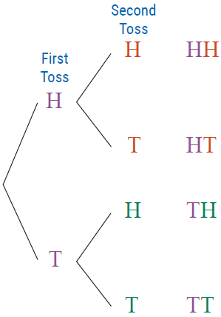
Example 2: Finding the Sample Space Using a Tree Diagram (cont.)
Outcomes: HH, HT, TH, TT

Slide 6
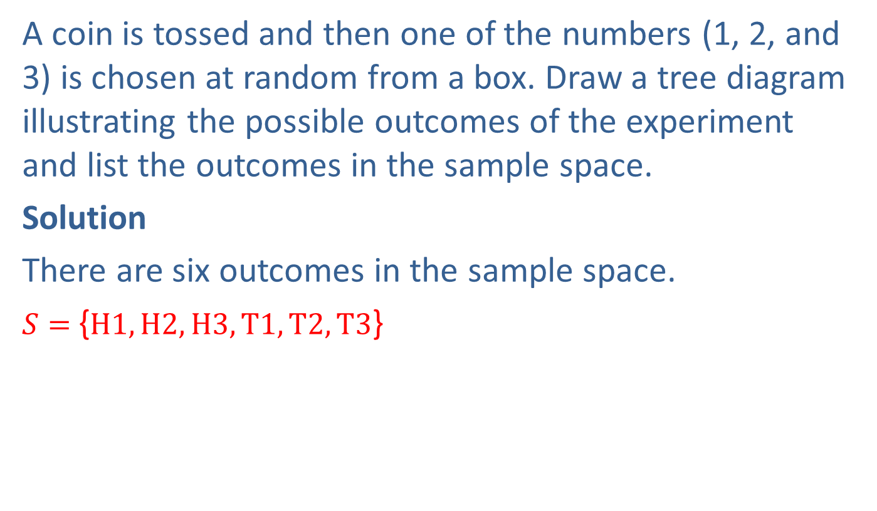
Example 3: Finding the Sample Space Using a Tree Diagram
A coin is tossed and then one of the numbers (1, 2, and 3) is chosen at random from a box. Draw a tree diagram illustrating the possible outcomes of the experiment and list the outcomes in the sample space.
Solution
There are six outcomes in the sample space.
$S=${$H1,H2,H3,T1,T2,T3$}

Slide 7
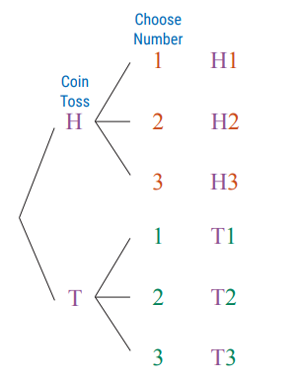
Example 3: Finding the Sample Space Using a Tree Diagram (cont.)
Outcomes:
H1, H2, H3, T1, T2, T3

Slide 8
Definition: Probability of an Event

Slide 9
Properties: Basic Characteristics of Probabilities
Probabilities are between 0 and 1, inclusive.
a. If an event can never occur, its probability is 0.
b. If an event will always occur, its probability is 1.
2. The sum of the probabilities of the outcomes in a sample space is 1.

Slide 10
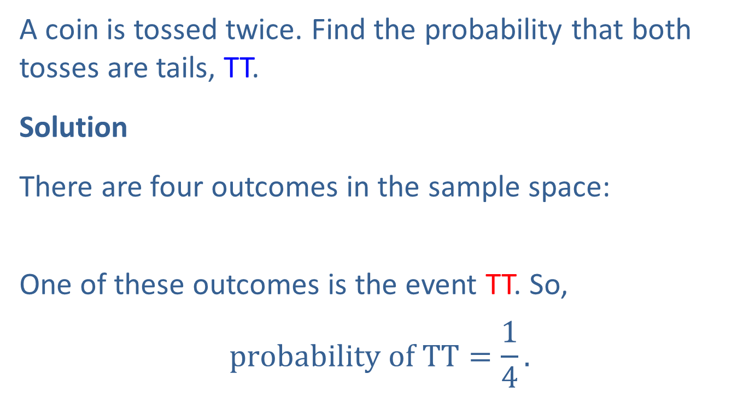
Example 4: Calculating a Probability
A coin is tossed twice. Find the probability that both tosses are tails, TT.
Solution
There are four outcomes in the sample space:
One of these outcomes is the event TT. So,
$$probability of TT=\frac{1}{4}.$$

Slide 11
Example 5: Calculating a Probability
A six-sided die is rolled once. Find the probability of rolling an even number.
Solution
There are six possible outcomes in rolling a die.
The sample space is
Of these six, three are even numbers: 2, 4, 6. So,

Slide 12
Example 6: Calculating a Probability
A standard deck of cards is 52 cards with four suits (hearts, diamonds, spades, and clubs) and 13 cards in each suit. The cards are ace, king, queen, jack, 10, 9, 8, 7, 6, 5, 4, 3, and 2. If one card is drawn from a deck of cards, find the probability of each of the following events.
The card is a 10.
The card is a diamond.
The card is a 2 or a 3.

Slide 13
Example 6: Calculating a Probability (cont.)
Solution
There are four 10s in a deck (one 10 in each suit). So,

Slide 14
Example 6: Calculating a Probability (cont.)
There are 13 diamonds in a deck (diamonds is one of the suits). So,

Slide 15
Example 6: Calculating a Probability (cont.)
There are four 2s and four 3s in a deck (one of each in each suit) for a total of 8. So,

