Slide 1
Section 9.10
Absolute Value Inequalities

Slide 2
Definition: Solving Absolute Value Inequalities with < (or ≤)
For c > 0:
If |x|< c, then –c < x < c.
If |ax + b|< c, then –c < ax + b < c.
The inequalities in a. and b. are also true if < is replaced by ≤.

Slide 3
Note
If the absolute value expression is isolated on one side of the inequality, we say that the inequality is in standard form. You may need to manipulate the absolute value inequality to get it into standard form before you can solve it. (See Examples 3 and 5.)

Slide 4

Example 1: Solving Absolute Value Inequalities
Solve the absolute value inequality and graph the solution set:
Solution
So, x is in

Slide 5

Example 2: Solving Absolute Value Inequalities
Solve the absolute value inequality and graph the solution set:
Solution
So, x is in

Slide 6

Example 3: Solving Absolute Value Inequalities
Solve the absolute value inequality and graph the solution set:
Solution
Divide both sides by 3 in order to get the inequality in standard form. Remember, we must get the expression in standard form before solving an absolute value inequality.
So, x is in

Slide 7
Example 4: Solving Absolute Value Inequalities
Solve the absolute value inequality and graph the solution set:
Solution
Since absolute value is always nonnegative (greater than
or equal to 0), no number has an absolute value less
than Thus, there is no solution, ∅.

Slide 8
Example 5: Solving Absolute Value Inequalities
Solve the absolute value inequality and graph the solution set:
Solution
Add −4 to both sides in order to get the
expression in standard form.

Slide 9
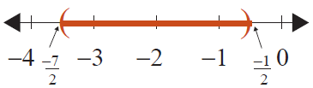
Example 5: Solving Absolute Value Inequalities (cont.)
So, x is in

Slide 10
Definition: Solving Absolute Value Inequalities with > (or ≥)
For c > 0:
If |x|> c, then x < –c or x > c.
If |ax + b|> c, then ax + b < –c or ax + b > c.
The inequalities in a. and b. are true if > is replaced by ≥.

Slide 11

Example 6: Solving Absolute Value Inequalities
Solve the absolute value inequality and graph the solution set:
Solution
or
So, x is in

Slide 12
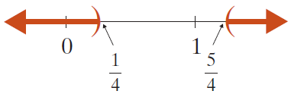
Example 7: Solving Absolute Value Inequalities
Solve the absolute value inequality and graph the solution set:
Solution
or
So, x is in

Slide 13

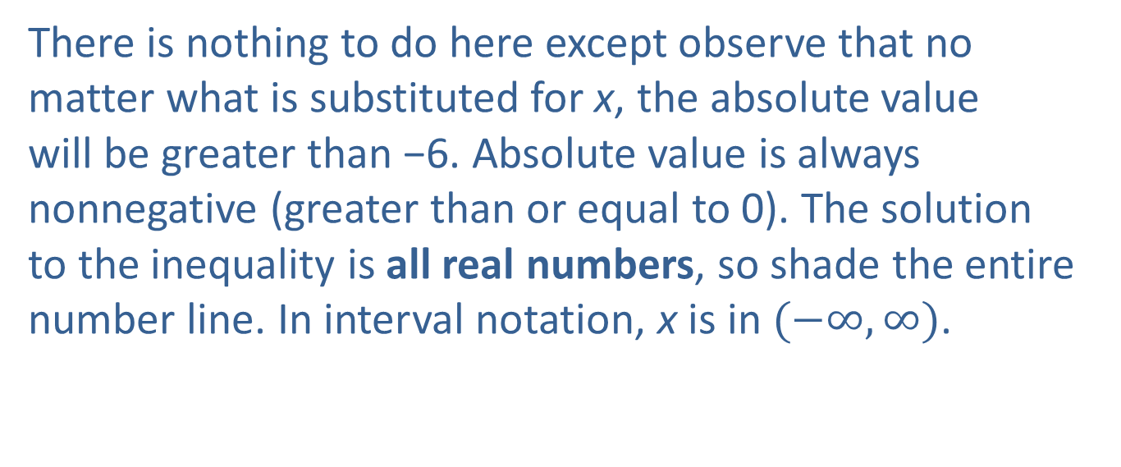
Example 8: Solving Absolute Value Inequalities
Solve the absolute value inequality and graph the solution set:
Solution
There is nothing to do here except observe that no matter what is substituted for x, the absolute value will be greater than −6. Absolute value is always nonnegative (greater than or equal to 0). The solution to the inequality is all real numbers, so shade the entire number line. In interval notation, x is in $(−∞,∞)$.

Slide 14

Example 9: Solving Absolute Value Inequalities
Solve the absolute value inequality and graph the solution set:
Solution
Add 5 to both sides in order to get the inequality in standard form.
or
So, x is in

