Slide 1
Section 9.4
Working with Formulas

Slide 2
Note
Be sure to use the letters just as they are given in the formulas. In mathematics, there is little or no flexibility between capital and small letters as they are used in formulas. In general, capital letters have special meanings that are different from corresponding small letters. For example, capital A may mean the area of a triangle and small a may mean the length of one side, two completely different ideas.

Slide 3
Example 1: Application: Evaluating Formulas
The formula for calculating simple interest is
I = Prt, where
I = interest (earned or paid)
P = principal (the amount invested or borrowed)
r = rate of interest (stated as an annual or yearly rate in percent form)
t = time (in years)
The rate of interest is usually given in percent form and converted to decimal or fraction form for calculations.

Slide 4
Example 1: Application: Evaluating Formulas (cont.)
Maribel loaned $5000 to a friend for 3 months at an
annual interest rate of 8%. How much will her friend
pay her at the end of the 3 months?
Solution
Here,

Slide 5
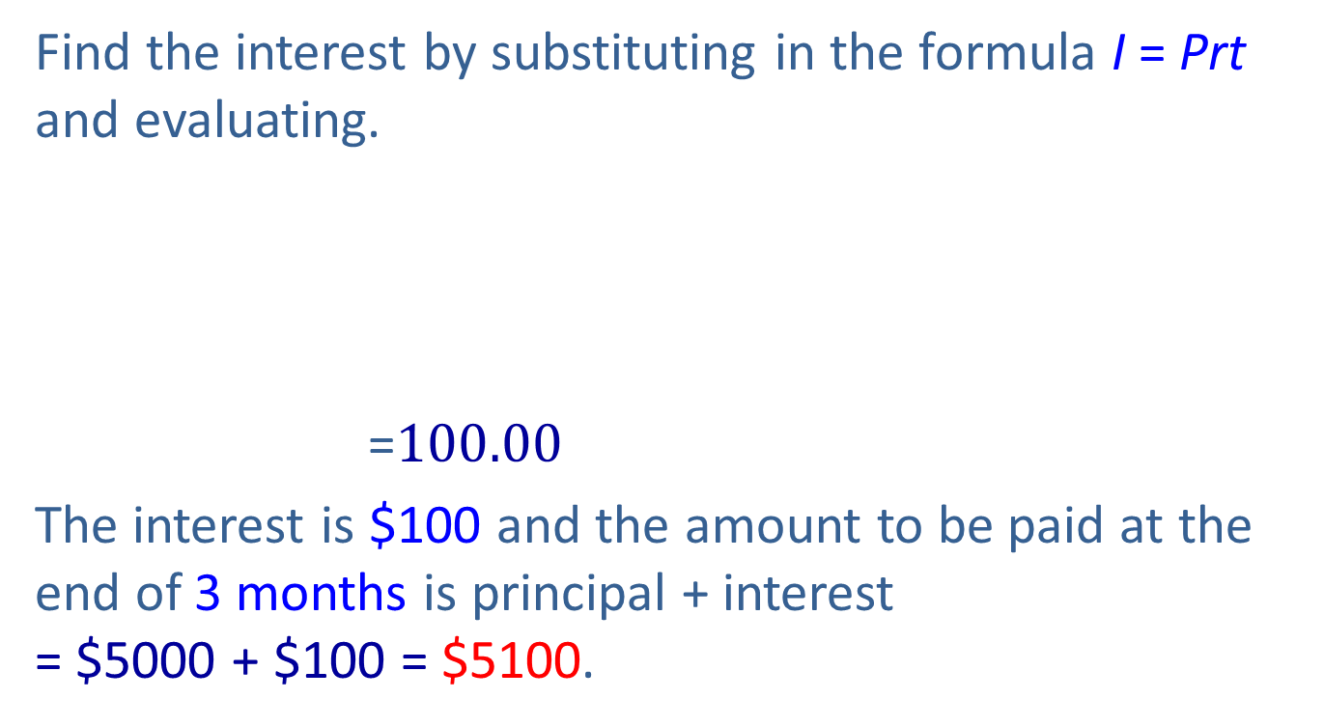
Example 1: Application: Evaluating Formulas (cont.)
Find the interest by substituting in the formula I = Prt and evaluating.
=$100.00$
The interest is $100 and the amount to be paid at the end of 3 months is principal + interest
= $5000 + $100 = $5100.

Slide 6
Example 2: Evaluating Formulas
Given the formula first find C if F = 212°
(212 degrees Fahrenheit) and then find F if C = 20°
(20 degrees Celsius).
Solution
F = 212°, so substitute 212 for F in the formula.
That is, 212°F is the same as 100°C. Water will boil at 212°F at sea level. This means that, if the temperature is measured in degrees Celsius instead of degrees Fahrenheit, water will boil at 100°C at sea level.

Slide 7
Example 2: Evaluating Formulas (cont.)
C = 20°, so substitute 20 for C in the formula.
That is, a temperature of 20°C is the same as a comfortable spring day temperature of 68°F.

Slide 8
Example 3: Application: Evaluating Formulas
The lifting force F exerted on an airplane wing is found
by multiplying some constant k by the area A of the
wing’s surface and by the square of the plane’s velocity
v. The formula is Find the force on a plane’s
wing during takeoff if the area of the wing is k
is and the plane is traveling 80 miles per hour during
takeoff.

Slide 9
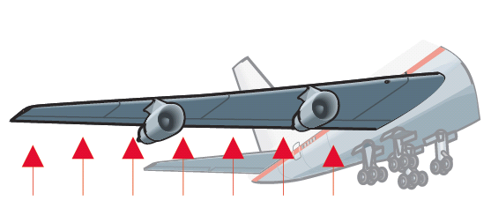
Example 3: Application: Evaluating Formulas (cont.)
Solution
We know that A = 120, and v = 80. Substitution
gives
Thus the force on the plane’s wing during takeoff is 1,024,000 lb.

Slide 10
Example 4: Evaluating Formulas
The perimeter of a triangle is 38 feet. One side is 5 feet long and a second side is 18 feet long. How long is the third side?
Solution
Using the formula P = a + b + c, substitute P = 38, a = 5, and b = 18. Then solve for the third side.

Slide 11
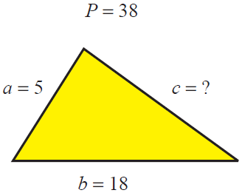
Example 4: Evaluating Formulas (cont.)
The third side is 15 feet long.

Slide 12
Example 5: Solving for Different Variables
Given d = rt, solve for t in terms of d and r. We want to represent the time in terms of distance and rate. We will use this concept later in word problems.
Solution

Slide 13

Example 6: Solving for Different Variables
Given $V=\frac{k}{P}$ , solve for P in terms of V and k.
Solution $V=\frac{k}{P}$
$P∙V=P∙\frac{k}{P}$
$PV=k$
$\frac{PV}{V}=\frac{k}{V}$
$P=\frac{k}{V}$

Slide 14
Example 7: Solving for Different Variables
Given , as in Example 2, solve for F in terms of C. This would give a formula for finding Fahrenheit temperature given a Celsius temperature value.
Solution

Slide 15
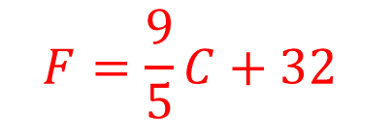
Example 7: Solving for Different Variables (cont.)
Thus, is solved for F, and , is
solved for C. These are two forms of the same formula.
$$F=\frac{9}{5}C+32$$

Slide 16
Example 8: Solving for Different Variables
Given the equation 2x + 4y = 10,
a. solve for x in terms of y, and then
solve for y in terms of x.

Slide 17
Example 8: Solving for Different Variables (cont.)
Solution
a. Solving for x yields the following.

Slide 18
Example 8: Solving for Different Variables (cont.)
b. Solving for y yields the following.

Slide 19
Example 8: Solving for Different Variables (cont.)
Alternatively, we can write the following.

Slide 20
Completion Example 9: Solving for Different Variables
Given 3x − y = 15, solve for y in terms of x.
Solution
Supply the reasons for each step in the following solution.
Multiply both sides by −1
(or divide both sides by −1).

