Slide 1
Section 9.7
Solving Linear Inequalities in
One Variable

Slide 2
Note
The symbol for infinity (or ) does not represent a number. The symbol is used to indicate that the interval is to include all real numbers from some point on (either in the positive direction or the negative direction) without end.

Slide 3
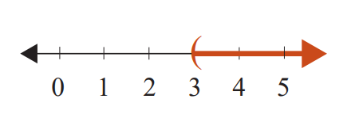
Example 1: Graphing Intervals
Graph the open interval
Solution

Slide 4
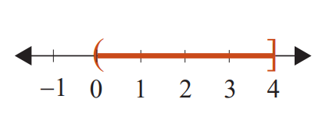
Example 2: Graphing Intervals
Graph the half-open interval 0 < x ≤ 4.
Solution

Slide 5
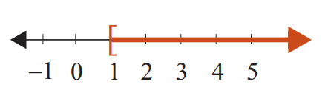
Example 3: Graphing Intervals
Represent the following graph using algebraic notation, and state what kind of interval it is.
Solution
x ≥ 1 is a half-open interval.

Slide 6
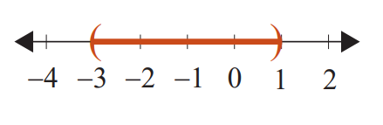
Example 4: Graphing Intervals
Represent the following graph using interval notation, and state what kind of interval it is.
Solution
(−3, 1) is an open interval.

Slide 7
Attention!
Any principle or rule stated for inequalities with the < symbol holds true for ≤, >, and ≥ as well.

Slide 8
Properties: Addition Principle for Solving Linear Inequalities
If A and B are algebraic expressions and C is a real number, then the inequalities
A < B
and
A + C < B + C
are equivalent.
(If a real number is added to both sides of an inequality, the new inequality is equivalent to the original.)

Slide 9

Example 5: Solving an Inequality and Graphing the Solution Set
Solve the inequality y − 3.2 ≥ 5.6 and graph the solution set. Write the solution set using interval notation.
Solution
y − 3.2 ≥ 5.6
y − 3.2 + 3.2 ≥ 5.6 + 3.2
y ≥ 8.8
y is in [8.8, ∞).
Simplify.
Note that the interval is a half-open interval.

Slide 10
Example 6: Solving an Inequality and Graphing the Solution Set
Solve the inequality and graph the solution set. Write the solution set using interval notation.
Solution

Slide 11
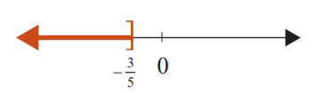
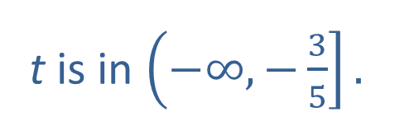
Example 6: Solving an Inequality and Graphing the Solution Set (cont.)
t is in $\left(−∞,−\frac{3}{5}\right].$
Note that the interval is a half-open interval.

Slide 12
Properties: Multiplication Principle for Solving Linear Inequalities
If A and B are algebraic expressions and C is a positive real number, then the inequalities
A < B
and
AC < BC
are equivalent.
If A and B are algebraic expressions and C is a negative real number, then the inequalities

Slide 13
Properties: Multiplication Principle for Solving Linear Inequalities (cont.)
A < B
and
AC > BC
are equivalent.
(In other words, if both sides are multiplied by a negative number, then the sense of the inequality is reversed.)

Slide 14

Example 7: Solving an Inequality and Graphing the Solution Set
Solve the inequality 5x > 15 and graph the solution set. Write the solution set using interval notation.
Solution
x is in (3, ∞).
Note that the interval is an open interval.

Slide 15



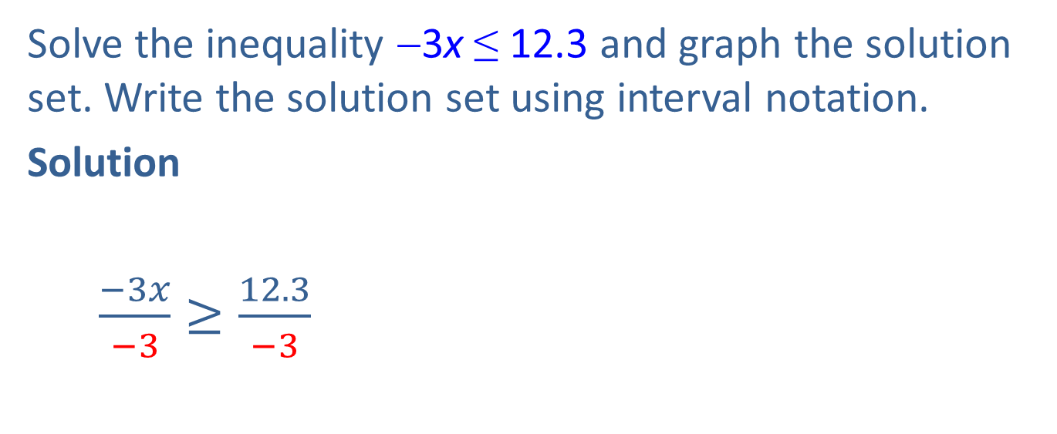
Example 8: Solving an Inequality and Graphing the Solution Set
Solve the inequality −3x ≤ 12.3 and graph the solution set. Write the solution set using interval notation.
Solution
$\frac{−3x}{−3}≥\frac{12.3}{−3}$
$$3x ≤12.3$$
Divide both sides by $−3$ and reverse the inequality.
$$x ≥−4.1$$
x is in [−4.1, ∞).
Note that the interval is a half-open interval.

Slide 16
Procedure: Solving Linear Inequalities
Combine like terms on each side of the inequality symbol.
Use the addition principle of inequality to add the opposites of constants or variable expressions to both sides so that constants are on one side and variables on the other.

Slide 17
Procedure: Solving Linear Inequalities (cont.)
Use the multiplication (or division) principle of inequality to multiply both sides by the reciprocal of the coefficient of the variable (or divide both sides by the coefficient itself). The coefficient of the variable will become +1. If this coefficient is negative, be sure to reverse the sense of the inequality.

Slide 18
Procedure: Solving Linear Inequalities (cont.)
A quick (and generally satisfactory) check is to select any one number in your solution set and substitute it into the original inequality. If the statement is false, you need to look for an error in your solution.

Slide 19
Example 9: Solving Linear Inequalities
Solve the inequality and graph the solution set. Write the solution set using interval notation. Solution

Slide 20
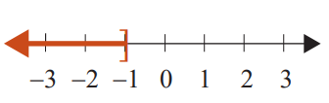
Example 9: Solving Linear Inequalities (cont.)
x is in (−∞, −1].
Check
As a check, pick a number in the solution interval and substitute it into the original inequality. For example, choose −3 and substitute it for x.

Slide 21
Example 9: Solving Linear Inequalities (cont.)
True statement
Note that it is not possible to check every number in an interval with infinitely many solutions. But a true result, as shown here, gives confidence in the solution interval.

Slide 22

Example 10: Solving Linear Inequalities
Solve the linear inequality and graph the solution set. Write the solution set using interval notation.
Solution
Add $−2$to both sides.

Slide 23
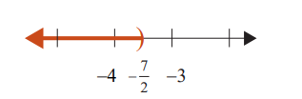

Example 10: Solving Linear Inequalities (cont.)
$$−\frac{7}{2}>x$$

Slide 24
Example 11: Solving Linear Inequalities
Solve the linear inequality and graph the solution set. Write the solution set using interval notation.
Solution

Slide 25
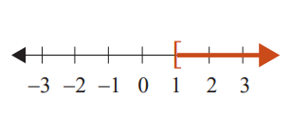

Example 11: Solving Linear Inequalities (cont.)
Divide both sides by $−5$. Note that the inequality
sign is reversed because of division by a negative
number!

Slide 26
Completion Example 12: Solving Linear Inequalities
Supply the reasons for each step in solving the linear inequality and graph the solution set. Write the solution set using interval notation.
Solution

Slide 27
Completion Example 12: Solving Linear Inequalities (cont.)
Add −2x to both sides.
Simplify.
Add 7 to both sides.
Simplify.
Divide both sides by 2.
Simplify.

Slide 28
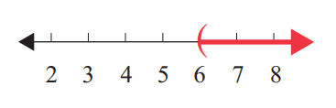
Completion Example 12: Solving Linear Inequalities (cont.)
Graph the interval on a number line.
x is in ______.

Slide 29
Example 13: Application: Using Inequalities
A math student has grades of 85, 98, 93, and 90 on four examinations. If he must average 90 or better to receive an A for the course, what scores can he receive on the final exam and earn an A? (Assume that the final exam counts the same as the other exams.)
Solution
Let x = the score on final exam.
The average is found by adding the scores and dividing by 5.

Slide 30
Example 13: Application: Using Inequalities (cont.)
If the student scores 84 or more on the final exam, he will average 90 or more and receive an A in math.

Slide 31
Example 14: Application: Using Inequalities
Taylor is at the local fair and purchases 30 ride tickets. She wants to get her money’s worth and she only has time to go on 8 rides. The rollercoaster requires 5 tickets to board and the merry-go-round requires 3 tickets to board. What is the maximum number of times she can ride the rollercoaster?
Solution
Let x = number rollercoaster rides,
then 8 − x = number of merry-go-round rides.
Taylor cannot use more than 30 tickets.

Slide 32







Example 14: Application: Using Inequalities (cont.)
Taylor can go on the rollercoaster ride at most 3 times.
$$5x+3\left(8−x\right)≤30$$
$$5x+24−3x≤30$$
$$2x+24≤30$$
$$2x+24−24≤30−24$$
$$2x≤6$$
$$\frac{2x}{2}≤\frac{6}{2}$$
$$x≤3$$

