Slide 1
Sections 1.1 – 1.5
1.1 The Meaning of Data
1.2 Statistics as a Career
1.3 The Data Explosion
1.4 The Fusion of Data, Computing, and Statistics
1.5 Big Data

Slide 2
The Meaning of Data
Historically we have associated data with measurements and numbers that were purposefully generated to help solve a problem.
What constitutes data is changing. Presently, the average smartphone owner uses about 3,000,000,000 (3 billion) bytes of data per month, and this number is growing rapidly. The word “data” in this context is different from the historical notion of purposeful measurement to solve a problem.

Slide 3
The Meaning of Data
Another category of data comes from the desire to create artificial intelligence. As researchers confront the problem of reproducing human “intelligence,” they must solve the same data problems we humans do—comprehending large volumes of visual and audio data. An enormous amount of what is considered data in the quest for artificial intelligence are not even measurements in the traditional sense.

Slide 4
The Meaning of Data
Statisticians analyze data using pictures and summary measurements to build data-driven predictive models. They develop methods of designing experiments and gathering data that are cost effective and diminish bias. Essentially, statistics is a “formal” way of thinking with data.

Slide 5
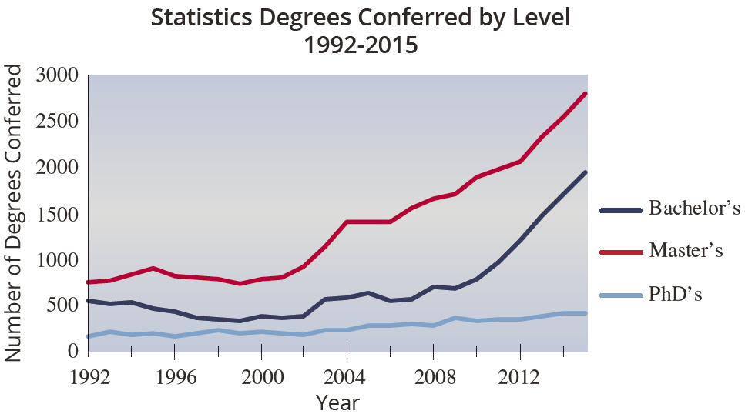
Statistics as a Career

Slide 6
The Data Explosion
According to IBM, 2.5 exabytes of data are created every day, worldwide. More recent estimates have been as large as 5 exabytes per day.

Slide 7
The Data Explosion
Quantifying Bytes
1,000,000,000 | 10⁹ | 1 gigabyte (1 billion bytes)
1,000,000,000,000 | 10¹² | 1 terabyte (1 trillion bytes)
1,000,000,000,000,000 | 10¹⁵ | 1 petabyte (1 quadrillion bytes)
1,000,000,000,000,000,000 | 10¹⁸ | 1 exabyte (1 quintillion bytes)
1,000,000,000,000,000,000,000 | 10²¹ | 1 zettabyte (1 sextillion bytes)

Slide 8
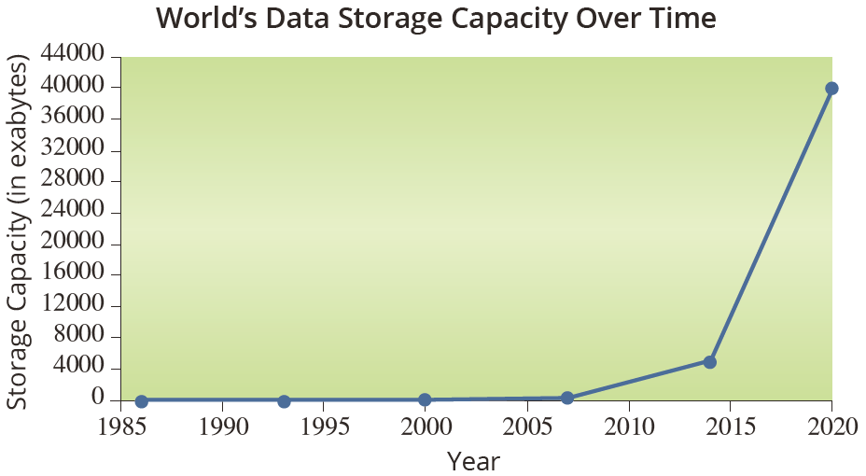
The Data Explosion

Slide 9
The Fusion of Data, Computing, and Statistics
When you apply statistical methods to increasingly larger data sets, there are very few data sets you are likely to encounter that could challenge modern computers. Using current computing technologies, data sets that are feasible to process simple statistical models in a reasonable amount of time are on the order of terabytes.
We will discuss some exceptions in the section on Big Data.

Slide 10
Big Data
Big Data is a loosely defined concept used to describe data sets produced by our globally networked, internet-driven, sensor-laden world.
The most common meaning of Big Data is a set of data sufficiently large to be challenging to analyze at a typical data center. As a frame of reference, the minimum for a large data center would be on the order of tens of thousands of servers and thousands of data storage arrays.

Slide 11
Big Data
Big Data seems to have four attributes that make it different.
Volume is the scale of the data, and Big Data implies large volumes of data.
Variety is the different forms data can take.
Velocity is how fast data is being sent to the data processing and data management infrastructure.
Veracity is the trustworthiness of the data.

Slide 12
Sources of Big Data
Medicine
Genomics
Astronomy and Cosmology
Physics
Business and Industry

