Slide 1
Section 1.6
Introduction to Statistical Thinking

Slide 2
Population
Definition
A population is the total set of subjects or things we are interested in studying.

Slide 3
Frame
Definition
A list containing all members of the population is referred to as a frame.

Slide 4
Census
Definition
A strict definition of a census is a survey that includes all the elements or units in the frame.

Slide 5
Population Parameters
Definition
Population parameters are facts about the population. Since parameters are descriptions of the population, a population can have many parameters.

Slide 6
Sample
Definition
A sample is a subset of the population which is used to gain insight about the population. Samples are used to represent a larger group, the population.

Slide 7
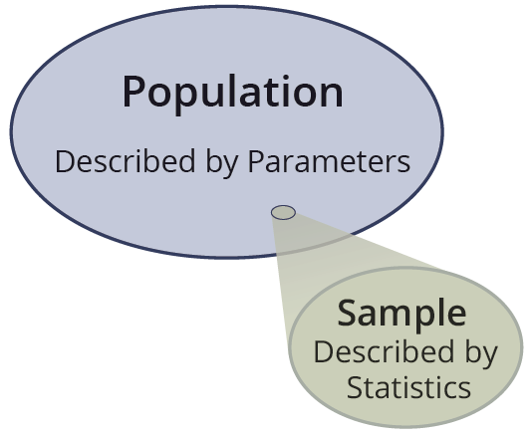
Statistic
Definition
A statistic is a fact or characteristic about the sample.

