Slide 1
Section 1.7
Descriptive vs. Inferential Statistics

Slide 2
Descriptive Statistics
Definition
Descriptive statistics is the collection, organization, analysis, and presentation of data.

Slide 3
Examples of Descriptive Statistics
• Frequency Distribution
• Measures of Central Tendency:
Mean
Median
Mode
• Measures of Dispersion:
Range
Variance
Standard Deviation

Slide 4
Inferential Statistics
Definition
The objective of inferential statistics is to make reasonable guesses about population characteristics using sample data.

Slide 5
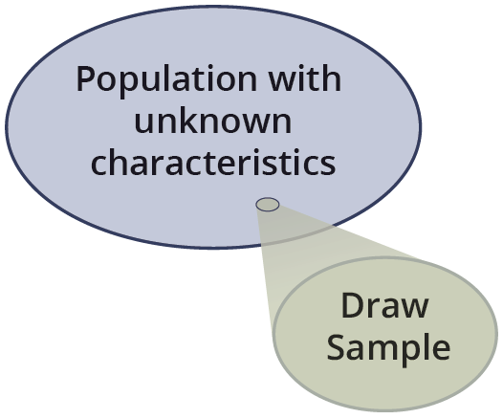
Inferential Statistics

