Slide 1
Section 10.2
Interval Estimation of the Population Mean

Slide 2
Interval Estimator and Confidence Interval
An interval estimator is made by developing an upper and lower boundary for an interval that will hopefully contain the population parameter.
The term confidence interval is used to describe the method of construction rather than a particular interval. A 95% confidence interval can be interpreted to mean that if all possible samples of a given size are taken from a populations, 95% of the samples would produce intervals that captured the true population mean and 5% would not.

Slide 3
100(1 − α)% Confidence Interval for the Population Mean, σ Known
Formula
If σ is known and the sample is drawn from a normal population or n > 30, a 100(1 − α )% confidence interval for the population mean is given by

Slide 4
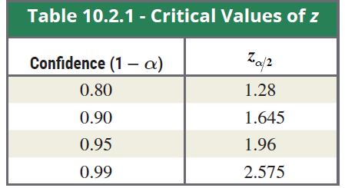

Critical Values of z and their Graphs
The term represents the z-value required to obtain
an area of 1- $α$ centered under the standard normal curve. The z-values for obtaining various (1- $α$) areas centered under the curve are given in Table 10.2.1 and graphed in Figure 10.2.4.

Slide 5
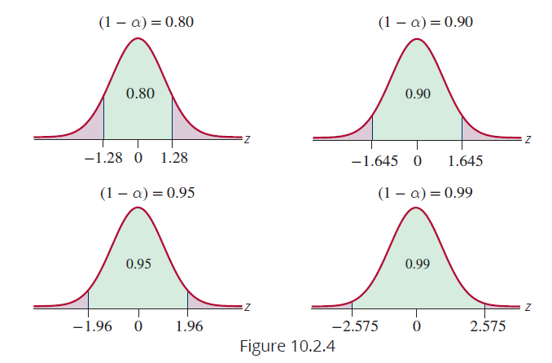
Critical Values of z and their Graphs (cont.)

Slide 6
Example 10.2.1
A random sample of 100 car engines has a mean weight of 425 pounds. Construct 80%, 90%, 95%, and 99% confidence intervals for the population mean if the standard deviation of the population is 900.
Solution
Since the random sample is from a population with a known standard deviation and n is greater than 30, we use the standard normal distribution to construct the confidence intervals.

Slide 7


Example 10.2.1 (cont.)
n = 100, and
80% Confidence Interval
90% Confidence Interval

Slide 8


Example 10.2.1 (cont.)
95% Confidence Interval
99% Confidence Interval

Slide 9
Maximum Error and Margin of Error, E
The part of the expression that is added and subtracted to the point estimate, , can be thought of as
the maximum error in estimating using the point estimate with a specified level of confidence. The maximum error of estimation is also referred to as the margin of error, E.

Slide 10
Example 10.2.2
An analyst is interested in investigating the average durability of the bladder within the soccer balls that his company manufactures. Suppose a random sample of 100 soccer balls is selected, and the balls are put through a pressure test to determine the PSI at which the bladder will burst. It is known from past experiences that the population standard deviation of the pressure at which a ball bursts is 13.25 PSI. The sample mean PSI necessary to pop a soccer ball is found to be 147.58 PSI.

Slide 11
Example 10.2.2 (cont.)
Calculate a 95 percent confidence interval for the population mean PSI necessary to pop a soccer ball.
Solution
From the information given, we know that
We can either use a table to find the value of z, or we can use statistical software to speed up the process. For this example, we will utilize Minitab.

Slide 12
Example 10.2.2 (cont.)
Enter the summarized data into the appropriate Minitab dialogue box, and make sure the correct confidence level is specified. Once the calculations are executed, the following output will be returned.

Slide 13
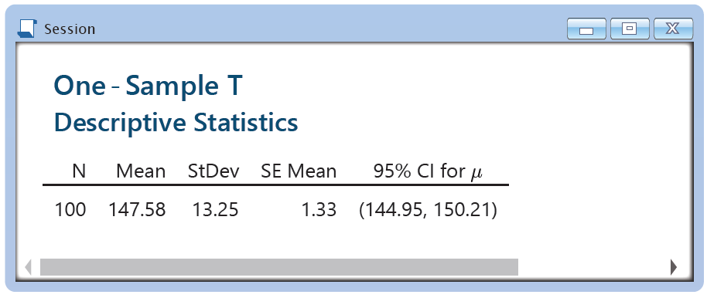
Example 10.2.2 (cont.)
Under the column titled “95% CI for μ”, two values are shown in interval format. These values are the endpoints for the 95% confidence interval. Therefore, the confidence interval for the population mean PSI necessary to pop a soccer ball is 144.95 to 150.21.

Slide 14
Student’s t-Distribution
Formula
Provided the population from which the sample is drawn is normally distributed or n > 30, the distribution of the quantity
where s is the standard deviation of the sample, has a Student’s t-distribution.

Slide 15
Degrees of Freedom
The t-distribution has one parameter, degrees of freedom. The number of degrees of freedom is the number of values from the sample that can vary after imposing restrictions on the data. For example, given the specific value for the mean of a set of data with n = 5, then four of the data values can vary freely, whereas the fifth one would be determined—it would have to have a particular value in order for the five data values to have the specified mean. Therefore, the number of degrees of freedom is equal to the sample size minus 1.

Slide 16
100(1 − α)% Confidence Interval for the Population Mean, σ Unknown
Formula
If σ is unknown and the sample is drawn from a normal population or n > 30, a 100(1 − α)% confidence interval for the population mean is given by
Where is the critical value for a t-distribution with
n − 1 degrees of freedom which captures an area of in the right tail of the distribution.

Slide 17
100(1 − α)% Confidence Interval for the Population Mean, σ Unknown
Formula (cont.)
For this confidence interval

Slide 18
Example 10.2.3
A random sample of hours worked in a week by student interns is drawn from a normal population with unknown mean and variance. The seven data values sampled are as follows.
25, 19, 37, 29, 40, 28, 31
Construct a 95% confidence interval for the population mean.

Slide 19
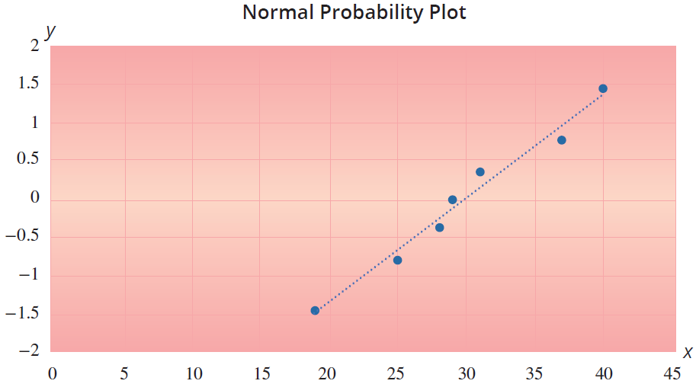
Example 10.2.3 (cont.)
Solution
Since we have n < 30, we should confirm the sample comes from an approximately normal distribution.

Slide 20
Example 10.2.3 (cont.)
Since the normal probability plot of the data indicates an approximately normal distribution and the standard deviation of the population is unknown, the Student’s t-distribution will be used to construct the confidence interval. The sample mean and standard deviation are
= 29.86 hours and s = 7.08 hours, respectively. The degrees of freedom associated with the problem are
df = n − 1 = 7 − 1 = 6.

Slide 21
Example 10.2.3 (cont.)
The t-value corresponding to 6 degrees of freedom and 95% confidence is given in Table D of Appendix A as t_{0.025, 6} = 2.447. The general form of the confidence interval is given by
Substituting the sample statistics and the critical value for the t-distribution into the confidence interval formula yields the following confidence interval for the population mean.

Slide 22
Example 10.2.3 (cont.)
Thus, we are 95% confident that the interval 23.31 hours to 36.41 hours will contain the population mean. The confidence interval can also be written as
23.31 hours < μ < 36.41 hours
or
(23.31 hours, 36.41 hours).

Slide 23
Example 10.2.3 (cont.)
An alternate interpretation would be that we are 95% confident that the point estimate (29.86 hours) has a maximum error of estimation (or margin of error) of 6.55 hours.

Slide 24
Example 10.2.4
A manufacturing company is interested in the amount of time it takes to complete a certain stage of the production process. The project manager randomly samples 10 products as they come from the production line and notes the time of completion. The average completion time is 23.45 minutes with a sample standard deviation of 4.32 minutes. Based on this sample, construct a 95% confidence interval for the average completion time for that stage in the production process.

Slide 25
Example 10.2.4 (cont.)
Assume that the population distribution of the completion times is approximately normal.
Solution
Since the company wants to calculate a 95% confidence interval for the average completion time, μ, we know that α = 0.05. We also have a sample size of n = 10 and thus, n− 1 = 10 − 1 = 9 degrees of freedom. Therefore, we use t_{α/2,n-1} = t_{0.025, 9} = 2.262 from Table D in the Appendix.

Slide 26
Example 10.2.4 (cont.)
We also know that the general form of the confidence interval for the population mean when σ is unknown and n < 30 is given by
20.36 min to 26.54 min.

Slide 27
Example 10.2.4 (cont.)
Thus, we are 95% confident that the true average completion time of that stage of the process is between 20.36 minutes and 26.54 minutes.

Slide 28
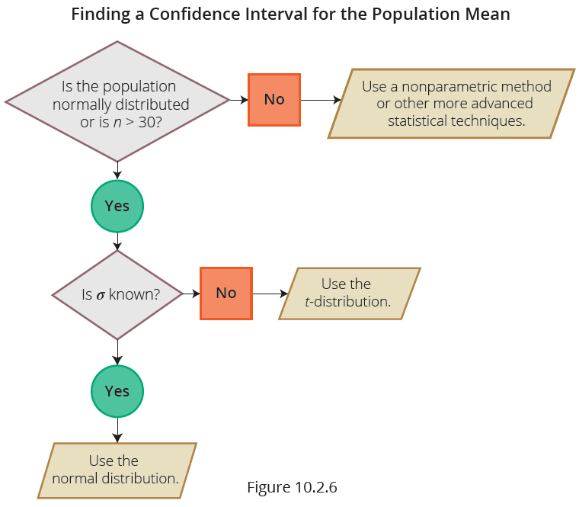
Interval Estimation of the Population Mean: A Summary

Slide 29
Sample Size Determination for Estimating a Population Mean
Formula

Slide 30
Example 10.2.5
Consider a population having a standard deviation of 15. We want to estimate the mean of the population. How large of a sample is needed to construct a 95% confidence interval for the mean of this population if the margin of error is equal to 1.5?
Solution

Slide 31
Example 10.2.5 (cont.)
Rounding up, we have to have a sample size of 385 to ensure that we get at least a 95% confidence interval with a margin of error equal to 1.5.

Slide 32
Example 10.2.6
Suppose that a quality control manager at Argon Chemical Company wishes to measure the average amount of cleaning fluid the company is placing in their 12 ounce bottles. From previous studies, they believe their population standard deviation to be 0.3 ounces. How large a sample must be taken in order to be 95% confident of estimating the mean cleaning fluid in a 12 ounce bottle to within 0.05 ounces?

Slide 33
Example 10.2.6 (cont.)
Solution
To be assured of finding the desired level of confidence, always round up. Thus, we are 95% confident that a sample of n = 139 observations would produce an estimate of the mean cleaning fluid in a 12 ounce bottle to within 0.05 ounces.

Slide 34
Example 10.2.6 (cont.)
Being able to know the accuracy of your estimate is one of the significant benefits of inferential statistics. In this case, if 139 bottles are measured, we will be 95% confident that the resulting sample mean is within five one-hundredths of an ounce of the true mean. That’s close.

Slide 35
Example 10.2.7
An airline’s maintenance manager desires to estimate the average time (in hours) required to replace a jet engine in a Boeing 767. How large a sample would be necessary if the manager wishes to be 95% confident of estimating the mean to within one-quarter of an hour (E = 0.25). Assume a preliminary sample of size n = 31 has an average replacement time of 16.7 hours with a standard deviation of 4.3 hours.

Slide 36
Example 10.2.7 (cont.)
Solution
Using the results from the initial sample,
n = 1137. (Always round up to assure the required confidence.)
Notice that while the sample data values are being collected they can be used to improve the estimate of the population standard deviation.

Slide 37
Example 10.2.7 (cont.)
For example, suppose the sample standard deviation after sampling the first 100 observations was 4.1. Using this estimate of s instead of 4.3 results in a sample size of 1034 compared to the original specification of 1137. The notion of modifying the sample size estimate as additional data is observed can be applied at regular intervals during the sampling process until the estimate of the standard deviation stabilizes.

