Slide 1
Section 10.4
Estimating the Population Standard Deviation or Variance

Slide 2
Interval Estimation of a Population Attribute
Note
The requirement of normality is very strict, regardless of sample size, as large errors may result.

Slide 3
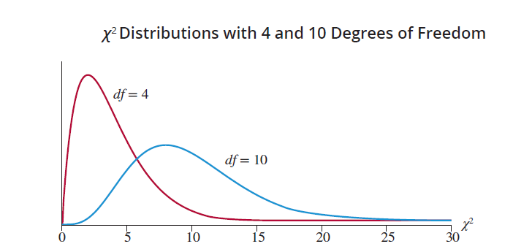
Chi-square Distribution
The chi-square distribution is a positively skewed (or skewed to the right) distribution. Like the t-distribution, the shape of the distribution is a function of its degrees of freedom.

Slide 4
Chi-square
To use the chi-square distribution, we need a chi-square value, denoted by (the Greek letter , pronounced Ki). We’ll call this our critical value for the chi-square distribution.

Slide 5
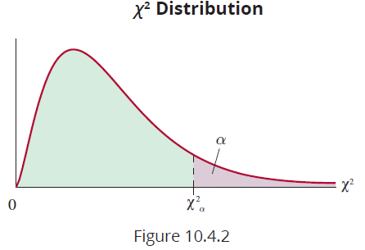
Chi-square (cont.)
As is shown in Figure 10.4.2,
is the point on the horizontal axis under the curve with an area of to the right of it. The value of
depends on the right-hand tail area, , and the number of degrees of freedom of the chi-square distribution. The values are tabulated in Table G in Appendix A.

Slide 6
Interval Estimation of a Population Attribute
Note
Although s² is an unbiased point estimate for 𝜎², s is a biased estimator for 𝜎.

Slide 7
100(1 − α)% Confidence Interval for σ²
Suppose we have a random sample of size n taken from a normal population and that s² is the estimate of the population variable, 𝜎².
Formula
A 100(1 − a)% confidence interval for 𝜎² is given by
where and are points under the curve of the chi-square distribution with n − 1 degrees of freedom.

Slide 8
100(1 − α)% Confidence Interval for σ
Formula
A 100(1 − a)% confidence interval for 𝜎 is given by
Where and are points under the curve of the chi-square distribution with n − 1 degrees of freedom.

Slide 9
Interval Estimation of a Population Attribute
Note
Since the chi-square distribution is not symmetric, confidence intervals for the population variance and standard deviation do not fit the format of previously studied confidence intervals where you add and subtract the margin of error, E, to a point estimate to get the upper and lower values for the confidence interval. The endpoints of the confidence intervals must be calculated separately.

Slide 10
Example 10.4.1
The quality control supervisor of a bottling plant is concerned about the variance of fill per bottle. Regulatory agencies specify that the standard deviation of the amount of fill should be less than 0.1 ounce. To determine whether the process is meeting this specification, the supervisor randomly selects ten bottles, weighs the contents of each, and finds that the sample standard deviation of these measurements is 0.04. Compute a 95% confidence interval for the standard deviation of ounces of fill for the bottling plant.

Slide 11
Example 10.4.1 (cont.)
Solution
We want to find a 95% confidence interval for the variance. We are given that
n = 10, s = 0.04, and α = 0.05.
To calculate a 95% confidence interval, we use the following formula.

Slide 12
Example 10.4.1 (cont.)
Thus, we need to find the values of and for n − 1 = 10 − 1 = 9 degrees of freedom.
Using Table G in Appendix A, at 9 degrees of freedom,

Slide 13
Example 10.4.1 (cont.)
Substituting the values in the formula above, we have
So, a 95% confidence interval for the variance of fill of the bottles is between 0.000757 and 0.00533 ounce.

Slide 14
Example 10.4.1 (cont.)
However, the problem mentions the tolerance for the standard deviation of fill. So, to ensure that we make our interpretation in terms of the problem, to find a 95% confidence interval for the standard deviation, we take the square root of the endpoints of the confidence interval for the variance, yielding
0.0275 ≤ σ ≤ 0.0730.
The 95% confidence interval for the standard deviation of fill for the bottles is between 0.0275 and 0.0730 ounces, indicating that the process is meeting the specifications of being less than 0.1 ounces.

