Slide 1
Section 11.1
Introduction to Hypothesis Testing

Slide 2
Example 11.1.1
A molecular biologist has been investigating several species of wild potato plants and believes she has discovered genetic properties that will increase the yield of the standard species. She has genetically engineered these new properties into the standard variety and produced a new variety. The standard species yields an average of 2.34 pounds per plant. She would like to know if her new plant has superior yield.

Slide 3
Example 11.1.1 (cont.)
The answer to this question can be investigated by testing the following rival hypotheses.
The new variety does not have superior yield.
The new variety does have superior yield.
To apply statistical methodology to answer this question, the preceding hypotheses must be translated into a problem statement concerning a statistical measure (e.g., mean, proportion, or variance). The statistical measure will be used in the definition of a criterion to decide the issue. There is a great deal of variability in the yields of potato plants.

Slide 4
Example 11.1.1 (cont.)
Comparing mean yield per plant of the new variety with the standard variety would provide a reasonable method of evaluating the new variety. The mean yield of the standard variety is known to be 2.34 pounds. However, the mean of the new variety is unknown, and that uncertainty is what makes the problem difficult. If the new variety does possess a superior yield, then the mean yield ought to be higher than the standard variety’s mean yield.

Slide 5
Example 11.1.1 (cont.)
If μ is defined as
μ = the average yield per plant for the new variety (population parameter),
then the two claims can be written in the following manner.
H₀, called the null hypothesis, contends that the mean yield of the new variety is equal to the mean yield of the standard variety.
The yield of the new variety is equal to the standard yield.
The new variety has superior yield.

Slide 6
Example 11.1.1 (cont.)
If this is the case, H₀ asserts that the new variety is no better than the standard variety. This would be a disappointing result for the genetic researcher. H_{a}, called the alternative hypothesis, declares that the mean yield for the new plant is superior to the mean yield of the standard variety. Once the problem statement is formulated in terms of a population parameter (in this case, the parameter is μ, the mean yield), sample data can be developed to help decide which hypothesis is more reasonable.

Slide 7
One-sided and Two-sided H_{a}
In Example 11.1.1, H_{a} involves a one-sided alternative, since the researcher is only interested in learning if there is sufficient evidence that yields are above the standard. If the research were interested in yields that were below the standard, then H_{a} would also have been one-sided, but the inequality would have been in the other direction ( 2.34 ). A two-sided alternative ( 2.34) would indicate that the researcher is concerned with yields that are above or below the standard.

Slide 8
Standard Value
In many research hypothesis tests, the investigator hopes to reject the null hypothesis in order to demonstrate the significance of a new idea. It is often the case that if there is a standard value for a population parameter, the null hypothesis states that the population parameter is equal to the standard value.

Slide 9
Properties of H₀ and H_{a}
Definition
The null hypothesis, denoted H₀, is a statement about the value of a population parameter. This statement is assumed to be true unless we find sample evidence that indicates it is not. If the sample evidence is strong enough to indicate it is not true, then we reject the null hypothesis. Otherwise, we fail to reject the null hypothesis.

Slide 10
Properties of H₀ and H_{a}
Definition (cont.)
The alternative hypothesis, denoted H_{a} or H₁, is also a statement about the value of a population parameter. It is the statement or claim that we are trying to find evidence to support.

Slide 11
Example 11.1.2
Suppose a potato chip manufacturer is concerned that the bagging equipment is not functioning properly when filling 10-ounce bags. He wants to test a hypothesis that will help determine if there is a problem with the bagging equipment. What is the correct hypothesis?

Slide 12
Example 11.1.2 (cont.)
Solution
Since the standard value in this problem is 10 ounces, the null hypothesis is H₀: μ = 10 oz. The bagging equipment ordinarily functions properly; thus the manufacturer requires overwhelming evidence that the machine is overfilling or underfilling the bags before shutting down the equipment.
When the alternative hypothesis allows values above and below the standard value, it is called a two-sided alternative.

Slide 13
Example 11.1.2 (cont.)
In this case, the manufacturer hopes that he fails to reject the null hypothesis, since that would suggest that his equipment is putting the right amount in the bags. This type of hypothesis is quite common in quality control and other kinds of system monitoring.

Slide 14
Example 11.1.3
Martha Brandon wants to assess her candidacy in a forthcoming race for the state senate. She is an incumbent and wants to raise sufficient support to retain her seat. How should she formulate an appropriate hypothesis to determine if there is overwhelming evidence she will retain her seat?
Solution
The correct formulation of the hypotheses is
Martha does not have sufficient support to retain her seat.
Martha does have sufficient support to retain her seat.

Slide 15
Example 11.1.3 (cont.)
where p = the fraction of voters that will vote for her.
This problem differs significantly from the other two examples. The problem’s formulation requires the use of a different statistical measure, p, the population proportion. The crucial value of the proportion is 0.5, since in order to retain the seat she must obtain more than half of the votes cast (assuming there is only one other candidate). The null hypothesis contends that she does not have sufficient support to retain her seat.

Slide 16
Example 11.1.3 (cont.)
If the null hypothesis is rejected in favor of the alternative, H_{a}: p > 0.5, there is overwhelming evidence that she has the blessing of more than half the voters.
The alternative is one-sided, since the intent of the study is to learn if she will win. (A two-sided alternative would imply interest in finding out if she will win or lose the election, a rather meaningless idea.) She hopes the conclusion of the test will be to reject the null hypothesis, since that implies that there is overwhelming sample evidence that she will receive more than half the votes cast.

Slide 17
Formulating Hypothesis Testing Problems
Procedure
To be successful at formulating hypothesis testing problems you must be able to:
Determine the appropriate statistical measure to test the desired hypothesis (population mean, proportion, or variance).
Determine the appropriate value to use in the null hypothesis. (This may be stated in the problem as a standard value or may need to be deduced from the information at hand.)

Slide 18
Formulating Hypothesis Testing Problems
Procedure (cont.)
Decide whether the alternative should be one-sided or two-sided.

Slide 19
Errors in Hypothesis Testing
Definition
Rejecting H₀ when in fact H₀ is the correct choice is called a Type I error.
Failing to reject H₀ when in fact H_{a} is the correct choice is called a Type II error.

Slide 20
Example 11.1.4
Suppose Jeremy was in a car accident and a doctor in the emergency room believes he is dead. Jeremy’s body has been sent to a mortician for preparation. Preparation, in this context, is a euphemism for draining the blood out of his body and replacing it with fluids which retard deterioration. If Jeremy isn’t dead when he gets to the mortician, he will be dead after he is prepared. How should the mortician frame the hypothesis when he/she begins to work on Jeremy’s body?

Slide 21
Example 11.1.4 (cont.)
Solution
Formulation A
H₀: Jeremy is dead.
H_{a}: Jeremy is alive.
Type I error using Formulation A
To have an error you must make a mistake. Suppose this is what happened.
Truth: H₀: Jeremy is dead.
Mortician’s Decision: H_{a}: Jeremy is alive.

Slide 22
Example 11.1.4 (cont.)
In order to have a Type I error, you must reject the null hypothesis when it is true. In this case, the mortician believes Jeremy is alive even though he is actually dead. What’s the consequence to the mortician?
Consequence: None, since Jeremy is already dead. From Jeremy’s vantage point, or the lack of it in this case, no problem. R.I.P.

Slide 23
Example 11.1.4 (cont.)
Type II error using Formulation A
Mortician’s Decision: H₀: Jeremy is dead.
Truth: H_{a}: Jeremy is alive.
A Type II error means failing to reject the null, when it is false. If the null is false, then the alternative is true. Jeremy is alive. Good news! Unfortunately, the mortician thought he was dead.
Consequence: Jeremy will die as soon as preparations begin.

Slide 24
Example 11.1.4 (cont.)
For the two errors, which has the worst consequence? Clearly, the Type II error has the worst consequence. Does Formulation A place the most serious error as a Type I? Not if life matters! Let’s try another formulation.

Slide 25
Example 11.1.4 (cont.)
Formulation B
H₀: Jeremy is alive.
H_{a}: Jeremy is dead.
Type I error using Formulation B
Truth: H₀: Jeremy is alive.
Mortician’s Decision: H_{a}: Jeremy is dead.
The mortician believes Jeremy is dead when, in fact, he is alive. He is prepared.
Consequence: Jeremy will die. R.I.P.

Slide 26
Example 11.1.4 (cont.)
Type II error using Formulation B
Mortician’s Decision: H₀: Jeremy is alive.
Truth: H_{a}: Jeremy is dead.
The mortician believes Jeremy is alive, when in fact, he is dead.
Consequence: None, since Jeremy is already dead.
Formulation B is the correct formulation of the problem, since the most serious consequence (death!) is the result of a Type I error. That’s good, because the probability of a Type I error can be controlled in the hypothesis testing procedure.

Slide 27
α, Type I Error
Definition
The probability of a Type I error is denoted by α (the Greek letter alpha), and is referred to as the level of the test, or the significance level of the test.

Slide 28
β, Type II Error
Definition
The probability of a Type II error is denoted by β (the Greek letter beta). Unfortunately, the value of β depends on the actual value of the population parameter and thus cannot be determined unless the actual value of the population parameter is known, which is rarely the case.

Slide 29
Why Not Make Both α and β as Small as Possible?
Unfortunately, the probability of making a Type I error, α, and the probability of making a Type II error, β, are inversely related. Thus, the smaller we make the probability of making a Type I error, the more likely we are to make a Type II error. In general, choose the largest level of α which is tolerable to avoid unnecessarily increasing the probability of making a Type II error.

Slide 30
Elements of Hypothesis Testing
Properties
The null hypothesis is presumed to be true unless sample data produces overwhelming evidence to the contrary. That is, the test statistic is calculated under the assumption that the null hypothesis is true.
Sample data from a random sample are used to calculate a test statistic.

Slide 31
Elements of Hypothesis Testing
Properties (cont.)
The form of the test statistic will change depending upon the statistical measure used in the hypothesis statement, μ, p, or σ ² (as well as with the assumptions about knowledge of the population).
Simple hypothesis testing models related to a single population parameter are explored in this chapter. Each model will have its own set of assumptions depending on the population parameter of interest and the underlying distribution of the population.

Slide 32
Elements of Hypothesis Testing
Properties (cont.)
In later chapters we will look at more complicated hypothesis testing models with multiple parameters which will also have a unique set of assumptions. If the researcher's goal is to attach statistical significance to the conclusions of the hypothesis test, it is critically important to validate the assumptions of the hypothesis testing model.

Slide 33
Elements of Hypothesis Testing
Properties (cont.)
The conclusion of the hypothesis test results in a decision to either reject or fail to reject the null hypothesis. Note that we do not accept the null hypothesis; we only conclude that there is insufficient evidence to support the alternative.
There is no way to be absolutely certain your decision is correct, no matter which hypothesis is selected.

Slide 34
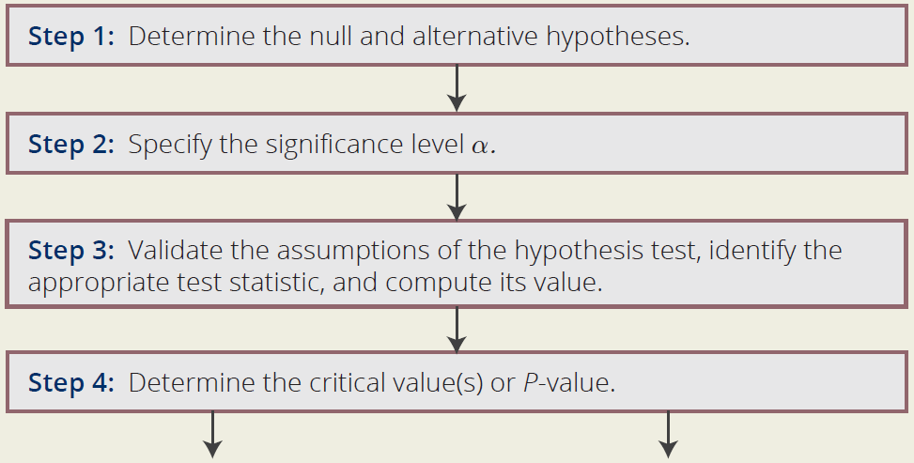
Steps in the Hypothesis Test
Procedure

Slide 35
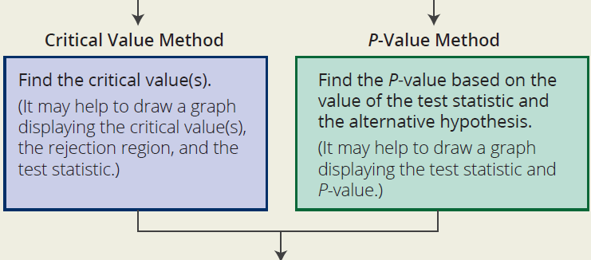
Steps in the Hypothesis Test
Procedure (cont.)

Slide 36
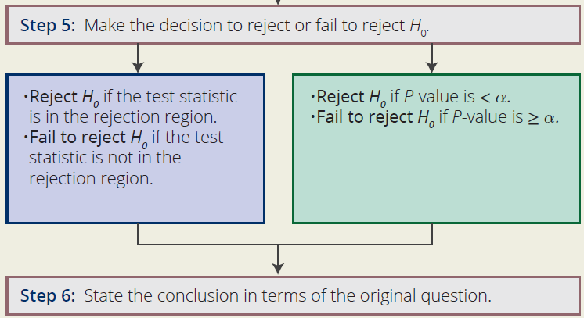
Steps in the Hypothesis Test
Procedure (cont.)

Slide 37
A Procedure for Hypothesis Testing
Note
Note at Step 4 there are two options; you can find the critical value of the test statistic or the P-value of the test statistic. Both methods will always produce equivalent results; meaning, the decision regarding the hypothesis test will always be the same with both methods. We will often cover both methods in an example to illustrate this.

Slide 38
A Procedure for Hypothesis Testing
Note (cont.)
Even though we may show a critical value and a P-value, only one of these is required to make the decision to reject or fail to reject the null hypothesis. You or your instructor may have a preference of one method over another.

