Slide 1
Section 11.2
Testing a Hypothesis about a Population Mean with σ Known and Unknown

Slide 2
Example 11.2.1
Suppose the average national reading level for high school sophomores is 150 words per minute with a standard deviation of 15. A local school board member wants to know if sophomore students at Lincoln High School read at a level different from the national average for tenth graders. The level of the test is to be set at 0.05. A random sample size of 100 tenth graders from Lincoln High School has been drawn, and the resulting average is 154 words per minute.

Slide 3
Example 11.2.1 (cont.)
Solution
Step 1: Determine the null and alternative hypotheses.
We will first define the hypotheses in plain English and then using symbols.
The hypotheses are fairly straightforward:
Null Hypothesis: Lincoln High School tenth graders are reading at the national average.
Alternative Hypothesis: They are not.

Slide 4
Example 11.2.1 (cont.)
Since the problem explicitly states that the school board member wishes to compare reading levels to the national average, the hypotheses will concern the population mean. Let
μ = the average number of words read per minute by Lincoln High School sophomores.
In symbolic form, the hypotheses are as follows.

Slide 5
Example 11.2.1 (cont.)
Table 11.2.1 - Hypotheses Concerning a Test about a Single Mean
 | Is the population mean different from μ₀? | Is the population mean greater than μ₀? | Is the population mean less than μ₀?
Null Hypothesis, H₀ | μ = μ₀ | μ = μ₀ | μ = μ₀
Alternative Hypothesis, H_{a} | μ ≠ μ₀ | μ > μ₀ | μ < μ₀
Type of Hypothesis Test | Two-tailed | Right-tailed | Left-tailed
Step 2: Specify the significance level α.
The level of the test has been defined in the problem statement as the α = 0.05 level.

Slide 6
Example 11.2.1 (cont.)
If it were not specified in the problem statement, then it would be necessary to select the value. Typical values for the level of the test are 0.10, 0.05, and 0.01. It is important to remember that the level of the test specifies the probability of a Type I error.
Step 3: Validate the assumptions of the hypothesis testing model, identify the appropriate test statistic, and compute its value.

Slide 7
Testing a Hypothesis About a Mean, σ Known
Procedure
Assumptions:
The data is quantitative.
The data is obtained via a random sample of size n.
The population is normally distributed or the sample size n is large, n > 30.
The population standard deviation σ is known.
Test statistic:
The test statistic is given by

Slide 8
Testing a Hypothesis About a Mean, σ Known
Procedure (cont.)
where,
n = the sample size,
= the sample mean,
μ₀ = the population mean (from the null hypothesis), and
σ = the known population standard deviation.

Slide 9

Example 11.2.1 (cont.)
Before proceeding with the test, we must check our assumptions.
Quantitative data
Random sample used to obtain data
n > 30 or population is normally distributed
σ known or
σ unknown

Slide 10
Example 11.2.1 (cont.)
Step 3 (cont.): Validate the assumptions of the hypothesis testing model, identify the appropriate test statistic, and compute its value.
The random sample of 100 tenth graders revealed a mean reading rate of 154 words per minute with a standard deviation of 15 words per minute. As discussed earlier, the z-test statistic is given by

Slide 11
Example 11.2.1 (cont.)
The sample mean is 2.67 standard deviations from the hypothesized value. Is the sample mean too far away from the value of the mean specified in the null hypothesis for us to believe the null is true?
Step 4: Determine the critical value(s).
In determining the critical value(s) of the test statistic, we must take into account whether the alternative hypothesis is one-sided or two-sided, the level of the test, and the distribution of the test statistic.

Slide 12
Example 11.2.1 (cont.)
Table 11.2.2 – Critical Values of the z-Test Statistic for Two‑Sided Alternatives
Significance Level | Definition of Ordinary Variability | z_{α/2}
0.20 | 80% interval around hypothesized mean | 1.28
0.10 | 90% interval around hypothesized mean | 1.645
0.05 | 95% interval around hypothesized mean | 1.96
0.01 | 99% interval around hypothesized mean | 2.575

Slide 13
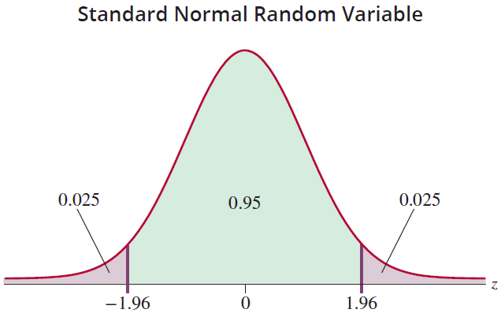
Example 11.2.1 (cont.)
Notice that the rejection region is divided into two parts. The right-hand rejection region indicates unexpectedly high reading levels if H₀ is true, and

Slide 14
Example 11.2.1 (cont.)
conversely the left-hand rejection region indicates unexpectedly low levels if H₀ is true. Also observe that the probability associated with the level of the test is divided equally between the two rejection regions, each region receiving 0.025. If the probabilities in these two regions are added together, 0.025 + 0.025 = 0.05, the sum equals the level of the test, α.
The level of the test can be thought of as a tolerance for rareness. The level of the test defines a rejection region which can be thought of as an intolerance zone.

Slide 15
Example 11.2.1 (cont.)
If the test statistic falls in this “intolerance” region, then the data has produced a sample mean that has in turn produced a test statistic that is too rare (according to our level of significance α) to have occurred by chance if the null were true and all the assumptions related to the hypothesis test are satisfied.
Essentially, we lose faith in the null hypothesis; the data has cast too much doubt. Consequently, the null hypothesis is rejected. The “fail to reject” zone can be interpreted as the zone of ordinary sampling variation given the null is true.

Slide 16
Example 11.2.1 (cont.)
For two-sided tests with the level of the test set to α = 0.05, the investigator is stating that any value of the test statistic which falls in a 95% interval around the hypothesized mean represents ordinary sampling variability. For the z-test statistic, this corresponds to a critical value of 1.96 standard deviation units (see Table 11.2.2). If the test statistic falls into the ordinary sampling variation zone, the null hypothesis will not be rejected.

Slide 17
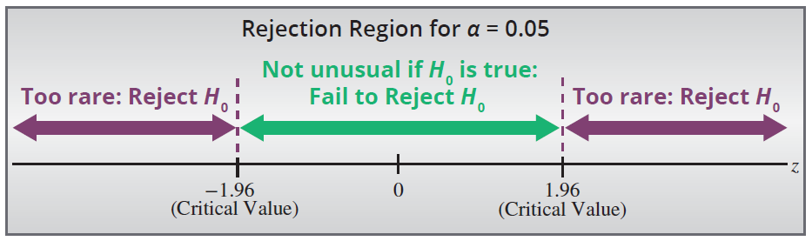
Example 11.2.1 (cont.)
Step 5: Make the decision to reject or fail to reject H₀. The critical values of the test statistic are ±1.96. If the null were true, observing a value of z larger in absolute value than 1.96 would occur only 5% of the time.

Slide 18
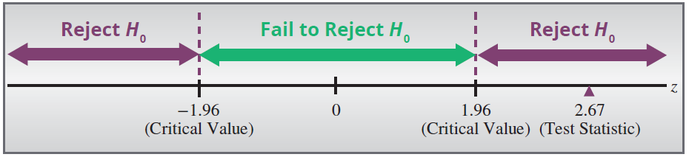
Example 11.2.1 (cont.)
The test statistic z = 2.67 implies is 2.67 standard deviation units from the mean which is substantially more than 1.96 standard deviations from the hypothesized value. The decision must be to reject H₀. The sample mean is too far from the hypothesized value for us to believe the difference is caused by ordinary sampling variation.

Slide 19

Example 11.2.1 (cont.)
Essentially, exceeds the tolerance for rareness that we have imposed by setting α = 0.05.
Step 6: State the conclusion in terms of the original question.
There is significant evidence at the 0.05 level that tenth graders at Lincoln High do not read at the national average.

Slide 20
Example 11.2.1 (cont.)
It would be tempting to conclude that they read above national levels, since the sample mean is considerably above the national average. However, we did not test the hypothesis for reading overachievement; we tested reading achievement either over or under the state average, and the conclusions must be consistent with the hypotheses tested.

Slide 21
P-Value
Definition
A P-value is the probability of observing a value of the test statistic as extreme or more extreme than the observed one, assuming the null hypothesis is true and all the assumptions related to the hypothesis test are satisfied.

Slide 22
Performing a Hypothesis Test Using P-Values
Procedure
If the computed P-value is less than α, reject the null hypothesis in favor of the alternative.
If the computed P-value is greater than or equal to α, fail to reject the null hypothesis.

Slide 23
Example 11.2.1 (cont.)
Let's repeat Steps 4 through 6 of the hypothesis testing procedure using the P-value approach.
Step 4: Determine the P-value.
In the example we have a two-tailed test, a critical value of z = 2.67, and α = 0.05.
For an upper one-tailed test (i.e., H_{a}: μ > 150), we would calculate the P-value as
P-value = p(z ≥ 2.67) = p(z ≤ −2.67) ≈ 0.0038.

Slide 24
Example 11.2.1 (cont.)
However, for a two-tailed test, the P-value is calculated as
P-value = 2P(z ≥ |z₀|), where z₀ is the observed value of the test statistic.
Thus, to compute the P-value for a two-tailed hypothesis test, we double the tail area. Hence,
P-value = 0.0038 + 0.0038 = 0.0076.

Slide 25
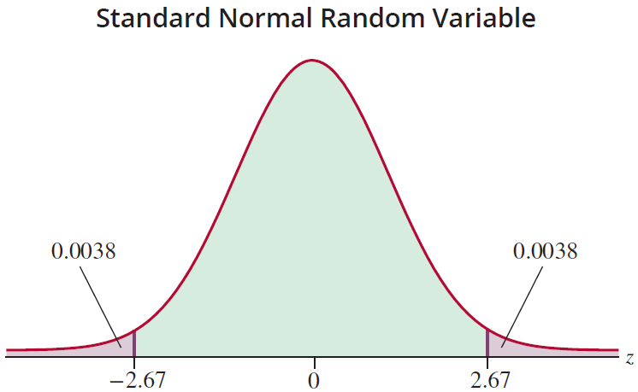
Example 11.2.1 (cont.)
The P-value of 0.0076 is the likelihood of observing a value of the test statistic greater than or equal to 2.67 or less than or equal to −2.67 given the null hypothesis is true and all assumptions are met.

Slide 26
Example 11.2.1 (cont.)
Step 5: Make the decision to reject or fail to reject H₀. The P-value of 0.0076 is less than our significance level α = 0.05, so we reject the null hypothesis.
Step 6: State the conclusion in terms of the original question.
As expected, our decision is the same one we obtained using the critical value approach, so our conclusion does not change. There is sufficient evidence at the 0.05 level that tenth graders at Lincoln High do not read at the national average.

Slide 27
Example 11.2.2
A microprocessor designer has developed a new fabrication process which he believes will increase the usable life of a chip. Currently the usable life is 16,000 hours with a standard deviation of 2500 hours. Test the hypothesis that the process increases the usable life of a chip, at the 0.01 level. A random sample of 1000 microprocessors will be tested. Assume the standard deviation of the life of the new chips will be equal to the standard deviation of the current chips.

Slide 28
Example 11.2.2 (cont.)
Solution
Step 1: Determine the null and alternative hypotheses.
We first state the hypotheses in plain English.
Null Hypothesis: The new fabrication does not increase the usable life of the chip.
Alternative Hypothesis: The new fabrication increases the usable life of the chip.

Slide 29
Example 11.2.2 (cont.)
Once again, the population mean is a suitable parameter to test this hypothesis. If the mean life of the newly fabricated chip is greater than the mean life of the standard chip, all other things being equal, the newly fabricated chip would be better. Let
μ = the mean life of the newly fabricated chips.
The goal is to determine if there is sufficient evidence that the new fabrication process produces chips with longer life. The hypothesis will be one-sided.

Slide 30
Example 11.2.2 (cont.)
In symbolic form the hypotheses are as follows.
If the purpose is to demonstrate that there is overwhelming evidence in support of a hypothesis, that hypothesis should be placed in the alternative hypothesis. In this example, the aim is to determine if there is sufficient evidence to conclude that the new chip has a longer life.
The mean life of the newly fabricated chip is equal to the life of the standard chip.
The newly fabricated chip has a longer mean life than the standard chip.

Slide 31
Example 11.2.2 (cont.)
Step 2: Specify the significance level α.
The level of the test is given in the problem to be α = 0.01. If it were not given, the investigator would choose the level.
Step 3: Validate the assumptions of the hypothesis test, identify the appropriate test statistic, and compute its value.
First, we validate the assumptions.

Slide 32
Example 11.2.2 (cont.)
Quantitative data (the number of hours of usable life of a chip)
Random sample used to obtain data
n > 30 (n = 1000)
σ known or
All of the assumptions of the z-test statistic are met.
Suppose a random sample of 1000 microprocessors has a mean life of 16,200 hours. The resulting test statistic,
σ unknown

Slide 33
Example 11.2.2 (cont.)
indicates that the sample mean life of new microprocessors is more than 2.5 standard deviations larger than the mean life of current microprocessors. Is it unlikely that ordinary sampling variation could have caused the sample mean to be more than 2.5 standard deviations from the hypothesized value?

Slide 34
Example 11.2.2 (cont.)
Step 4: Determine the critical value(s) or P-value. Since the alternative hypothesis is one-sided, we want to know if there is evidence that μ (the mean life of the newly fabricated chips) is greater than the hypothesized value μ₀ (16,000 hours, the standard life of existing chips). If (the mean life of the 1000 microprocessors samples) is much larger than μ₀, that would suggest that H_{a} is a more reasonable choice than H₀. Of course, through ordinary sampling variation, could be larger than μ₀.

Slide 35
Example 11.2.2 (cont.)
How much greater than μ₀ does have to be in order for us to believe that mean life of the newly fabricated chips is greater than 16,000 hours and select H_{a}?
Table 11.2.3 – Critical Values of the z-Test Statistic for One‑Sided (Greater Than) Alternatives
Significance Level | Definition of Ordinary Variability | z_{α}
0.20 | Lower 80% of the distribution | 0.84
0.10 | Lower 90% of the distribution | 1.28
0.05 | Lower 95% of the distribution | 1.645
0.01 | Lower 99% of the distribution | 2.33

Slide 36
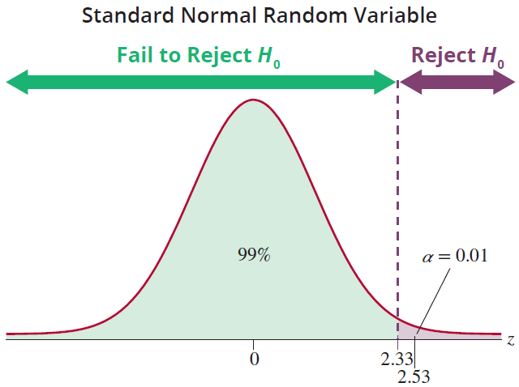
Example 11.2.2 (cont.)
The z-test statistic has a standard normal distribution; so critical values are determined from the probability distribution of the standard normal distribution.

Slide 37
Example 11.2.2 (cont.)
The alternative hypothesis is one-sided (H_{a}: μ > 16,000) and α = 0.01. From Table 11.2.3, we find that the appropriate critical value for the test is 2.33. This critical value means that if is 2.33 standard deviations larger than μ₀, then H₀ should be rejected in favor of Ha. However, if H₀ is true and all assumptions are met, ordinary variation would cause to be greater than 2.33 about 1% of the time. Thus, 1% of the time H₀ will be rejected when it is true, a Type I error.

Slide 38
Example 11.2.2 (cont.)
To locate the critical value of z for a one-sided “greater-than” alternative, find the value of z that cuts off α worth of probability in the right-hand tail of the distribution. The critical values for “greater than” alternative hypotheses are given in Table 11.2.3 for typical values of α.
To determine the P-value for the test we proceed as follows.
P-value = P(z ≥ 2.53 ) = P(z ≤ −2.53) ≈ 0.0057.

Slide 39
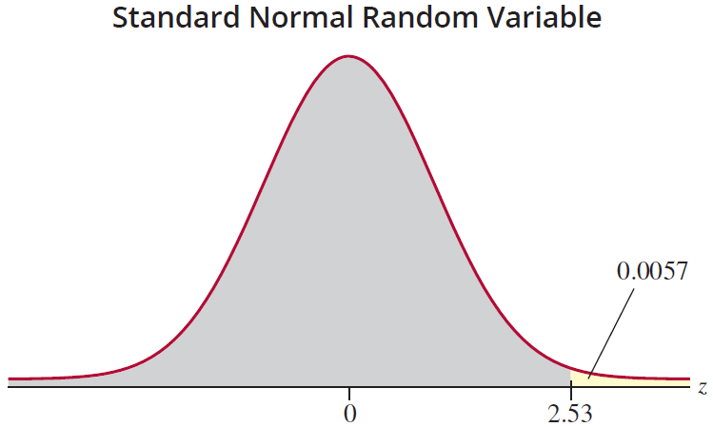
Example 11.2.2 (cont.)
Step 5: Make the decision to reject or fail to reject H₀. Since the test statistic value of 2.53 is larger than the critical value, 2.33, the conclusion is to reject H₀ in favor of H_{a}.

Slide 40
Example 11.2.2 (cont.)
Note that the P-value of 0.0057 is less than the significance level, α = 0.01, also leading us to the decision to reject H₀.
Step 6: State the conclusion in terms of the original question.
There is sufficient evidence at the α = 0.01 level to conclude that the new fabricating technique is superior and leads to longer chip life.

Slide 41
One-Sided "Less Than" Alternatives
Procedure
For tests which are based on a test statistic which has a standard normal distribution and “less than” alternatives, find the value of z that cuts off α worth of probability in the left-hand tail of the distribution. The critical values for “less than” alternative hypotheses are given in Table 11.2.4 for typical values of α.

Slide 42
One-Sided "Less Than" Alternatives
Procedure (cont.)
Table 11.2.4 – Critical Values of the z-Test Statistic for One‑Sided (Less Than) Alternatives
Significance Level | Definition of Ordinary Variability | −z_{α}
0.20 | Upper 80% of the distribution | −0.84
0.10 | Upper 90% of the distribution | −1.28
0.05 | Upper 95% of the distribution | −1.645
0.01 | Upper 99% of the distribution | −2.33

Slide 43
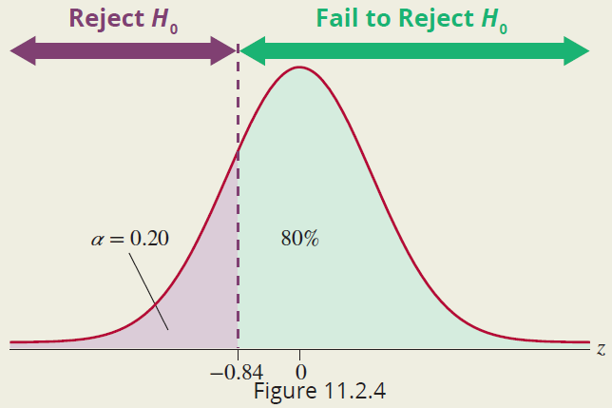
One-Sided "Less Than" Alternatives
Procedure (cont.)
The figure above shows the rejection region for a test with a one-sided “less than” alternative hypothesis, and a significance level of 0.20.

Slide 44
One-Sided "Less Than" Alternatives
Procedure (cont.)
For this test, the null hypothesis will be rejected if the calculated value of the test statistic is less than −0.84. The P-value is given by P(z ≤ z₀), where z₀ is the observed value of the test statistic.

Slide 45
Testing a Hypothesis About a Mean, σ Unknown
Procedure
Assumptions:
The data is quantitative.
The data is obtained via a random sample of size n.
The population is normally distributed or the sample size n is large, n > 30.
The population standard deviation σ is unknown.
Test Statistic:
The test statistic is given by

Slide 46
Testing a Hypothesis About a Mean, σ Unknown
Procedure (cont.)
where,
n = the sample size,
= the sample mean,
μ₀ = the population mean (from the null hypothesis), and
s = the sample standard deviation.
The test statistic has a t-distribution with n−1 degrees of freedom.

Slide 47
Example 11.2.3
A personnel researcher has designed a questionnaire she believes will take an average time of 35 minutes to complete. Suppose she randomly samples 20 employees and finds that the mean time to take the test is 29 minutes with a standard deviation of s = 8 minutes. Determine if there is sufficient evidence to conclude that the completion time of the newly designed test differs from its intended duration. Conduct the test at the 0.05 level. Assume the sample comes from a normally distributed population.

Slide 48
Example 11.2.3 (cont.)
Solution
Step 1: Determine the null and alternative hypotheses. In plain English the hypotheses are as follows.
Null Hypothesis: The questionnaire takes 35 minutes to complete.
Alternative Hypothesis: It takes more or less than 35 minutes to complete.

Slide 49
Example 11.2.3 (cont.)
The population of interest consists of all employees who could take this test. Since the test is specified as having an average duration of 35 minutes, the parameter of interest will be the population mean.
Let μ = the average time in minutes for employees to complete the questionnaire.
From the lack of information to the contrary, we must assume she is interested in detecting whether the test is too long or too short. Thus, the test is two-sided. The resulting hypotheses in symbolic form would be

Slide 50
Example 11.2.3 (cont.)
Step 2: Specify the significance level α.
The level of the test is specified in the problem at 0.05. Step 3: Validate the assumptions of the hypothesis test, identify the appropriate test statistic, and compute its value.

Slide 51
Example 11.2.3 (cont.)
First, we validate the assumptions.
Quantitative data (time to complete the questionnaire)
Random sample used to obtain data
n < 30 (n = 20), but population assumed to be normally distributed
σ known or
All of the assumptions are met. Since we do not know σ, we will use the t-test statistic.
σ unknown

Slide 52
Example 11.2.3 (cont.)
The computed value of the test statistic is
The observed sample mean is over 3 standard deviations less than the hypothesized mean. The value of the test statistic signifies a noteworthy difference between and the hypothesized value, μ₀. It is unlikely that the cause of such a difference would be ordinary sampling variation.

Slide 53
Example 11.2.3 (cont.)
Step 4: Determine the critical value(s) or P-value.
The t-distribution has a parameter called degrees of freedom, which must be defined in order to utilize the distribution. Since 20 employees were sampled, the degrees of freedom are df = n − 1 = 20 − 1 = 19.
Since the alternative hypothesis (H_{a}) is two-sided, two tails of the distribution must be “cut off” as rejection regions. Each tail will receive half of the allotted significance level of the test. The value of t which begins the right-hand side rejection region is t_{0.025,19}, which corresponds to a value of 2.093.

Slide 54
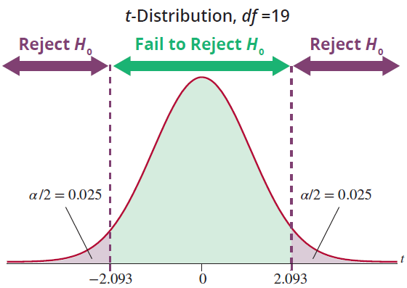
Example 11.2.3 (cont.)
Since the t-distribution is symmetrical, the left-hand side cutoff value for the rejection region is −2.093.

Slide 55
Example 11.2.3 (cont.)
What the picture says is that it is unlikely (only occurs 5% of the time) that ordinary sampling variability will cause to differ by 2.093 or more standard deviation units from the hypothesized mean of 35.
If you do not have technology, you can refer to Table D in the Appendix. Looking at the row corresponding to 19 degrees of freedom, we see that the absolute value of our test statistic, 3.35, is larger than the largest value, 2.861, displayed. This value has an area of 0.005 in the tail, so we know that the P-value corresponding to our test statistic is smaller than 2 · 0.005 = 0.010.

Slide 56
Example 11.2.3 (cont.)
Using technology the exact P-value corresponding to t = −3.35 with df = 19 is found to be approximately 0.0034.
Step 5: Make the decision to reject or fail to reject H₀.
Since the test statistic falls in the rejection region (and P-value < α), we reject H₀ in favor of H_{a}.
df t_{0.100} t_{0.050} t_{0.025} t_{0.010} t_{0.005}
19 | 1.328 | 1.729 | 2.093 | 2.539 | 2.861

Slide 57
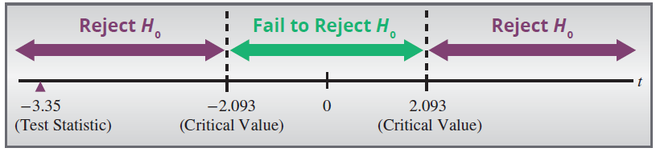
Example 11.2.3 (cont.)
Step 6: State the conclusion in terms of the original question.
There is sufficient evidence at the 0.05 level to conclude that the mean time to take the test is not 35 minutes.

Slide 58
Example 11.2.3 (cont.)
Since the sample mean was so much less than 35 minutes, it is tempting to conclude that the test requires less than 35 minutes to complete. However, we did not test the one-sided hypothesis. If the researcher wishes to demonstrate the completion time is significantly less than 35 minutes, we must start the process over: testing a one-sided hypothesis and obtaining new sample data.

Slide 59
Example 11.2.4
The Alexander Bolt Company produces half-inch A-class stainless steel bolts that have a mean tensile strength of more than 4000 pounds per square inch (psi), the specified quality standard. These bolts are primarily used in the manufacturing of farm implements. The company is very concerned about quality and wants to be sure that its A-class product is above the quality standard. A sample of 25 bolts is to be randomly selected from stock and tested for tensile strength.

Slide 60
Example 11.2.4 (cont.)
Design a test of hypothesis to determine if there is overwhelming evidence that the bolts are better than the specified quality standard.
Sample values:
4023 3993 4009 4006 4039 3984 4003 4007
4007 4055 4004 4049 4000 3995 4019 4003 4029
4009 4041 4021 4012 3984 4040 4025 3986
Solution
Step 1: Determine the null and alternative hypotheses.

Slide 61
Example 11.2.4 (cont.)
The hypotheses in plain English are:
Null Hypothesis: The half-inch A-class stainless steel bolts have a mean tensile strength of 4000 psi.
Alternative Hypothesis: The half-inch A-class stainless steel bolts have a mean tensile strength of more than 4000 psi.
Although there is nothing in the problem that specifically defines the population parameter of interest, there is mention of a “standard value.”

Slide 62
Example 11.2.4 (cont.)
By comparing the mean breaking strength of the population to the standard value, 4000 pounds per square inch, a conclusion about quality can be drawn. Let
μ = the mean tensile strength of the half-inch A-class stainless steel bolts.
If μ is significantly above the standard, then there would be evidence that the desired quality is being produced. Thus, the alternative hypothesis will be one-sided.
The resulting hypotheses would be

Slide 63
Example 11.2.4 (cont.)
Step 2: Specify the significance level α.
The level of the test is not stated in the problem, and thus the selection is left to the researcher.
Mean tensile strength is equal to the quality standard of 4000 pounds per square inch. The bolt production system is working at the quality standard.
Mean tensile strength is above 4000 pounds per square inch. The bolt production system is working better than the quality standard.

Slide 64
Example 11.2.4 (cont.)
If we set α too high, management will too frequently believe the quality level is being met, when it is not. A small level of α would be desirable. Let’s use α = 0.01.
Step 3: Validate the assumptions of the hypothesis test, identify the appropriate test statistic, and compute its value.
First, we validate the assumptions.
Quantitative data (tensile strength)
Random sample used to obtain data

Slide 65
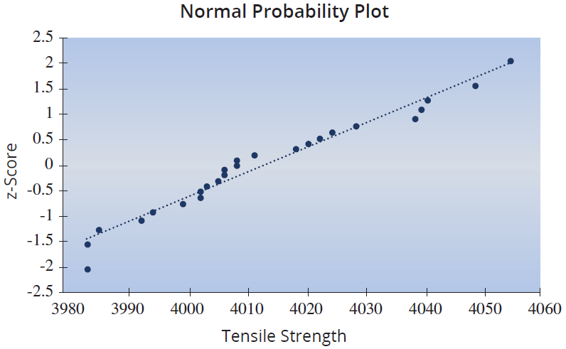
Example 11.2.4 (cont.)
The sample size is less than 30, so we need to confirm that the population is approximately normally distributed. A normal probability plot of the data is given below.
The plot does not indicate a significant departure from normality.

Slide 66
Example 11.2.4 (cont.)
Population is approximately normally distributed
σ known or
The assumptions are met such that the t-statistic is appropriate.
The average tensile strength is 4014 pounds per square inch, with a standard deviation of 20 pounds. Symbolically this is expressed as
σ unknown

Slide 67
Example 11.2.4 (cont.)
The resulting test statistic is
The sample mean is 3.5 standard deviations more than the hypothesized value of the mean. Is this difference caused by ordinary sampling variation, or is this evidence of a false null hypothesis?

Slide 68
Example 11.2.4 (cont.)
Keep in mind that rejecting the null hypothesis (H₀) will be a desirable outcome since the null states that the bolts are at quality standards.
Step 4: Determine the critical value(s) or P-value. Since the alternative hypothesis implies that we are interested in discovering if the mean is above the standard value, the rejection region will only be on the right-hand side of the sampling distribution. Because the level of the test has been chosen at 0.01, the interval encompassing 0.01 of the area on the right-hand side of the curve will define the rejection region.

Slide 69
Example 11.2.4 (cont.)
The test statistic has a t-distribution.
To obtain the critical value, first determine the degrees of freedom.
n − 1 = 25 − 1 = 24.
Using Table D in Appendix A, t_{0.01,24} = 2.492. If the observed t-value is greater than 2.492 then the observed mean is presumed to be too far from the hypothesized value to have occurred from ordinary sampling variation.

Slide 70
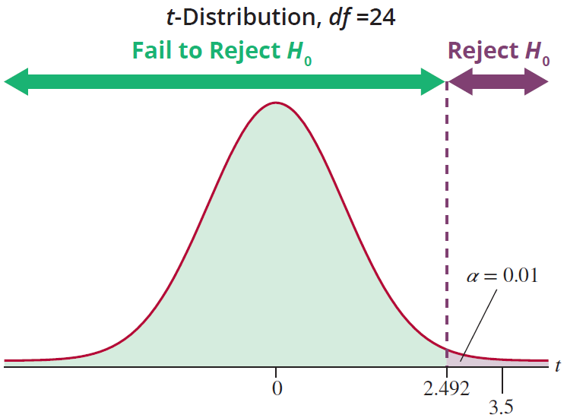
Example 11.2.4 (cont.)
If t > 2.492, the presumption will be that the mean tensile strength is greater than 4000 pounds per square inch.

Slide 71
Example 11.2.4 (cont.)
The P-value of the test statistic (t = 3.5) can be found using technology to be P(t ≥ 3.5) ≈ 0.0009, with degrees of freedom equal to 24. Alternatively, using Table D we observe that the test statistic is greater than the t-value of 2.797, which has a tail area of 0.005. This implies that the P-value is less than 0.005.
Step 5: Make the decision to reject or fail to reject H₀. Since the value of the test statistic (3.5) falls in the rejection region, the sample mean is too far from the hypothesized value to believe it is due to ordinary sampling variation.

Slide 72
Example 11.2.4 (cont.)
(In other words, = 4014 is a rare observation and has exceeded our tolerance for rareness.) The null hypothesis can be rejected in favor of the alternative hypothesis.
Alternatively, this decision is confirmed by our P-value; the P-value is 0.0009, which is less than α = 0.01.
Step 6: State the conclusion in terms of the original question.
There is sufficient evidence to conclude that bolt tensile strength is above 4000 psi.

Slide 73
ASA Guidelines Regarding P-Values
P-values can indicate how incompatible the data are with a specified statistical model.
P-values do not measure the probability that the studied hypothesis is true, or the probability that the data were produced by random chance alone.
Scientific conclusions and business or policy decisions should not be based only on whether a P-value passes a specific threshold.

Slide 74
ASA Guidelines Regarding P-Values
Proper inference requires full reporting and transparency.
A P-value, or statistical significance, does not measure the size of an effect or the importance of a result.
By itself, a P-value does not provide a good measure of evidence regarding a model or hypothesis.

