Slide 1
Section 11.4
Testing a Hypothesis about a Population Proportion

Slide 2
Developing the Test
Testing a hypothesis concerning a population proportion is nearly identical to testing a hypothesis about a population mean. The major changes in the procedure include the use of the population proportion (p) in the formulation of the hypothesis, rather than the population mean (μ), and similar changes in the calculation of the test statistic.

Slide 3
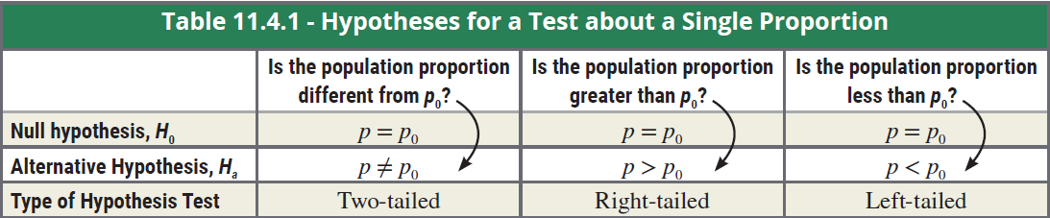
Hypotheses for a Test about a Single Proportion
Table 11.4.1 contains the correct formulation of the hypotheses for a test about a single proportion.

Slide 4
Testing a Hypothesis about a Population Proportion, p
Procedure
Assumptions:
The data is obtained via a random sample of size n.
The conditions for a binomial random variable are met. That is, there is a fixed number n of independent trials with only two possible outcomes on each trial, referred to as a success or failure. The probability of success on any trial is the same.
The conditions np₀ ≥ 10 and n(1 − p₀) ≥ 10 are both satisfied.

Slide 5
Using a Confidence Interval to Test a Two-Sided Hypothesis
Procedure (cont.)
Test Statistic: The test statistic is given by
p₀ = the population proportion (the value used in the null hypothesis),
n = the sample size, and
= the sample proportion.

Slide 6
Example 11.4.1
A college is trying a new student registration system and would like to know if there is sufficient evidence to conclude that more than 60% of the students favor the new system.
Solution
Step 1: Determine the null and alternative hypotheses. Let’s first state the hypotheses in plain English.
Null Hypothesis: 60% of students favor the new system.

Slide 7
Example 11.4.1 (cont.)
Alternative Hypothesis: More than 60% of the students favor the new system.
Since the problem concerns the percent of students that favor the new system, the appropriate statistical measure will be a proportion.
Let p = the proportion of the student population who believe the new system is superior to the old system.
Since the problem is concerned with finding evidence that the percentage is greater than 60%, the formation of the alternative hypothesis will be one-sided.

Slide 8
Example 11.4.1 (cont.)
In symbolic form the hypotheses would then be as follows.
Step 2: Specify the significance level α.
Since the level of the test is not specified in the problem, let’s use α = 0.05.
60% of the students prefer the new system.
More than 60% of the students prefer the new system.

Slide 9
Example 11.4.1 (cont.)
Step 3: Validate the assumptions of the hypothesis test, identify the appropriate test statistic, and compute its value.
The test statistic measures how far the sample proportion, , is from the unknown population proportion, p, measured in standard deviation units. This is exactly the same concept used in testing hypotheses about a population mean. There is one interesting aspect to the calculation of the standard deviation of , which is denoted by it requires knowledge of p.

Slide 10
Example 11.4.1 (cont.)
This may seem odd, since the entire purpose of the hypothesis test is to make an inference about the unknown value of p. If p is unknown, how can it be used to compute ?
The answer to this riddle lies in the hypothesis testing procedure. The null hypothesis is assumed to be true, unless there is overwhelming evidence to the contrary. Since the null is presumed to be true, let p equal the value hypothesized in the null hypothesis (p₀).

Slide 11

Example 11.4.1 (cont.)
In a random sample of 520 students, 352 said that the new registration system is superior.
First, we must check our assumptions.
Random sample
There are only two outcomes for each of the 520 independent trials—a student prefers the new system or does not—so we have a binomial random variable.
np₀ = 520(0.6) = 312 > 10 and n(1 − p₀) = 520(1 − 0.6) = 208 > 10

Slide 12
Example 11.4.1 (cont.)
We can proceed with the test. The value of , is given by
In this case, the difference between p₀ and is 3.58 standard deviation units.

Slide 13
Example 11.4.1 (cont.)
If H₀ is true, would we expect a difference between p₀ and to be 3.58 standard deviation units? Or, is this test statistic (z = 3.58) overwhelming evidence in favor of the alternative hypothesis?
Step 4: Determine the critical value(s) or P-value.
The test statistic, z, has a normal distribution with a mean of zero and a variance of one. So designating the decision rule is exactly like what has been done in previous problems. The test is a one-tailed test, and in Step 2 we decided to set the level of the test at 0.05.

Slide 14
Example 11.4.1 (cont.)
The decision rule will be to reject H₀: p = 0.6 if the value of z is greater than 1.645. In essence, we are saying that ordinary sampling variation might account for a up to 1.645 standard deviations larger than the hypothesized value. But if a z-value is observed that is larger than 1.645, then we will lose faith in the null hypothesis because we have observed something that is too rare by the standards we have set for the level of the test.

Slide 15
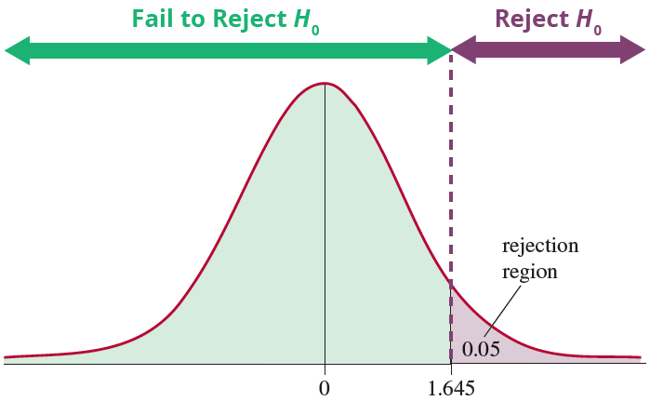
Example 11.4.1 (cont.)
We can use exactly the same idea in determining a P-value for a test about a proportion as we did in calculating
P-values for the test statistic of a hypothesis concerning a population mean.

Slide 16
Calculating P-Values for a Hypothesis Test for a Proportion
Procedure
For an upper one-tailed test (i.e., H_{a}: p > 0.6), we calculate the P-value as
P-value = P(z ≥ z₀) = P(z ≤ −z₀), where z₀ is the observed value of the test statistic.
For a lower one-tailed test (i.e., H_{a}: p < 0.6), we calculate the P-value as P-value = P(z ≤ z₀).
For a two-tailed test (i.e., H_{a} ≠ 0.6), the P-value is calculated as P-value = 2·P(z ≥ |z₀|).

Slide 17
Calculating P-Values for a Hypothesis Test for a Proportion
Procedure (cont.)
If the computed P-value is less than α, reject the null hypothesis in favor of the alternative.
If the computed P-value is greater than or equal to α, fail to reject the null hypothesis.
Since this is an upper one-tailed test, the P-value is computed as
P-value = P(z ≥ 3.58) = P(z ≤ −3.58) ≈ 0.0002.

Slide 18
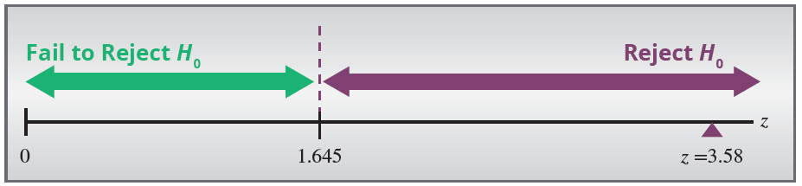
Example 11.4.1 (cont.)
Step 5: Make the decision to reject or fail to reject H₀.
The value of the test statistic, z = 3.58, falls into the rejection region. According to the standard of rareness established in Step 4, the z-value is too rare to believe the null hypothesis (H₀: p = 0.6) is true.

Slide 19
Example 11.4.1 (cont.)
The sample evidence contradicts the null hypothesis, and it will be rejected in favor of the alternative hypothesis,
Comparing the P-value to the significance level, we see that 0.0002 < 0.05, which leads us to the same conclusion to reject the null hypothesis.

Slide 20
Example 11.4.1 (cont.)
Step 6: State the conclusion in terms of the original question.
There is overwhelming evidence that over 60% of the students prefer the new system at a significance level of 0.05.

Slide 21
Example 11.4.2
The city of Savannah wants to know if its citizens are in favor of building a toll bridge across the Savannah River. A research company was hired to survey a sample of local residents to determine their views on the construction of a toll bridge. The mayor would like to know if the majority of the residents are in favor of the bridge before calling a formal referendum on the topic. Test at the α = 0.01 level.

Slide 22
Example 11.4.2 (cont.)
Solution
Step 1: Determine the null and alternative hypotheses. In plain English the hypotheses are
Null Hypothesis: Half of the residents favor the new toll bridge.
Alternative Hypothesis: The majority of the residents favor the new toll bridge.
A majority would be any percentage greater than 50%. Since the problem concerns the percentage of residents, the appropriate statistical measure is a proportion.

Slide 23
Example 11.4.2 (cont.)
The mayor wants to take action if there is overwhelming evidence that greater than 50% of the residents favor the new bridge. Therefore, the problem should be formulated with a one-sided alternative.
H₀: p = 0.5 50% of the residents favor the new toll bridge.
H_{a}: p > 0.5 More than 50% of the residents favor the new toll bridge.
Step 2: Specify the significance level α.
The problem specifies the level of the test is α = 0.01.

Slide 24
Example 11.4.2 (cont.)
Step 3: Validate the assumptions of the hypothesis test, identify the appropriate test statistic, and compute its value.
The appropriate test statistic is given by
of the 420 residents that were randomly selected, 228 favored the new bridge.

Slide 25
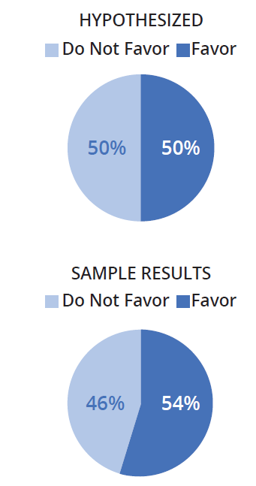
Example 11.4.2 (cont.)
First, we must check our assumptions.
Random sample
There are only two outcomes for each trial—a resident favors the toll bridge or does not—so we have a binomial random variable.
np₀ = n(1 − p₀) = 420(0.5) = 210 > 10.
We can proceed with the test. The proportion favoring the new bridge in the sample is

Slide 26
Example 11.4.2 (cont.)
and
The z-value indicates that the sample proportion is 1.76 standard deviation units above the hypothesized proportion.

Slide 27
Example 11.4.2 (cont.)
Could this have happened by ordinary sampling variation, or is this overwhelming evidence that the null is not true and the alternative should be selected?
Step 4: Determine the critical value(s) or P-value.
The null hypothesis should only be rejected if there is overwhelming evidence that the population proportion is larger than 0.5. Since the test is one-sided, the entire probability associated with the level of the test
(α = 0.01) will be placed in the right -hand tail of the distribution.

Slide 28
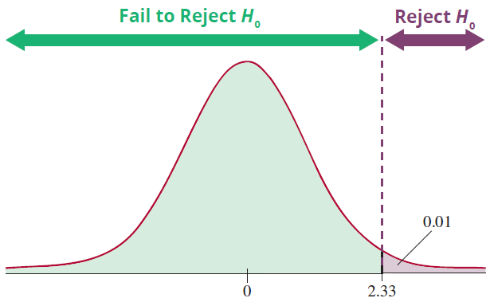
Example 11.4.2 (cont.)
Recall from Table 11.2.3 that the critical value for the test is 2.33. The rejection region is the shaded region in the above graph.

Slide 29
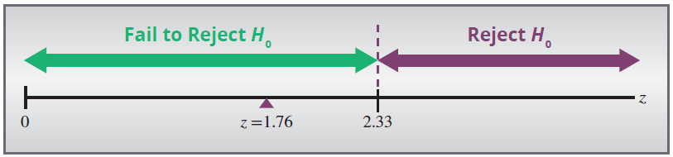
Example 11.4.2 (cont.)
The decision will be to reject the null hypothesis if the calculated value of the test statistic is greater than 2.33.
The P-value is computed as
P(z ≥ 1.76) = P(z ≤ −1.76) ≈ 0.0392.
Step 5: Make the decision to reject or fail to reject H₀.

Slide 30
Example 11.4.2 (cont.)
The value of z does not fall in the rejection region. Do not reject H₀: p = 0.5. There is not sufficient evidence (at the 0.01 level) to reject the null hypothesis. Another way of thinking about this is that the sample proportion was not sufficiently rare to reject
H₀: p = 0.5.
The P-value of 0.0392 is greater than α = 0.01, so we fail to reject the null hypothesis.

Slide 31
Example 11.4.2 (cont.)
Step 6: State the conclusion in terms of the original question.
There is not overwhelming evidence at the α = 0.01 level to conclude that the residents favor the new toll bridge.

