Slide 1
Section 12.1
Inference about Two Means: Independent Samples

Slide 2
Independent Experimental Design or Completely Randomized Design
When observations are randomly selected from two independent populations or experimental units are randomly assigned to two different treatments where the variation between experimental units is small, the sampling design is called an independent experimental design or a completely randomized design.

Slide 3
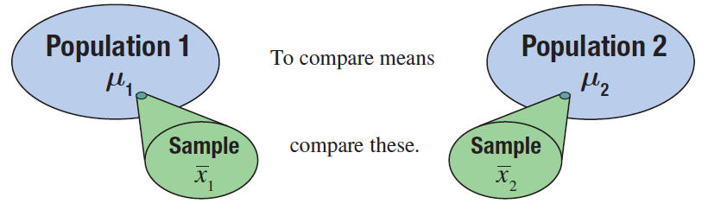
Inferences about the Means of Two Independent Populations, σ₁ and σ₂ Known
We will use the sample means and to compare the means of two populations.

Slide 4
Properties of the Sampling Distribution of
Properties
If n₁ > 30 and n₂ > 30, the sampling distribution of has an approximately normal distribution. As well, the sampling distribution of is normally distributed if both samples come from populations that are normally distributed.
if the two samples are independent.

Slide 5
100(1 − α)% Confidence Interval for μ₁ − μ₂
Formula
The 100(1 −α)% confidence interval estimate for the difference in the population means of two independent populations is given by
where z_{α/2} is the critical value of the standard normal distribution with an area of α/2 in the upper tail. σ₁ and σ₂ are known, and the independent samples are drawn from normally distributed populations or the samples sizes are large; i.e., n₁ > 30 and n₂ > 30.

Slide 6
Testing a Hypothesis about Two Independent Population Means, σ₁ and σ₂ Known
Procedure
Assumptions:
The samples are independent of one another.
Both samples are simple random samples.
The populations from which the two samples are drawn are normally distributed or the sample sizes are both large (n₁ > 30 and n₂ > 30).
The population standard deviations, σ₁ and σ₂, are known.

Slide 7
Testing a Hypothesis about Two Independent Population Means, σ₁ and σ₂ Known
Procedure (cont.)
Test Statistic:
The test statistic for a hypothesis test about μ₁− μ₂ is given by

Slide 8
Testing a Hypothesis about Two Independent Population Means, σ₁ and σ₂ Known
Procedure (cont.)
For Population 1 For Population 2
μ₁ = the population mean, μ₂ = the population mean, σ₁ = the population σ₂ = the population standard deviation, standard deviation,
n₁ = the sample size, and n₂ = the sample size, and
= the sample mean. = the sample mean.

Slide 9
Testing a Hypothesis about Two Independent Population Means, σ₁ and σ₂ Known
Procedure (cont.)
Note that μ₁− μ₂ represents the hypothesized difference between the population means and that the z-statistic follows the standard normal distribution.

Slide 10

Example 12.1.1
A telecommunications analyst is interested in knowing if there is a significant difference in the average service outage times between cable television subscribers and satellite television subscribers. She randomly selects 50 cable subscribers and 50 satellite subscribers for the study.
She gives each subscriber a survey and asks them to record the length of time of each service outage for a month. She summarizes the results of the survey and calculates the mean outage for each television service. The results of the study are shown in the following table.

Slide 11
Example 12.1.1 (cont.)
Calculate a 95% confidence interval for the mean difference in average service outage time between cable and satellite subscribers.
Is there persuasive evidence for the analyst to conclude at α = 0.05 that there is a difference in mean service outage time between cable and satellite subscribers?
Service Outage Time (in minutes)
 | n |  | σ
Cable | 50 | 8.8 | 3
Satellite | 50 | 9.5 | 2

Slide 12
Example 12.1.1 (cont.)
Solution
From the information given in the problem, we know the following.
Since both sample sizes are greater than 30, we can invoke the Central Limit Theorem and assume that the sample means are approximately normally distributed.

Slide 13

Example 12.1.1 (cont.)
Independent random samples
The samples sizes are large (n₁ > 30 and n₂ > 30).
σ₁ and σ₂ are known or
Since we want a 95% confidence interval, we need to find the value of Remember that represents the z-value required to obtain an area of (1 – α) centered under the standard normal curve. For a 95% confidence interval, α = 0.05 and therefore,
□ σ₁ and σ₂ are unknown

Slide 14
Example 12.1.1 (cont.)
A 95% confidence interval for the difference in the average service outage time between cable and satellite providers is given by
This gives,

Slide 15
Example 12.1.1 (cont.)
Thus, we are 95% confident that the true mean difference in service outage time between cable and satellite subscribers is between −1.7 and 0.3 minutes. Since the confidence interval includes zero, this indicates that the difference in the average service outage time between cable and satellite subscribers is not statistically significant at the 0.05 level.

Slide 16
Example 12.1.1 (cont.)
The steps for the hypothesis test are as follows.
Step 1: Determine the null and alternative hypotheses.
Null Hypothesis: There is no difference in average service outage time between cable and satellite subscribers.
Alternative Hypothesis: There is a difference in average service outage time between cable and satellite subscribers.

Slide 17
Example 12.1.1 (cont.)
Since the analyst is interested in comparing the average service outage time between cable and satellite subscribers, the appropriate statistical measures are the following.
μ₁ = the true mean service outage time for cable subscribers
μ₂ = the true mean service outage time for satellite subscribers

Slide 18
Example 12.1.1 (cont.)
The analyst is interested in whether or not there is a difference in the average service outage time between cable and satellite subscribers. Thus, the alternative hypothesis is two-sided and the test is two-tailed.
Since the analyst is interested in comparing the two population means, a natural way to make this comparison is to look at the difference between the two population means. Hence the null and alternative hypotheses are formulated as follows.

Slide 19
Example 12.1.1 (cont.)
In this situation, the hypothesized difference in average service outage time is 0. However, it is possible to be interested in nonzero differences. For example, if the analyst had been interested in testing if the difference in average service outage time was one minute, the hypothesized difference would have been one.
There is no difference in average service outage time.
There is a difference in average service outage time.

Slide 20
Example 12.1.1 (cont.)
Step 2: Specify the significance level α.
The level of the test is specified in the problem as α = 0.05.

Slide 21
Example 12.1.1 (cont.)
Step 3: Validate the assumptions of the hypothesis test, identify the appropriate test statistic and compute its value.
The assumptions for the test were validated in part a.
The difference in sample means, is an unbiased point estimate of the difference in population means, μ₁ − μ₂. The sampling distribution for the point estimate, provides essential information for determining the test statistic.

Slide 22
Example 12.1.1 (cont.)
If n₁ > 30 and n₂ > 30 and an independent experimental design is used, the sampling distribution of has an approximately normal distribution with mean, and standard deviation,
Thus, the test statistic is a standard normal random variable which is calculated by using the familiar
z-transformation.

Slide 23
Example 12.1.1 (cont.)
The test statistic is given by
If the null hypothesis is true, z has an approximately normal distribution. If the observed value of is significantly larger or smaller than μ₁ − μ₂, the hypothesized value of the difference,

Slide 24
Example 12.1.1 (cont.)
this will produce a large or small value of the test statistic, causing us to doubt whether or not the null hypothesis is in fact true. How large is large? This is answered by the critical value of the test statistic specified in Step 4.
Based on the data in the table, the computed value of the test statistic is given by

Slide 25
Example 12.1.1 (cont.)
Note
Recall that this is similar to our initial discussion of z-scores in Chapter 4:

Slide 26
Example 12.1.1 (cont.)
Step 4: Determine the critical value(s) or P-value.
The role of the critical value(s) in this test is exactly the same as for all of the hypothesis tests discussed earlier. It defines a range of values for the test statistic, the rejection region, that will be so rare that it is unlikely that the test statistic occurred from ordinary sampling variability, assuming the null is true. The level of the test defines the size of the rejection region. Should the computed value of the test statistic fall within the rejection region, the null hypothesis will be rejected.

Slide 27
Example 12.1.1 (cont.)
If the null hypothesis is true, the test statistic has an approximately normal distribution. Thus the critical value is determined in the same way as for the other tests of hypothesis in which the test statistic had an approximately normal distribution. The rejection region for a two-tailed test with level of significance, α = 0.05, is displayed in the figure below.

Slide 28
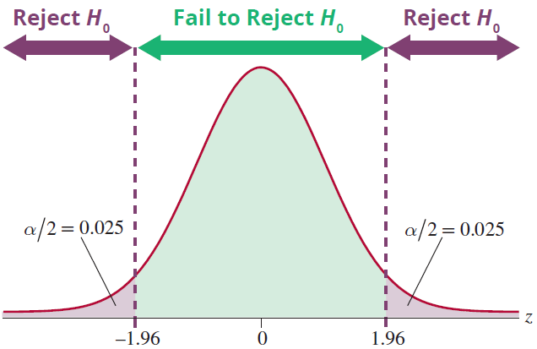
Example 12.1.1 (cont.)
The null hypothesis will be rejected if the computed value of the test statistic is greater than or equal to 1.96 or less than or equal to −1.96.

Slide 29
Example 12.1.1 (cont.)
In other words, we will reject the null hypothesis if the observed difference in the average service outage time is at least 1.96 standard deviations above or below the hypothesized value of 0 (no difference in service outage time between cable and satellite).
The P-value for the test statistic of −1.373 can be obtained from the normal table, or more easily using technology, and is approximately 0.1698.

Slide 30
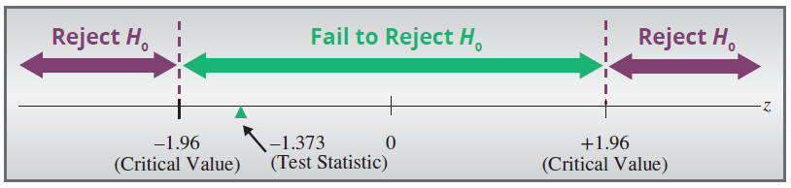
Example 12.1.1 (cont.)
Step 5: Make the decision to reject or fail to reject H₀.
Note
Remember that you can use either P-values or rejection regions to make a decision in a hypothesis test. The examples will show you both methods but you need only use one of them.

Slide 31
Example 12.1.1 (cont.)
As shown on the previous slide, the calculated value of the test statistic does not fall in the rejection region because −1.373 falls between the critical values −1.96 and 1.96. There is insufficient evidence to conclude that the difference between the observed value and the hypothesized value is due to anything other than ordinary sampling variation. Thus, we fail to reject the null hypothesis at α = 0.05.
Since the P-value of 0.1698 is greater than α = 0.05, we fail to reject the null hypothesis.

Slide 32
Example 12.1.1 (cont.)
Step 6: State the conclusion in terms of the original problem.
There is not sufficient evidence at the 0.05 level to conclude that the average service outage time is significantly different between cable and satellite television subscribers.
The following is another example of performing a hypothesis test about two population means, but with a one-sided alternative hypothesis.

Slide 33

Example 12.1.2
An elementary school teacher is interested in knowing if fifth-grade girls take longer to read a passage from a book than fifth-grade boys. She randomly selects 40 fifth-grade boys and 40 fifth-grade girls for the study. She gives each student several pages of the same book to read. The time it takes each group to complete the reading is recorded in minutes. The results of the study are shown in the following table.

Slide 34
Example 12.1.2 (cont.)
Is there persuasive evidence for the teacher to conclude at α = 0.05 that fifth-grade girls have longer reading times than fifth-grade boys?
Solution
Step 1: Determine the null and alternative hypotheses.
State the hypotheses in plain English.
Reading Times (in minutes)
 | n
Girls | 40 | 11 | 2
Boys | 40 | 10 | 3

Slide 35
Example 12.1.2 (cont.)
Null Hypothesis: There is no difference in the average reading time of fifth-grade boys and girls.
Alternative Hypothesis: The average reading time of fifth-grade girls is longer than that of fifth-grade boys.
Since the teacher is interested in comparing the average reading time of fifth grade boys and fifth grade girls, the appropriate statistical measures are:
μ₁ = the true average reading time of fifth-grade girls;
μ₂ = the true average reading time of fifth-grade boys.

Slide 36
Example 12.1.2 (cont.)
The teacher’s interest is in whether the average reading time of fifth-grade girls is longer than that of fifth-grade boys. Thus, this test is one-sided and the null and alternative hypotheses are formulated as follows.
There is no difference in average reading times.
The average reading time of fifth-grade girls is longer.

Slide 37
Example 12.1.2 (cont.)
Note
Testing μ₁ − μ₂ = 0 is the same as testing that the two means are equal. Therefore an alternate form of these hypotheses are H₀: μ₁ = μ₂, H_{a}: μ₁ > μ₂.

Slide 38
Example 12.1.2 (cont.)
Step 2: Specify the significance level α.
The level of the test is specified in the problem as
α = 0.05.

Slide 39
Example 12.1.2 (cont.)
Step 3: Validate the assumptions of the hypothesis test, identify the appropriate test statistic and compute its value.
Independent random samples
The samples sizes are large (n₁ > 30 and n₂ > 30).
σ₁ and σ₂ are known or
The test statistic is the standard normal random variable which is calculated by using the familiar
z-transformation. The test statistic is as follows.
□ σ₁ and σ₂ are unknown

Slide 40
Example 12.1.2 (cont.)
Based on the data in the table, the computed value of the test statistic is given by

Slide 41
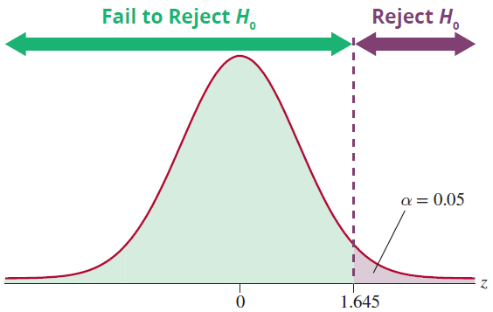
Example 12.1.2 (cont.)
Step 4: Determine the critical value(s) or P-value.

Slide 42
Example 12.1.2 (cont.)
If the null hypothesis is true, the test statistic has an approximately normal distribution. Thus the critical value is determined in the same way as for the other tests of hypothesis in which the test statistic had an approximately normal distribution.
The rejection region for a one-sided test with level of significance α = 0.05 was displayed in the previous slide.
The null hypothesis will be rejected if the computed value of the test statistic is larger than 1.645.

Slide 43
Example 12.1.2 (cont.)
In other words, we will reject the null hypothesis if the observed difference in average reading time is at least 1.645 standard deviations above the hypothesized value of 0 (no difference in reading time).
The P-value for the test statistic of 1.754 can be obtained from the normal table or using technology and is approximately 0.0397.

Slide 44
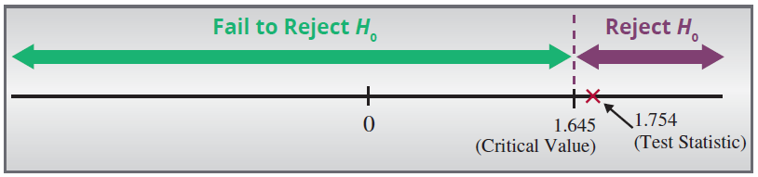
Example 12.1.2 (cont.)
Step 5: Make the decision to reject or fail to reject H₀.
As shown in the figure above, the calculated value of the test statistic falls in the rejection region because 1.754 is greater than 1.645. There is sufficient evidence to conclude that the difference between the observed value and the hypothesized value is due to something other than ordinary sampling variation.

Slide 45
Example 12.1.2 (cont.)
Thus, we reject the null hypothesis at α = 0.05.
Since the P-value of 0.0397 is less than α = 0.05, we can also reject the null hypothesis.
Step 6: State the conclusion in terms of the original problem.
There is sufficient evidence at α = 0.05 to conclude that the average reading time is significantly higher for fifth-grade girls.

Slide 46
Interval Estimation
Assumptions
The samples are independent of one another.
Both samples are simple random samples.
The populations from which the two samples are drawn are approximately normally distributed or the sample sizes are both large (n₁ > 30 and
n₂ > 30).
The values of σ₁ and σ₂ are unknown but assumed equal.

Slide 47
100(1 − α)% Confidence Interval for μ₁ − μ₂ Assuming σ₁ and σ₂ are Unknown but Equal
Formula
Assuming equal population standard deviations, the 100(1 − α)% interval estimate for the difference between two population means if σ₁ and σ₂ are unknown is given by

Slide 48
100(1 − α)% Confidence Interval for μ₁ − μ₂ Assuming σ₁ and σ₂ are Unknown but Equal
Formula (cont.)
where is the pooled sample
variance and is the critical value of the
t-distribution with n₁ + n₂ − 2 degrees of freedom, capturing an area of in the upper tail.

Slide 49
Example 12.1.3
For a consumer product, the mean dollar sales per retail outlet last year in a random sample of 15 stores was $3425 with a standard deviation of $200. For a second product, the mean dollar sales per outlet in a random sample of 16 stores was $3250 with a standard deviation of $175. The sales amounts per outlet are assumed to be approximately normally distributed for both products. Assume that the population variances are equal.

Slide 50
Example 12.1.3 (cont.)
Calculate a 95% confidence interval for the difference in average dollar sales between the two products.
Solution
From the information given in the problem, we know that
Retail Sales (Dollars)
 | n |  | s
Product 1 | 15 | $3425 | 200
Product 2 | 16 | $3250 | 175

Slide 51
Example 12.1.3 (cont.)
Independent random samples (assumed)
The two samples are drawn from populations that are approximately normally distributed.
          or
The population standard deviations are assumed equal.
Since we have assumed that the samples are drawn from normally distributed populations and that the population variances are equal,
□ σ₁ and σ₂ are known
          σ₁ and σ₂ are unknown

Slide 52
Example 12.1.3 (cont.)
we will use the t-distribution and calculate the pooled standard deviation of the two samples. Since we want a 95% confidence interval, we need to find the value of
Note that df = n₁ + n₂ – 2 = 15 + 16 – 2 = 29. Thus,
t_{0.025} = 2.045 is the critical value for a t-distribution with 29 degrees of freedom.
A 95% confidence interval for the difference in average dollar sales between the two products is given by

Slide 53
Example 12.1.3 (cont.)
where
First we need to calculate

Slide 54
Example 12.1.3 (cont.)
The confidence interval is then calculated as follows.

Slide 55
Example 12.1.3 (cont.)
Thus, we are 95% confident that the true mean difference in dollar sales between Product 1 and Product 2 is between $37.20 and $312.80. That is, on average, Product 1 generates between $37.20 and $312.80 more dollar sales than Product 2.

Slide 56
Testing a Hypothesis about Two Independent Population Means, σ₁ and σ₂ Unknown but Equal
Procedure
Assumptions:
The samples are independent of one another.
Both samples are simple random samples.
The populations from which the two samples are drawn are normally distributed or the sample sizes are both large (n₁ > 30 and n₂ > 30).
Both of the populations have approximately equal, but unknown standard deviations, i.e., σ₁ = σ₂ = σ.

Slide 57
Testing a Hypothesis about Two Independent Population Means, σ₁ and σ₂ Unknown but Equal
Procedure (cont.)
Test Statistic:
If the assumptions outlined above are satisfied, the sampling distribution of has a t-distribution with n₁ + n₂ − 2 degrees of freedom. The t-test statistic is given by

Slide 58
Testing a Hypothesis about Two Independent Population Means, σ₁ and σ₂ Unknown but Equal
Procedure (cont.)
Where is the pooled sample variance.
For Population 1 For Population 2
μ₁ = the population mean, μ₂ = the population mean,
σ₁ = the population standard σ₂ = the population
deviation, standard deviation,

Slide 59
Testing a Hypothesis about Two Independent Population Means, σ₁ and σ₂ Unknown but Equal
Procedure (cont.)
For Population 1 For Population 2
n₁ = the sample size, n₂ = the sample size,
= the sample mean, and = the sample mean, and
s₁ = the sample standard s₂ = the sample standard deviation. deviation.

Slide 60
Example 12.1.4
A cancer researcher believes that there may be an increase in the life expectancy of women diagnosed with terminal breast cancer if they attend group therapy to discuss their illness. He randomly selects 40 women with breast cancer. Twenty of the women are randomly assigned to a group that attends a group therapy session one day per week. The other 20 women do not attend therapy and are designated as the control group. The life expectancy, in number of years, from diagnosis until death is measured for each of the women.

Slide 61
Example 12.1.4 (cont.)
The results of the study are shown in the following tables.
Summary Statistics
Women in Therapy | Women Not in Therapy
n₁ = 20 | n₂ = 20
s₁ = 0.6 | s₂ = 0.5
Women in Therapy
4.7 | 3.8 | 4 | 3.5 | 3.3
2.9 | 3.5 | 4.2 | 2.8 | 3.1
4.7 | 4.4 | 3.4 | 3.2 | 4.1
4.2 | 3.7 | 3.4 | 3.6 | 4.8
Women Not in Therapy
2.0 | 2.3 | 2.7 | 1.8 | 1.2
1.6 | 1.7 | 2.4 | 1.5 | 1.6
1.9 | 2.5 | 1.7 | 1.1 | 2.9
2.4 | 2.2 | 1.4 | 2.2 | 2.1

Slide 62
Example 12.1.4 (cont.)
Is there persuasive evidence for the researcher to conclude at α = 0.05 that the average life expectancy from diagnosis until death is significantly longer for women diagnosed with terminal breast cancer who attend group therapy once per week than those who do not attend group therapy?

Slide 63
Example 12.1.4 (cont.)
Solution
Step 1: Determine the null and alternative hypotheses. Null Hypothesis: There is no difference in average life expectancy from diagnosis until death for women with terminal breast cancer whether or not they attend therapy.
Alternative Hypothesis: For women who have been diagnosed with terminal breast cancer the average life expectancy from diagnosis until death is greater for those women who attend weekly group therapy meetings than those who do not.

Slide 64
Example 12.1.4 (cont.)
Since the researcher is interested in comparing the average life expectancies from diagnosis until death for each of the groups, the appropriate statistical measures are
μ₁ = the true average life expectancy from diagnosis until death for women diagnosed with terminal breast cancer who attend weekly group therapy;
μ₂ = the true average life expectancy from diagnosis until death for women diagnosed with terminal breast cancer who do not attend weekly group therapy.

Slide 65
Example 12.1.4 (cont.)
Since the researcher’s interest is in whether or not the average life expectancy is higher for women who attend group therapy than those who don’t, this test is a one-sided test.
The researcher is interested in determining if the average life expectancy is higher for the women in the therapy group, μ₁, versus those in the control group, μ₂. A way to state this in terms of the statistical measures in Step 2 is μ₁ > μ₂.

Slide 66
Example 12.1.4 (cont.)
But in order to perform the hypothesis test, this statement must be rewritten in a form for which we have a point estimate, or μ₁ − μ₂ > 0. The resulting hypotheses in symbolic notation are as follows.
H₀: μ₁ − μ₂ = 0 There is no difference in average life expectancy for the two groups.
H_{a}: μ₁ − μ₂ > 0 The life expectancy is larger for the group who attend weekly therapy than for those who do not attend therapy.

Slide 67
Example 12.1.4 (cont.)
Step 2: Specify the significance level α.
The level of the test is specified in the problem as α = 0.05.
Step 3: Validate the assumptions of the hypothesis test, identify the appropriate test statistic and compute its value.
To develop the appropriate test statistic, a random variable whose value will be used to make the decision to reject or fail to reject H₀ must be found.

Slide 68
Example 12.1.4 (cont.)
The sampling distribution provides essential information in assessing the rareness of the test statistic. Two questions must be answered in order to use the test statistic from the previous example.
Are the samples taken from populations with normal distributions? Are the variances approximately equal?

Slide 69
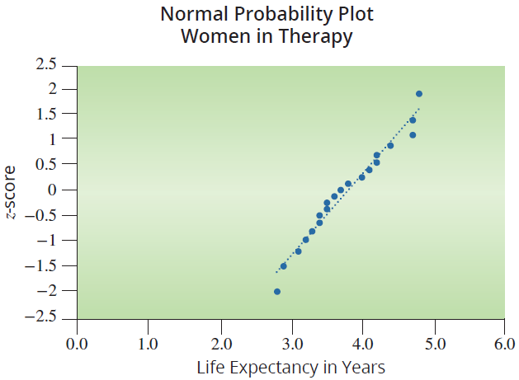
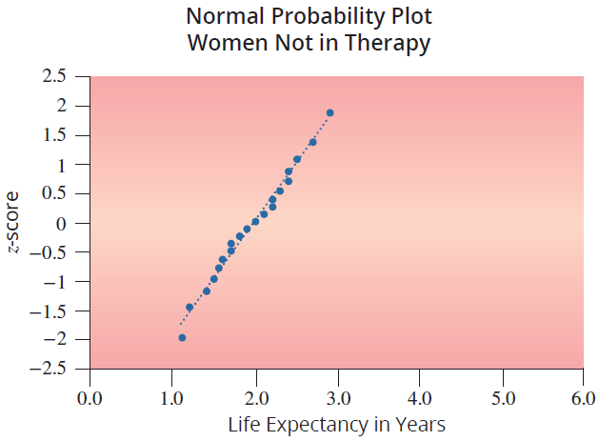
Example 12.1.4 (cont.)
The normal probability plots of the two data sets do not show any severe departure from normality for either sample.

Slide 70
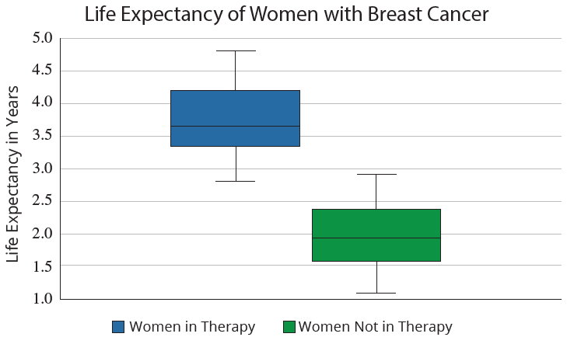
Example 12.1.4 (cont.)
The box plots indicate that the spread of the two samples is similar.

Slide 71
Example 12.1.4 (cont.)
Thus we can use a t-distribution and pool the variances of the two samples. This combined sample variance is referred to as the pooled variance,

Slide 72
Example 12.1.4 (cont.)
Therefore, the assumptions for the test are as follows:
Independent random samples
The two samples are drawn from populations that are approximately normally distributed.
    or
The population standard deviations are assumed equal.
□ σ₁ and σ₂ are known
σ₁ and σ₂ are unknown

Slide 73
Example 12.1.4 (cont.)
If the null hypothesis is true, t has a t-distribution with n₁ + n₂ − 2 degrees of freedom. If the observed value of is significantly larger than the hypothesized value of the difference (H₀: μ₁ − μ₂ = 0), this will produce a large value of the test statistic, causing us to doubt whether or not the null hypothesis is in fact true. How large is large? The critical value of the test statistic specified in Step 4 will implicitly define the notion of “large.”

Slide 74
Example 12.1.4 (cont.)
Based on the data given to us in the problem, the computed value of the test statistic is
where

Slide 75
Example 12.1.4 (cont.)
Step 4: Determine the critical value(s) or P-value.
The role of the critical value in this test is exactly the same as for all of the hypothesis tests discussed earlier. It defines a range of values for the test statistic, the rejection region, that will be so rare that it is unlikely that values in this range occurred from ordinary sampling variability if the null hypothesis is true. The level of the test defines the size of the rejection region. Should the computed value of the test statistic fall in the rejection region,

Slide 76
Example 12.1.4 (cont.)
we will presume that the value of the test statistic is too large to have occurred from ordinary sampling variation, and the null hypothesis will be rejected.
If the null hypothesis and the assumptions of the hypothesis testing model are true, the test statistic has a t-distribution. Thus, the critical value is determined in the same way as for the other tests of hypothesis where the test statistic had a t-distribution, except that the degrees of freedom are n₁ + n₂ − 2, or
38 (20 + 20 −2).

Slide 77
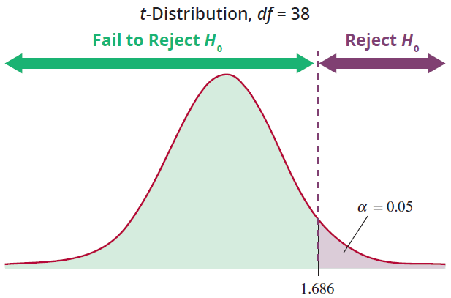
Example 12.1.4 (cont.)
The rejection region corresponding to the alternative hypothesis, H_{a}: μ₁ − μ₂ > 0, with α = 0.05 for a t-test statistic with 38 degrees of freedom is given in the following figure.

Slide 78
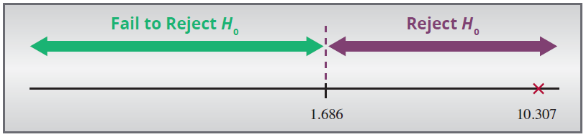
Example 12.1.4 (cont.)
We will reject the null hypothesis if the computed value of the test statistic is larger than 1.686. Also, note that the P-value is extremely small for the test statistic value of 10.307; it is approximately 0.
Step 5: Make the decision to reject or fail to reject H₀.

Slide 79
Example 12.1.4 (cont.)
As displayed on the previous slide, the value of the test statistic does fall in the rejection region. In fact, a test statistic of 10.307 says that the observed difference between the means is over 10 standard deviations higher than the hypothesized difference of zero. It is highly unlikely that the difference between the observed value and the hypothesized value is due to ordinary sampling variation. The P-value is less than 0.05, thus we reject the null hypothesis using the P-value approach as well.

Slide 80
Example 12.1.4 (cont.)
Step 6: State the conclusion in terms of the original problem.
There is sufficient evidence for the researcher to conclude that the average life expectancy from diagnosis until death for women diagnosed with terminal breast cancer is significantly longer for those women who attend therapy once a week than for those who don’t.

Slide 81
Inferences about the Means of Two Independent Populations, σ₁ and σ₂ Unknown and Assumed Unequal
Assumptions
The samples are independent of one another.
Both samples are simple random samples.
The populations from which the two samples are drawn are approximately normally distributed or the sample sizes are both large (n₁ > 30 and
n₂ > 30).
The values of σ₁ and σ₂ are unknown and we do not assume they are equal.

Slide 82
100(1 − α)% Confidence Interval for μ₁ − μ₂ Assuming σ₁ and σ₂ are Unknown and Unequal
Formula
Assuming unequal population standard deviations, the 100(1 − α)% interval estimate for the difference between two population means if σ₁ and σ₂ are unknown is given by
where is the critical value of the t-distribution capturing an area of α/2 in the upper tail.

Slide 83
100(1 − α)% Confidence Interval for μ₁ − μ₂ Assuming σ₁ and σ₂ are Unknown and Unequal
Formula (cont.)
Degrees of Freedom
There are two options for determining the degrees of freedom for the t-distribution when the population standard deviations are assumed to be unequal. Although the two methods usually result in different values for the degrees of freedom, the conclusion reached in the hypothesis test is seldom affected by the option selected.

Slide 84
100(1 − α)% Confidence Interval for μ₁ − μ₂ Assuming σ₁ and σ₂ are Unknown and Unequal
Formula (cont.)
Option 1: Use the smaller of n₁ −1 and n₂ − 1 for the degrees of freedom.
Option 2: Use the following formula to calculate the degrees of freedom.

Slide 85
100(1 − α)% Confidence Interval for μ₁ − μ₂ Assuming σ₁ and σ₂ are Unknown and Unequal
Formula (cont.)
The calculation for degrees of freedom should be rounded down to the nearest integer.

Slide 86
Interval Estimation
Note
Option 1 is often the easiest method for determining the degrees of freedom and results in a conservative estimate for the critical value(s) or P-value.
The calculation of the degrees of freedom as shown in Option 2 is known as Satterthwaite’s Approximation.

Slide 87
Example 12.1.5
A statistics instructor wants to know if using the courseware that accompanied her statistics textbook will improve students' test scores. Since she is teaching two sections of a statistics course this term, she decides to use the courseware in one class and not the other. The courseware contained premade homework assignments for each section of the book, so she had the students in one of her classes do the online homework. For the other class she gave them a similar homework assignment from the textbook.

Slide 88
Example 12.1.5 (cont.)
The instructor believes that the immediate feedback from the online courseware on homework assignments will likely improve students’ performance on tests. For the first test she gave the students in both classes the same test. She took a simple random sample of 16 students’ test scores on the first test from each class. One student subsequently dropped the class, so that student’s test score was omitted from the data. The results were as follows.

Slide 89
Example 12.1.5 (cont.)
Calculate a 95% confidence interval for the mean difference between the test scores for the two statistics classes.
Test Scores Using Courseware
73 | 75 | 76 | 78 | 78 | 80 | 82 | 83
84 | 85 | 87 | 88 | 88 | 92 | 93
Test Scores Not Using Courseware
60 | 62 | 65 | 67 | 72 | 74 | 74 | 75
77 | 79 | 79 | 80 | 81 | 85 | 88 | 93

Slide 90
Example 12.1.5 (cont.)
Solution
Before calculating the confidence interval we must first check that the assumptions have been satisfied. The samples were simple random samples taken from two statistics classes containing a different set of students, so the samples are independent of one another.
A normal probability plot of each sample is shown in the next slide. The plots do not show any significant departures from normality for either sample.

Slide 91
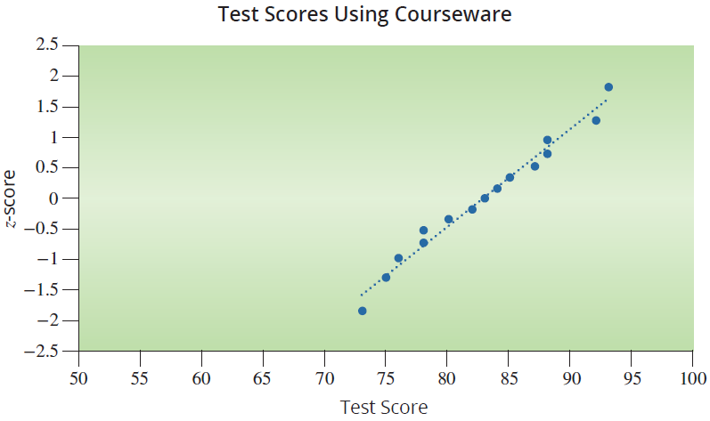
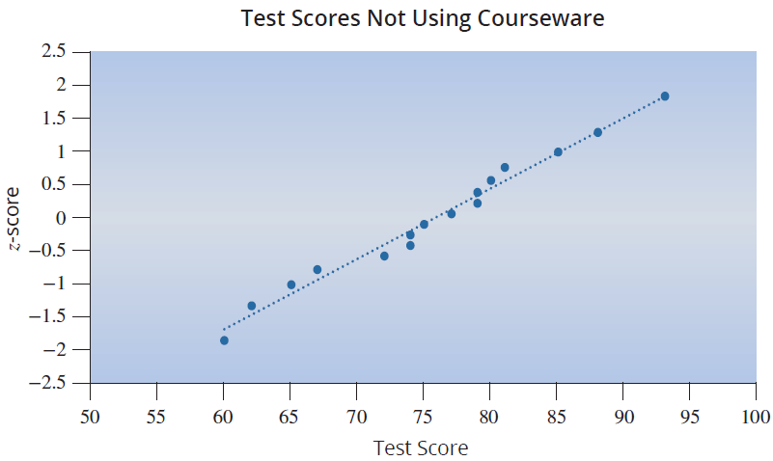
Example 12.1.5 (cont.)

Slide 92
Example 12.1.5 (cont.)
Independent random samples
The two samples are drawn from populations that are approximately normally distributed.
or
The population standard deviations are assumed to be unequal.
Now we can proceed to calculate the confidence interval estimate for the difference in mean test scores between the two classes. By calculating the summary statistics for each set of data above, we find that
□ σ₁ and σ₂ are known
σ₁ and σ₂ are unknown

Slide 93
Example 12.1.5 (cont.)
Since the samples are drawn from normally distributed populations we will use the t-distribution to find the critical value for the confidence interval. Since we want a 95% confidence interval, we need to find the value of
For the degrees of freedom for the t-distribution, we will use Option 1. The degrees of freedom will be the smaller of n₁ − 1 = 15 − 1 = 14 or n₂ − 1 = 16 − 1 = 15.

Slide 94
Example 12.1.5 (cont.)
Therefore, the critical value for a t-distribution with 14 degrees of freedom and is
A 95% confidence interval for the difference in mean test scores is given by
The confidence interval is then calculated as follows.

Slide 95
Example 12.1.5 (cont.)
1.15 to 13.07
Thus, we are 95% confident that the true mean difference in test scores is between 1.15 and 13.07. That is, on average, using the courseware resulted in an increase in the score on the first test between 1.15 and 13.07 points.

Slide 96
Example 12.1.5 (cont.)
If Option 2 had been used to calculate the degrees of freedom for the test, the 95% confidence interval would have been (1.4054, 12.815) and the critical value would have come from a t-distribution with 26.34 degrees of freedom. Note that this interval is not as wide as our conservative estimate calculated above, but both intervals are similar and neither contain zero, which indicates that the mean test scores for the two classes are significantly different from one another.

Slide 97
Hypothesis Testing of μ₁ − μ₂ with σ₁ and σ₂ Unknown and Unequal
Procedure
Assumptions:
The samples are independent of one another.
Both samples are simple random samples.
The populations from which the two samples are drawn are approximately normally distributed or the sample sizes are both large (n₁ > 30 and
n₂ > 30).
The values of σ₁ and σ₂ are unknown and we do not assume they are equal.

Slide 98
Hypothesis Testing of μ₁ − μ₂ with σ₁ and σ₂ Unknown and Unequal
Procedure (cont.)
Test Statistic:
The test statistic follows a t-distribution and there are two options for calculating the degrees of freedom.

Slide 99
Hypothesis Testing of μ₁ − μ₂ with σ₁ and σ₂ Unknown and Unequal
Procedure (cont.)
Option 1: Use the smaller of n₁ − 1 and n₂ − 1 for the degrees of freedom.
Option 2: Use the following formula to calculate the degrees of freedom.

Slide 100
Hypothesis Testing of μ₁ − μ₂ with σ₁ and σ₂ Unknown and Unequal
Procedure (cont.)
The calculation for degrees of freedom should be rounded down to the nearest integer.

Slide 101

Example 12.1.6
A biologist is interested in comparing the size of blue crabs in two river basins: (1) Cooper and (2) Stono River. Based on the health of the rivers, she believes the crabs in the Stono will have a higher average weight.
She samples 32 crabs from the Stono River, and this sample has a mean weight of 800 g with a standard deviation of 225 g. She takes a random sample of 35 crabs from the Cooper River and finds the crabs have a mean weight of 700 g with a standard deviation of 175 g.

Slide 102
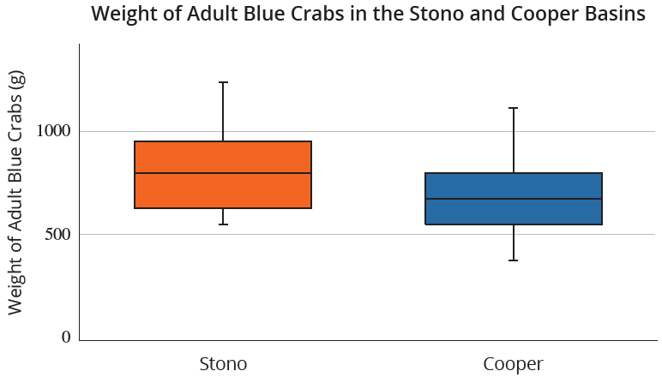
Example 12.1.6 (cont.)
Is there persuasive evidence at α = 0.01 in support of the biologist’s belief?

Slide 103
Example 12.1.6 (cont.)
Solution
Step 1: Determine the null and alternative hypotheses.
This is a one-sided test, since the biologist wants to know if the average crab weights are higher in the Stono River than the Cooper. The biologist is interesting in comparing two population means, so we formulate the null and alternative hypotheses to look at the difference between the two population means.

Slide 104
Example 12.1.6 (cont.)
Step 2: Specify the significance level α.
The significance level is specified to be α = 0.01.
Step 3: Validate the assumptions of the hypothesis test, identify the appropriate test statistic and compute its value.
There is no difference in average crab weight.
The average crab weights in the Stono River are higher.

Slide 105
Example 12.1.6 (cont.)
Looking at the box plots, the data for each sample appears to be roughly symmetric and the variances do not appear to be equal (the spreads of the two boxes are different). Also, the samples are from independent random samples.
Independent random samples
The samples sizes are large (n₁ > 30 and n₂ > 30).
or
The population standard deviations are assumed unequal.
□ σ₁ and σ₂ are known
σ₁ and σ₂ are unknown

Slide 106
Example 12.1.6 (cont.)
Since the assumptions are validated we can proceed with the hypothesis test. We use the t-test statistic given by
Based on the sample statistics, the computed value of the test statistic is

Slide 107
Example 12.1.6 (cont.)
Using Option 1 for the degrees of freedom, our test statistic has n₁ − 1 = 32 − 1 = 31 degrees of freedom.
Step 4: Determine the critical value(s) or P-value.
The rejection region corresponding to the alternative hypothesis, H_{a}: μ₁ − μ₂ > 0, with α = 0.01 for a t-test statistic with 31 degrees of freedom is given in the figure on the next slide.

Slide 108
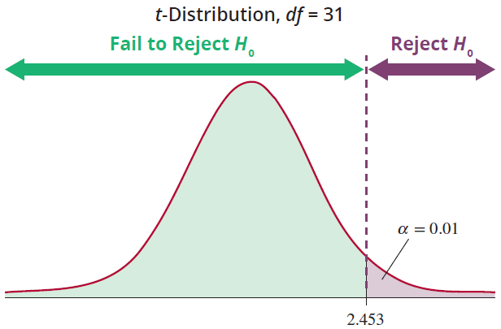
Example 12.1.6 (cont.)
We will reject the null hypothesis if the computed value of the test statistic is larger than 2.453.

Slide 109
Example 12.1.6 (cont.)
We find the P-value to be P(t > 2.0174) ≈ 0.0262 for
31 degrees of freedom.
Step 5: Make the decision to reject or fail to reject H₀.
The value of the test statistic does not fall in the rejection region. Also, the P-value is greater than 0.01, so we fail to reject the null hypothesis.

Slide 110
Example 12.1.6 (cont.)
Step 6: State the conclusion in terms of the original problem.
There is insufficient evidence for the biologist to conclude that the average weight of blue crabs is higher in the Stono River than in the Cooper River at the 0.01 significance level.

