Slide 1
Section 12.2
Inference about Two Means: Dependent Samples
(Paired Difference)

Slide 2
Paired Difference Experimental Design
In a paired design, experimental units are paired such that units within a pair are much more alike than in the population as a whole. If we have been successful at significantly reducing the variation among the sample observations by pairing, we will create very potent data to make decisions.

Slide 3
Inference about Two Means: Dependent Samples (Paired Difference)
Assumptions
The sample data is dependent, which means that the experimental units can be paired such that they are more alike within the pair than within the population as a whole.
The matched pairs are a simple random sample.
The number of pairs of sample data is large (n > 30) or the differences are from a population that is approximately normally distributed.

Slide 4
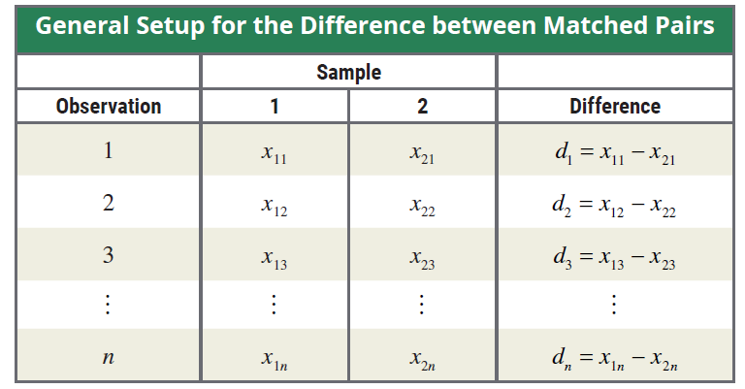
Difference between Matched Pairs
To test the mean difference between two related population means, we treat the different scores, denoted by d_{i}, as values from a single sample. The general data setup is shown in the table.
Note that d_{i} is the difference between the i^{th} observations in each sample.

Slide 5
100(1 − α)% Confidence Interval for μ_{d}
Formula (cont.)
A 100(1 − α)% confidence interval for the mean difference is given by
where is the sample mean of the differences, n is the
number of pairs of sample data,
and is the critical value

Slide 6
100(1 − α)% Confidence Interval for μ_{d}
Formula (cont.)
of the t-distribution with an area of α/2 in the upper tail with n − 1 degrees of freedom.

Slide 7
Testing a Hypothesis about Two Dependent Population Means
Procedure
Assumptions:
The samples are dependent (matched pairs).
The matched pairs are a simple random sample.
The number of pairs of sample data is large (n > 30) or the differences are approximately normally distributed.

Slide 8
Testing a Hypothesis about Two Dependent Population Means
Procedure
Test Statistic:
If the differences are normally distributed and the null hypothesis is assumed to be true, the sampling distribution of has a t-distribution with n − 1 degrees of freedom. Note that n represents the number of pairs of sample data. The t-test statistic is given by

Slide 9
Testing a Hypothesis about Two Dependent Population Means
Procedure (cont.)
where
= the mean value of the sample of differences,
μ_{d} = the mean value of the population of differences,
s_{d} = the standard deviation of the sample of
differences, and
n = the number of pairs of sample data.

Slide 10

Example 12.2.1
Bull & Bones Brewhaus is a microbrewery that has two restaurants located within 15 miles of each other. The owner of the microbrewery wants to compare the average daily food sales of the two restaurants. To do so, the owner randomly selects 10 days over a five-month period (college football season) and records the daily food sales. The results are
given in the following table.

Slide 11
Example 12.2.1 (cont.)
Calculate a 95% confidence interval for the mean difference in restaurant sales.
The owner wants to know if there is evidence of a difference between the average daily food sales of the two restaurants. Test using α = 0.01.
Daily Food Sales for Two Restaurants ($)
Day | Restaurant 1 | Restaurant 2 | Difference = Restaurant 1 – Restaurant 2
1 | 5828 | 7894 | −2066
2 | 9836 | 11,573 | −1737
3 | 3984 | 5319 | −1335
4 | 5845 | 6389 | −544

Slide 12
Example 12.2.1 (cont.)
Solution
From the information given, we know that n = 10 and α = 0.05.
Daily Food Sales for Two Restaurants ($)
Day | Restaurant 1 | Restaurant 2 | Difference = Restaurant 1 – Restaurant 2
5 | 5210 | 6055 | −845
6 | 9668 | 10,631 | −963
7 | 6768 | 7866 | −1098
8 | 6726 | 7976 | −1250
9 | 4399 | 5652 | −1253
10 | 6692 | 8083 | −1391

Slide 13
Example 12.2.1 (cont.)
The data can be paired by day as shown in the table in order to compare the sales between the two restaurants. Since we only have 10 days' worth of data, we first need to determine if it’s reasonable to assume that the differences come from a normal population. Based on the normal probability plot and the histogram that follow, it appears that the differences are approximately normal and it is safe to calculate the confidence interval using a paired difference approach.

Slide 14
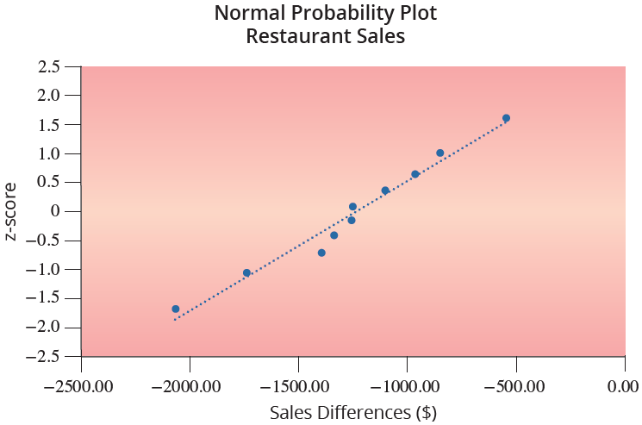
Example 12.2.1 (cont.)

Slide 15
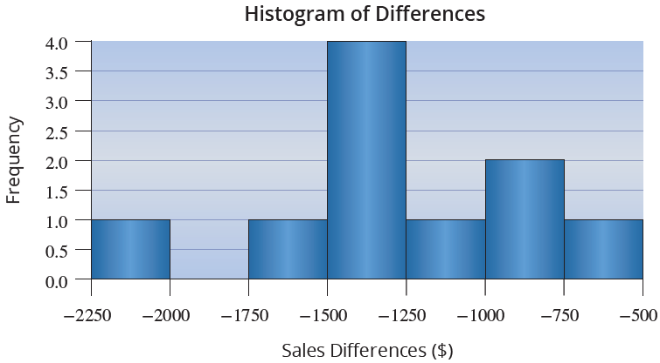
Example 12.2.1 (cont.)

Slide 16

Example 12.2.1 (cont.)
The samples are dependent (matched pairs).
The matched pairs are a simple random sample.
The differences are approximately normally distributed.
Next we calculate the mean and standard deviation of the differences, and s_{d}, respectively.

Slide 17
Example 12.2.1 (cont.)

Slide 18
Example 12.2.1 (cont.)
Since we want a 95% confidence interval, we need to find the value of Note that df = n − 1 = 9. Thus, a 95% confidence interval for the average difference in daily food sales between the two restaurants is calculated as follows.

Slide 19
Example 12.2.1 (cont.)
We are 95% confident that the true mean difference in sales between Restaurant 1 and Restaurant 2 is between −$1558.90 and −$937.50. That is, on average, Restaurant 2 averages between $937.50 and $1558.90 more in daily sales.
Based on the histogram and normal probability plot in part a., it appears that the differences are approximately normal and it is safe to proceed with the paired difference hypothesis test.

Slide 20
Example 12.2.1 (cont.)
Step 1: Determine the null and alternative hypotheses.
Null Hypothesis: There is no difference in the average sales between the two restaurants on a given day.
Alternative Hypothesis: There is a difference in the average sales between the two restaurants on a given day.
In a paired difference experimental design, the population parameter of interest is the population mean of the differences. Thus, the appropriate statistical measure is given by

Slide 21
Example 12.2.1 (cont.)
μ_{d} = the average of the differences in daily sales between the two restaurants.
Since the owner is interested in whether or not the average daily sales are different between the two restaurants, the alternative hypothesis will be two-sided and this will be a two-tailed test.
The statistical measure being used is the average difference in daily sales between the two restaurants. Since we have a two-tailed test, the hypotheses will be as follows.

Slide 22
Example 12.2.1 (cont.)
There is no difference in average daily sales between the two restaurants.
Step 2: Specify the significance level α.
The level of the test is specified in the problem to be α = 0.01.
Step 3: Validate the assumptions of the hypothesis test, identify the appropriate test statistic and compute its value.
The assumptions were validated in part a.
There is a difference in average daily sales between the two restaurants.

Slide 23
Example 12.2.1 (cont.)
To develop the appropriate test statistic, a random variable whose value will be used to make the decision to reject or fail to reject H₀ must be developed. It is interesting to notice that by evaluating the differences of the paired data, we have effectively reduced the two-sample problem into a one-sample t-test for a population mean. The point estimate for the population mean of the differences, μ_{d}, is the sample mean of the differences. Hence, the sampling distribution for provides essential information for testing the hypothesis.

Slide 24
Example 12.2.1 (cont.)
If the differences are normally distributed and the null hypothesis is assumed to be true, the sampling distribution of has a t-distribution with n − 1 degrees of freedom. Note that n represents the number of differences. The t-test statistic is given by
where s_{d} is the sample standard deviation of the differences.

Slide 25
Example 12.2.1 (cont.)
If the observed value of is significantly smaller or larger than the hypothesized difference (0), this will produce a large negative (or positive) value of the test statistic, causing us to question whether the null hypothesis is in fact true. How large is large? This is answered by the critical value of the test statistic specified in Step 4.
Based on the data in the table on daily food sales, and the computed value of the test statistic is as follows.

Slide 26
Example 12.2.1 (cont.)
Step 4: Determine the critical value(s) or P-value.
Should the computed value of the test statistic fall in the rejection region, its value will be presumed to be too rare to have occurred because of ordinary sampling variation, and the null hypothesis will be rejected.

Slide 27
Example 12.2.1 (cont.)
If the null hypothesis is true, the test statistic has a
t-distribution with n − 1 degrees of freedom. Thus, the critical value is determined in the same way as for the other tests of hypothesis where the test statistic had a t-distribution, except that the degrees of freedom are n − 1 = 10 − 1 = 9. The rejection region for the alternative hypothesis, H_{a}: μ_{d} ≠ 0, with α = 0.01 and
9 degrees of freedom is displayed in the following figure. Because we have a two-sided hypothesis, we reject H₀ if the test statistic is less than –3.250 or if it is greater than 3.250.

Slide 28
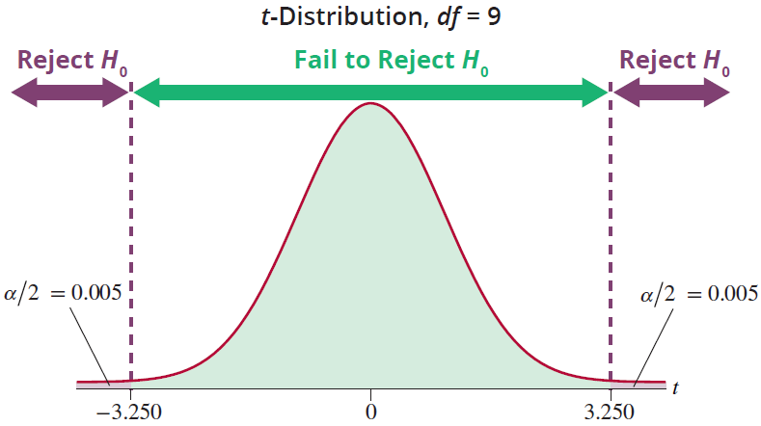
Example 12.2.1 (cont.)
Using technology the P-value is approximately 0.000008.

Slide 29
Example 12.2.1 (cont.)
Step 5: Make the decision to reject or fail to reject H₀. As shown below, the value of the test statistic falls in the rejection region to the left. The test statistic indicates that the observed average daily sales are more than 9 standard deviations below the hypothesized value of 0. It is highly unlikely that the difference between the observed value and the hypothesized value is due to ordinary sampling variation. Thus, the null hypothesis is rejected at α = 0.01.

Slide 30
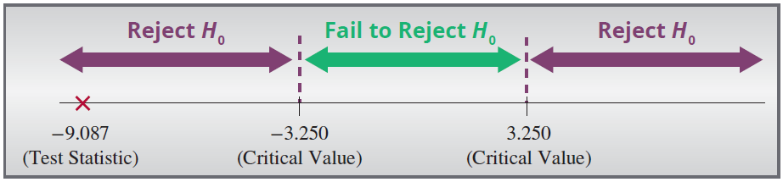
Example 12.2.1 (cont.)
Since the P-value of 0.000008 is less than α = 0.01, H₀ is rejected.
Step 6: State the conclusion in terms of the original problem.
There is sufficient evidence for the owner to conclude at the α = 0.01 level that the average daily sales between the two restaurants are significantly different.

Slide 31
Example 12.2.2
A researcher is interested in knowing the effect which one ounce of 100-proof alcohol has on his subjects. To study this effect the researcher randomly selects 10 subjects and records their reaction times (in seconds) both before and after drinking one ounce of 100-proof alcohol. The results of the study are displayed in the following table.
Can the researcher conclude at α = 0.01 that the average reaction time is longer after consuming one ounce of 100-proof alcohol?

Slide 32
Example 12.2.2 (cont.)
Reaction Times (in seconds)
Subject | Before | After | Difference
1 | 0.4 | 0.5 | −0.1
2 | 0.5 | 0.5 | 0.0
3 | 0.6 | 0.7 | −0.1
4 | 0.4 | 0.6 | −0.2
5 | 0.5 | 0.6 | −0.1
6 | 0.4 | 0.4 | 0.0
7 | 0.4 | 0.5 | −0.1
8 | 0.5 | 0.7 | −0.2
9 | 0.6 | 0.8 | −0.2
10 | 0.4 | 0.5 | −0.1

Slide 33
Example 12.2.2 (cont.)
Solution
Step 1: Determine the null and alternative hypotheses.
In plain English the hypotheses would be stated as follows.
Null hypothesis: There is no difference in average reaction time before versus after drinking one ounce of 100-proof alcohol.
Alternate hypothesis: The reaction time is significantly longer after drinking one-ounce of 100-proof alcohol.

Slide 34
Example 12.2.2 (cont.)
In a paired difference experimental design, the population parameter of interest is the population mean of the differences. Thus, the appropriate statistical measure is given by
μ_{d} = the average of the differences in reaction time before and after drinking one ounce of 100-proof alcohol for the population of interest.
Since the researcher is interested in whether or not the average reaction time is longer after drinking one ounce of 100-proof alcohol, this test is one-sided.

Slide 35
Example 12.2.2 (cont.)
Note from the table that subtracting the After data from the Before data would result in a negative difference if the null hypothesis is not true.
The statistical measure being used is the average difference in reaction times before and after consuming the alcohol. If the reaction time is longer after the alcohol has been consumed, then the difference, μ_{d}, will be negative because the reaction time before drinking the alcohol is shorter than the reaction time after drinking the alcohol. Thus we will use the following hypotheses.

Slide 36
Example 12.2.2 (cont.)
H₀: μ_{d} = 0 There is no difference in average reaction time before drinking 1 oz. of 100 proof alcohol versus after drinking 1 oz. of 100 proof alcohol.
H_{a}: μ_{d} < 0 The average reaction time is higher after drinking 1 oz. of 100 proof alcohol than before drinking the alcohol.
Note that if we had subtracted the Before data from the After data, the alternative hypothesis would have been H_{a}: μ_{d} > 0. The results from the hypothesis test would still be the same.

Slide 37
Example 12.2.2 (cont.)
Step 2: Specify the significance level α.
The level of the test is specified in the problem to be α = 0.01.
Step 3: Validate the assumptions of the hypothesis test, identify the appropriate test statistic and compute its value.
Before continuing with the test of hypothesis, let’s make sure that the assumption that the differences have a normal distribution is reasonable for the reaction time data.

Slide 38
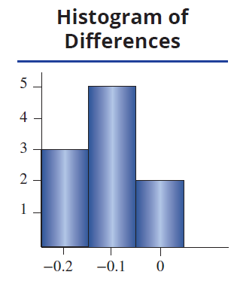
Example 12.2.2 (cont.)
A histogram of the differences is shown.
Based on this histogram, it appears that the differences are approximately normal and it is safe to proceed with the paired difference test.
The samples are dependent (matched pairs).
The matched pairs are a simple random sample.
The differences are approximately normally distributed.

Slide 39
Example 12.2.2 (cont.)
Based on the assumptions above being met, the test statistic for the differences is computed as
Step 4: Determine the critical value(s) or P-value.
If the null hypothesis is true, the test statistic has a t-distribution with n − 1 degrees of freedom. Thus, the critical value is determined in the same way as for the other tests of hypothesis where the test statistic had a t-distribution, except that the degrees of freedom are n − 1 = 10 −1 = 9.

Slide 40
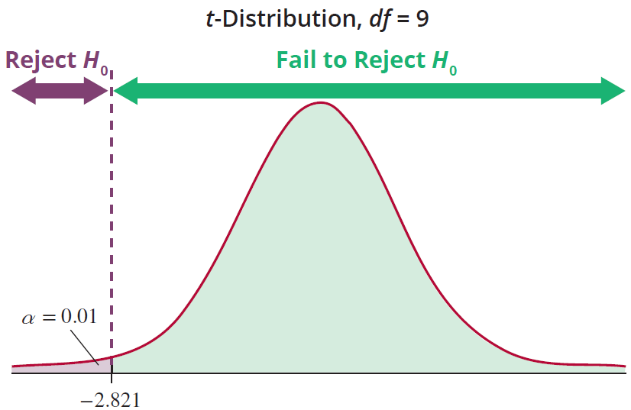
Example 12.2.2 (cont.)
The rejection region for the alternative hypothesis, H_{a}: μ_{d} < 0, with α = 0.01 and 9 degrees of freedom is displayed in the following figure.

Slide 41
Example 12.2.2 (cont.)
The null hypothesis will be rejected if the computed value of the test statistic is less than −2.821.
Using technology, the P-value of the test statistic, −4.714, for a t-distribution with 9 degrees of freedom is 0.00055.
Step 5: Make the decision to reject or fail to reject H₀.
As shown in the following figure, the value of the test statistic falls in the rejection region. The test statistic indicates that the observed average difference is almost 5 standard deviations below the hypothesized value of 0. It is highly unlikely that the difference between the

Slide 42
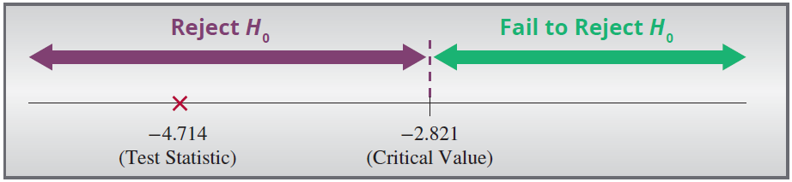
Example 12.2.2 (cont.)
observed value and the hypothesized value is due to ordinary sampling variation. Thus, the null hypothesis is rejected at α = 0.01.
Since the P-value of 0.00055 is much smaller than α = 0.01, the null hypothesis is rejected.

Slide 43
Example 12.2.2 (cont.)
Step 6: State the conclusion in terms of the original problem.
There is sufficient evidence for the researcher to conclude at α = 0.01 that the average response time is significantly higher for those subjects who have drunk one ounce of 100-proof alcohol than those who have not.

