Slide 1
Section 13.2
Inference Concerning β₁

Slide 2
100(1 − 𝛼)% Confidence Interval for β₁
Definition
The 100(1 − α)% confidence interval for β₁ is given by
where is the critical value for a t-distribution with n − 2 degrees of freedom.

Slide 3
Example 13.2.1
In Section 5.2, a model relating the age of a Honda Civic LX sedan to the asking price of the automobile was constructed.
Asking Price of a Honda Civic = β₀ + β₁ ⋅ (Age of Civic).
If the relationship is to be applicable for all Honda Civics, then a substantial amount of data will be required. If the data given below is considered a random sample of Honda Civics, then a relationship can be constructed from the sample data.

Slide 4
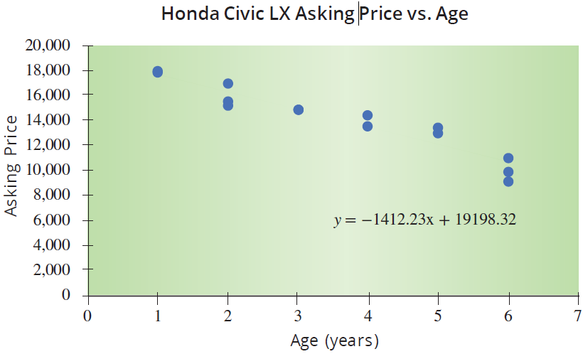
Example 13.2.1 (cont.)
Price of a Honda Civic LX Sedan
Age (Years) | Asking Price
1 | 17,850
1 | 18,000
2 | 15,195
2 | 16,995
2 | 15,625
3 | 14,935
3 | 14,879
4 | 14,460
4 | 13,586
5 | 13,050
5 | 13,495
6 | 9,150
6 | 9,950
6 | 10,995

Slide 5

Example 13.2.1 (cont.)
To use the method of least squares to estimate the model parameters from the sample data, we must verify the assumptions. It is evident from the scatterplot, that there is a definite linear relationship between the variables age and asking price.
Random sample of paired data
Error terms are normally distributed and independent (assumed).
If we are fitting a simple linear model, the scatterplot should show a linear relationship between the variables.

Slide 6
Example 13.2.1 (cont.)
The least squares regression line relating age to asking price is
Asking Price of Honda Civic = $19,198.32 − $1412.23 (Age)
where
b₀ = $19,198.32 The sample estimate of β₀, the y-intercept estimate.
b₁ = −$1412.23 The sample estimate of β₁, the slope.

Slide 7
Example 13.2.1 (cont.)
To draw conclusions about the relationship between asking price and age for the entire population of Honda Civics, statistical inference must be applied. We will begin by estimating a 95% confidence interval for β₁.
Solution
Three pieces of information are required to calculate a confidence interval for β₁.
A sample estimate of β₁, which would be b₁;

Slide 8
Example 13.2.1 (cont.)
A t-value corresponding to the level of confidence and the degrees of freedom associated with the data used to estimate the model;
A sample estimate of the standard deviation of b₁, which is denoted by

Slide 9
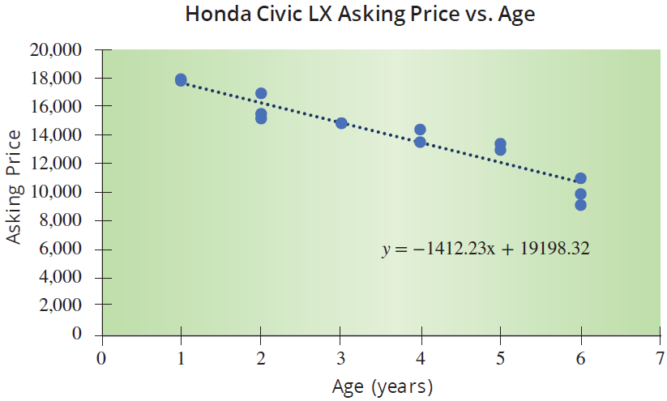
Example 13.2.1 (cont.)
Estimating the least squares line from sample data produces b₁ = −1412.23.

Slide 10
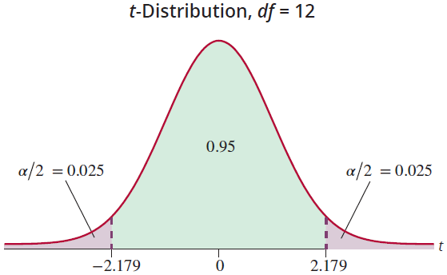
Example 13.2.1 (cont.)
Since 95% confidence is required, α = 0.05 and
The degrees of freedom will be
n – 2 = 14 – 2 = 12.
Thus,

Slide 11
Example 13.2.1 (cont.)
The remaining piece of missing information is the standard deviation of b₁,
Determining will require the knowledge of two quantities: the variance of the error terms (the mean square error), and the sum of the squared deviations of the independent variable,

Slide 12
Example 13.2.1 (cont.)
Age (Years) x | Sum of Squared Deviations | Age (Years) x | Sum of Squared Deviations
1 | (1 − 3.57)² | 4 | (4 − 3.57)²
1 | (1 − 3.57)² | 4 | (4 − 3.57)²
2 | (2 − 3.57)² | 5 | (5 − 3.57)²
2 | (2 − 3.57)² | 5 | (5 − 3.57)²
2 | (2 − 3.57)² | 6 | (6 − 3.57)²
3 | (3 − 3.57)² | 6 | (6 − 3.57)²
3 | (3 − 3.57)² | 6 | (6 − 3.57)²
Total

Slide 13
Example 13.2.1 (cont.)
The mean square error was computed in Section 5.3 as follows
The sum of the squared deviations of the independent variable (age), is given in the bottom row of the table. Thus, the standard deviation of b₁ is calculated as follows.

Slide 14
Example 13.2.1 (cont.)
The manual calculation of is tedious. Virtually every statistical analysis program that performs regression analysis calculates

Slide 15
Example 13.2.1 (cont.)
A portion of the summary output from Excel is shown in the following figure. Most software packages will automatically include a confidence interval for β₁ or it will include the pieces required to compute a confidence interval. Microsoft Excel automatically displays the 95% confidence interval for β₁, and is capable of displaying an interval for any level of confidence you choose.

Slide 16
Example 13.2.1 (cont.)
ANOVA
 | df | SS | MS | F | Signiﬁcance F
Regression | 1 | 86613696.0169 | 86613696.0169 | 114.7823 | 1.69218E-07
Residual | 12 | 9055089.1974 | 754590.77
Total | 13 | 95668785.2143
 | Coeﬃcients | Standard Error | t Stat | P-value | Lower 95% | Upper 95%
Intercept | 19198.3224 | 524.9047 | 36.5749 | 1.12E-13 | 18054.65333 | 20341.99141
Age (Years) |  |  | −10.7137 | 1.69E-07 | −1699.432551 | −1125.027975

Slide 17
Example 13.2.1 (cont.)
Note
Since the hand calculation of the confidence interval for β₁ used values that were rounded, the interval varies slightly from what is reported by Minitab or Microsoft Excel.

Slide 18
100(1 − α)% Confidence Interval for β₁
Formula

Slide 19

Example 13.2.1 (cont.)
−1412.23 ± 2.179 ⋅ 131.81
−1412.23 ± 287.21
Putting the pieces together results in an interval which spans from −1699.44 to −1125.02. We are 95% confident that this interval contains the true value of β₁. There are two possible interpretations of this interval.

Slide 20
Example 13.2.1 (cont.)
We are 95% confident that the true decrease in the price of a Honda Civic for a one-year increase in the age of the car is between $1125.02 and $1699.44.
We are 95% confident that the maximum error of the point estimate (b₁ = −1412.23) in estimating the unknown β₁ (the true decrease in the price of a Honda Civic for a one-year increase in the age of the car) is at most $287.21.

Slide 21
Example 13.2.1 (cont.)
Note
95% confidence does not imply there is a 95% probability that β₁ is in the interval. We are 95% confident in the procedure. If we create 1000 intervals using this procedure, about 950 would include the true value of β₁.

Slide 22
Example 13.2.2
Construct a 99% confidence interval for β₁ using the model described in Example 13.2.1.
Solution
The difference between a 95% confidence interval and a 99% confidence interval is expressed in the value of
For 99% confidence 1 − α = 0.99, which implies
α = 0.01; hence,
The degrees of freedom will remain n − 2 = 14 − 2 = 12.

Slide 23

Example 13.2.2 (cont.)
The appropriate t-value is
99% Confidence Interval for β₁
−1412.23 ± 3.055 ⋅ 131.81
−1412.23 ± 402.68

Slide 24
Example 13.2.2 (cont.)
Requiring more confidence in the interval results in a much wider interval. The trade-off is less precision (interval with wider width) for more confidence.
It is important to remember that the assumptions of the linear model given in Section 13.1 must hold in order to retain the specified degree of confidence in the interval.

Slide 25

Example 13.2.3
In Section 5.3 we examined a model relating SAT score to graduating GPA. A portion of the data is repeated here.
SAT Scores and Graduating GPA
Student | SAT Verbal | SAT Math | SAT Total | College GPA
1 | 680 | 554 | 1234 | 3.42
2 | 486 | 562 | 1048 | 2.37
3 | 500 | 564 | 1064 | 2.52
4 | 501 | 564 | 1065 | 2.25
5 | 503 | 583 | 1086 | 2.9
. . .

Slide 26
Example 13.2.3 (cont.)
Assuming the goal is to estimate a model that could be applied to all students that have graduated from college during the last five years, then the population under consideration would be quite large, too large to obtain all the measurements. If we assume the data in Chapter 5 is a sample, then we can estimate a model using the sample data and make inferences about the population. The population regression model to be estimated is
Graduating GPA = β₀ + β₁ ⋅ (SAT Score).

Slide 27
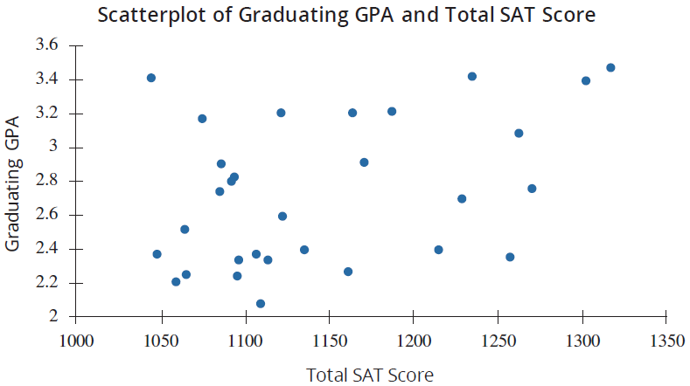
Example 13.2.3 (cont.)
We will begin by making an inference concerning β₁. Construct a 95% confidence interval for β₁.

Slide 28
Example 13.2.3 (cont.)
Solution
As noted in section 5.3, the paired data on SAT score and graduating GPA are taken from a random sample of students. The scatterplot does not show an overwhelming linear pattern, but a slight linear trend is apparent.
Random sample of paired data
Error terms are normally distributed and independent (assumed).

Slide 29
Example 13.2.3 (cont.)
If we are fitting a simple linear model, the scatterplot should show a linear relationship between the variables.
Using Excel’s statistical analysis package to estimate the linear regression model, the output is given below.
ANOVA
 | df | SS | MS | F | Signiﬁcance F
Regression | 1 | 0.854832198 | 0.854832198 | 5.321848064 | 0.028670474
Residual | 28 | 4.497554469 | 0.160626945
Total | 29 | 5.352386667

Slide 30
Example 13.2.3 (cont.)
 | Coeﬃcients | Standard Error | t Stat | P-value | Lower 95% | Upper 95%
Intercept | 0.273342604 | 1.067710391 | 0.256008189 | 0.799816021 | −1.913762987 | 2.460448195
SAT Score | 0.002144823 | 0.000929737 | 2.306913103 | 0.028670474 | 0.000240343 | 0.004049304
Note
In the summary output from Excel, the confidence interval is already given (see the highlighted values above), but some technologies may require you to pull the pieces from the output to calculate the confidence interval.

Slide 31
Example 13.2.3 (cont.)
Using the computer output will make the job of calculating a confidence interval easy. Two of the three pieces of information required to calculate a confidence interval are given in the output.
The sample estimate of β₁ is given in the Coefficients column associated with the variable SAT Score. That is, b₁ is 0.0021.
The standard deviation of b₁ is given in the Standard Error column associated with the variable SAT Score. That is, is 0.00093.

Slide 32
Example 13.2.3 (cont.)
The missing piece of information is the value of .
Determining requires the calculation of and the degrees of freedom. Since the level of confidence is specified to be 0.95, then 1 − α = 0.95, which implies
α = 0.05 and The degrees of freedom are
n − 2 = 30 − 2 = 28.

Slide 33
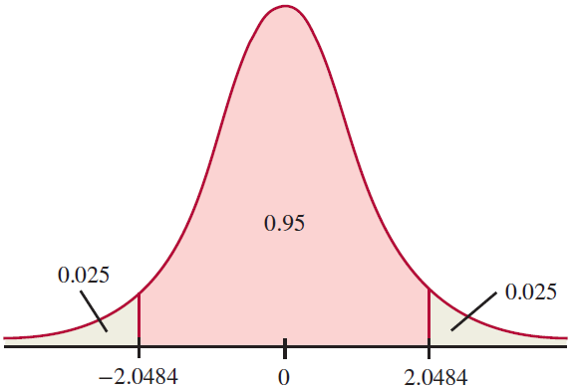
Example 13.2.3 (cont.)
Consequently, using technology
t-Distribution, df = 28

Slide 34

Example 13.2.3 (cont.)
Now, let's assemble all the pieces. The 100(1 − α)% confidence interval for β₁ is
0.0021 ± 2.0484 · 0.00093
0.0021 ± 0.001905
We are 95% confident that the interval contains the true value of β₁. There are two possible interpretations of this interval.

Slide 35
Example 13.2.3 (cont.)
We are 95% confident that the true increase in GPA for a one-point increase in SAT scores is between 0.0002 and 0.0040.
We are 95% confident the maximum error of the point estimate (b₁ = 0.0021) in estimating the unknown β₁ is at most 0.001905.

Slide 36
Testing a Hypothesis about the Slope
Procedure
Assumptions:
The sample is a random sample of paired data, (x, y).
The error terms are normally distributed with mean 0 and a constant variance,
The errors are independent of one another.
The scatterplot shows that the sample points appear to follow a linear pattern.

Slide 37
Testing a Hypothesis about the Slope
Procedure (cont.)
Hypotheses:

Slide 38
Testing a Hypothesis about the Slope
Procedure (cont.)
Test Statistic:
The test statistic follows a t-distribution with n − 2 degrees of freedom.
where
b₁ is the estimated value of the slope β₁, is the standard deviation of b₁, and 0 is the hypothesized
value of β₁ in H₀.

Slide 39
Example 13.2.4
Using the data in Example 13.2.1, determine if there is overwhelming evidence at the α = 0.05 level of a relationship between the price of a Honda Civic and its age.
Solution
Step 1: Determine the null and alternative hypotheses.
Is there a linear relationship between the age of a Honda Civic and its price?

Slide 40
Example 13.2.4 (cont.)
Implies there is no linear relationship between age and price.
Step 2: Specify the significance level α.
The level of the test has been defined in the problem statement as the 0.05 level.
Step 3: Validate the assumptions of the hypothesis testing model, identify the appropriate test statistic and compute its value.
Implies a linear relationship exists between age and price.

Slide 41
Example 13.2.4 (cont.)
The assumptions for conducting a linear regression of the Honda Civic data were verified before constructing a confidence interval for β₁ in Example 13.2.1. Therefore, a test of the slope parameter, b₁, can proceed.
The test statistic is similar in nature to the other test statistics developed in Chapter 11. It measures how far b₁ is from the hypothesized value of β₁, which is 0. This distance is measured in standard deviation units.

Slide 42
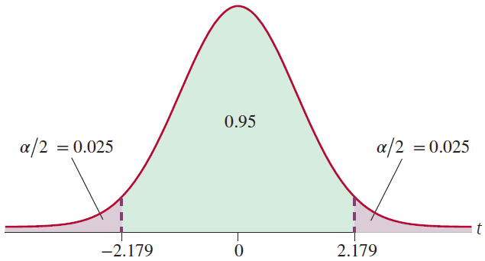
Example 13.2.4 (cont.)
If t is "close" to 0, then b₁ is "close" to 0 and H₀: β₁ = 0 is the more reasonable conclusion. However, if t is far from zero then b₁ is far from its hypothesized value and H_{a}: β₁ ≠ 0 would seem more reasonable.
t-Distribution, df = 12

Slide 43
Example 13.2.4 (cont.)
SUMMARY OUTPUT
Regression Statistics
Multiple R | 0.951498605
R Square | 0.905349596
Adjusted R Square | 0.897462062
Standard Error | 868.6718405
Observations | 14
ANOVA
 | df | SS | MS | F | Signiﬁcance F
Regression | 1 | 86613696.0169 | 86613696.0169 | 114.7823 | 1.69218E-07
Residual | 12 | 9055089.1974 | 754590.8
Total | 13 | 95668785.2143

Slide 44
Example 13.2.4 (cont.)
The estimated value of b₁ is nearly eleven standard deviations from zero. This is very persuasive evidence in favor of β₁ ≠ 0.
 | Coeﬃcients | Standard Error | t Stat | P-value | Lower 95% | Upper 95%
Intercept | 19198.3224 | 524.9047 | 36.5749 | 1.12E-13 | 18054.65333 | 20341.99141
Age (Years) | −1412.2303 | 131.8160 | −10.7137 | 1.69E-07 | −1699.432551 | −1125.027975

Slide 45
Example 13.2.4 (cont.)
Step 4: Determine the critical value(s) or P-value.
This criterion is defined by the critical value of the test statistic. The test is two-tailed and the level of the test is specified to be 0.05, which implies
α = 0.05 and
The test statistic has a t-distribution with
n − 2 = 14 − 2 = 12.
The critical value corresponds to

Slide 46
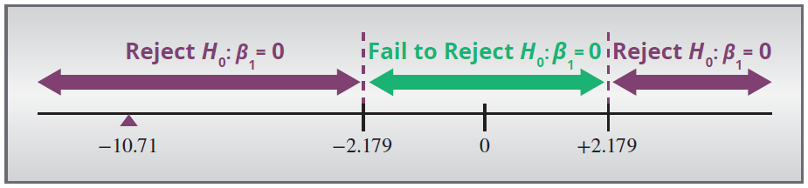
Example 13.2.4 (cont.)
Notice from the output above that the P-value for the age term is approximately 0.
Step 5: Make the decision to reject or fail to reject H₀.
Since the value of the test statistic falls into the rejection region, reject the null hypothesis in favor of the alternative.

Slide 47
Example 13.2.4 (cont.)
Similarly, since the P-value is essentially 0, which is less than α, we would also make the decision to reject H₀.
Step 6: State the conclusion in terms of the original problem.
There is overwhelming evidence at the 0.05 level that H_{a}: β₁ ≠ 0. This implies that it is reasonable to believe (at the 0.05 level) that there is a linear relationship between the age and the price of a Honda Civic. In fact, there appears to be a negative linear relationship between the age and the price of a Honda Civic.

Slide 48
Example 13.2.4 (cont.)
However, our hypothesis test did not address the issue of a negative relationship, so we cannot make this conclusion.
Note
The P-values reported by most forms of technology are already adjusted (doubled) for a two-tailed test.

