Slide 1
Section 13.3
Inference Concerning the Model’s Prediction

Slide 2
100(1 − α)% Confidence Interval for the Mean Value of y Given x
Formula
If x_{p} is a value of x for which we wish to know the mean value of y, then the 100(1 − α)% confidence interval is given by
is the predicted value of y when
is the t-value associated with 1 − α confidence (the same t used in constructing confidence intervals for β₁),

Slide 3
100(1 − α)% Confidence Interval for the Mean Value of y Given x
Formula (cont.)
s_{e} is the standard deviation of the error terms, and
measures how far x_{p} is from in relation
to the total variation of the x's. The further that x_{p} is from the larger this ratio will become and consequently the wider the confidence interval.

Slide 4
Example 13.3.1
For the Honda Civic model, calculate the 95% confidence interval for the mean value of price when age equals two years.
Solution
Four pieces of information are required to calculate a confidence interval for the mean value of y given x = x_{p}:
Use the estimated regression line to calculate for the value given for x = x_{p},

Slide 5
Example 13.3.1 (cont.)
Find a t-value corresponding to the level of confidence and the degrees of freedom associated with the data used to estimate the model,
Determine the standard deviation of the error terms,
Compute the term

Slide 6
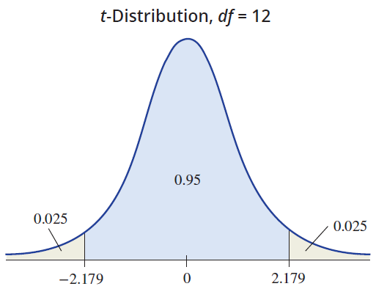
Example 13.3.1 (cont.)
In Example 13.2.1, x_{p} = 2 and the predicted value of y for this given x is

Slide 7
Example 13.3.1 (cont.)
For a 95% confidence interval α = 0.05, and the degrees of freedom = n − 2 = 14 − 2 = 12. Thus,
The estimated variance of the error terms,
is given in the Excel summary output of Example 13.2.1 under the column labeled MS and the row labeled Residual. The standard deviation of the error terms, s_{e} ,
can be computed by taking the square root of the mean square error, Therefore, s_{e} = 868.67.

Slide 8
Example 13.3.1 (cont.)
The last piece of information is the quotient
The bottom row of the table contains the calculation for the sum of the squared deviations

Slide 9
Example 13.3.1 (cont.)
Age (Years) x | Sum of Squared Deviations
1 | (1−3.57)²
1 | (1−3.57)²
2 | (2−3.57)²
2 | (2−3.57)²
2 | (2−3.57)²
3 | (3−3.57)²
3 | (3−3.57)²
4 | (4−3.57)²
4 | (4−3.57)²
5 | (5−3.57)²
5 | (5−3.57)²

Slide 10
Example 13.3.1 (cont.)
Age (Years) x | Sum of Squared Deviations
6 | (6−3.57)²
6 | (6−3.57)²
6 | (6−3.57)²
Total
Assembling the pieces for the 95% confidence interval, we have

Slide 11

Example 13.3.1 (cont.)

Slide 12
Example 13.3.1 (cont.)
The confidence interval can be interpreted in two ways.
We are 95% confident that the mean price of a two-year-old Honda Civic is between $15,696.06 and $17,051.66. (Note, like all confidence intervals, the confidence is in the method not in a particular interval.)
We are 95% confident that the maximum error of estimation for the mean price of a two-year-old Honda Civic is $677.80.

Slide 13
100(1 − α)% Confidence Interval for the Predicted Value of y Given x
Formula
A 100(1 − α)% confidence interval for the predicted value of y given x, also known as a prediction interval, is given by

Slide 14
Example 13.3.2
Suppose you have a two-year-old Honda Civic you are considering selling. Compute the 95% prediction interval for the price of your Honda Civic.
Solution
The predicted price of your two-year-old Honda Civic is given by
Civic Price = $19,198.32 − $1412.23(2) = $16,373.86,
and

Slide 15
Example 13.3.2 (cont.)
and
Computing the interval, we have

Slide 16
Example 13.3.2 (cont.)
We are 95% confident that the actual price of your two-year-old Honda Civic will be within $2010.52 of the average price for two-year-old Honda Civics, $16,373.86. Specifically, we are 95% confident that the price of your Honda Civic will be between $14,363.34 and $18,384.38.

