Slide 1
Section 14.4
Inference Concerning the Multiple Regression Model and Its Coefficients

Slide 2
Properties of an F-Distribution
Properties
The F-distribution is skewed to the right.
The values of F are always greater than or equal to 0.
The shape of the F-distribution is completely determined by its two parameters, the degrees of freedom for the numerator and the degrees of freedom for the denominator.

Slide 3
Testing the Multiple Regression Model
Procedure
Assumptions:
The error terms are normally distributed with mean 0 and a constant variance, σ_{e}.
The errors are independent of one another.
Hypotheses:

Slide 4
Testing the Multiple Regression Model
Procedure (cont.)
Test Statistic:

Slide 5
Testing the Multiple Regression Model
Procedure (cont.)
The F-statistic has an F-distribution with k and n − (k + 1) degrees of freedom if the null hypothesis, β ₁ = β ₂ = ... = β _{k} = 0, is true.
The F-statistic is a ratio which compares the variation explained by the model (SSR) to the unexplained variation (SSE). Both of these quantities were discussed in Chapter 13. The number of independent variables in the model is represented by k and the number of observations is n.

Slide 6
Example 14.4.1
For the Mount Pleasant Real Estate data in Table 14.1.1 determine if there is sufficient evidence at the 0.05 significance level that the overall model is useful in explaining the variation in home prices.
Solution
Step 1: Determine the null and alternative hypotheses.
Is the overall model useful in explaining the variation in home prices? If some of the model’s independent variables are useful predictors of y, then the coefficients, β _{i}, of these variables will have a non-zero value.

Slide 7
Example 14.4.1 (cont.)
H₀: β ₁ = β ₂ = … = β _{k} = 0 Implies the overall model is insignificant.
H_{a}: At least one β _{i} ≠ 0 Implies at least one of the independent variables is useful in explaining the variation in home prices.
Step 2: Specify the significance level α.
The value of α is given as 0.05. Step 3: Validate the assumptions of the hypothesis testing model, identify the appropriate test statistic and compute its value.

Slide 8

Example 14.4.1 (cont.)
The errors are presumed to be from a normal distribution with a mean of 0 and a constant variance.
The errors are presumed to be independent of one another.
Tests for these assumptions are beyond the scope of this text. We will use the F-statistic as the test statistic for the hypotheses.
The ANOVA table for the Mount Pleasant Real Estate model from Figure 14.1.1 is repeated below. The value of F is given to be 263.4224.

Slide 9
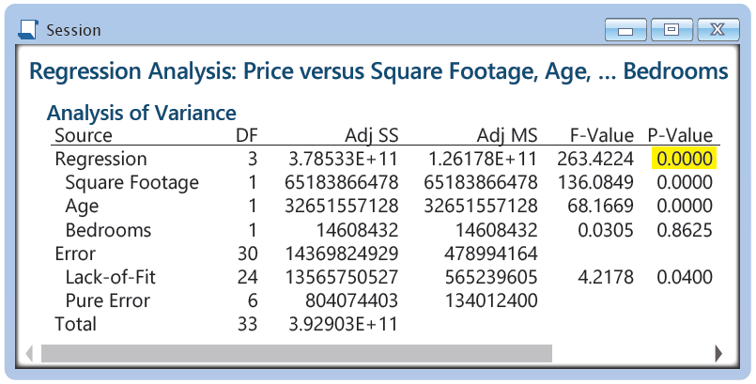
Example 14.4.1 (cont.)
Step 4: Determine the critical value(s) or P-value.
Since there are three independent variables (square footage, age, and number of bedrooms) in the model,

Slide 10
Example 14.4.1 (cont.)
the degrees of freedom for the numerator are k = 3 and for the denominator n − (k + 1) = 34 − (3 + 1) = 30. The critical value for F at the 0.05 level is, therefore, 2.9223.
An F-value larger than 2.9223 will indicate a value of F that is too rare to have occurred by chance if the null hypothesis were true.
Note the P-value for this test statistic, as shown in the ANOVA table output is approximately 0.

Slide 11
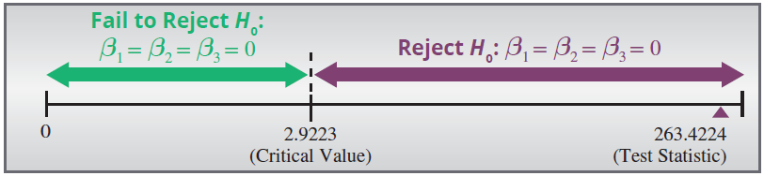
Example 14.4.1 (cont.)
Step 5: Make the decision to reject or fail to reject H₀.
Since the value of the F-statistic, 263.4224, falls in the rejection region, the null hypothesis will be rejected in favor of the alternative.
Alternatively, the P-value for the F-statistic of 263.4224 is 0.0000 to four decimal places. Since 0.0000 is less than 0.05, we reject the null hypothesis.

Slide 12
Example 14.4.1 (cont.)
Step 6: State the conclusion in terms of the original question.
The null hypothesis is rejected in favor of the alternative, which states that at least one of the independent variables is useful in explaining the variation in home prices.

Slide 13
Confidence Interval for Each Coefficient
Definition
The 100(1 − α)% confidence interval for each coefficient, β_{i}, in a multiple regression model is given by

Slide 14
Example 14.4.2
Compute and interpret the 95% confidence interval for β ₁ in the Mount Pleasant Real Estate model.
Solution
The β ₁ model coefficient relates to the variable square footage in the Mount Pleasant Real Estate model. The output in Figure 14.1.1 provides two parts of the information necessary to develop a confidence interval for β ₁. You will find this information under the label Coefficients.

Slide 15
Example 14.4.2 (cont.)
A portion of the output from Figure 14.1.1 is repeated here.
Coefficients
Term | Coef | SE Coef | T-Value | P-Value | VIF
Constant | 163579.06 | 21007.63 | 7.787 | 0.0000
Square Footage | 108.24 | 9.28 | 11.666 | 0.0000 | 2.967
Age | −6318.47 | 765.29 | −8.256 | 0.0000 | 1.634
Bedrooms | 1284.92 | 7357.66 | 0.175 | 0.8625 | 2.437

Slide 16
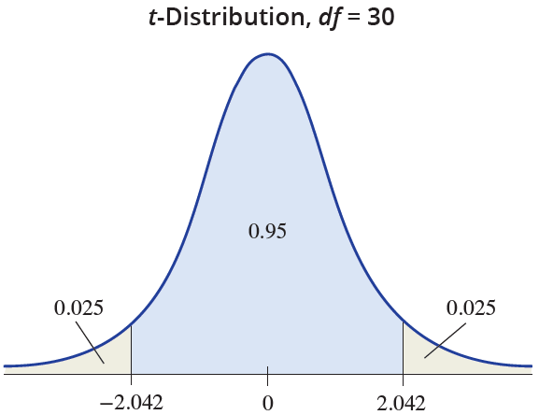
Example 14.4.2 (cont.)
b₁ is given in the output to be 108.24.
is given in the output to be 9.28.

Slide 17
Example 14.4.2 (cont.)
In order to compute the t-value, the degrees of freedom must be determined
df = n − (k + 1) = 34 − (3 + 1) = 30.
For a 95% confidence interval will be The resulting confidence interval will be
108.24 ± 2.042 ⋅ 9.28
108.24 ± 18.94976 or (89.29024, 127.18976).

Slide 18
Example 14.4.2 (cont.)
We are 95% confident that the true value of β₁, the increase in the price of a house per square foot given a particular number of bedrooms and age, will be between $89.29 and $127.19.

Slide 19
Example 14.4.3
For the Mount Pleasant Real Estate model constructed in Figure 14.1.1,
Price of Home = β ₀ + β ₁ (Square Footage) + β ₂ (Age of Home) + β ₃ (Number of Bedrooms).
Is the independent variable number of bedrooms a useful predictor of home price? Use α = 0.05 as the level of significance.
Solution
Step 1: Determine the null and alternative hypotheses.

Slide 20
Example 14.4.3 (cont.)
For the Mount Pleasant Real Estate model, if number of bedrooms is not a useful predictor of home price, then its coefficient in the model, β ₃, will equal 0. The sample estimate of β ₃, namely b₃. will be used to evaluate the reasonableness of the hypothesis β ₃ = 0.
The alternative hypothesis should be two-sided since the relationship between the number of bedrooms and home price can be positive or negative. Therefore, our hypotheses are as follows:

Slide 21
Example 14.4.3 (cont.)
H₀: β ₃ = 0 Implies that the number of bedrooms is not a useful predictor of home price.
H_{a}: β ₃ ≠ 0 Implies that the number of bedrooms is a useful predictor of home price.
Step 2: Specify the significance level α.
The level of the test is specified in the problem as α = 0.05.
Step 3: Validate the assumptions of the hypothesis testing model, identify the appropriate test statistic and compute its value.

Slide 22
Example 14.4.3 (cont.)
The assumptions for the Mount Pleasant Real Estate model have been discussed in previous examples.
The test statistic is The test statistic is
identical in form to the test statistic used in Section
13.2 for the simple linear model. If the value of the test statistic is near zero, then there is evidence that the number of bedrooms variable is not a significant predictor of home price.

Slide 23
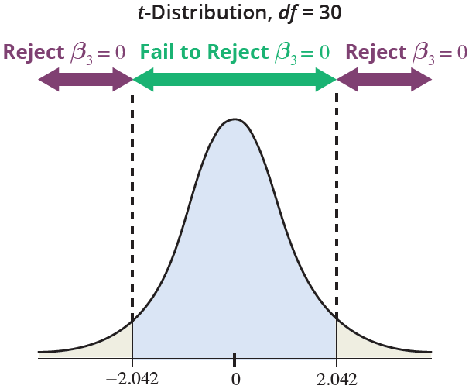
Example 14.4.3 (cont.)

Slide 24
Example 14.4.3 (cont.)
A portion of the output from Figure 14.1.1 is repeated here.
Coefficients
Term | Coef | SE Coef | T-Value | P-Value | VIF
Constant | 163579.06 | 21007.63 | 7.787 | 0.0000
Square Footage | 108.24 | 9.28 | 11.666 | 0.0000 | 2.967
Age | −6318.47 | 765.29 | −8.256 | 0.0000 | 1.634
Bedrooms | 1284.92 | 7357.66 | 0.175 | 0.8625 | 2.437

Slide 25
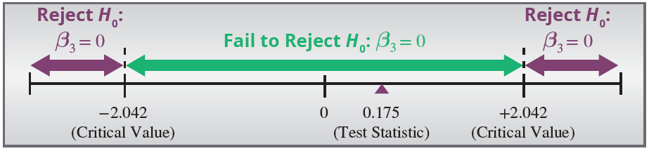
Example 14.4.3 (cont.)
Using the output in Figure 14.1.1 we find that
The estimated value of b₃ is 0.175 standard deviations from zero. Is this persuasive evidence that β ₃ ≠ 0?

Slide 26
Example 14.4.3 (cont.)
Step 4: Determine the critical value(s) or P-value.
This criteria is defined by the critical value of the test statistic. Since the test is two-tailed and the level of confidence is specified to be 0.95, then 1 − α = 0.95,
which implies α = 0.05 and The test
statistic has a t-distribution with df = 34 − (3 + 1) = 30. The critical value corresponds to t_{0.025,30} = 2.042. The P-value for the number of bedrooms is given in the output as 0.8625.

Slide 27
Example 14.4.3 (cont.)
Step 5: Make the decision to reject or fail to reject H₀.
Since the value of the test statistic falls into the Fail to Reject region, there is insufficient evidence at the 0.05 level to reject the null hypothesis β ₃ = 0. Alternatively, the P-value of 0.8625 is greater than α = 0.05, we fail to reject the null hypothesis.
Step 6: State the conclusion in terms of the original question.
Since we did not reject the null hypothesis H₀: β ₃ = 0,

Slide 28
Example 14.4.3 (cont.)
then the variable number of bedrooms is not a significant predictor of home price, given the other variables currently in the model.
We apply the exact same t-test to the other variables in the model. Both b₁ and b₂, the coefficients of the variables square footage and age, are significant. This suggests that a model with only two independent variables, square footage and age, may produce a model almost as good as the one containing three variables.

