Slide 1
Section 14.6
Multiple Regression Models with Qualitative Independent Variables

Slide 2
Indicator (or Dummy) Variables
In order to use qualitative variables in regression analysis, we need to identify the classes of the qualitative variables quantitatively. To do this, we will use indicator (or dummy) variables that take on values of 0 and 1. If we have a quantitative variable with c classes, that variable will be represented by c – 1 indicator variables in the regression model, with each indicator variable taking on a value of 0 or 1.

Slide 3
Example 14.6.1
The table below contains the real estate data set from Table 14.1.1, but with the added column of the variable porch, indicating whether the house has a screened porch or not.
Mount Pleasant Real Estate Data
Price | Square Feet | Age | Number of Bedrooms | Porch | Screened Porch?
350000 | 2592 | 8 | 3 | 1 | Yes
119900 | 777 | 17 | 1 | 1 | Yes
179900 | 1137 | 17 | 2 | 0 | No
124900 | 777 | 17 | 1 | 0 | No
349999 | 2151 | 4 | 4 | 0 | No
. . .

Slide 4
Example 14.6.1 (cont.)
You may recall that we are interested in modeling home price as a function of the following variables.
x₁ = square footage
x₂ = age
x₃ = bedrooms
The multiple regression model is given by

Slide 5
Example 14.6.1 (cont.)
The fitted regression model is as follows.
Price of Home = 163626.79 + 114.95 (square footage) − 6152.36 (age) − 1358.31 (bedrooms) − 13506.64 (porch)
SUMMARY OUTPUT
Regression Statistics
Multiple R | 0.983153945
R Square | 0.96659168
Adjusted R Square | 0.961983636
Standard Error | 21275.07421
Observations | 34

Slide 6
Example 14.6.1 (cont.)
ANOVA
 | df | SS | MS | F | Signiﬁcance F
Regression | 4 | 3.79777E+11 | 94944231937 | 209.7618082 | 5.92154E-21
Residual | 29 | 13126234702 | 452628782.8
Total | 33 | 3.92903E+11
 | Coeﬃcients | Standard Error | t Stat | P-value | Lower 95% | Upper 95%
Intercept | 163626.7916 | 20421.30079 | 8.012554798 | 7.76213E-09 | 121860.5419 | 205393.0413
Square Feet | 114.9454965 | 9.88474698 | 11.62857246 | 1.93724E-12 | 94.72891896 | 135.162074
Age | −6152.363638 | 750.6484437 | −8.196065268 | 4.89101E-09 | −7687.612086 | −4617.11519
Number of Bedrooms | −1358.306077 | 7327.914624 | −0.185360522 | 0.854236625 | −16345.57428 | 13628.96213
Porch | −13506.63879 | 8148.538447 | −1.657553545 | 0.108188125 | −30172.27116 | 3158.993583

Slide 7
Example 14.6.1 (cont.)
Now that we are fitting the model with porch as the indicator variable, we are interested in the effect that having a screened porch or not has on the average home price. The estimate of β₄ is −13506.64. This means that the difference in average home price is approximately $13,506.64. Specifically, the average home price with a porch is about $13,506.64 less. Intuitively, this doesn't make sense.
The important question would be, is the slope associated with the porch variable significant?

Slide 8
Example 14.6.1 (cont.)
The formal test can be carried out just as we did in Section 14.5. That is, our hypotheses are the following.
H₀: β₄ = 0 Implies porch is not a useful predictor of home price.
H_{a}: β₄ ≠ 0 Implies porch is a useful predictor of home price.
According to the Excel output, we have a t-statistic of −1.658 with a P-value of 0.1082. Given the large P-value associated with this test, we would fail to reject the null hypothesis and conclude that the porch variable is not a useful predictor of home price.

Slide 9
Example 14.6.2
A real estate investor wants to study the relationship between annual return on his commercial retail shops (measured in thousands of dollars) as it relates to their location and the number of homes near the shops. Specifically, the investor has collected data on the annual return of the shops, the number of households within 15 miles of the shops (measured in thousands), and the location of the shops (whether the shops are in a suburban area, near a shopping mall, or downtown). The annual return data are given in the following table.

Slide 10
Example 14.6.2 (cont.)
Shop Data
Shop | Location | Annual Return (Thousands of Dollars) | Number of Households (Thousands)
1 | Mall | 185.69 | 163
2 | Suburban | 203.00 | 215
3 | Mall | 245.81 | 232
4 | Mall | 137.07 | 108
5 | Suburban | 207.36 | 220
. . .
Solution
Given the data, we can define our variables as follows.
x₁ = number of households

Slide 11
Example 14.6.2 (cont.)
Since location is a qualitative variable and there are three locations, we will use c − 1 = 3 − 1 = 2 variables to represent the locations. The variables representing locations are

Slide 12
Example 14.6.2 (cont.)
The suburban location is known as the base level variable since for suburban locations x₂ = 0 and x₃ = 0. The coefficients estimated for the x₂ and x₃ indicator variables will represent a difference between the mall and downtown locations and the suburban location.
The multiple regression model for annual return is given by

Slide 13
Example 14.6.2 (cont.)
The fitted regression model is
Estimated Annual Return = 15.5071 + 0.8704 (number of households) + 27.8186 (mall) + 6.7185 (downtown).
Let’s discuss the model and its implications. First of all, we want to know if the location and the number of households in the area are useful predictors of annual return of the shops. You may recall that the test of the model’s significance is conducted using the F-test that tests the following hypothesis.

Slide 14
Example 14.6.2 (cont.)
SUMMARY OUTPUT
Regression Statistics
Multiple R | 0.999974838
R Square | 0.999949677
Adjusted R Square | 0.999943871
Standard Error | 0.288707033
Observations | 30
ANOVA
 | df | SS | MS | F | Signiﬁcance F
Regression | 3 | 43062.89567 | 14354.29856 | 172213.5214 | 5.5533E-56
Residual | 26 | 2.167145526 | 0.083351751
Total | 29 | 43065.06282

Slide 15
Example 14.6.2 (cont.)
Examining the Excel output, we see that the F-statistic for the test is 172,213.5214 with a P-value near zero. This is an indication that we reject H₀ and conclude that at least one of the slopes in the model is significantly different from zero, and the model can be useful in predicting the variability of annual returns.
 | Coeﬃcients | Standard Error | t Stat | P-value | Lower 95% | Upper 95%
Intercept | 15.50707387 | 0.261037514 | 59.40553771 | 2.6636E-29 | 14.97050357 | 16.04364416
# of Households | 0.870441943 | 0.001225001 | 710.5645401 | 2.77306E-57 | 0.867923919 | 0.872959968
Mall | 27.81856958 | 0.138873816 | 200.3154397 | 5.45545E-44 | 27.53311037 | 28.1040288
Downtown | 6.718542409 | 0.13223228 | 50.80864057 | 1.49967E-27 | 6.446735064 | 6.990349754

Slide 16
Example 14.6.2 (cont.)
Having concluded that the model is significant, we focus our attention on the individual regression coefficients. That is, we can test the following hypothesis.
If we examine the P-values in the Excel output for each of the coefficients, it is noted that each of them is near zero, indicating that each coefficient is different from zero, and each independent variable is useful in predicting annual return.

Slide 17
Example 14.6.2 (cont.)
Now we can examine the average annual return of the investments as a function of the location of the shops (i.e., whether they are near a mall, downtown, or in a suburban area). The estimated models can be written as follows.
For the mall location (x₂ = 1, x₃ = 0):
Estimated Annual Return = (b₀ + b₂) + b₁ (number of households)
= (15.5071 + 27.8186) + 0.8704 (number of households)

Slide 18
Example 14.6.2 (cont.)
For the downtown location (x₂ = 0, x₃ = 1):
Estimated Annual Return = (b₀ + b₃) + b₁ (number of households)
= (15.5071 + 6.7185) + 0.8704 (number of households)
For the suburban location (x₂ = 0, x₃ = 0):
Estimated Annual Return = b₀ + b₁ (number of households)
= 15.5071 + 0.8704 (number of households).

Slide 19
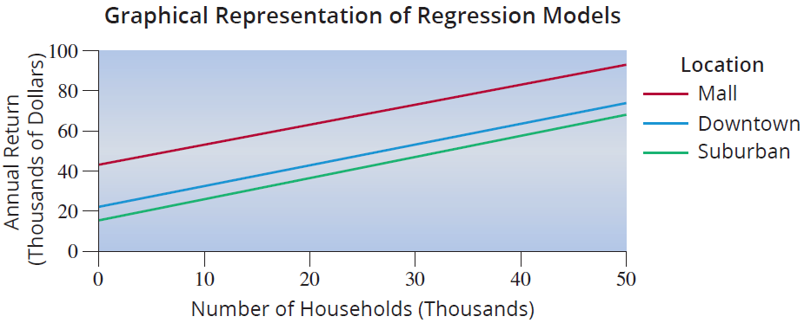
Example 14.6.2 (cont.)
Notice that the best fit line for each location has a different intercept value, but the same slope. Plotting the three lines illustrates this difference.

Slide 20
Example 14.6.2 (cont.)
So, modeling with the qualitative variables allows us to compare the average difference in annual return of the shops by location. That is, in order to compare the mall and suburban locations, the difference (as can be seen in the model) is
Therefore, the estimate of ϐ₂ (which is 27.8186) represents the difference between the average annual return for shops in the mall locations having x₁ households in the area and the average annual return

Slide 21
Example 14.6.2 (cont.)
for shops in the suburban locations having x₁ households in the area. Thus, we can say that for any number of households in a given area, the average annual return in a mall location will be approximately $27,818.60 greater than the average annual return in a suburban location.
Similarly, to compare downtown and suburban returns, we get

Slide 22
Example 14.6.2 (cont.)
Thus, the estimate of β₃ (which is 6.7185) represents the difference between the average annual return for shops in the downtown locations having x₁ households in the area and the average annual return for shops in the suburban locations having x₁ households in the area. So, we can say that for any number of households in a given area, the average annual return in a downtown location will be $6718.50 greater than the average annual return in a suburban location.

Slide 23
Example 14.6.2 (cont.)
Lastly, to compare mall and downtown locations, we look at
The estimated difference between β₂ and β₃ is given by β₂ − β₃ ( 21.1001) which represents the difference between the average annual return for shops in the mall locations having x₁ households in the area and the average annual return for shops in the downtown locations having x₁ households in the area.

Slide 24
Example 14.6.2 (cont.)
In terms of the problem, we can say that for any number of households in a given area, the average annual return in a mall area will be $21,100.10 greater than the average annual return in a downtown location.

Slide 25
Using Regression Results
There are three potential issues to keep in mind when using these regression results.
1. These results are only meaningful within the relevant range of the data that was used to estimate the regression equation. For example, using the model in Example 14.6.2 to predict annual return for a shop with 1000 households or 1,000,000 households in the surrounding area would likely yield an unreliable point estimate.

Slide 26
Using Regression Results
2. The regression lines for the three locations in Example 14.6.2 are assumed to have the same slope, but in reality they could have very different slopes. Using a regression model with interaction terms allows the slopes for the regression lines to differ.
3. The regression lines estimated in this example are all linear. This implies that annual return increases by the same amount for each additional thousand households within 15 miles of the shops. This assumption is sometimes unrealistic. This issue can be addressed using polynomial (or nonlinear) regression models.

