Slide 1
Section 15.1
One-Way ANOVA

Slide 2
Experimental Units
Definition
Individuals or objects on which the experiment is performed are called experimental units.

Slide 3
Treatment
Definition
An experimental condition applied to the units is called a treatment.

Slide 4
Sample Variance
Formula
where
is the sample mean of all of the observations, and is called the grand mean,
n_{j} is the number of observations in the j^{th} treatment,
x_{ij} is the i^{th} data value from the j^{th} sample,
k is the number of treatments, and
N is the total number of observations in all samples.

Slide 5
Total Sum of Squares
Formula
Total Sum of Squares

Slide 6
Sum of Squares for Treatments
Formula
The mathematical expression for the sum of squares for treatments is given by
where
n_{j} is the number of observations in the j^{th} treatment,
is the sample mean of the observations in the j^{th} treatment, and
is the grand mean.

Slide 7
Sum of Squares for Error
Formula
The mathematical expression for the sum of squares for error is given by the following formula.

Slide 8
ANOVA
As you might expect, these measures of variability are the fundamental pieces which will be used to develop a hypothesis test for determining whether or not there is a significant difference among population means. This is precisely the reason that the test which we will use to make this decision is often called an Analysis of Variance, or ANOVA. The expressions are complicated. Fortunately, most statistical analysis programs will compute these quantities.

Slide 9
ANOVA Formulas
Formula
Grand Mean:
Sum of Squares for Treatments:
Mean Square for Treatments:

Slide 10
ANOVA Formulas
Formula (cont.)
Sum of Squares for Error:
Mean Square for Error:
Total Sum of Squares:
Total Sum of Squares

Slide 11
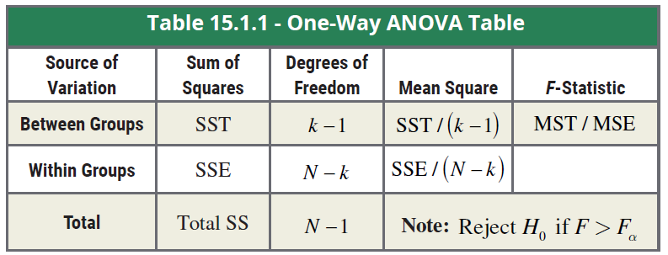
One-Way ANOVA Table

Slide 12
ANOVA Assumptions
Assumptions
In order for an analysis of variance to be valid, the following three assumptions must hold.
The sample observations are randomly selected and the samples are independent of one another.
The distributions of all k populations of interest are approximately normal.
The variances of the k populations are equal.

Slide 13
Assumptions of the Test
Note
There is a simple “rule of thumb’ that you can use to check the variance assumption. If the largest standard deviation is no more than twice the smallest, then the presumption is that the assumption holds.

Slide 14

ANOVA F-Test
is a natural test statistic to use in determining whether or not a difference exists among the population means. We will reject the null hypothesis that the population means are equal for large values of the F-statistic. This is why the test for differences among population means is often referred to as the F-test.
$$F=\frac{MST}{MSE}$$

Slide 15
ANOVA F-Test
Procedure
Assumptions
The observations from each sample are randomly selected and the samples are independent of one another.
The distributions of the k populations of interest are approximately normally distributed.
The variances of the k populations are equal.

Slide 16
ANOVA F-Test
Procedure (cont.)
Hypotheses:
H₀: μ₁ = μ₂ = … = μ_{k} The k population means are equal. H_{a}: At least one μ_{i} is different.
Test Statistic:

Slide 17
ANOVA F-Test
Procedure (cont.)
Rejection Region:
H₀ will be rejected for large values of In
particular, we will reject H₀ if F > F_{α} with (k − 1)
numerator degrees of freedom and (N − k) denominator degrees of freedom.

Slide 18
ANOVA F-Test
Procedure (cont.)
P-value:
The P-value should be available from the output of an ANOVA test performed using technology. The ANOVA test will always be a right-tailed test since large values of the test statistic cause us to reject equality of the population means.
If the computed P-value is less than α, reject the null hypothesis in favor of the alternative.
If the computed P-value is greater than or equal to α, fail to reject the null hypothesis.

Slide 19
Computational Formulas for MST and MSE
Formula
Let k be the total number of treatments and N = n₁ + n₂ +...+ n_{k} be the total number of observations, then

Slide 20
Example 15.1.1
You have just been promoted to sales manager of a company manufacturing robots used to assemble automobiles. Although your sales force is given a suggested price at which to sell the robots, they have considerable leeway in negotiating the final price. Past sales records indicate that sometimes there is a large difference in the sales price which different sales reps are able to negotiate.

Slide 21
Example 15.1.1 (cont.)
You are interested in knowing if this difference is significant, possibly because of a more effective negotiating strategy or exceptional interpersonal skills, or whether this observed difference in sales price is just due to random variation. You decide to randomly select four sales over the last year for each of your three sales representatives and observe the actual selling price of the robot. The table on the next slide shows the amounts at which the robots sold in thousands of dollars.

Slide 22
Example 15.1.1 (cont.)
Based on the results of your survey, can you conclude that there is a significant difference in the average sale price which the three sales reps have been able to negotiate? Use α = 0.05.
Selling Prices (Thousands of Dollars)
 | Salesperson 1 | Salesperson 2 | Salesperson 3
 | 10 | 11 | 11
 | 14 | 16 | 13
 | 13 | 14 | 12
 | 12 | 15 | 15
Total | 49 | 56 | 51
Average | 12.25 | 14.00 | 12.75
Standard Deviation | 1.708 | 2.160 | 1.708

Slide 23

Example 15.1.1 (cont.)
Solution
Step 1: Determine the null and alternative hypotheses.
In plain English we can write the hypotheses as follows.
Null Hypothesis: There is no difference in average sale price among the three sales reps.
Alternative Hypothesis: There is a difference in average sale price among the three sales reps.

Slide 24
Example 15.1.1 (cont.)
Since the sales manager is interested in comparing the average sale price of the three sales reps, the population parameters of interest are the true average sale price for each salesperson.
μ₁ = the true average sale price for sales rep #1
μ₂ = the true average sale price for sales rep #2
μ₃ = the true average sale price for sales rep #3

Slide 25
Example 15.1.1 (cont.)
Based on the way the test statistic is constructed, we will reject the null hypothesis for large values of the test statistic, meaning that the variability among the sample means is much larger than the variability within the sample observations. Thus, the F-test is always a one-sided test.

Slide 26
Example 15.1.1 (cont.)
Therefore, in symbols the hypotheses can be written as
H₀: μ₁ = μ₂ = μ₃ The average sale price is the same for all three sales reps.
H_{a}: At least one μ_{i} is different.

Slide 27
Example 15.1.1 (cont.)
Step 2: Specify the significance level α.
The level of the test is specified in the problem as
α = 0.05.

Slide 28
Example 15.1.1 (cont.)
Step 3: Validate the assumptions of the hypothesis testing model, identify the appropriate test statistic, and compute its value.
There are three key questions which we must ask.
Were the sample sale prices for each of the sales reps collected in an independent and random fashion?
Are the sale prices for each of the sales reps normally distributed?
Do the sale prices for each of the sales reps have essentially the same variance?

Slide 29
Example 15.1.1 (cont.)
Based on prior studies and normal probability plots of each salesperson's sales (only the plot for Salesperson 1 is shown on a later slide), you have reason to believe that the sale prices of the robots for each of the sales reps has an approximately normal distribution.

Slide 30

Example 15.1.1 (cont.)
The standard deviation of the selling prices for each salesperson, shown at the bottom of the table, are reasonably similar. Therefore, we can assume that the variances of the three distributions are approximately equal. Also, you used random sampling to collect your data.
Independent random samples for each salesperson
The distribution of selling prices is approximately normally distributed for each salesperson.
The variances in selling price for each salesperson are approximately equal.

Slide 31
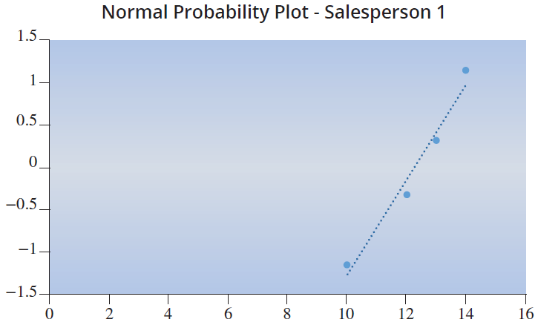
Example 15.1.1 (cont.)
Since the assumptions for the ANOVA test have been met, the appropriate test statistic is

Slide 32
Example 15.1.1 (cont.)
Using the computational formulas presented previously,

Slide 33
Example 15.1.1 (cont.)
The resulting calculated value of the test statistic is

Slide 34
Example 15.1.1 (cont.)
Step 4: Determine the critical value or P-value.
The level of the test is α = 0.05, and there are
(k − 1) = (3 − 1) = 2 (numerator) degrees of freedom and
(N − k) = (12 − 3) = 9 (denominator) degrees of freedom. Thus, the critical value is F_{0.05} = 4.2565. We will reject H₀ if the computed value of the test statistic is larger than 4.2565. The following figure displays the rejection region.

Slide 35
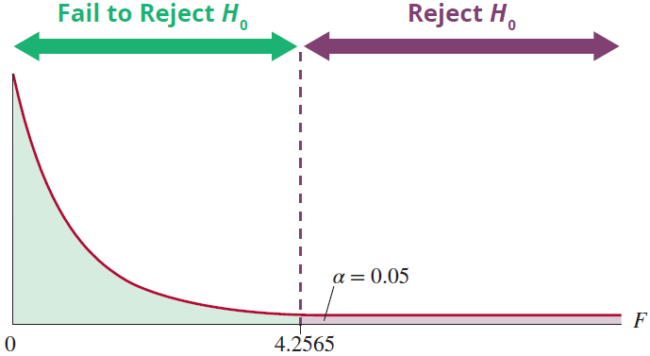
Example 15.1.1 (cont.)
F-Distribution
numerator df = 2, denominator df = 9

Slide 36
Example 15.1.1 (cont.)
The P-value can be obtained through technology,
P(F > 0.9286) ≈ 0.4299.

Slide 37
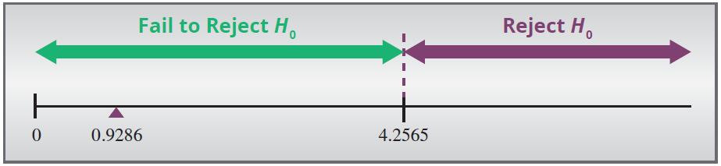
Example 15.1.1 (cont.)
Step 5: Make the decision to reject or fail to reject H₀. Since the resulting value of the test statistic, 0.9286, is less than the critical value of 4.2565, we fail to reject the null hypothesis. Likewise, the P-value, 0.4299, is greater than α = 0.05 so we also fail to reject the null hypothesis using the P-value method.

Slide 38
Example 15.1.1 (cont.)
Step 6: State the conclusion in terms of the original problem.
There is not sufficient evidence at α = 0.05 to reject the null hypothesis. Thus, we cannot conclude that there is a difference in average sale price among the three sales reps.

Slide 39
Example 15.1.1 (cont.)
It is recommended to use statistical software (rather than computational formulas) to perform an ANOVA. The summary output from Microsoft Excel for this example is as follows.
ANOVA: Single Factor
SUMMARY
Groups | Count | Sum | Average | Variance
Column 1 | 4 | 49 | 12.25 | 2.916667
Column 2 | 4 | 56 | 12.14 | 4.666667
Column 3 | 4 | 61 | 12.75 | 2.916667

Slide 40
Example 15.1.1 (cont.)
ANOVA
Source of Variation | SS | df | MS | F | P-value | F crit
Between Groups | 6.5 | 2 | 3.25 | 0.928571 | 0.429904 | 4.256495
Within Groups | 31.5 | 9 | 3.5
Total |  | 11

Slide 41
Multiple Comparison Procedures
If the null hypothesis that all population means are equal is rejected, the ANOVA procedure does not tell you which means are not equal. There are procedures called multiple comparison procedures, that allow us to determine which means are different. Some of the more popular multiple comparisons procedures are the Bonferroni method, Scheffe’s method, and the Tukey method. However, these procedures are beyond the scope of this text.

