Slide 1
Section 15.2
Two-Way ANOVA: The Randomized Block Design

Slide 2
Two-Way ANOVA: The Randomized Block Design
The purpose of the randomized block design is to control for potentially confounding variables in a research experiment.
Suppose a nutritionist is interested in comparing the average weight loss for three different diets: a banana diet, a cabbage diet, and a grapefruit diet. She has been funded to use nine people in studying these diets. One approach in designing this study is to randomly select nine people and then randomly assign three of them to each of the three diets for six months.

Slide 3
Two-Way ANOVA: The Randomized Block Design
We could then compare the average weight loss for each of the diets at the end of that period, using the F-test described in Section 15.1.
This type of design is called a completely randomized design. Although this may be a perfectly reasonable approach, it does have some shortcomings
For example, what if all of the people selected to try the banana diet are at least 100 pounds overweight, whereas all of the people selected to try the grapefruit diet are only 10 pounds overweight?

Slide 4
Two-Way ANOVA: The Randomized Block Design
What can be done to reduce the effect of this factor which affects weight loss, but which is not directly related to how well the diets work?
One approach would be to divide our study participants into several weight bands called blocks: those people who are more than 100 pounds overweight, those people who are between 51 and 100 pounds overweight, and those people who are between 0 and 50 pounds overweight.

Slide 5
Two-Way ANOVA: The Randomized Block Design
Then randomly select people, three from each of the weight bands, to try each of the diets. And finally compare the average weight loss of each of the diets for individuals in each of the three weight bands.
This design is an extension of the paired difference design for comparing two means, which we discussed in Chapter 12

Slide 6
Two-Way ANOVA: The Randomized Block Design
As with the paired difference design, we give up degrees of freedom when we block. Thus, we must be sure that the reduction in variation among sample observations is enough to compensate for the loss of degrees of freedom. This type of design is an example of a randomized block design.
Table 15.2.1 gives the data collected by the nutritionist for the randomized block design

Slide 7
Two-Way ANOVA: The Randomized Block Design
Table 15.2.1 - Completely Randomized Block Design
 |  | Blocks
 |  | >100 lb overweight | 51-100 lb overweight | 0-50 lb overweight
Treatment | Banana Diet | 25 | 15 | 10
 | Cabbage Diet | 45 | 25 | 15
 | Grapefruit Diet | 30 | 20 | 15

Slide 8
Two-Way ANOVA: The Randomized Block Design
Before proceeding with the ANOVA F-test, we need to verify that the assumptions are met. Recall from Section 15.1 that the ANOVA procedure is robust against departures from the normality and equal variance assumptions.
For this example, we do not have repeated observations for each combination of treatment and block to be able to verify the normality and equal variance assumptions.

Slide 9
Two-Way ANOVA: The Randomized Block Design
The nutritionist should actually collect more data in each cell of the table to verify those assumptions, and to provide additional degrees of freedom for the test. We will demonstrate the ANOVA procedure for this simplified randomized block example nonetheless.

Slide 10

Two-Way ANOVA: The Randomized Block Design
Treatments are assigned at random within blocks and the sample measurements in each cell (treatment and block combination) are random samples that are independent of each other.
The measurements in each cell come from a population that is approximately normally distributed (assumed).
The populations have approximately equal variances (assumed).
All the cells have an equal number of measurements (a balanced design).

Slide 11
Two-Way ANOVA: The Randomized Block Design
Don't let the blocking distract from the intent of the experiment. Our interest is still in comparing the treatment means. For the nutritionist, the treatments of interest are the diets. Thus, the null and alternative hypotheses are the same as they were in the one-way ANOVA F-test.
H₀: μ₁ = μ₂ = μ₃ The average weight loss on each of the diets is the same. H_{a}: At least one of the μ_{i} is different.

Slide 12
Two-Way ANOVA: The Randomized Block Design
The test statistic appears to be exactly the same as that used for the one-way ANOVA F-test,
However, the denominator of the F-statistic is calculated differently because it takes into account the fact that we were able to eliminate some of the variation between our sample responses by blocking the experimental units.

Slide 13
Two-Way ANOVA: The Randomized Block Design
The total sum of squares and the degrees of freedom which we discussed in Section 15.1 can be broken down further as follows.
Sum of Squares: Total SS = SSTreatment + SSBlock + SSError
Degrees of Freedom: N − 1 = k − 1 + b − 1 + (b−1)(k−1)
where
N is the total number of observations,
k is the number of treatments, and
b is the number of blocks.

Slide 14
Two-Way ANOVA: The Randomized Block Design
If any of the observed variation in the sample observations has been reduced by blocking, then the SSError (SSE) is reduced.
But it is important to note that the degrees of freedom which are used by the SSBlock (SSBL) are taken from the SSE, thus the reduction in variation achieved by blocking must offset this loss in degrees of freedom..

Slide 15
Two-Way ANOVA: Randomized Block Design
Procedure
Assumptions:
Treatments are assigned at random within blocks and the sample measurements in each cell are random samples that are independent of each other.
The measurements in each cell come from a population that is approximately normally distributed (assumed).

Slide 16
Two-Way ANOVA: Randomized Block Design
Procedure (cont.)
The populations have approximately equal variances (assumed).
All the cells have an equal number of measurements.
Hypothesis:
H₀: μ₁ = μ₂ = … = μ_{k} The k treatment means are equal. H_{a}: At least one of the μ_{i} is different.

Slide 17
Two-Way ANOVA: Randomized Block Design
Procedure (cont.)
Test Statistic:
where SSE = Total Sum of Squares − SST − SSBL.

Slide 18
Two-Way ANOVA: Randomized Block Design
Procedure (cont.)
Rejection Region:
H₀ will be rejected for large values of In
particular, we will reject H₀ if F > F_{α} with (k − 1) numerator degrees of freedom and (k − 1)(b − 1) denominator degrees of freedom.

Slide 19
Two-Way ANOVA: Randomized Block Design
Procedure (cont.)
P-value:
(The P-value should be available from the output of an ANOVA test performed using technology.)
If the computed P-value is less than α, reject the null hypothesis in favor of the alternative.
If the computed P-value is greater than or equal to α, fail to reject the null hypothesis.

Slide 20
Two-Way ANOVA: Randomized Block Design
Table 15.2.2 - ANOVA Summary Table for a Randomized Block Design
Source of Variation | SS | df | MS | F
Treatment | SST | k − 1 | MST
Block | SSBL | b − 1 | MSBL
Error | SSE | (b − 1) (k − 1) | MSE
Total | Total SS | N −1

Slide 21
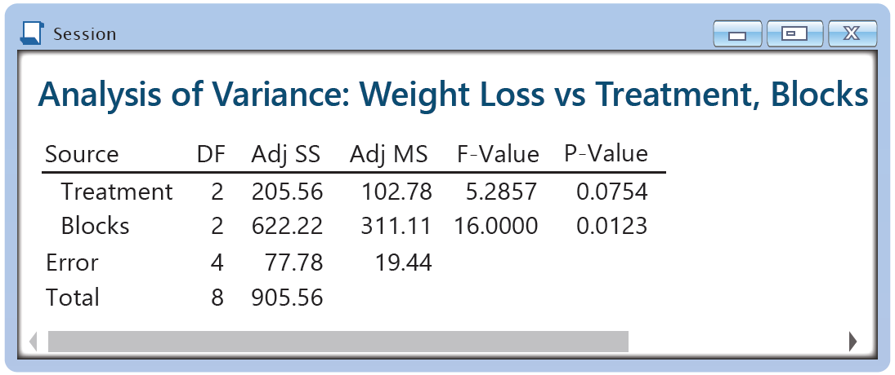
Two-Way ANOVA: Randomized Block Design
The results of the nutritionist’s test are given in Figure 15.2.1.
Figure 15.2.1 - ANOVA for Diet Data

Slide 22
Two-Way ANOVA: Randomized Block Design
The F-test statistic in our diet example has numerator degrees of freedom equal to two and denominator degrees of freedom equal to four. Thus, for α = 0.05, the F-critical value is 6.9443.
The calculated value of the test statistic is given by

Slide 23
Two-Way ANOVA: The Randomized Block Design
Note
When using statistical software programs like Excel and Minitab to per form a two-way ANOVA, it is important to pay attention to how the data is organized so that you can identify treatments and blocks on the summary output and accurately interpret the results.

Slide 24
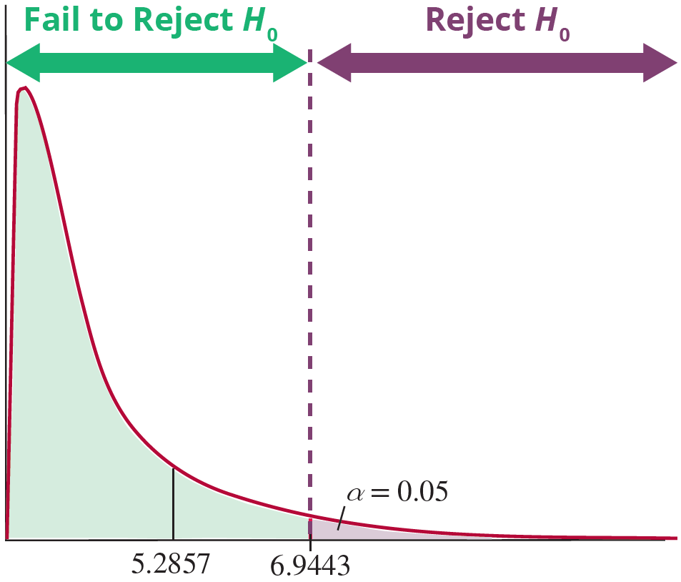
Two-Way ANOVA: Randomized Block Design
F-Distribution numerator df = 2, denominator df = 4
Figure 15.2.2

Slide 25
Two-Way ANOVA: The Randomized Block Design
As shown in Figure 15.2.2, the value of our test statistic, 5.2857, is less than the F critical value of 6.9443. Note also that the P-value from the Minitab output in Figure 15.2.1 is 0.0754, which is greater than α = 0.05. The nutritionist will fail to reject the null hypothesis.
There is not sufficient evidence to conclude that there is a difference in average weight loss among the three diets.

Slide 26
Two-Way ANOVA: The Randomized Block Design
Did the Experimental Design Benefit from the Blocking?
To determine if the blocking was successful at reducing variation among the sample observations, we use the test statistic

Slide 27
Two-Way ANOVA: The Randomized Block Design
Under the null hypothesis that block means are the same (we were not successful in reducing variation by blocking because the blocked means are not significantly different), the F-test statistic has an F-distribution with b − 1 numerator degrees of freedom and (k − 1)(b − 1) denominator degrees of freedom.

Slide 28
Two-Way ANOVA: The Randomized Block Design
At α = 0.05 the nutritionist will reject the null hypothesis that block means are all equal (blocking was unsuccessful) if the calculated value of the test statistic is larger than the F critical value with 2 numerator degrees of freedom and 4 denominator degrees of freedom, which is 6.9443. The calculated value of the test statistic is given by

Slide 29
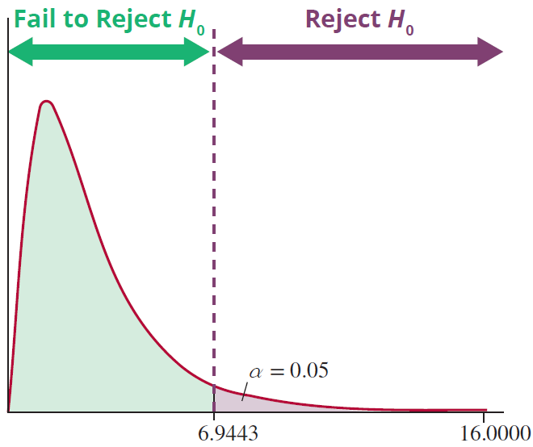
Two-Way ANOVA: The Randomized Block Design
F-Distribution numerator df = 2, denominator df = 4
Figure 15.2.3

Slide 30
Two-Way ANOVA: The Randomized Block Design
Figure 15.2.3 displays the rejection region and the calculated value of the test statistic. Since 16.0000 is larger than 6.9443, we reject the null hypothesis that the block means are all equal. Note that the P-value for this test from the ANOVA output is 0.0123, which is less than the significance level of 0.05.
Therefore, the nutritionist was able to reduce a significant amount of variation among sample observations by blocking.

