Slide 1
Section 15.3
Two-Way ANOVA: The Factorial Design

Slide 2
Two-Way ANOVA: The Factorial Design
The randomized block test presented in the previous section is one example of a two-way ANOVA. There were two independent factors considered in the analysis, namely the block (the different weight classes) and the treatment (diets), and each level of the treatment occurred with each level of the block. However, there was only one factor which was truly of interest to our experimenter, the treatment (diets).

Slide 3
Two-Way ANOVA: The Factorial Design
In order for the director of personnel to evaluate the relationship of average salary to age and experience, he chooses the following experimental design. He selects four different age groups and three different experience levels, and observes two salaries for each of the possible combinations of age and experience. The resulting data is displayed in Table 15.3.1.

Slide 4
Two-Way ANOVA: The Factorial Design
Table 15.3.1 - Salaries (Thousands of Dollars)
Years of Experience | Age
 | 25 – 34 | 35 – 44 | 45 – 54 | 55 – 64
0 – 4 | 22 27 | 25 35 | 34 36 | 37 43
5 – 9 | 34 36 | 35 45 | 42 48 | 49 51
10 – 14 | 39 41 | 40 50 | 53 57 | 51 59

Slide 5
Two-Way ANOVA: The Factorial Design
Again, this type of design is called a two-way analysis of variance because it involves two classifications. It is also called a complete factorial experiment since there is at least one observation for every possible combination of age and salary. Factorial experiments provide valuable information by enabling the interaction between the two variables to be estimated.

Slide 6
Two-Way ANOVA: The Factorial Design
Interaction between the two variables means that the average salary is affected by the combination of age and experience. An example of two variables which interact is shown in Figure 15.3.1. This figure is called an interaction plot, which is a plot of the means for each level of the factors. An example of two variables which do not interact is shown in Figure 15.3.2.

Slide 7
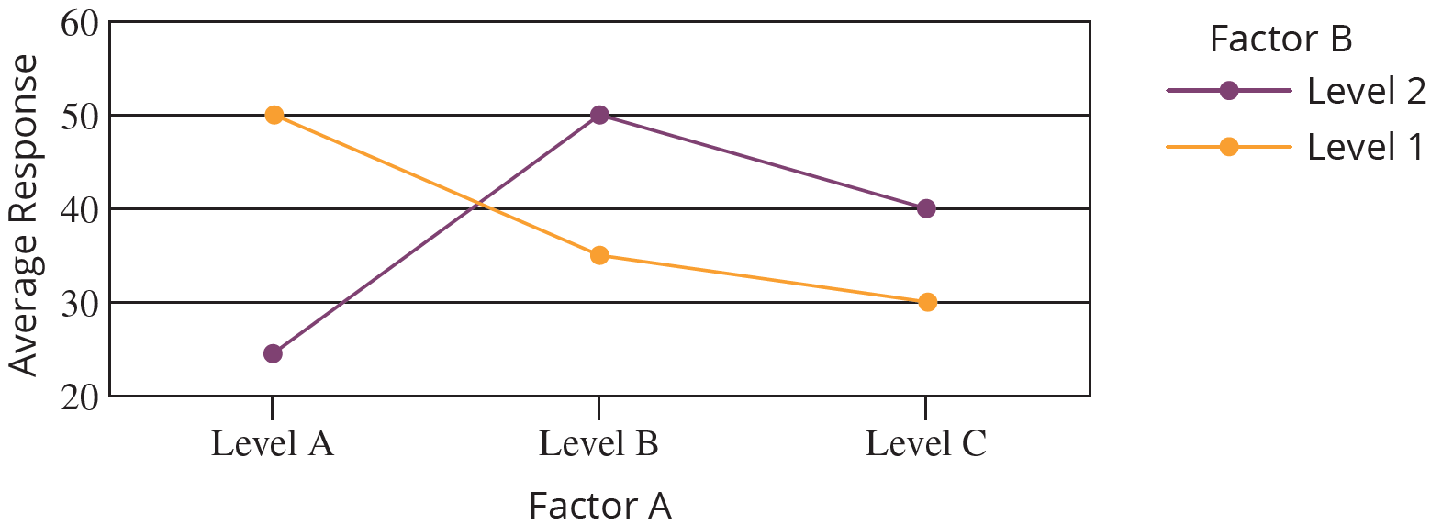
Two-Way ANOVA: The Factorial Design
Variables That Interact
Figure 15.3.1

Slide 8
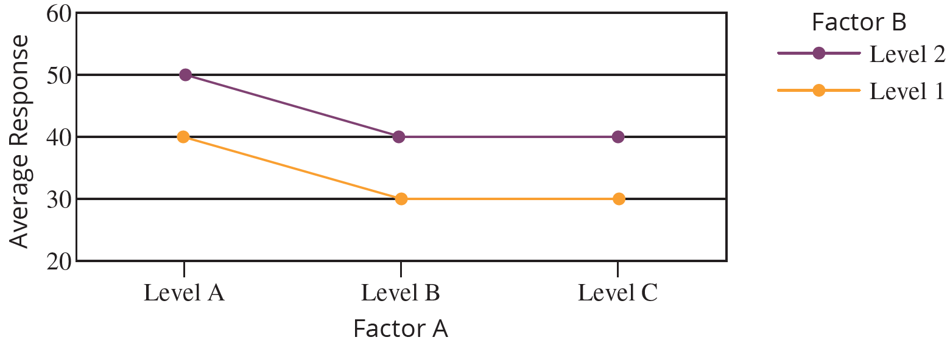
Two-Way ANOVA: The Factorial Design
Variables That Do Not Interact
Figure 15.3.2

Slide 9
Two-Way ANOVA: The Factorial Design
There are three effects on average salary that will interest the personnel director. The first is the effect that the interaction between age and experience has on average salary, called the main effect for interaction. The second is the effect that experience has on average salary, called the main effect for experience (Factor A). The third is the effect that age has on average salary, called the main effect for age (Factor B).

Slide 10
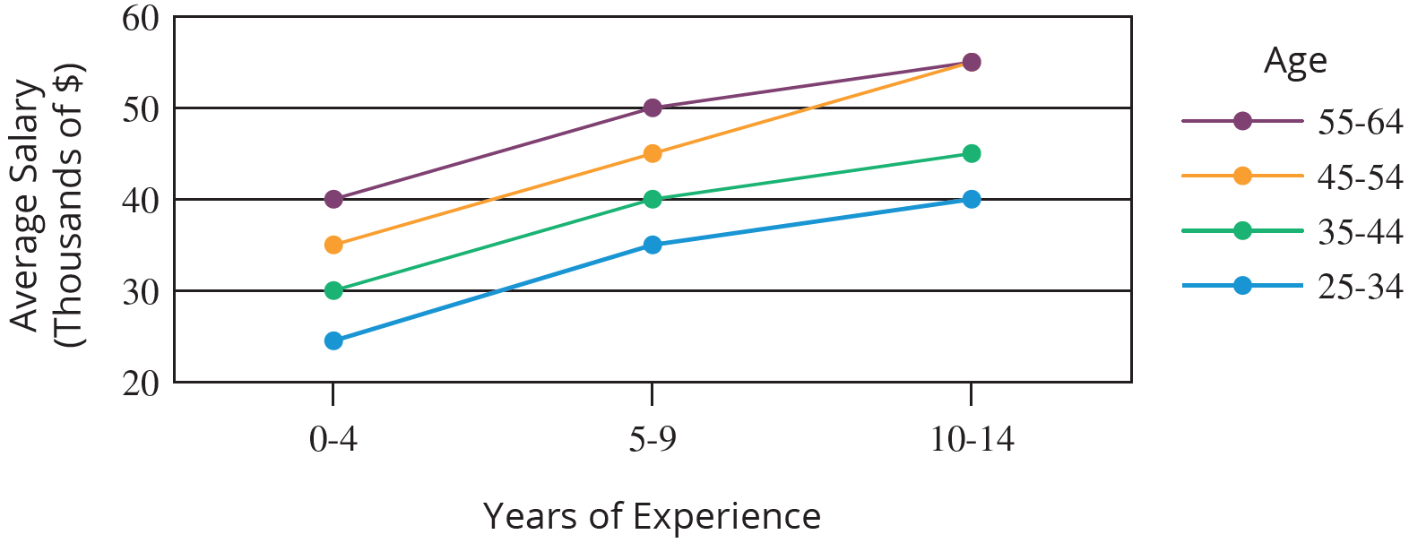
Two-Way ANOVA: The Factorial Design
Salary Data
Figure 15.3.3

Slide 11
Two-Way ANOVA: The Factorial Design
To develop the test procedure for the two-way ANOVA we again rely on the concepts presented in Section 15.1. The variation among the sample observations, represented by the total sum of squares, can be broken down into four pieces: the sum of squares for Factor A (SSA), the sum of squares for Factor B (SSB), the sum of squares for interaction (SSAB), and the sum of squares for error, SSE.

Slide 12
Two-Way ANOVA: The Factorial Design
Thus,
Sum of Squares Total Sum of Squares = SSA + SSB + SSAB + SSE
Degrees of n −1 = a −1 + b −1 + (a−1)(b−1) + ab(r−1)
Freedom
where
n is the total number of observations,
a is the number of levels of Factor A,
b is the number of levels of Factor B, and
r is the number of observations in the combinations of levels of Factor A and Factor B (i.e., the number of observations in each cell).
The assumptions for the tests in a two-way ANOVA are as follows.

Slide 13
Two-Way ANOVA Assumptions
Assumptions
The sample measurements in each cell are random samples that are independent of each other.
The measurements in each cell come from a population that is approximately normally distributed (assumed).
The populations have approximately equal variances (assumed).
All the cells have an equal number of measurements (a balanced design).

Slide 14
Note
Note
To test for interaction between the factors you must have at least 2 observations per cell (r ≥ 2).

Slide 15
Test for Interaction between Factors
Procedure
Hypotheses:
H₀: There is no interaction between Factor A and Factor B.
H_{a}: There is interaction between Factor A and Factor B.
Test Statistic:

Slide 16
Test for Interaction between Factors
Procedure (cont.)
Rejection Region:
Reject the null hypothesis if F > F_{α} with (a − 1)(b − 1) numerator degrees of freedom and ab(r − 1) denominator degrees of freedom.

Slide 17
Test for Interaction between Factors
Procedure (cont.)
P-value:
(The P-value should be available from the output of an ANOVA test performed using technology.)
If the computed P-value is less than α, reject the null hypothesis in favor of the alternative.
If the computed P-value is greater than or equal to α, fail to reject the null hypothesis.
Note: If the null hypothesis is rejected, then interaction exists. If interaction exists, do not proceed with the main effects tests for Factor A and Factor B.

Slide 18
Test for Main Effects for Factor A
Procedure
Hypotheses:
H₀: Factor A has no effect on average response.
H_{a}: Factor A has an effect on average response.
Test Statistic:

Slide 19
Test for Main Effects for Factor A
Procedure (cont.)
Rejection Region:
Reject the null hypothesis if F > F_{α} with (a − 1) numerator degrees of freedom and ab(r − 1) denominator degrees of freedom.

Slide 20
Test for Main Effects for Factor A
Procedure (cont.)
P-value:
If the computed P-value is less than α, reject the null hypothesis in favor of the alternative.
If the computed P-value is greater than or equal to α, fail to reject the null hypothesis.

Slide 21
Test for Main Effects for Factor B
Procedure
Hypotheses:
H₀: Factor B has no effect on average response.
H_{a}: Factor B has an effect on average response.
Test Statistic:

Slide 22
Test for Main Effects for Factor B
Procedure (cont.)
Rejection Region:
Reject the null hypothesis if F > F_{α} with (b − 1) numerator degrees of freedom and ab(r − 1) denominator degrees of freedom.

Slide 23
Test for Main Effects for Factor B
Procedure (cont.)
P-value:
If the computed P-value is less than α, reject the null hypothesis in favor of the alternative.
If the computed P-value is greater than or equal to α, fail to reject the null hypothesis.

Slide 24
Two-Way ANOVA: The Factorial Design
Table 15.3.2 - ANOVA Summary Table for a Factorial Experiment
Source of Variation | SS | Df | MS | F
Factor A | SSA | a − 1 | MSA
Factor B | SSB | b − 1 | MSB
Interaction | SSAB | (a − 1)(b − 1) | MSAB
Error | SSE | ab(r − 1) | MSE
Total | Total SS | N −1

Slide 25
Two-Way ANOVA: The Factorial Design
Before proceeding with the ANOVA test we must verify that the assumptions are met. We know that the ANOVA procedure is robust against departures from the normality and equal variance assumptions. For this example, we do not have sufficient repeated observations for each combination of factors to be able to verify the normality and equal variance assumptions are met.
It is highly recommended that as many observations as the budget and time allows be collected for each combination of factors in a factorial experiment. We will demonstrate the ANOVA procedure for this simplified factorial experiment.

Slide 26

Two-Way ANOVA: The Factorial Design
Cell measurements are independent random samples.
Cell measurements come from a population that is approximately normally distributed (assumed).
The populations have approximately equal variances (assumed).
All the cells have an equal number of measurements.

Slide 27
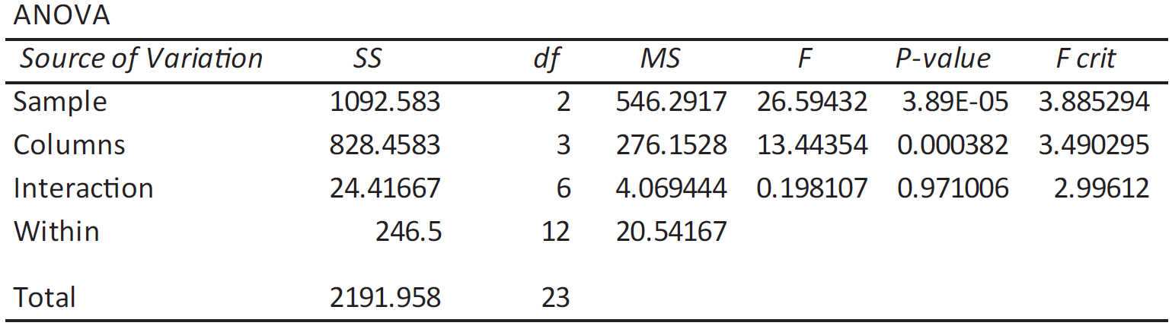
Two-Way ANOVA: The Factorial Design
The results of the two-way ANOVA for the personnel director’s salary data are given in Figure 15.3.4.
Figure 15.3.4 - Two-Way ANOVA for Salary Data

Slide 28
Two-Way ANOVA: The Factorial Design
In the ANOVA table, the row labeled "Sample" corresponds to Experience (Factor A) since the three experience levels were organized by rows in the original data table. The row of the output labeled "Columns" corresponds to Age (Factor B) since the age groups are organized by column. The row labeled "Interaction" corresponds to the interaction between experience and age, and "Within" corresponds to the variation within the sample observations, or error.

Slide 29
Two-Way ANOVA: The Factorial Design
The personnel director must first decide if there is interaction between age and experience. The appropriate test statistic for testing for interaction, which is the mean square of the interaction term divided by the mean square for error, is given by

Slide 30
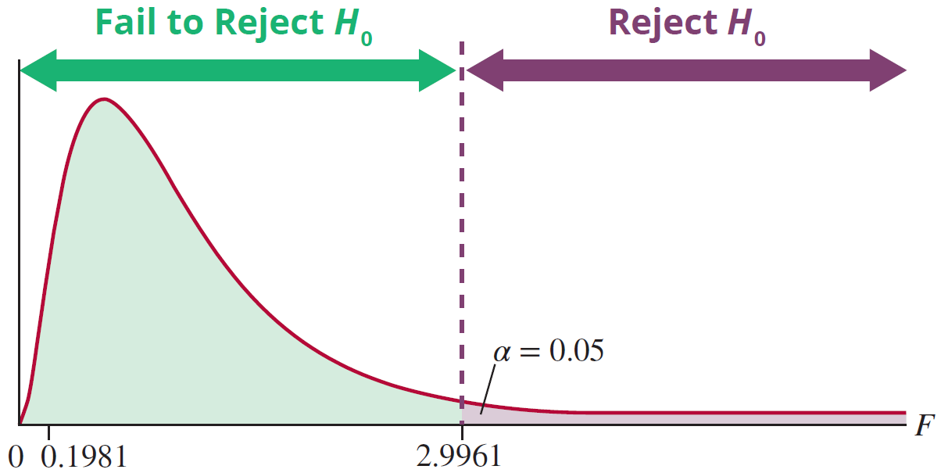
Two-Way ANOVA: The Factorial Design
F-Distribution
numerator df = 6, denominator df = 12
Figure 15.3.5

Slide 31
Two-Way ANOVA: The Factorial Design
To test whether or not experience has an effect on average salary, we let the null hypothesis be that the average salary is equal for each of the experience levels. The appropriate test statistic, which is the mean square of the experience factor divided by the mean square for error, is given by

Slide 32
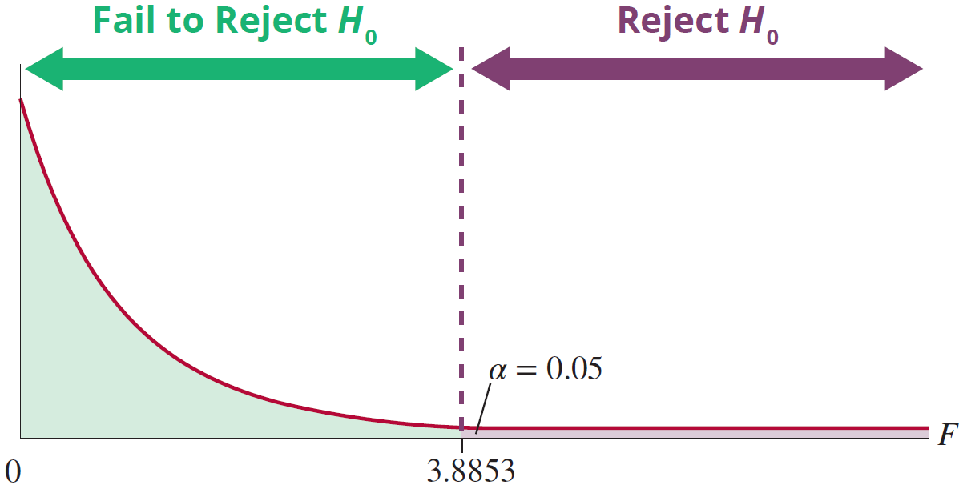
Two-Way ANOVA: The Factorial Design
F-Distribution
numerator df = 2, denominator df = 12
Figure 15.3.6

Slide 33
Two-Way ANOVA: The Factorial Design
To test whether or not age has an effect on average salary, we let the null hypothesis be that the average salary is equal for each of the age levels. The appropriate test statistic, which is the mean square of the age factor divided by the mean square for error, is given by

Slide 34
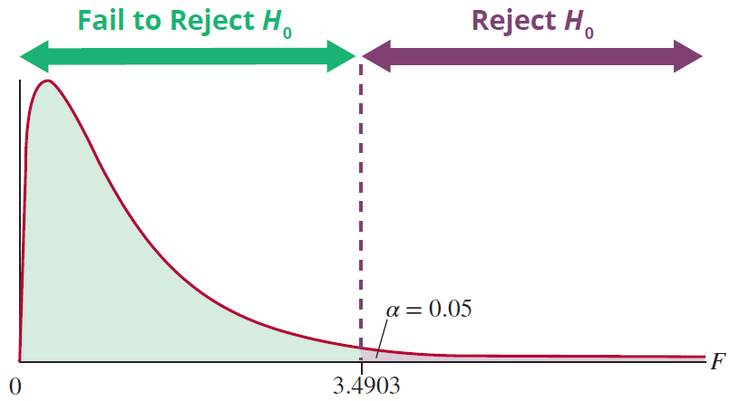
Two-Way ANOVA: The Factorial Design
F-Distribution
numerator df = 3, denominator df = 12
Figure 15.3.7

