Slide 1
Section 16.1
The Chi-Square Distribution

Slide 2
Chi-Square Statistic
Formula
If n observations are randomly selected from a normal population with variance σ ², and s² is computed for the sample, then the chi-square statistic
has a chi-square distribution with n−1 degrees of freedom (df).

Slide 3
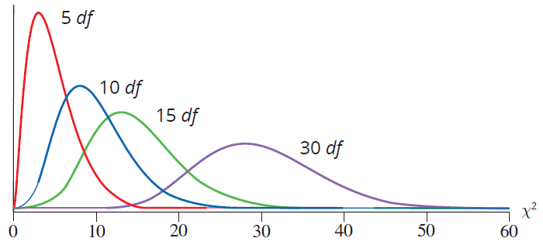
The Chi-Square Distribution
χ ² Distributions
Figure 16.1.1

Slide 4
The Chi-Square Distribution
Chi-Square Distribution Characteristics
Continuous
Not symmetric, very skewed for small values of n
Only takes on values which are nonnegative
Uniquely defined by its degrees of freedom

