Slide 1
Section 16.2
The Chi-Square Test for Goodness of Fit

Slide 2
Chi-Square Test for Goodness of Fit
Definition
The chi-square goodness-of-fit test is a hypothesis test used to determine if an observed frequency distribution follows a specified distribution. It accomplishes this by comparing observed frequencies to expected frequencies based on the specified distribution.

Slide 3
Multinomial Probability Distribution
Definition
The multinomial probability distribution is an extension of the binomial probability distribution to more than two possible outcomes on each trial, each with a constant probability of occurring from trial to trial.

Slide 4
Properties of a Multinomial Experiment
Properties
The experiment consists of n independent, identical trials.
There are k possible outcomes for each trial.
The probability of the k outcomes, p₁, p₂, ..., p_{k} are constant from trial to trial.
The random variables of interest are the counts for each of the k possible outcomes, n₁, n₂, ..., n_{k}.

Slide 5
Chi-Square Test for Goodness of Fit
Procedure
Assumptions:
The conditions for a multinomial random variable are met.
The expected value of n_{i} is at least 5 for each category.
Hypotheses:
H₀: p₁ = p_{1,0}, p₂ = p_{2,0}, … , p_{k} = p_{k,0}
H_{a}: Any possible difference.

Slide 6
Chi-Square Test for Goodness of Fit
Procedure (cont.)
Test Statistic:
where n_{i} is the actual number of observations in each category, and E(n_{i}) is the expected number of observations for each category given that the null hypothesis is true.
Given the assumptions are met, the test statistic has a chi-square distribution with k − 1 degrees of freedom.

Slide 7
Chi-Square Test for Goodness of Fit
Procedure (cont.)
Rejection Region:
Reject H₀ if with k − 1 degrees of freedom.
P-value:
The P-value is the probability of observing a value as extreme or more extreme than the value of the test statistic, given a chi-square distribution with k − 1 degrees of freedom.

Slide 8
Chi-Square Test for Goodness of Fit
Procedure (cont.)
If the computed P-value is less than α, reject the null hypothesis in favor of the alternative.
If the computed P-value is greater than or equal to α, fail to reject the null hypothesis.

Slide 9
Example 16.2.1
SeQuix has been developed for treating kidney disease. It has been found to have the following side effects in patients when taken over a two-month period.
SeQuix
Side Effect | Percent
At least a 5% increase in systolic blood pressure | 50
Less than a 5% change in systolic blood pressure | 40
At least a 5% decrease in systolic blood pressure | 10

Slide 10
Example 16.2.1 (cont.)
A competitor has developed a new drug for treating kidney disease. The competitor hopes the new drug will not have as severe blood pressure side effects as SeQuix. Two hundred and fifty patients are treated with the new drug and their blood pressures are monitored over a two-month period. The following results are observed.

Slide 11
Example 16.2.1 (cont.)
New Drug
Side Effect | Percent
At least a 5% increase in systolic blood pressure | 100
Less than a 5% change in systolic blood pressure | 120
At least a 5% decrease in systolic blood pressure | 30
Can the researchers conclude that there is a difference in systolic blood pressure side effects between SeQuix and the new drug?

Slide 12
Example 16.2.1 (cont.)
Solution
Step 1: Determine the null and alternative hypotheses.
Null Hypothesis: There is no difference in blood pressure side effects between the two drugs.
Alternative Hypothesis: There is a difference in blood pressure side effects between the two drugs.

Slide 13
Example 16.2.1 (cont.)
The variable to be analyzed is Side Effect, which has three possible values: at least a 5% increase in systolic blood pressure, less than a 5% change in systolic blood pressure, and at least a 5% decrease in systolic blood pressure. Further, our interest is in the proportion (or percent) of the patients who fall into each of the blood pressure side effect categories:

Slide 14
Example 16.2.1 (cont.)
p₁ = the proportion of patients with at least a 5% increase in blood pressure,
p₂ = the proportion of patients with less than a 5% change in blood pressure,
p₃ = the proportion of patients with at least a 5% decrease in blood pressure.
The chi-square test for goodness of fit is always a one-sided test because of the way the test statistic is constructed. We will reject the null hypothesis in favor of the alternative hypothesis for large values of the test statistic.

Slide 15
Example 16.2.1 (cont.)
In symbolic notation the resulting hypotheses would be
H₀: p₁ = 0.5, p₂ = 0.4, p₃ = 0.1 No difference in patient’s blood pressure response between the two drugs.
H_{a}: Any possible difference.
Step 2: Specify the significance level α.
The level of the test is not stated in the problem; therefore, we must choose α ourselves.

Slide 16
Example 16.2.1 (cont.)
Let’s assume that the researchers are very concerned about making a Type I error (believing that there is a difference in systolic blood pressure side effects between the two drugs when in fact there is not). Although the choice of α is arbitrary, a reasonable choice might be α = 0.01.

Slide 17

Example 16.2.1 (cont.)
Step 3: Validate the assumptions of the hypothesis testing model, identify the appropriate test statistic and compute its value.
The number of patients falling into a particular category of blood pressure response satisfies the properties of a multinomial experiment.
The expected number of observations in each category is at least five.

Slide 18
Example 16.2.1 (cont.)
Consequently, the chi-square test for goodness of fit can be used to make inferences concerning the difference in proportions. The chi-square test statistic is
This test statistic has a chi-square distribution with 3 − 1 = 2 degrees of freedom, assuming the null hypothesis is true.

Slide 19
Example 16.2.1 (cont.)
Since 250 patients were sampled,
E(n₁) = 250 ⋅ 0.5 = 125,
E(n₂) = 250 ⋅ 0.4 = 100, and
E(n₃) = 250 ⋅ 0.1 = 25.
Thus,

Slide 20
Example 16.2.1 (cont.)
Step 4: Determine the critical value(s) or P-value.
The level of the test is α = 0.01, and we will reject the null hypothesis for large values of the test statistic. Large values of the test statistic would indicate that the proportion of patients falling into a category is so different for at least one category that it could not be due to random chance alone.

Slide 21
Example 16.2.1 (cont.)
As shown the following figure, the chi-square critical
value is with 2 degrees of freedom or 9.210. Any value of the test statistic larger than the critical value will be considered too large to be due to ordinary sampling variation.

Slide 22
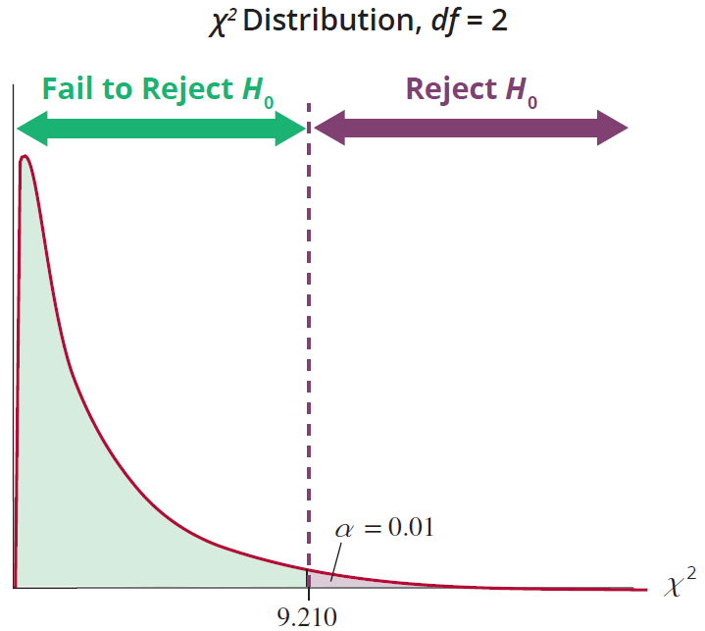
Example 16.2.1 (cont.)
The P-value for a test statistic value of 10 and degrees of freedom equal to 2 is approximately 0.0067.

Slide 23
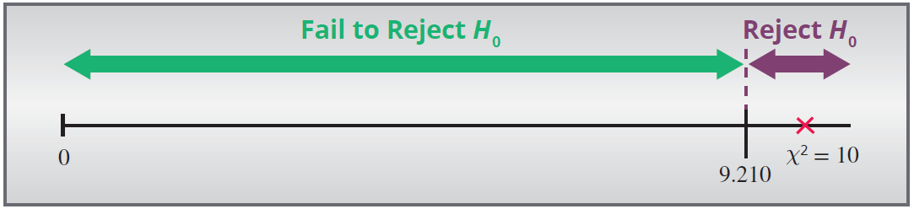
Example 16.2.1 (cont.)
Step 5: Make the decision to reject or fail to reject H₀.
Since the test statistic falls in the rejection region (10 is greater than 9.210) the null hypothesis should be rejected.

Slide 24
Example 16.2.1 (cont.)
Likewise, using the P-value method the null hypothesis would be rejected since 0.0067 is less than α = 0.01.
Step 6: State the conclusion in terms of the original data.
There is sufficient evidence to conclude at α = 0.01 that there is a difference in systolic blood pressure side effects between SeQuix and the new drug.

Slide 25
Example 16.2.1 (cont.)
Caution
It may be tempting to conclude that the new drug actually results in less of an increase in blood pressure than SeQuix or that the new drug actually decreases blood pressure. These conclusions would not be valid given that we were testing for any difference in categories. A new test would need to be performed to determine if the new hypothesis is supported by the data.

Slide 26
Example 16.2.2
The ABC Distribution company prints sports trading cards. Their 2017 baseball set contains 100 cards and is claimed to contain approximately an equal percentage of four card types: rookies, veterans, All-Stars, and Hall of Famers. A customer recently ordered a set and reported the actual frequency of cards of each type. The chi-square test for goodness of fit can be used to answer the question of whether or not the company’s claim is correct. Using α = 0.10, determine if the distribution of the four types of cards is approximately the same in the set the customer ordered.

Slide 27
Example 16.2.2 (cont.)
Card Type | Claim Frequency | Actual Frequency
Rookie | 25 | 23
Veteran | 25 | 28
All-Star | 25 | 27
Hall of Famer | 25 | 22
(Since there are 100 cards in the set, the claim of an equal distribution of the four types would result in 25 cards of each type.)

Slide 28
Example 16.2.2 (cont.)
Solution
Step 1: Determine the null and alternative hypotheses.
Null hypothesis: The proportion of the four card types in the set is the same.
Alternative hypothesis: The proportion of the four card types in the set is not the same.
Here we are interested in the proportion of each of the types of cards.
p₁ = the proportion of rookie cards in the set
p₂ = the proportion of veteran cards in the set
p₃ = the proportion of All-Star cards in the set
p₄ = the proportion of Hall of Famer cards in the set

Slide 29
Example 16.2.2 (cont.)
In symbolic notation, the resulting hypotheses would be
H₀: p₁ = p₂ = p₃ = p₄ = 0.25. The proportion of the four card types in the set is the same.
H_{a}: Any possible difference.
Step 2: Specify the significance level α.
The level of the test is specified in the statement of the problem as α = 0.10.

Slide 30

Example 16.2.2 (cont.)
Step 3: Validate the assumptions of the hypothesis testing model, identify the appropriate test statistic and compute its value.
The number of cards of each type of baseball card satisfies the properties of a multinomial probability distribution.
The expected number of observations in each category is at least 5.
Thus, we can use the chi-square test for goodness of fit.

Slide 31
Example 16.2.2 (cont.)
The chi-square test statistic is given by,
This test statistic has an approximate chi-square distribution with (4 − 1) = 3 degrees of freedom, assuming the null hypothesis is true.
Our test statistic would be calculated as

Slide 32
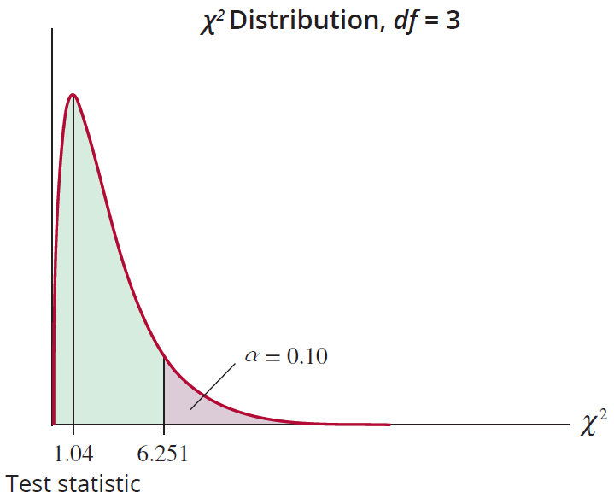
Example 16.2.2 (cont.)
Step 4: Determine the critical value(s) or P-value.

Slide 33
Example 16.2.2 (cont.)
Since the test level is α = 0.10 and we reject the null hypothesis for large values of the test statistic, the chi-
square critical value is with 3 degrees of freedom or 6.251.
Using technology, the P-value for the test statistic of 1.04 with degrees of freedom equal to 3 is 0.7916.

Slide 34
Example 16.2.2 (cont.)
Step 5: Make the decision to reject or fail to reject H₀.
If the null hypothesis is true, the test statistic will be larger than the critical value 6.251 only 10% of the
time. Since is not larger than 6.251, we fail to reject H₀.
The P-value is much larger than α = 0.10, so we fail to reject the null hypothesis.

Slide 35
Example 16.2.2 (cont.)
Step 6: State the conclusion in terms of the original problem.
At the 0.10 level, there is insufficient evidence to conclude that the distribution of the card types in the set differs from the company claim that the proportion of each card type is approximately equal.

