Slide 1
Section 16.3
The Chi-Square Test for Association

Slide 2
Contingency Table (or Two-Way Frequency Table)
Definition
A contingency table organizes data on two characteristics simultaneously. Each cell in a contingency table contains either a count or a proportion which represents the number of observations falling into that cell. It is important to note that contingency tables are composed of two variables which each satisfy the properties of the multinomial distribution.

Slide 3
Chi-Square Test for Association
Procedure
Assumptions:
The conditions for a multinomial random variable are met for both variables.
The expected value of n_{i} is at least 5 for each category.

Slide 4
Chi-Square Test for Association
Procedure (cont.)
Hypotheses:
H₀: The two qualitative variables are independent (not related).
H_{a}: The two qualitative variables are dependent (related).

Slide 5
Chi-Square Test for Association
Procedure (cont.)
Test Statistic:
where r = the number of rows, c = the number of
columns.

Slide 6
Chi-Square Test for Association
Procedure (cont.)
where n is the total number of
observations and and are estimates of the true population proportions, p_{i} and p_{j}, calculated as follows:

Slide 7
Chi-Square Test for Association
Procedure (cont.)
If the null hypothesis is true and n is large enough so that the expected number of observations in each cell is at least 5, then the test statistic has an approximate chi-square distribution with (r − 1)(c − 1) degrees of freedom.
Rejection Region:
Reject H₀ if with (r − 1)(c − 1) degrees of freedom.

Slide 8
Chi-Square Test for Association
Procedure (cont.)
P-value:
The P-value is the probability of observing a value as extreme or more extreme than the value of the test statistic, given a chi-square distribution with (r − 1)(c − 1) degrees of freedom.
If the computed P-value is less than α, reject the null hypothesis in favor of the alternative.
If the computed P-value is greater than or equal to α, fail to reject the null hypothesis.

Slide 9
Note
Note
An alternate way to calculate the expected cell frequencies is given by

Slide 10
Example 16.3.1
Consider a particular question from the Quinnipiac University poll. The Quinnipiac University poll is often used as a barometer of public opinion regarding matters of public concern.
The question: Would you support or oppose raising the national minimum wage?
For those who responded to the question, the results of the poll are presented in the table below.

Slide 11
Example 16.3.1
Based on the data can we conclude that support for raising the national minimum wage is dependent on political affiliation or is political affiliation independent of support for raising the minimum wage?
Raising the National Minimum Wage
Political Affiliation | Yes | No | Total
Republican | 208 | 193 | 401
Democrat | 387 | 30 | 416
Independent | 476 | 193 | 669
Total | 1071 | 416 | 1487

Slide 12
Example 16.3.1 (cont.)
Solution
Step 1: Determine the null and alternative hypotheses.
For this example, we are interested in the proportion of the respondents who fall into each of the Support for National Minimum Wage and Political Affiliation categories.
The chi-square test for association between two variables is always a one-sided test because of the way we construct the test statistic. We will reject the null hypothesis for large values of the test statistic.

Slide 13
Example 16.3.1 (cont.)
The resulting hypotheses would be
H₀: Support for raising the national minimum wage and political affiliation are independent (not related).
H_{a}: Support for raising the national minimum wage and political affiliation are dependent (related).
Step 2: Specify the significance level α.
We must specify the level of the test ourselves since we are not given one in the problem. Let’s choose α = 0.10.

Slide 14
Example 16.3.1 (cont.)
Step 3: Validate the assumptions of the hypothesis testing model, identify the appropriate test statistic and compute its value.
Each respondent was not allowed to respond to more than one category (multinomial random variables).
The expected cell count for each category is greater than 5.

Slide 15
Example 16.3.1 (cont.)
We can use the chi-square test for association. Our test statistic is the chi-square test statistic with (3 − 1)(2 − 1) = 2 degrees of freedom. The formula for the test statistic is given as follows.

Slide 16
Example 16.3.1 (cont.)
The table below gives the actual responses in each category versus the expected responses in each category.
Raising the National Minimum Wage
 | Yes |  | No
Political Affiliation | Actual | Expected | Actual | Expected
Republican | 208 | 288.82 | 193 | 112.18
Democrat | 387 | 299.62 | 30 | 116.38
Independent | 476 | 481.84 | 193 | 187.16

Slide 17
Example 16.3.1 (cont.)
Based on these results the test statistic is calculated as follows.

Slide 18
Example 16.3.1 (cont.)
Step 4: Determine the critical value(s) or P-value.
Since the level of the test is α = 0.10 and we will reject the null hypothesis for large values of the test statistic, the chi-square critical value is with 2 degrees of freedom or 4.605. Values of the test statistic larger than 4.605 would indicate that the apparent dependence of the two classifications could not be due to ordinary sampling variation alone.

Slide 19
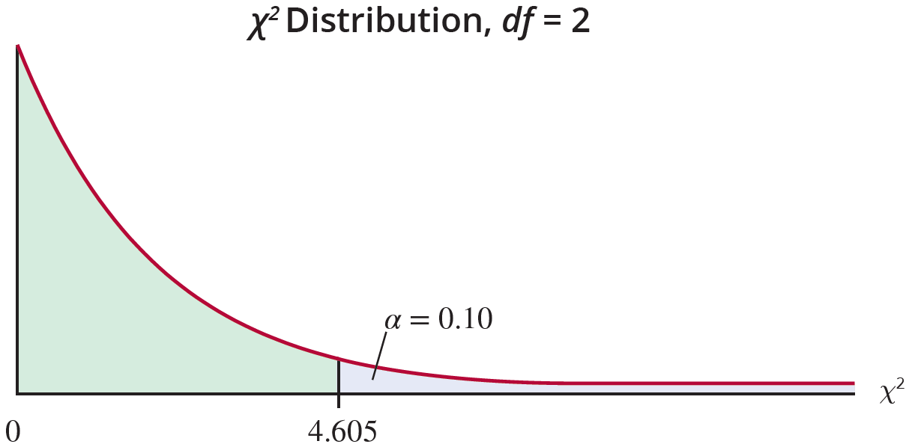
Example 16.3.1 (cont.)
Using technology we obtain a test statistic of 170.467 (slightly different from our calculated value due to our intermediate rounding), and find that the P-value is essentially zero.

Slide 20
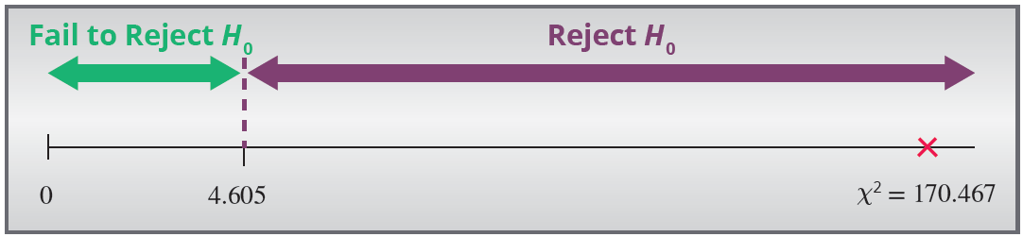
Example 16.3.1 (cont.)
Step 5: Make the decision to reject or fail to reject H₀.
Since the test statistic falls in the rejection region, the null hypothesis should be rejected.
Since the P-value, which is approximately 0, is less than α = 0.10, we also reject H₀ using the P-value method.

Slide 21
Example 16.3.1 (cont.)
Step 6: State the conclusion in terms of the original problem.
There is evidence at the 0.10 level to conclude that support for raising the national minimum wage and political affiliation are dependent. The difference in support is too great to believe it to be attributed to ordinary sampling variation alone.

