Slide 1
Section 17.4
The Rank Correlation Test

Slide 2
The Rank Correlation Test
Procedure
Assumptions:
Pairs of data have been selected in a random fashion.
Data are quantitative.
There are no ties in the rank data.

Slide 3
The Rank Correlation Test
Procedure (cont.)
Hypothesis:
H₀: ρ = 0 There is no correlation between the two variables.
H_{a}: ρ ≠ 0 There is a correlation between the two variables.

Slide 4
The Rank Correlation Test
Procedure (cont.)
Test Statistic:
where
and n = the total number of pairs of data.

Slide 5
The Rank Correlation Test
Procedure (cont.)
Critical Values:
If n ≤ 30,
Reject if |r_{s}| is greater than the critical value in the table for the Rank Correlation Test.
If n > 30,
Reject if

Slide 6
Example 17.4.1
Consider the given data set.
Original Data
X | 7 | 5 | 8 | 9
Y | 4 | 7 | 9 | 8
Converting the data to ranks, we obtain:
Ranked Data
X | R(X) | Y | R(Y)
7 | 2 | 4 | 1
5 | 1 | 7 | 2
8 | 3 | 9 | 4
9 | 4 | 8 | 3

Slide 7
Example 17.4.1 (cont.)
The value of r_{s} is then given by

Slide 8
The Rank Correlation Test
We want to test the null hypothesis that there is no correlation between the two variables against the alternative hypothesis that there is a correlation. More specifically, we test
H₀: ρ = 0 There is no correlation between the two variables.
H_{a}: ρ ≠ 0 There is a correlation between the two variables.

Slide 9
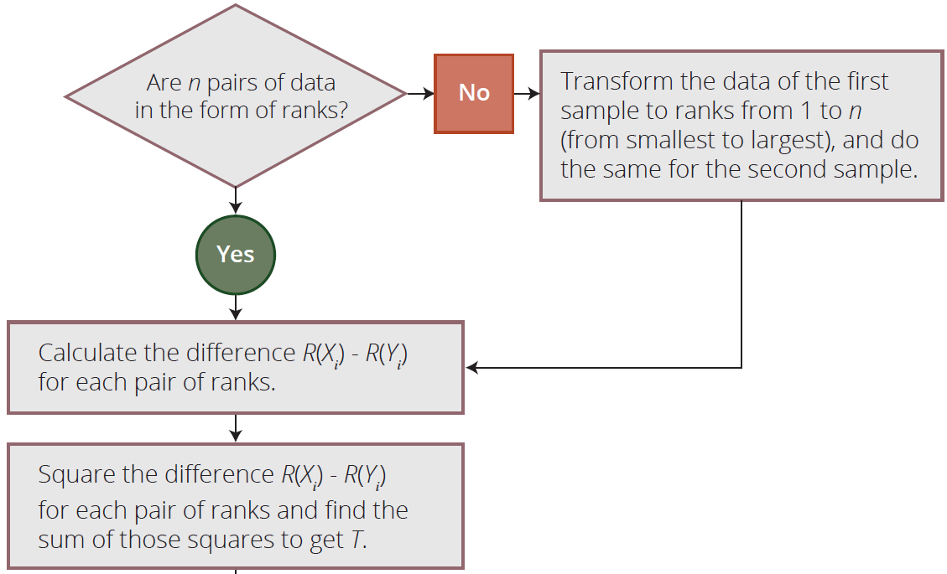
Rank Correlation Procedure

Slide 10
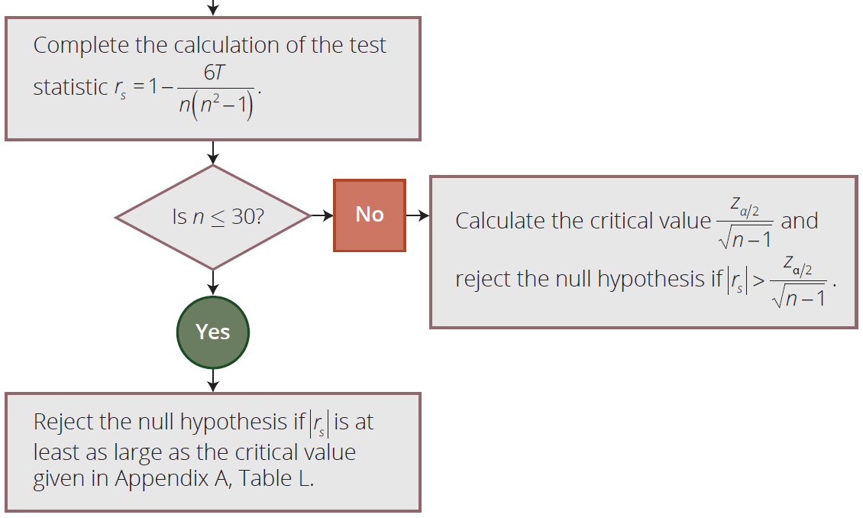
Rank Correlation Procedure

Slide 11
Measure of Correlation
Note
The advantage of Spearman’s rank correlation coefficient is that it can be used to test for a monotonic, nonlinear relationship, i.e., y increases as x increases or y decreases as x increases, but not necessarily linearly.

Slide 12
Example 17.4.2
The academic performances of fifteen college graduates are observed to examine the relationship between their SAT scores and their GPAs. The SAT scores and the GPAs are given in the following table.

Slide 13
Example 17.4.2 (cont.)
Student | SAT Total | College GPA | Student | SAT Total | College GPA
1 | 1064 | 2.52 | 9 | 1122 | 2.59
2 | 1085 | 2.74 | 10 | 1163 | 3.20
3 | 1270 | 2.76 | 11 | 1187 | 3.21
4 | 1093 | 2.83 | 12 | 1302 | 3.39
5 | 1170 | 2.91 | 13 | 1044 | 3.41
6 | 1135 | 2.40 | 14 | 1234 | 3.42
7 | 1262 | 3.08 | 15 | 1316 | 3.47
8 | 1074 | 3.17
Test the hypothesis that there is no relationship between the variables at the α = 0.10 level.

Slide 14
Example 17.4.2 (cont.)
Solution
In order to test whether an association exists between these two variables at α = 0.10, we prepare the following table.
H₀: ρ = 0
H_{a}: ρ ≠ 0

Slide 15
Example 17.4.2 (cont.)
Student | SAT Total (X) | College GPA (Y) | R(X) | R(Y) | [R(X) − R(Y)]²
1 | 1064 | 2.52 | 2 | 2 | 0
2 | 1085 | 2.74 | 4 | 4 | 0
3 | 1270 | 2.76 | 13 | 5 | 64
4 | 1093 | 2.83 | 5 | 6 | 1
5 | 1170 | 2.91 | 9 | 7 | 4
6 | 1135 | 2.40 | 7 | 1 | 36
7 | 1262 | 3.08 | 12 | 8 | 16
8 | 1074 | 3.17 | 3 | 9 | 36
9 | 1122 | 2.59 | 6 | 3 | 9
10 | 1163 | 3.20 | 8 | 10 | 4
11 | 1187 | 3.21 | 10 | 11 | 1
12 | 1302 | 3.39 | 14 | 12 | 4
13 | 1044 | 3.41 | 1 | 13 | 144
14 | 1234 | 3.42 | 11 | 14 | 9
15 | 1316 | 3.47 | 15 | 15 | 0

Slide 16
Example 17.4.2 (cont.)
We then calculate the test statistic
Since our sample size is
15 (n ≤ 30), the value of the statistic is compared with the critical value obtained using Appendix A Table L.
n | ... | α = 0.10 | α = 0.05 | α = 0.02
11 |  | 0.523 0.497 0.475 0.457 | 0.623 | 0.736
12 |  |  | 0.591 | 0.703
13 |  |  | 0.566 | 0.673
14 |  |  | 0.545 | 0.646
15 |  | 0.441 | 0.525 | 0.623

Slide 17
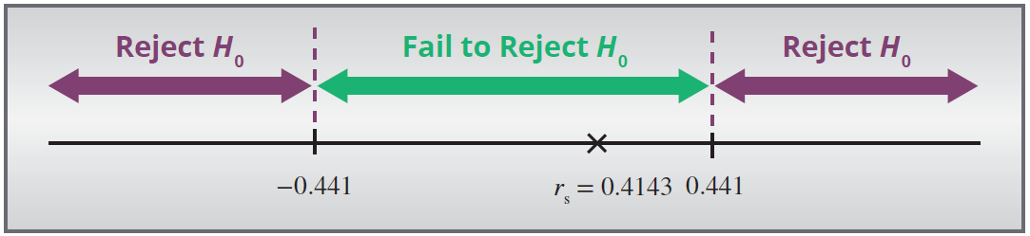
Example 17.4.2 (cont.)
Note: Table L in Appendix A is constructed for a two-tailed test. So, we want to reject H₀ if r_{s} < −0.441 or r_{s} > 0.441. Since 0.4143 < 0.441, we fail to reject the null hypothesis at the 10% level of significance. Hence, there does not seem to be an association between SAT scores and GPAs.

