Slide 1
Section 17.5
The Runs Test for Randomness

Slide 2
Test Procedure for the Runs Test for Randomness
Procedure
Assumptions:
The data consists of an ordered sequence of two events.
For numerical data, the values in the ordered sequence will be compared to the median of the data, with values above the median categorized as A and values below the median categorized as B. Eliminate any values that equal the median.

Slide 3
Test Procedure for the Runs Test for Randomness
Procedure (cont.)
Hypothesis:
H₀: The sequence is random.
H_{a}: The sequence is not random.

Slide 4
Test Procedure for the Runs Test for Randomness
Procedure (cont.)
Test Statistic:
If m and n are both less than or equal to 20 and α = 0.05, then the test statistic is R, the number of runs.
If either m or n is greater than 20, then the test statistic is

Slide 5
Test Procedure for the Runs Test for Randomness
Procedure (cont.)
where N is the number of ordered observations,

Slide 6
Test Procedure for the Runs Test for Randomness
Procedure (cont.)
Critical Values:
If m and n are both less than or equal to 20 and α = 0.05,
Reject if R is in the two-sided rejection region defined by the critical values in the table for the Runs Test.
If either m or n is greater than 20,
Reject if where is a critical value from
the standard normal table.

Slide 7
Example 17.5.1
Let us apply the runs test for randomness to each of the sequences of heads and tails seen earlier in this section. In each test the hypotheses are as follows.
H₀: The sequence is random.
H_{a}: The sequence is not random.

Slide 8
Example 17.5.1 (cont.)
H H H H H T T T T T T T T T T H H H H H
Solution
N (the number of observations) = 20
m (the number of heads) = n (the number of tails) = 10
R (the number of runs) = 3
Using Appendix A Table M we see that r ≤ 6 or r ≥ 16 at 0.05 level of significance. Therefore, we conclude that there is strong evidence of nonrandomness.

Slide 9
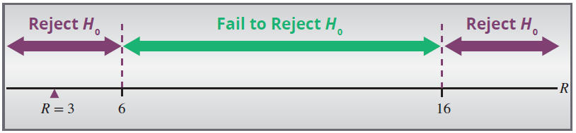
Example 17.5.1 (cont.)

Slide 10
Example 17.5.1 (cont.)
H T H T H T H T H T H T H T H T H T H T
Solution
N (the number of observations) = 20
m (the number of heads) = n (the number of tails) = 10
R (the number of runs) = 20
Using Appendix A Table M we see that r ≤ 6 or r ≥ 16 at 0.05 level of significance. Therefore, we conclude that there is strong evidence of nonrandomness.

Slide 11
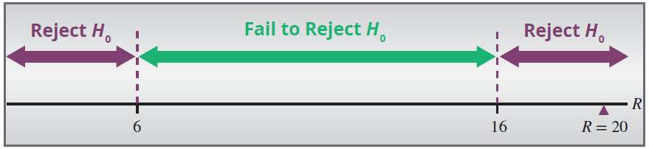
Example 17.5.1 (cont.)

Slide 12
Example 17.5.1 (cont.)
H H T H T T T H T H H T H T H H H T T H
Solution
N (the number of observations) = 20
m (the number of heads) = 11
n (the number of tails) = 9
R (the number of runs) = 13
Using Appendix A Table M we see that r ≤ 6 or r ≥ 16 at 0.05 level of significance. Therefore, we conclude that there is no evidence of nonrandomness.

Slide 13
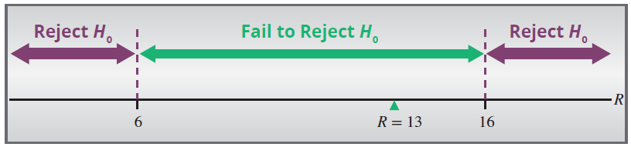
Example 17.5.1 (cont.)

Slide 14
Example 17.5.2
The Admissions Office of a college records the gender of the first 28 applicants in the order their applications arrive. The data set is given as
M F F M M M F F F F M M M M M M M M M M F M M M M M M M.
Is this sequence random? Test at the 0.05 level.

Slide 15
Example 17.5.2 (cont.)
Solution
To test the randomness of this sequence at a 5% level of significance, we obtain
N (the number of observations) = 28
m (the number of males) = 21
n (the number of females) = 7
R (the number of runs) = 7

Slide 16
Example 17.5.2 (cont.)
Since m > 20, we calculate

Slide 17
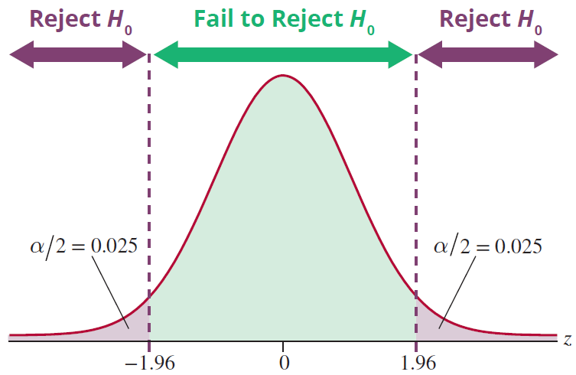
Example 17.5.2 (cont.)
Thus,

Slide 18
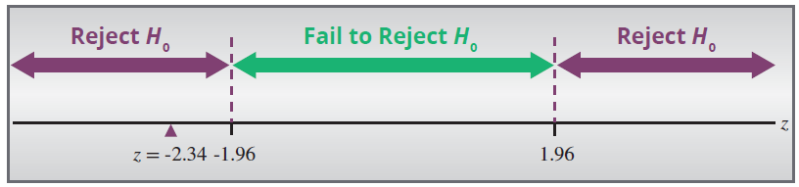
Example 17.5.2 (cont.)
Since the test statistic is in the rejection region, reject the null hypothesis that the gender of arriving students follow a random sequence.

Slide 19
Example 17.5.3
Is the following data random?
16, 25, 52, 11, 38, 47, 12, 98, 4
Solution
How do you test randomness with a numerical set? Create a new data set comparing each value to the median value. To do this, substitute each value in the original data set with an A if it is above the median value, a B if it is below the median value, and eliminate any values that equal the median.

Slide 20
Example 17.5.3 (cont.)
H₀: The data is random.
H_{a}: The data is not random.
Median = 25
16, 25, 52, 11, 38, 47, 12, 98, 4
B, Ø, A, B, A, A, B, A, B
m (the number of A’s) = 4
n (the number of B’s) = 4
R (the number of runs) = 7
critical values = 1,…, 9

Slide 21
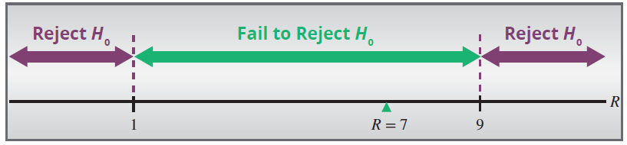
Example 17.5.3 (cont.)
Fail to reject H₀; there is no evidence of nonrandomness.

