Slide 1
Section 2.1
The Lords of Data

Slide 2
The Scientific Method
Procedure
Gather information about the phenomenon being studied;
On the basis of the data, formulate a preliminary generalization or hypothesis;
Collect further data to test the hypothesis;
If the data and other subsequent experiments support the hypothesis, it becomes a law.

Slide 3
Confounding Variables
Definition
Confounding variables are “extra” variables that are not accounted for during experimentation and can cause results to become skewed.

Slide 4
Decision-Making Method
Procedure
Clearly define the problem and any influential variables.
Decide upon objectives and decision criteria for choosing a solution.
Create alternative solutions.
Compare alternatives using the criteria established in the second step.

Slide 5
Decision-Making Method
Procedure (cont.)
Implement the chosen alternative.
Check the results to make sure the desired results are achieved.

Slide 6
Collecting Data
Essentially, there are two ways to obtain data: observation and controlled experiments.
The data collection method is related to the nature of the problem to be solved and the ethical and practical constraints of collecting data in some environment.

Slide 7
Collecting Data
Caution
The conclusions suggested by statistics can be no stronger than the quality of the measurements which produced the statistical evidence. Fuzzy or confounded measurements must produce fragile conclusions.

Slide 8
Response Variable
Definition
A response variable measures the outcome of interest in a study.

Slide 9
Explanatory Variable
Definition
An explanatory variable causes or explains changes in a response variable.

Slide 10
Example 2.1.1
Suppose a new species of tomato has been genetically engineered to increase yields. How can we measure whether the new species produces higher yields?
Solution
In this experimental design, the plots of tomatoes will be divided into two groups, one that contains the new species and another that contains the unaltered variety. The plots containing the genetically engineered variety will be the treatment group, and the plots containing the standard variety will be the control group.

Slide 11
Example 2.1.1 (cont.)
If the experiment is properly performed, any change in the response variable (yield) can be attributed to the explanatory variable (genetic engineering) and not to other variables that are controlled.
Variables like rainfall, amount of sunshine, or type of soil can affect the yield of tomatoes. These variables must be controlled in the experiment so that differences in yields between plots can be attributed just to the genetically-engineered species.

Slide 12
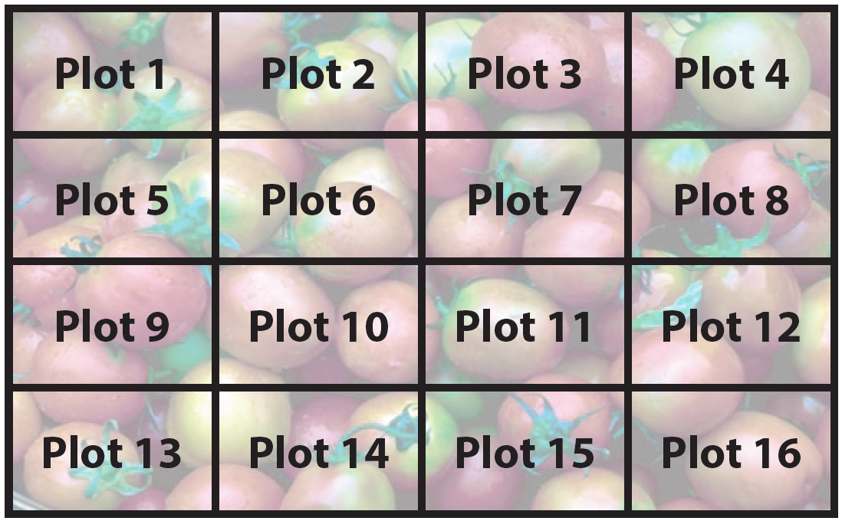
Example 2.1.1 (cont.)
One possible method of controlling for these variables is to create small plots in the same field all with similar soil types.

Slide 13
Example 2.1.1 (cont.)
Several plots of each type of tomato are planted. Each plot contains only one type of tomato. Rainfall is measured and supplemented with irrigation to assure that each plot has the same amount of water. By controlling for these variables in this manner, we can say that any differences noted in the yield (response variable) between the genetically-engineered variety (treatment group) and the unaltered variety (control group) is due to genetic improvements (explanatory variable).

Slide 14
Example 2.1.2
Does an SAT preparation course improve performance on the SAT?
Solution
A group of high school students take the SAT. Then they are given an SAT preparation course. They retake the SAT. If the group’s second SAT performance improves, then it may be related to the SAT preparation course.
Explanatory variable: SAT preparation course
Response variable: SAT scores

Slide 15
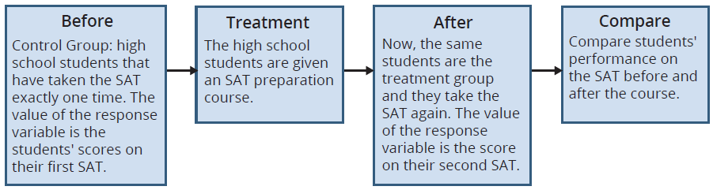
Example 2.1.2 (cont.)
In this experiment there is only one group of students. Suppose there were two groups of students, one that had taken the course (treatment group) and one that had not (the control group). Could you assign any difference in results solely to the SAT preparation course?

Slide 16
Example 2.1.2 (cont.)
Because of potential differences in the cognitive abilities of the two groups of students, this experiment would be much more vulnerable to the justifiable criticism that the differences in student cognitive ability caused the difference in the group’s SAT performance rather than the SAT preparation course. However, by using the before and after method we have only one group of students and cognitive ability is controlled.

Slide 17
Placebos
Definition
A placebo is a fake treatment that has the potential to cause a response.

Slide 18
Double-Blind Study
Definition
Double-blind studies are used to counteract the placebo effect. In a double-blind study the subjects are not told whether they are members of the treatment group or the control group. The evaluators (the persons that measure the response variable) are not told whether their subjects are members of the control or experimental group.

Slide 19
Bias
Definition
Bias is the tendency to overestimate or underestimate the value of a certain population parameter.

