Slide 1
Section 2.3
Time Series Data vs. Cross-Sectional Data

Slide 2
Time Series
Definition
Time series data originates as measurements usually taken from some process over equally spaced intervals of time.

Slide 3
Example 2.3.1
A batting average represents the percentage of the time a player gets on base as a result of a hit. In major league baseball the better players have batting averages between .300 and .400, which means they get on base as a result of a hit between 30% and 40% of the time.
The following table is a list of the batting average champions of the American League since 1970.

Slide 4
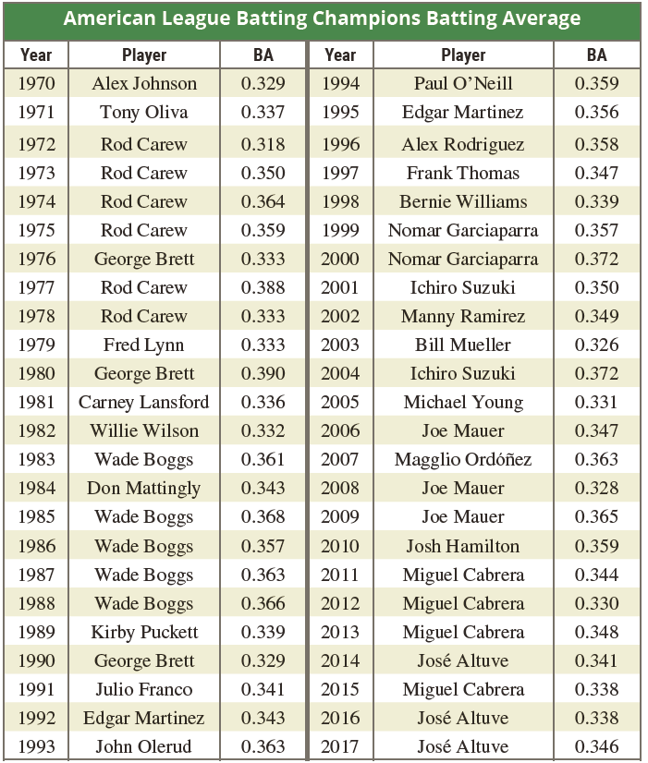
Example 2.3.1 (cont.)
Baseball-reference.com

Slide 5
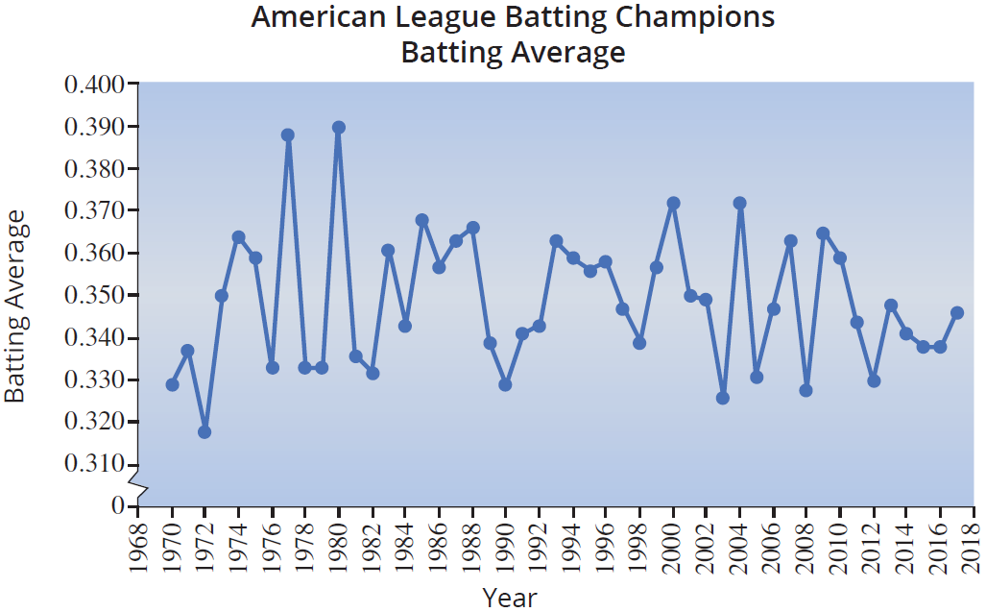
Example 2.3.1 (cont.)

Slide 6
Example 2.3.1 (cont.)
Glancing at a plot of the data suggests the conditions for stationary seem to be met. The time series seems to be wobbling around a central value and the dispersion around the central value is reasonably constant throughout the series. Thus, the series appears to be stationary.

Slide 7
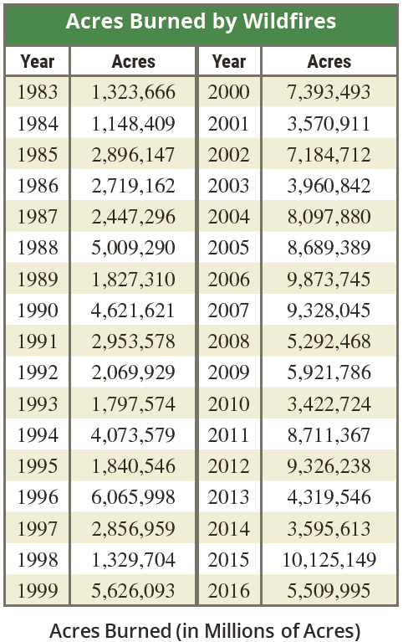
Example 2.3.2
Look at the wildfire data in the given table.
National Interagency Fire Center

Slide 8
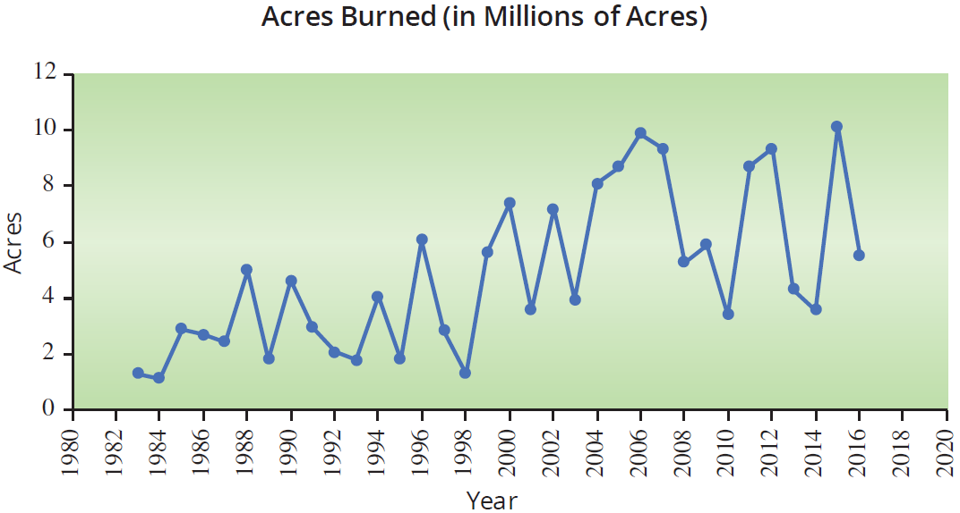
Example 2.3.2 (cont.)
The variation in the data seems to be increasing over time, and the central value around which those variations occur is also increasing. Thus the series seems to meet the conditions of a nonstationary series.

Slide 9
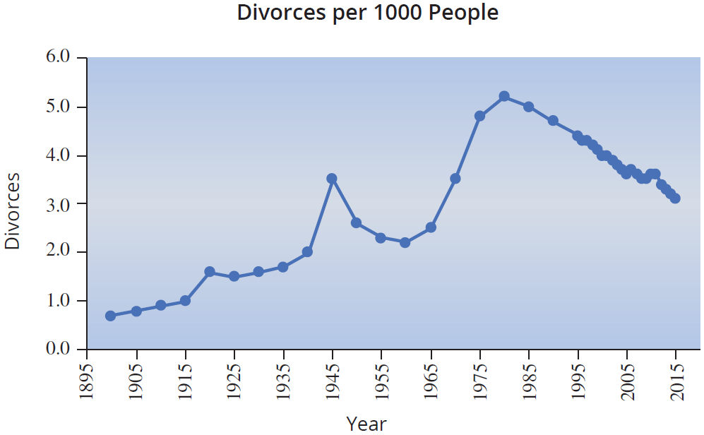
Example 2.3.3
Look at the divorce rate data below.

Slide 10
Example 2.3.3 (cont.)
The graphed data suggests that there is strong evidence of an upward trend until about 1980, and then the data begins to trend downward after 1980. However, the data never seems to gravitate towards a central value, thus the time series is nonstationary.

Slide 11
Example 2.3.4
The U.S. is a large country that depends greatly on the use of automobiles for transportation. Let’s look at the data on automobile registration and see if there are any trends.

Slide 12
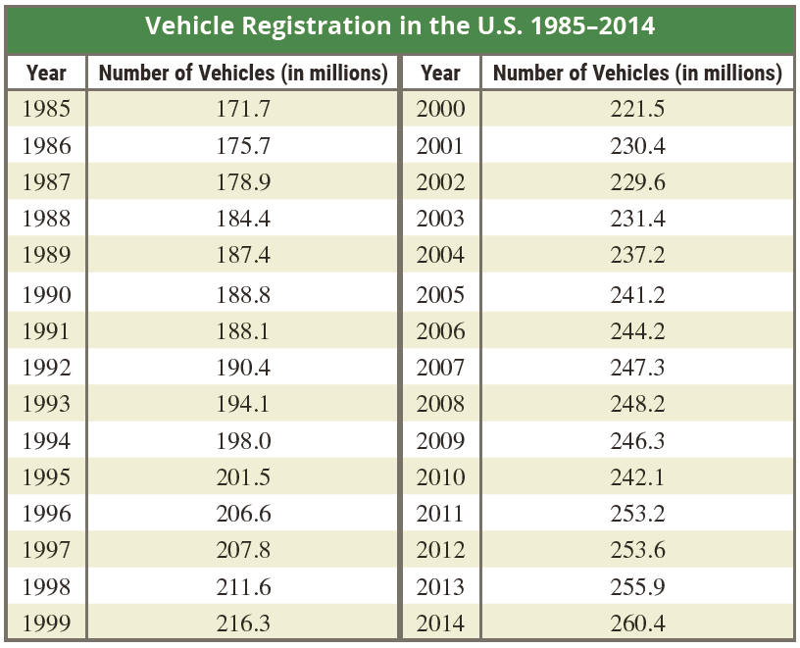
Example 2.3.4 (cont.)

Slide 13
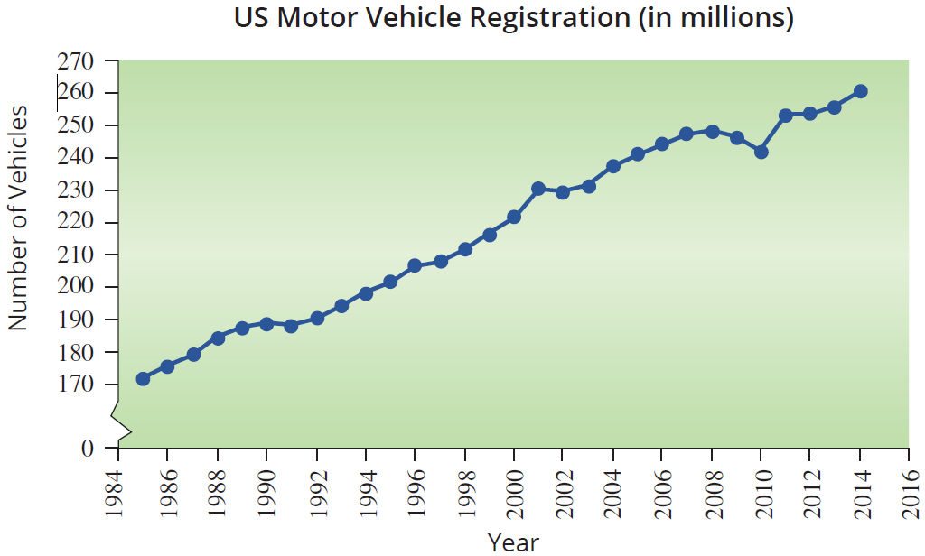
Example 2.3.4 (cont.)
The graph reveals an obvious upward trend in vehicle registration. The trend is probably attributable to population increases during the period.

Slide 14
Cross-Sectional Data
Definition
Cross-sectional data are measurements created at approximately the same period of time.

