Slide 1
Section 3.2
Displaying Qualitative Data Graphically

Slide 2
Bar Chart
Definition
The bar chart is a simple graphical display in which the length of each bar corresponds to the number of observations in a category.

Slide 3
The Aesthetics of Bar Chart Construction
Bar charts can be constructed horizontally or vertically.
If the categories have some associated order, they maintain that order in the bar chart.
Miscellaneous or “other” categories should be listed at the bottom of the chart (if oriented horizontally) or at the far right (if oriented vertically).
The difference in bar length is the principal visual feature in comparing differences in category amounts.

Slide 4
The Aesthetics of Bar Chart Construction
Bar widths should be chosen that are pleasing visually and should not be allowed to vary within a particular chart.
Appropriate shading, crosshatching, and coloring of the bars can help in presenting the data.
The spacing between bars can dramatically affect the perception of the graph.
Gridlines extended into the body of the chart are often useful and may be included if deemed helpful.

Slide 5
The Aesthetics of Bar Chart Construction
If there is sufficient room on the graphs, labels should be provided for each bar (category) and for each axis.
Notes on sources of data or other footnotes should be given below the chart.

Slide 6
The Aesthetics of Bar Chart Construction
Scales for the axes should be chosen that will most effectively allow for the desired comparisons.
Unless there is a good reason, the axis used to measure the bars should start at zero. Otherwise, the axis can be stretched to exaggerate differences in the bar lengths.

Slide 7
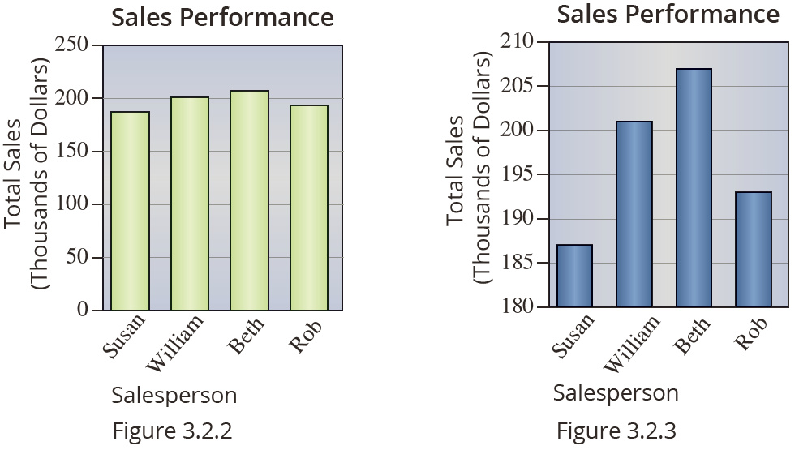
The Aesthetics of Bar Chart Construction
Figures 3.2.2 and 3.2.3 are plots of the same data.

Slide 8
Pareto Chart
Definition
The Pareto chart is a bar graph whose bars are
arranged in decreasing order of frequency.

Slide 9
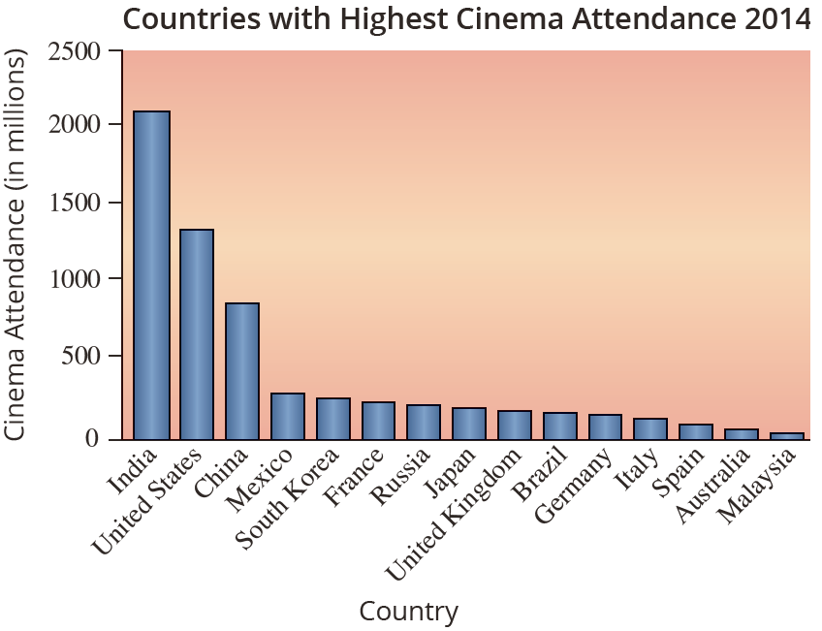
Pareto Chart
The following Pareto chart shows the cinema attendance in 2014 for 15 selected countries.
The Economist: Pocket World in Figures 201 Edition

Slide 10
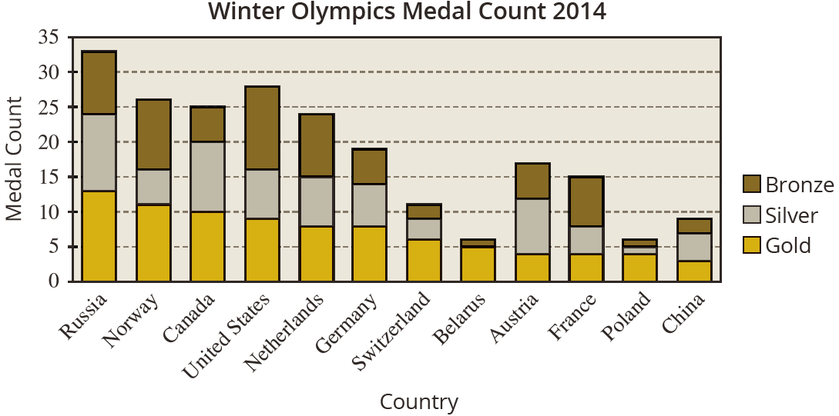
Stacked Bar Charts
Stacked bar charts are an interesting variation on the standard bar chart.

Slide 11
Pie Chart
Definition
A pie chart (or circle graph) is a graph used to display categorical data as slices of a circle. The size of each slice is proportional to the amount or frequency in each category. The proportion of the total that each slice represents is often displayed as a percentage on the chart. These percentages should total 100%.

Slide 12
Pie Chart
The circle represents the total “pie” available, and the slices are proportional to the amount in each category.
One of the advantages of the pie chart is the ability to easily compare the total in each of the classifications to the total number of observations.

Slide 13
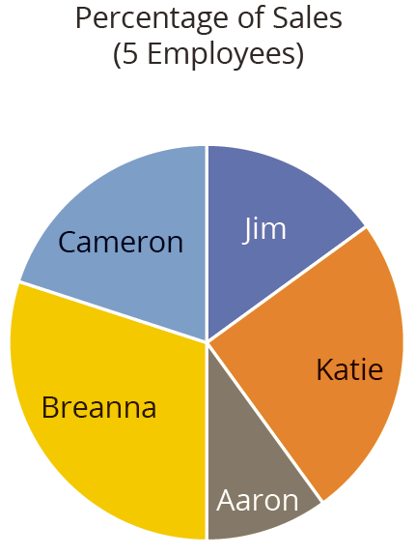
Pie Chart

Slide 14
Pie Chart
Although pie charts are useful displays of categorical data, they have their limitations.
Once the number of categories rises above ten, the information conveyed by a pie chart is less meaningful. As Figure 3.2.11 and Figure 3.2.12 demonstrate, when the number of employees increases from 5 to 40, using a pie chart to show the percentage of sales for each employee is not as informative.

Slide 15
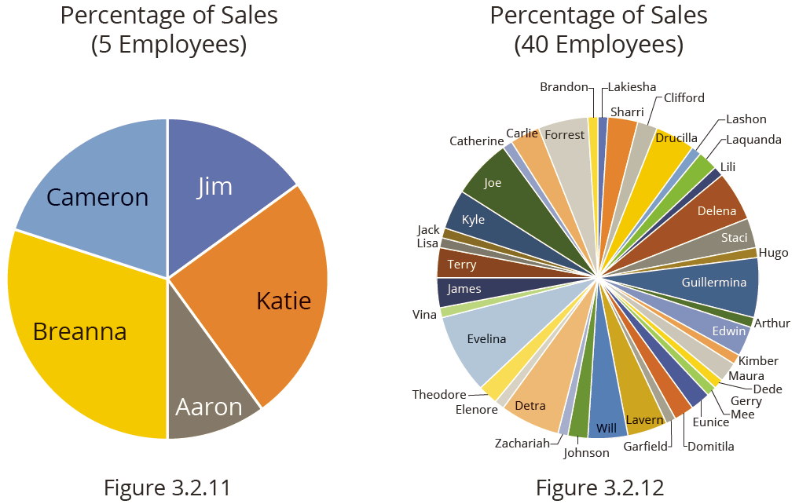
Pie Chart

