Slide 1
Section 3.4
Histograms and Other Graphical Displays of Quantitative Data

Slide 2
Histogram
Definition
A histogram is a graphical representation of a frequency or relative frequency distribution. The horizontal scale corresponds to classes of quantitative data values and the vertical scale corresponds to the frequency or relative frequency of each class.

Slide 3
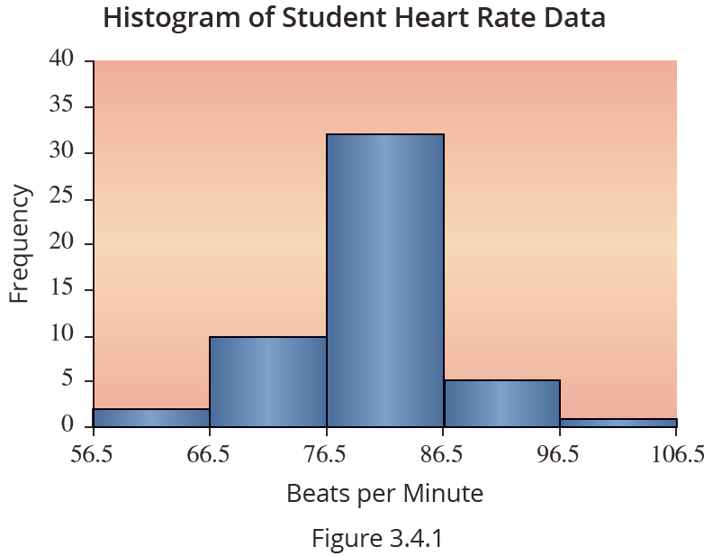
Sample Histogram

Slide 4
Symmetric vs. Skewed
Definition
If you split the histogram of a distribution down the center, and the left and right sides of the histogram are approximately mirror images of one another, the distribution is said to be symmetric.
A skewed distribution is a nonsymmetric (or asymmetric) distribution that extends more to one side than the other. The distribution is said to be skewed to the right (or positively skewed) if the tail to the right of the peak of the distribution is longer than the tail to the

Slide 5
Symmetric vs. Skewed
Definition (cont.)
left of the peak. The distribution is said to be skewed to the left (or negatively skewed) if the tail to the left of the peak of the distribution is longer than the tail to the right of the peak.

Slide 6
Stem-and-Leaf Plot
Definition
The stem-and-leaf plot is a graph representing quantitative data that separates each data value into two parts: the stem and the leaf.

Slide 7
Example 3.4.1
Construct a stem and leaf plot that compares the annual home run production Babe Ruth and Barry Bonds hit per season.
Barry Bonds
Year | 1986 | 1987 | 1988 | 1989 | 1990 | 1991
HR | 16 | 25 | 24 | 19 | 33 | 25
Year | 1992 | 1993 | 1994 | 1995 | 1996 | 1997
HR | 34 | 46 | 37 | 33 | 42 | 40
Year | 1998 | 1999 | 2000 | 2001 | 2002 | 2003
HR | 37 | 34 | 49 | 73 | 46 | 39
Year | 2004 | 2005 | 2006 | 2007
HR | 45 | 5 | 26 | 28

Slide 8
Example 3.4.1 (cont.)
Babe Ruth
Year | 1914 | 1915 | 1916 | 1917 | 1918 | 1919
HR | 0 | 4 | 3 | 2 | 11 | 29
Year | 1920 | 1921 | 1922 | 1923 | 1924 | 1925
HR | 54 | 59 | 35 | 41 | 46 | 25
Year | 1926 | 1927 | 1928 | 1929 | 1930 | 1931
HR | 47 | 60 | 54 | 46 | 49 | 46
Year | 1932 | 1933 | 1934 | 1935
HR | 41 | 34 | 22 | 6

Slide 9
Example 3.4.1 (cont.)
Solution
Home runs Hit per Season: Babe Ruth vs Barry Bonds
Ruth |  | Bonds
0 4 3 2 6 | 0 | 5
1 | 1 | 6 9
9 5 2 | 2 | 5 4 5 6 8
5 4 | 3 | 3 4 7 3 7 4 9
1 6 7 6 9 6 1 | 4 | 6 2 0 9 6 5
4 9 4 | 5
0 | 6
 | 7 | 3
Key:0 | 6 | 1 = 60 HR for Ruth, 61 HR for Bonds

Slide 10
Example 3.4.1 (cont.)
Note that in order to compare the two sets of data more readily, we needed to use the same stems for each. This was accomplished in this example by sharing the common stems and creating one plot instead of two separate ones. This is commonly referred to as a side-by-side (or back-to-back) stem-and-leaf plot.

Slide 11
The Ordered Array
An ordered array is a listing of all the data in either increasing or decreasing magnitude.
Data listed in increasing order are said to be listed in rank order.
If listed in decreasing order, they are listed in reverse rank order.

Slide 12
Example 3.4.2
The personnel records for a clothing department store located in the local mall are examined, and the current ages for all employees are noted. There are 25 employees, and their ages are listed in the following table. It is desired that their ages be placed in rank order.
Ages of Employees
32 | 21 | 24 | 19 | 61 | 18 | 18 | 16 | 16 | 35 | 39 | 17 | 22
21 | 60 | 18 | 53 | 18 | 57 | 63 | 28 | 20 | 29 | 35 | 45

Slide 13
Example 3.4.2 (cont.)
Solution
It is always a good idea to get a look at the ordered array of the data early in your analysis. Examining the ranked data produces a good intuitive sense for the data. Looking at the ordered array, it is evident that over half of the employees are younger than 25 and only three employees are 60 or older.
Ages (Ordered)
16 | 16 | 17 | 18 | 18 | 18 | 18 | 19 | 20 | 21 | 21 | 22 | 24
28 | 29 | 32 | 35 | 35 | 39 | 45 | 53 | 57 | 60 | 61 | 63

Slide 14
Example 3.4.2 (cont.)
We can also easily see that the youngest employee is 16 years old and the oldest employee is 63 years old. Ordering the data makes it easy to analyze the data quickly and easily.

Slide 15
Example 3.4.3
A dot plot is a graph where each data value is plotted as a point above a horizontal axis.
The following table contains the number of wins by baseball’s Chicago Cubs for a recent 50 year period. Use this data to construct a dot plot.
Wins by the Chicago Cubs (1967–2016)
61 | 85 | 67 | 68 | 78 | 76 | 73 | 81 | 85 | 87
66 | 97 | 88 | 90 | 84 | 77 | 71 | 79 | 77 | 84
73 | 83 | 89 | 67 | 49 | 93 | 96 | 80 | 66 | 92
97 | 75 | 79 | 65 | 73 | 77 | 77 | 64 | 75 | 84
103 | 71 | 66 | 88 | 76 | 77 | 70 | 38 | 75 | 83

Slide 16
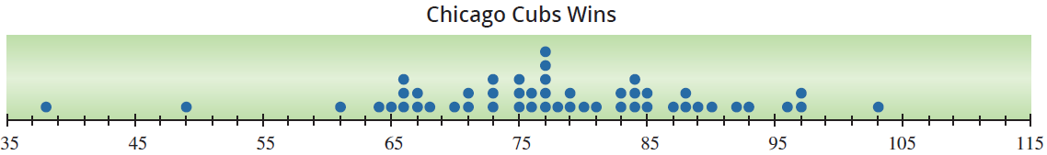
Example 3.4.3 (cont.)
Solution
We plot each data value on the axis. For values where there are multiple entries, such as for 77, we stack the points on top of one another.
From the dot plot we see that most values occur between 64 and 97 and the value that occurs most frequently is 77.

Slide 17
Geospatial Graphs
Notes
You frequently hear data visualization specialists refer to encoding data into a graphic. For example, in a histogram the data is encoded into different categories. If you are creating a choropleth map, the data is encoded spatially by placing the data in a region (usually county, state, or country). The magnitude of the data is usually represented by a color shade. So, the data is encoded in two dimensions.

