Slide 1
Section 3.5
Analyzing Graphs

Slide 2
Graph Labeling
Every graph should be properly labeled with an appropriate title that tells you what type of information is being displayed. Also, if the graph has a horizontal and vertical axis, these should be labeled and should include the unit of measurement when necessary for the understanding of the data.

Slide 3
Sources
When examining graphs in the media it is very important to consider the source of the information, i.e., who is telling the story.

Slide 4
Appropriateness of a Graph
We want to be able to determine whether the type of graph being used is best suited for the data being displayed.
Bar graphs
Line graphs
Pie charts

Slide 5
Scaling of Graphs
Another important feature to keep in mind when analyzing graphs is whether a graph is scaled appropriately. If you stretch or shrink the scale on either axis, the shape of the graph can change dramatically, and thus affect the interpretation of the graph.

Slide 6
Data Transformations
It is often useful to transform data by replacing a variable in the data set by a function of that variable so that the distribution is easier to work with or interpret.

Slide 7
Log Transformations
The log transformation is often used to help “unclutter” data points for visualization purposes. When the data is tightly grouped together, it can be hard to visualize and make inferences about individual data points. Log transformations numerically “stretch” the portion of the axis closest to zero, and “compress” the portion of the axis farthest from zero.
This allows us to better visualize each individual point while also maintaining the underlying relationship between the variables being graphed.

Slide 8
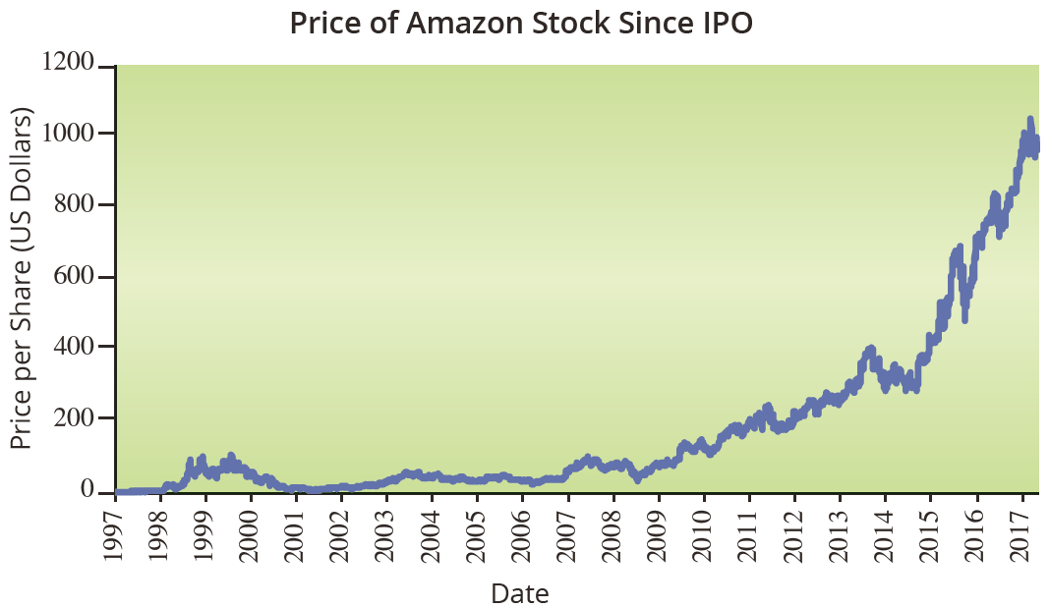
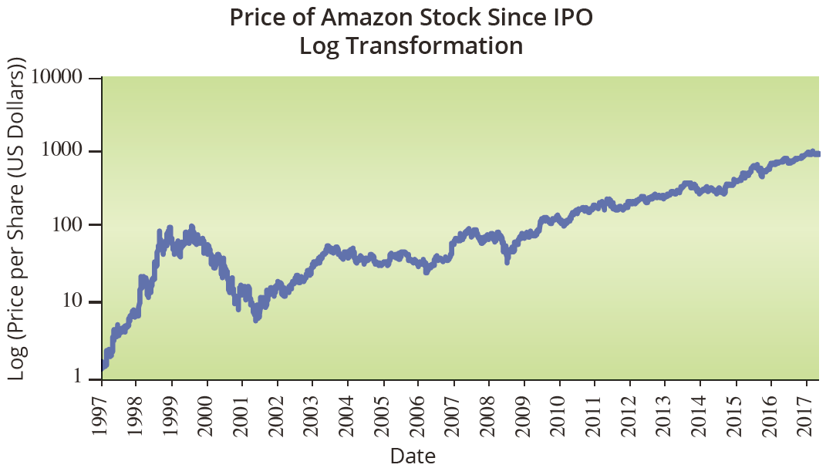
Log Transformations

Slide 9
Misleading Graphs
An issue related to scaling that is often used to mislead readers is to start the vertical scale at some value other than zero.

