Slide 1
Section 4.2
Measures of Dispersion

Slide 2
Range
Definition
The range is the difference between the largest and smallest data values.

Slide 3
Example 4.2.1
Calculate the range of the following data set consisting of the number of times the television channel was changed in a 1-hour time span.
Solution
The largest value equals 24 and the smallest value equals 1. Thus, the range is calculated as
Range = 24 – 1 = 23.
4 | 6 | 16 | 9 | 24 | 8 | 12 | 1

Slide 4
Mean Absolute Deviation
Formula
The sample mean absolute deviation (MAD) is given by

Slide 5
Example 4.2.2
Suppose six people participated in a 1000-meter run. Their times, measured in minutes, are given below.
The mean time is 8.5 minutes. In the table shown on the next slide we do the basic calculations for the mean absolute deviation.
5 | 10 | 9 | 11 | 9 | 7

Slide 6
Example 4.2.2 (cont.)
Solution
Calculating Mean Absolute Deviation
Time (Minutes) | Deviation | Absolute Deviation | % of Total Deviation
5 | 5 – 8.5 | 3.5 | 35%
10 | 10 – 8.5 | 1.5 | 15%
9 | 9 – 8.5 | 0.5 | 5%
11 | 11 – 8.5 | 2.5 | 25%
9 | 9 – 8.5 | 0.5 | 5%
7 | 7 – 8.5 | 1.5 | 15%
TOTAL |  | 10.0 | 100%

Slide 7
Example 4.2.2 (cont.)
Thus, on average, the points are 1.7 units from the mean. Note that the contribution to the sum of the deviations is proportional to the size of the deviation. That is, if one absolute deviation is twice as large as another, it contributes twice as much to the value of the statistic. For example, compare the data point 7, which is 1.5 units from the mean, to the data point 11, which is 2.5 units from the mean. The percentage contribution to the total deviation is 15% for 7 and 25% for 11, which is in proportion to their respective distances from the mean.

Slide 8
Example 4.2.2 (cont.)
A variability measure in which each data value contributes proportionally to its distance from the mean seems reasonable.
The mean absolute deviation is sensitive to outliers and is not a resistant measure, as demonstrated in the next example.

Slide 9
Example 4.2.3
Suppose the value 200 is added to the data set given in Example 4.2.2.
The mean is drastically affected, increasing from 8.5 to 35.86. In the table on the next slide we redo the basic calculations for the mean absolute deviation. What effect, if any, does the value of 200 have on the MAD?

Slide 10
Example 4.2.3 (cont.)
Solution
Calculating Mean Absolute Deviation
Data | Deviation | Absolute Deviation
5 | 5 – 35.86 | 3.5
10 | 10 – 35.86 | 1.5
9 | 9 – 35.86 | 0.5
11 | 11 – 35.86 | 2.5
9 | 9 – 35.86 | 0.5
7 | 7 – 35.86 | 1.5
200 | 200 – 35.86 | 164.14
TOTAL |  | 328.30

Slide 11
Example 4.2.3 (cont.)
The mean absolute deviation changes dramatically, increasing to 46.9. Therefore, the mean absolute deviation is sensitive to outliers and is not a resistant measure. The mean absolute deviation is a very intuitive measure of variation, but is not used very often.

Slide 12
Variance
Formula
The variance of a data set containing the complete set of population data is given by
and is called the population variance.

Slide 13
Variance
Formula (cont.)
The variance of a data set containing sample data is given by
and is called the sample variance.

Slide 14
Example 4.2.4
Given the following times in minutes of 6 persons running a 1000-meter course, compute the sample variance.
Solution
We previously computed the mean of this sample as 8.5. In the table on the next slide we do the basic calculations needed to compute the sample variance.
5 | 10 | 9 | 11 | 9 | 7

Slide 15
Example 4.2.4 (cont.)
Calculating the Sample Variance
Data | Deviation | Squared Deviation | % of Total Squared Deviation
5 | 5 – 8.5 = –3.5 | 12.25 | 52.13%
10 | 10 – 8.5 = 1.5 | 2.25 | 9.57%
9 | 9 – 8.5 = 0.5 | 0.25 | 1.06%
11 | 11 – 8.5 = 2.5 | 6.25 | 26.60%
9 | 9 – 8.5 = 0.5 | 0.25 | 1.06%
7 | 7 – 8.5 = –1.5 | 2.25 | 9.57%
TOTAL |  | 23.5 | 100%

Slide 16
Example 4.2.4 (cont.)
Thus the average squared deviation of the data is 4.7 squared minutes. The phrase “squared minutes” in the last sentence may seem a bit odd. No one carries out transactions in square minutes, or square dollars, or square tons, so it is difficult to interpret the significance of the measurement in this form. That is why the standard deviation exists. It converts the measure into the original units by taking the square root of the variance.

Slide 17
Standard Deviation
Definition
The standard deviation is also a measure of how much the data varies around the mean. It is found by taking the square root of the variance.

Slide 18
Properties of the Standard Deviation
Properties
The standard deviation is always nonnegative. It is zero only if all the data values are exactly the same.
The standard deviation can increase dramatically if there are one or more outliers in the data.
The standard deviation is expressed in the same units as the original data values.

Slide 19
Empirical Rule
Properties
If the distribution of the data is bell-shaped, then
About 68% of the data should lie within 1 standard deviation of the mean.
About 95% of the data should lie within 2 standard deviations of the mean.
About 99.7% of the data should lie within 3 standard deviations of the mean.

Slide 20
Example 4.2.5
Suppose a group of high technology stocks has an average earnings per share of $6.26, with a standard deviation of $1.37. If the data possesses a bell-shaped distribution, which interval contains 68% of the earnings? Which interval contains 95% of the earnings?
Solution
Using the one sigma rule, we will capture 68% of the observations.

Slide 21
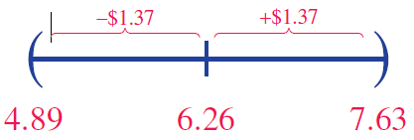
Example 4.2.5 (cont.)
$6.26 ± $1.37
Using the one sigma rule results in an interval from $6.26 − $1.37 to $6.26 + $1.37. Doing the arithmetic produces an interval from $4.89 to $7.63.

Slide 22
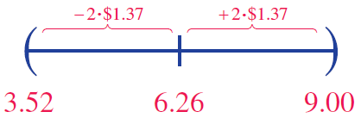
Example 4.2.5 (cont.)
To capture 95% of the earnings, use the two sigma rule, $6.26 ± 2 ⋅ $1.37. Doing the arithmetic results in an interval from $3.52 to $9.00.
Note that to increase the percentage of data captured from 68% to 95% requires an interval that is twice as large.

Slide 23
Chebyshev’s Theorem
Definition
The proportion of any data set lying within k standard deviations of the mean is at least
If k = 2 at least (or 75 %) of the data values lie
within 2 standard deviations of the mean, for any data
set.

Slide 24
Chebyshev’s Theorem
Definition (cont.)
If k = 3 at least (or 88.9 %) of the data values lie within 3 standard deviations of the mean, for any data set.

Slide 25

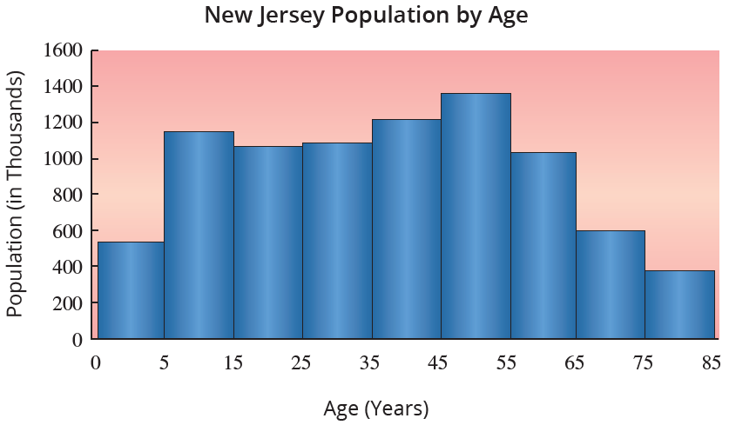
Example 4.2.6
The age distribution histogram for New Jersey in 2017 is shown in the graph. The mean of the data is 37.2, while the standard deviation is 22. What can we conclude from Chebyshev’s Theorem using k = 2?

Slide 26
Example 4.2.6 (cont.)
Solution
Because we are interested in k = 2, we will look at the values two standard deviations above and below the mean.
Two standard deviations above the mean is
and two standard deviations below the mean is

Slide 27
Example 4.2.6 (cont.)
Because age cannot be negative, we have a natural boundary so we will consider this as zero.
Therefore, by Chebyshev’s Theorem, we can say that at least 75% of the population of New Jersey is between 0 and 81.2 years old. It is doubtful that this revelation will become breaking news.

Slide 28
Coefficient of Variation
Formula
For population data, the measure is defined as
and for sample data,

