Slide 1
Section 4.3
Measures of Relative Position, Box Plots, and Outliers

Slide 2
Percentile
Definition
Given a set of data x₁, x₂,… x_{n}, the percentile is a value, say x, such that approximately P percent of the data is less than or equal to x and approximately (100 − P) percent of the data is greater than or equal to x.

Slide 3
Finding the Percentile
Procedure
To determine the percentile:
Form an ordered array by placing the data in order from smallest to largest.
To find the location of the percentile in the ordered array, let

Slide 4
Finding the Percentile
Procedure (cont.)
where n is the number of observations in the ordered data.
If is not an integer, then round up to the next greatest integer. For example, if = 7.1, then round up to 8 and find the data value in the location. If is an integer value, then average the data value in the location with the data value in the location.

Slide 5
Range
Caution
It is important to remember that when you find the value of , this result is not the percentile. It is the location of the percentile in the ordered array.

Slide 6
Example 4.3.1
Find the 50th percentile for the following data on the number of spelling errors found on 7 pages of a web site.
Solution
Number of observations, n = 7.
The percentile, P = 50.
The location of the percentile,
3 | 5 | 0 | 1 | 9 | 2 | 7

Slide 7
Example 4.3.1 (cont.)
Since the location of the percentile is not an integer, the value is rounded up to 4.
Thus, the fourth observation in the ordered array is the 50th percentile.
0, 1, 2, 3, 5, 7, 9
Therefore, the median value (which is the 50th percentile) is 3.
fourth observation

Slide 8
Example 4.3.2
Suppose that 40 members of your company are given a screening test for a new position. These scores are reported in the table on the next slide. To inform potential employees of their screening test performance you may wish to report various percentiles for the test scores. Find the 10th and 88th percentiles for the test.

Slide 9
Example 4.3.2 (cont.)
Test Scores
67 | 45 | 18 | 82
45 | 54 | 61 | 55
63 | 47 | 21 | 31
58 | 46 | 43 | 49
34 | 71 | 69 | 56
54 | 80 | 73 | 77
27 | 70 | 41 | 29
66 | 32 | 44 | 33
21 | 64 | 52 | 81
48 | 55 | 57 | 62
Ordered Test Scores
18 | 43 | 54 | 66
21 | 44 | 55 | 67
21 | 45 | 55 | 69
27 | 45 | 56 | 70
29 | 46 | 57 | 71
31 | 47 | 58 | 73
32 | 48 | 61 | 77
33 | 49 | 62 | 80
34 | 52 | 63 | 81
41 | 54 | 64 | 82

Slide 10
Example 4.3.2 (cont.)
Solution
In order to calculate the percentiles, the data must be placed in an ordered array (Ordered Test Scores). To compute the 10th percentile, its position in the ordered array must be determined. The number of observations is n = 40. The percentile is P = 10. The location of the percentile is found by

Slide 11
Example 4.3.2 (cont.)
Since is an integer, the 4th and 5th observations in the array must be averaged. Since the fourth data value is 27 and the fifth data value is 29, then the 10th percentile is calculated as follows.
To determine the 88th percentile, first calculate its location in the ordered array.

Slide 12
Example 4.3.2 (cont.)
Since the location is not an integer, its value is rounded up to 36. The 36th observation in the ordered array will correspond to the 88th percentile. The 36th value in the table of ordered scores is 73, so 73 is the 88th percentile.

Slide 13
Percentile
Formula
The percentile of some data value x is given by

Slide 14
Quartiles
Definition
The 25th, 50th, and 75th percentiles are known as quartiles and are denoted as Q₁, Q₂ , and Q₃ respectively.

Slide 15
Interquartile Range
Formula
The interquartile range is a measure of dispersion which describes the range of the middle fifty percent of the data. It is calculated as follows.
IQR = Q₃− Q₁

Slide 16
5-Number Summary
Definition
For a set of data, the 5-number summary consists of the following five values:
Minimum
First quartile, Q₁
Second quartile, Q₂, or the median
Third quartile, Q₃
Maximum

Slide 17
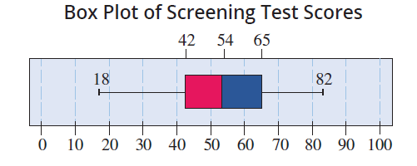
Box Plots
Box plots are a graphical summary of the central tendency, the spread, the skewness, and the potential existence of outliers in the data. The figure below displays a box plot of the screening test data from Example 4.3.2.

Slide 18
Box and Whisker Plot
In the previous figure, a line is drawn from the 25th percentile to the smallest test score of 18, and another line is drawn from the 75th percentile to the largest score of 82. These lines are often referred to as “whiskers”. Adding “whiskers” to the box plot creates a box and whisker plot. The box plot for the screening test scores shows that the test score data is slightly skewed to the left. Why? Because the whisker extending from Q₁ appears to be longer that the whisker that extends from Q₃.

Slide 19
Procedure for Constructing a Box Plot
Procedure
Determine the 5-number summary for the data set.
Draw a scale that includes the minimum and maximum data values.
Construct a box extending from Q₁ to Q₃.
Draw a line through the box at the value of the median.
Draw lines extending from Q₁ to the minimum and from Q₃ to the maximum.

Slide 20
Detecting Outliers
Caution
Different technologies may yield different box plots due to differences in the procedures used for determining quartiles.

Slide 21
Outlier
Definition
A data point is considered an outlier if it is 1.5 times the interquartile range above the 75th percentile or 1.5 times the interquartile range below the 25th percentile.

Slide 22
Example 4.3.3
Education attainment seems to have a positive association with a person’s income. The amount of education a person has can be divided into five categories.
Less than a high school diploma
High school graduate, no college
Some college or associate degree
Bachelor’s degree only
Advanced degree

Slide 23
Example 4.3.3 (cont.)
The categories are ordered according to educational attainment. The vertical box plots in the figure on the next slide show the distributions of personal income per each level of education, for individuals age 25 and older. Rather than extending the whiskers to the smallest and largest income values in each category, the whisker endpoints represent the 10th and 90th percentiles. What conclusions can be drawn from this figure?

Slide 24
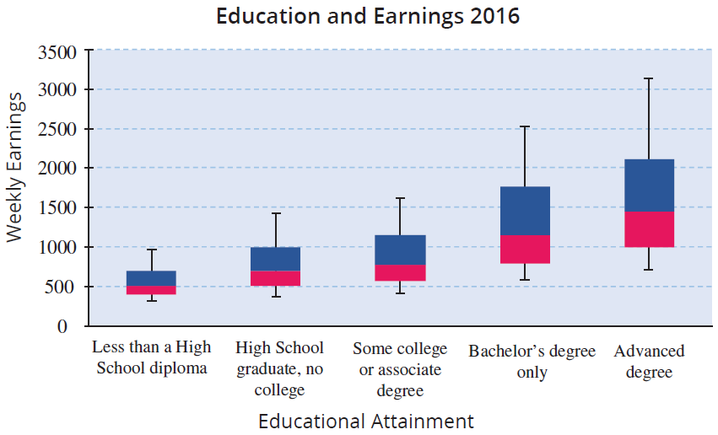
Example 4.3.3 (cont.)

Slide 25
Example 4.3.3 (cont.)
Solution
It is rather obvious from this figure that more education equates to higher earnings. Also, there is a lot of spread in the last two box plots as shown by the longer lengths of the boxes. This is probably due in part to the market demands for degrees in scientific disciplines, especially computer science.

Slide 26
z-Score
Formula
The z-score transforms a data value into the number of standard deviations that value is from the mean.

Slide 27
Example 4.3.4
Suppose you scored an 86 on your biology test and a 94 on your psychology test. The mean and standard deviations of the two tests are given in the following table.
What are the z-scores for your two tests? On which of the tests did you perform relatively better?
Test Scores
Course | Mean | Standard Deviation
Biology | 74 | 10
Psychology | 82 | 11

Slide 28
Example 4.3.4 (cont.)
Solution
The z-score for the biology test is
The z-score for the psychology test is
On the biology test you scored 1.2 standard deviations above the mean, compared to only 1.09 standard deviations above the mean for the psychology test.

Slide 29
Example 4.3.4 (cont.)
Even though the raw score on the psychology test is larger than the raw score on the biology test, relative to the means and variability in the data sets, the performance on the biology test was slightly better. Once again, changing the scale of the data has beneficial effects. It enables the comparison of two measurements that are drawn from different populations.

Slide 30
Properties of a z-Score
Properties
If a z-score is negative, the corresponding data value is less than the mean.
Conversely, if a z-score is positive, the corresponding data value is greater than the mean.
The z-score is a unit-free measure. That is, regardless of the original units of measurement (centimeters, meters, or kilometers), an observation’s z-score will be the same.

