Slide 1
Section 4.4
Data Subsetting

Slide 2
Subsetting
Definition
The structure of a set of data is often exposed by using another variable to break the data into smaller groups. This is called subsetting.

Slide 3
Example 4.4.1
A few years ago, a discrimination lawsuit was filed against the California Department of Developmental Services (DDS). The California DDS provides funding for developmentally-disabled individuals within the state. The lawsuit claimed that White Non-Hispanics were receiving more funding than Hispanics. If this was true, the DDS would face some serious legal and financial ramifications, so they hired several statisticians to analyze the data behind the issue. Were these claims of discrimination by a state department actually true?

Slide 4
Example 4.4.1 (cont.)
Solution
First, we will create box plots to visualize how the lawsuit arose. We will look at the relationship between ethnicity and expenditure by plotting expenditure grouped by the different ethnicities.

Slide 5
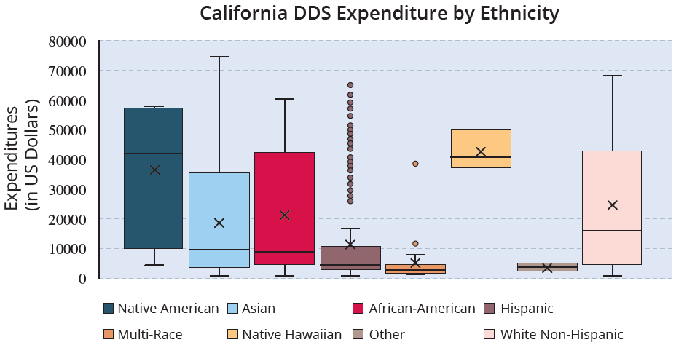
Example 4.4.1 (cont.)

Slide 6
Example 4.4.1 (cont.)
If the data is examined on a purely ethnic basis, then the figure above suggests that there is discrimination towards multiple different ethnic groups. But, now we need to think about any variables that could be confounding this picture.
The statisticians discovered that age played a massive role in the expenditure per person, because more costs are associated with caring for older developmentally-disabled individuals.

Slide 7
Example 4.4.1 (cont.)
To account for the variation in expenditure between different ages, the statisticians decided to subset the whole data set into six different age groups, and then examine the expenditure by ethnicity within each age group to see if the discrimination claim still held true. The box plots in the following figure illustrate their findings.

Slide 8
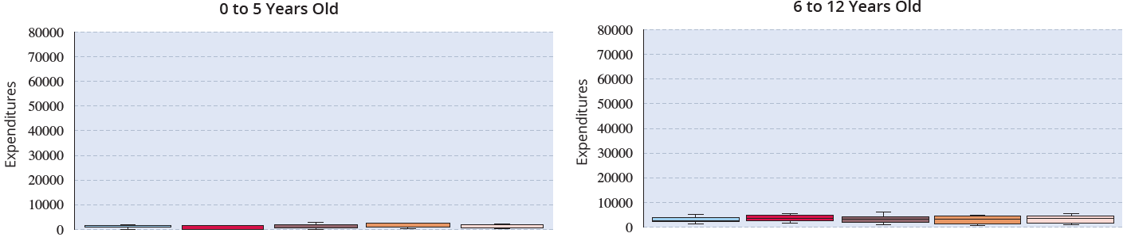
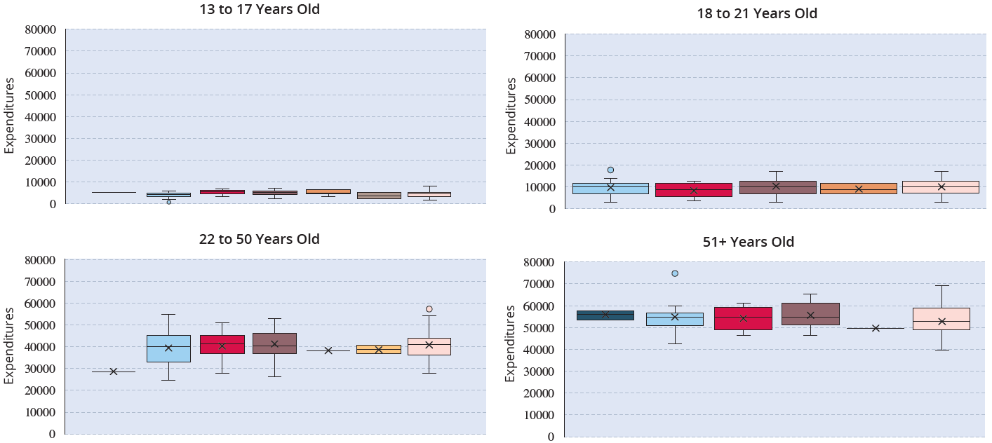
Example 4.4.1 (cont.)

Slide 9
Example 4.4.1 (cont.)
To the surprise of many involved, the box plots were roughly the same for each ethnic group once age was considered. There was no evidence of discrimination once the confounding variable “age” was accounted for.
This is a classic example of Simpson’s paradox, which states that the perceived association between two variables (ethnicity and expenditures per person in this case) can be drastically affected by a third variable.

Slide 10
Example 4.4.1 (cont.)
When the data is partitioned by the third variable (age in our case) the “alleged” relationship may not exist or be just the opposite.
When analyzing data, it is good to keep in mind Oscar Wilde’s cautionary quote, “the truth is rarely pure, and never simple”. We must always be very cautious when attributing causation.

