Slide 1
Section 5.1
Scatterplots and Correlation

Slide 2
Bivariate Data
Definition
Bivariate data is data in which two variables are recorded or measured on an entity.

Slide 3
Scatterplot
Definition
A scatterplot is a graph used to display the relationship between two quantitative variables measured on the same entity. Data pairs (x, y) representing the two variables are plotted as a single point on a graph with x (the explanatory variable) along the horizontal axis and y (the response variable) along the vertical axis.

Slide 4
Inverse Relationships
Definition
When there is an inverse relationship between two variables, as one variable increases, the other variable decreases and vice versa.

Slide 5
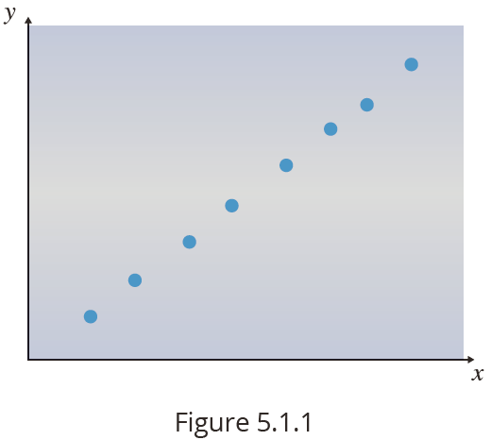
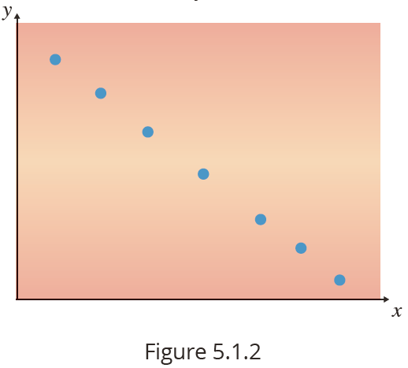
Examples of Scatterplots
In Figure 5.1.1, the slope of the linear relationship is positive, that is, as the x variable increases the y variable also increases.
In Figure 5.1.2, the relationship is negative; as the x variable increases, the y variable decreases.

Slide 6
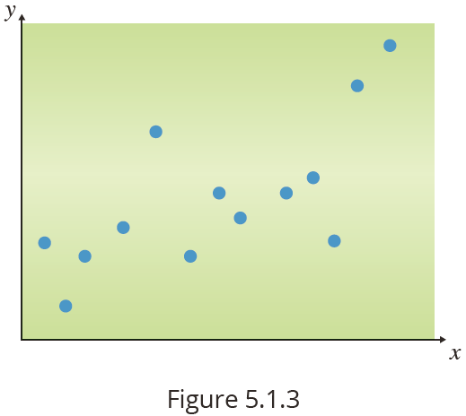
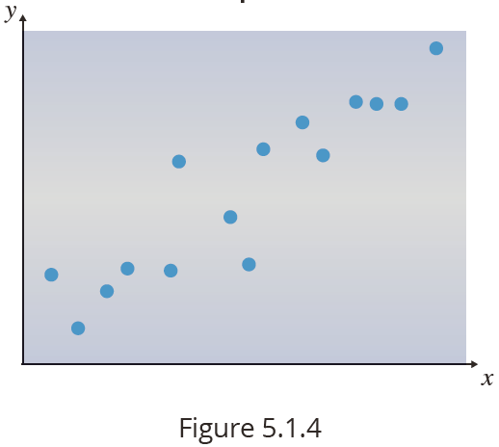
Examples of Scatterplots (cont.)
Figure 5.1.3 reveals a very imprecise relationship between x and y, although as x increases, y tends to increase.
The relationship between x and y is much more apparent in Figure 5.1.4 than in Figure 5.1.3

Slide 7
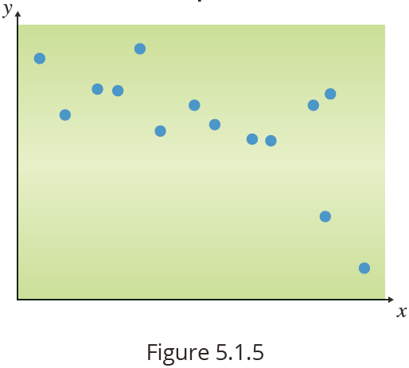
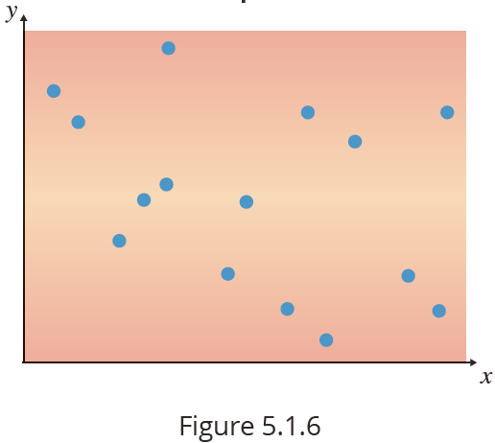
Examples of Scatterplots (cont.)
Figure 5.1.5 reveals a downward sloping relationship between x and y. That is, as x increases y tends to decrease.
In Figure 5.1.6, there is no apparent relationship between x and y. That is, here is no tendency for y to increase or decrease as x increases.

Slide 8
Correlation Coefficient
Formula

Slide 9
Computational Formula for the Correlation Coefficient
Formula
The computational formula for the correlation coefficient is as follows.

Slide 10
Properties of the Correlation Coefficient
Properties
The correlation coefficient, r, measures the degree of linear relationship; i.e., how well the data clusters around a line. If the scatterplot indicates a relationship that is not linear, you cannot use r to measure the strength of the relationship.
The value of r is always between −1 and +1. (It is a unitless measurement.)
A value of r near −1 or +1 means the data is tightly bundled around a line.

Slide 11
Properties of the Correlation Coefficient
Properties (cont.)
Positive association is indicated by r > 0 and an upward sloping relationship.
Negative association is indicated by r < 0 and a downward sloping relationship.
A value of r near zero means there is no linear relationship between x and y.
It does not matter whether you correlate y with x or x with y; you will still get the same value for r.

Slide 12
Properties of the Correlation Coefficient
Properties (cont.)
If either variable is converted to different units, the value of r will not change.
As a statistical measure, r is very sensitive to the presence of outliers. A single outlier can drastically affect the value of r.

Slide 13
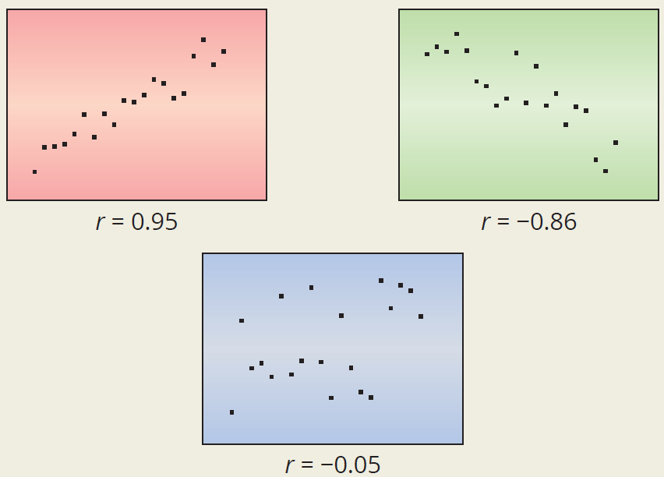
Properties of the Correlation Coefficient
Properties (cont.)

Slide 14
Common Response
Definition
In statistics, common response refers to the phenomenon where changes in both the explanatory and the response variables result from a change in a third variable.

Slide 15
Quadratic Relationship
Definition
A quadratic relationship is a mathematical relationship between two variables that follows the form of a quadratic equation (degree = 2). A scatterplot of the data will look like a parabola.

