Slide 1
Section 5.2
Fitting a Linear Model

Slide 2
Linear Equation
If two variables appear to be related in a straight line manner, we can use a linear equation to model their relationship.

Slide 3
Linear Relationship
Definition
A linear relationship is graphically described as a line. Mathematically, a line is a set of points that satisfy the functional relationship
y = mx + b
where m is the slope of the line and b is the point where the function crosses the y-axis, which is called the y-intercept.

Slide 4
Slope
The slope determines if the line slopes upward (positive slope) or if the line slopes downward (negative slope).

Slide 5
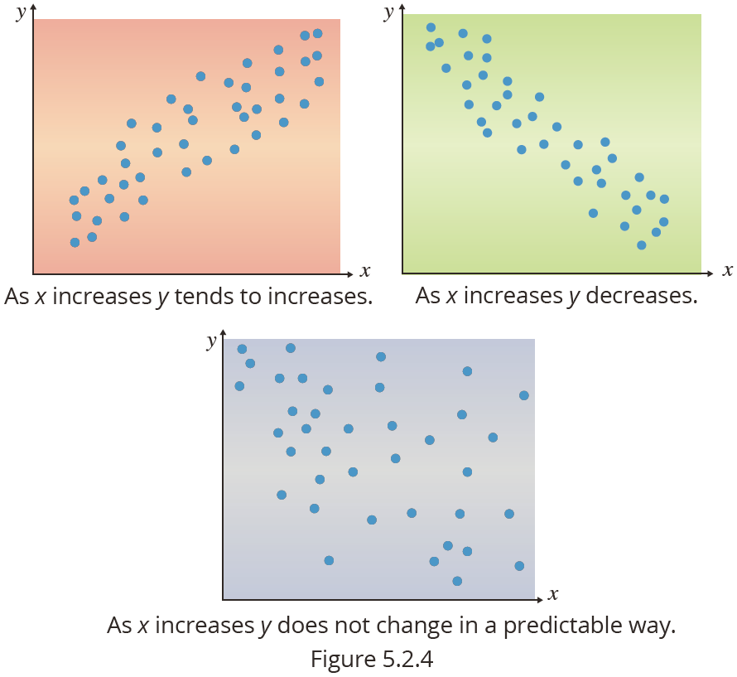
Linear Relationships

Slide 6
Regression Analysis
In the previous section, the correlation coefficient was used to measure the degree of linear relationship between two variables. However, it does not describe the exact linear association between x and y. That is the role of regression analysis. By determining a specific relationship between x and y, we may be able to use x to help predict y.

Slide 7
Equation of a Line
Earlier in this section, we defined the equation of a line to be
y = mx + b
where m is the slope, and b is the y-intercept.
However, traditional statistics uses different symbols for the slope and intercept in the equation of the line. Instead of b, let b₀ be the symbol used to describe the y-intercept and b₁ be the symbol used to represent the slope of the line. Using this new set of symbols, the equation of the line becomes
y = b₀ +b₁x.

Slide 8
Mathematical Model
By providing b₀ and b₁, the relationship between x and y is completely specified. The linear equation relating x to y is also referred to as a mathematical model. Note that the value of y is completely dependent on the value of x. Consequently, the y variable is called the dependent variable. The x variables in the model is called the independent variable.

Slide 9

How Do We Measure How Close a Line Is to the Data?
One possible method of choosing the best fitting line is to use the line to predict the y-value for each observation. The superior line is the one that does the best job of predicting the observed y-values. Let’s look at a small data set.

Slide 10
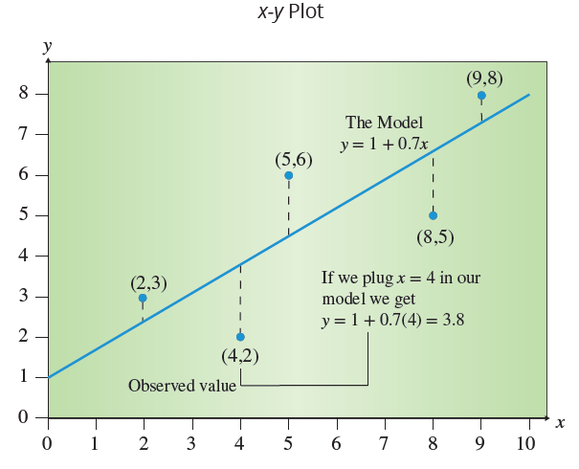
How Do We Measure How Close a Line Is to the Data?
We plotted this data in the following figure and then tried to draw a line through the points. Notice that there is no straight line that passes through all of the data points. However, one line that seems to fit the data reasonably well is
y=1+0.7x.

Slide 11
How Do We Measure How Close a Line is to the Data?
Although other lines might do a better job of fitting the data, let’s see how well this line predicts the y-values. In order to evaluate how well a given line fits the data we must construct a method of measuring how well any line fits the data. If a reasonable measurement is developed, it can serve as a decision-making criterion which will enable us to look for the best line. To develop the appropriate criterion we need to examine the purpose of the regression line
y = b₀ +b₁x.

Slide 12
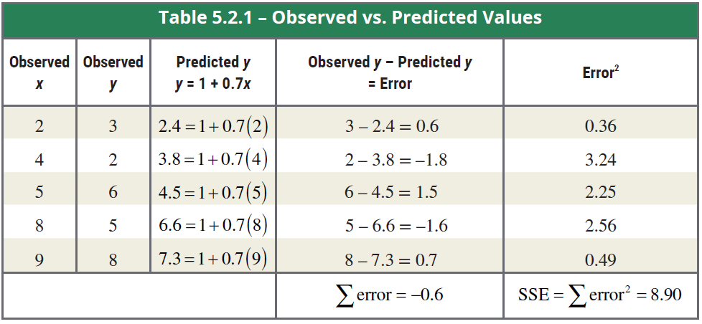
How Do We Measure How Close a Line Is to the Data?

Slide 13
How Do We Measure How Close a Line Is to the Data?
The difference between the observed value of y and the predicted value of y is called the model’s error. One possible criterion that could be used to compare different lines that might fit the data would be to sum all the errors and choose the line with the smallest sum. But as you can see in the previous table, some of the large positive errors were canceled out by equally large negative errors. It is possible to develop a line that has a small sum of errors, but the errors themselves are quite large.

Slide 14
How Do We Measure How Close a Line Is to the Data?
Thus, the sum of the errors is not the criterion we have been looking for, but it is close. By squaring the error terms and then adding the squared errors, there are no negative errors to cancel out the positive ones.

Slide 15
Sum of Squared Errors (SSE)
Formula
The sum of squared errors (SSE) is given by

Slide 16
Least Squares Lines
SSE can be used as a criterion for selecting the best fitting line through a set of points. If SSE is zero, then the model fits the data exactly and the observed data must lie in a straight line. If Line A’s SSE is larger than Line B’s, then Line B fits the data better than Line A. For the model we have been studying, the value of SSE is 8.90. Without studying other possible lines, there is no way to judge whether this is a large or small value for SSE.

Slide 17
Least Squares Lines
However, if there were a method that would find the best line (the line with the least sum of squared errors), then our problem would be solved. This best line would be called the least squares line since it would have the smallest SSE.

Slide 18
Slope and y-Intercept of the Least Squares Line
Formula

Slide 19
Estimating a Linear Relationship
Anyone who has ever purchased a car knows that a relationship exists between the price of a car and its age. In Table 5.2.2, data on age and asking price of a Honda Civic LX sedan has been gathered from fourteen classified car ads in a local newspaper.

Slide 20
Estimating a Linear Relationship
Table 5.2.2 – Price of a Honda Civic LX Sedan
Age (Years) | Asking Price | Age (Years) | Asking Price
1 | 17,850 | 4 | 14,460
1 | 18,000 | 4 | 13,586
2 | 15,195 | 5 | 13,050
2 | 16,995 | 5 | 13,495
2 | 15,625 | 6 | 9,150
3 | 14,935 | 6 | 9,950
3 | 14,879 | 6 | 10,995

Slide 21
Estimating a Linear Relationship
Using the least squares equations, we can estimate the following coefficients:
and,
Therefore the model to estimate the price of the Honda Civic LX is:

Slide 22
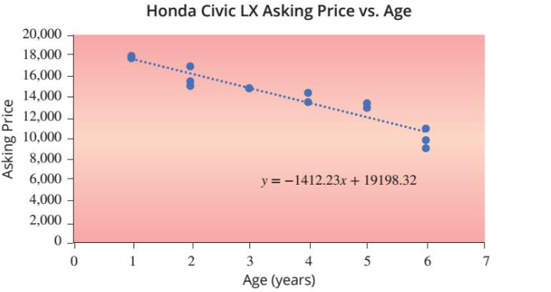
Estimating a Linear Relationship

Slide 23
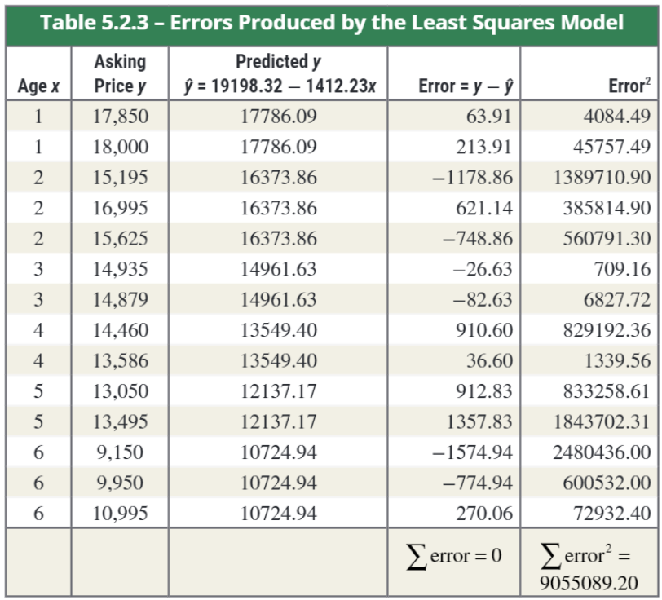
Estimating a Linear Relationship

Slide 24
Interpretation of b₀ and b₁
Definition
The intercept coefficient, b₀, is the average value of the dependent variable, y, when the independent variable, x, is equal to zero.
The slope coefficient, b₁, is the average change in the dependent variable, y, for a one unit change in the independent variable, x.

