Slide 1
Section 5.3
Evaluating the Fit of a Linear Model

Slide 2
Variance of the Error
Formula
The variance of the error is given by

Slide 3
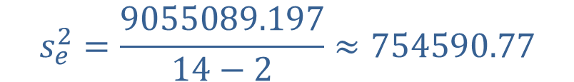
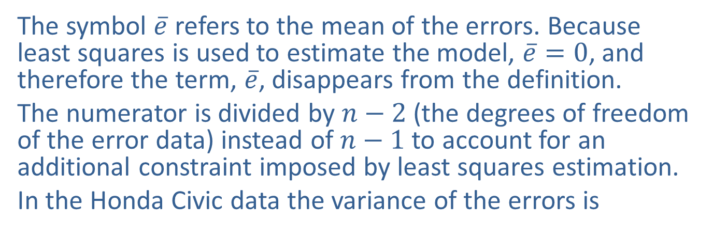

Variance of the Error
The symbol $\overline{e}$ refers to the mean of the errors. Because least squares is used to estimate the model, $\overline{e}=0$, and therefore the term, $\overline{e}$, disappears from the definition.
The numerator is divided by $n−2$ (the degrees of freedom of the error data) instead of $n−1$ to account for an additional constraint imposed by least squares estimation.
In the Honda Civic data the variance of the errors is
$$s_{e}^{2}=\frac{9055089.197}{14−2}≈754590.77$$
and the standard error (standard deviation of the error terms) is given by
$$s_{e}=\sqrt{754590.77}≈868.67$$

Slide 4
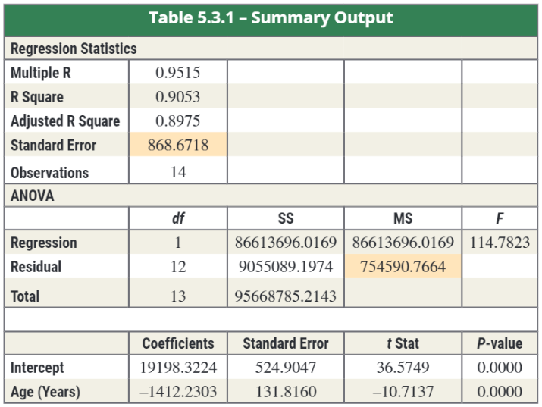
Summarizing Errors for the Honda Civic Model
Table 5.3.1 shows the summary output from Microsoft Excel for the regression analysis of the Honda Civic data.
Standard error of the model
Mean Square Error

Slide 5
Standard Error
Should you be satisfied with a model whose standard error is $868.67? It would certainly be more desirable if the model’s standard deviation of error was only $100. If you know a great deal about the used car market (you have an intuitive model), then perhaps the current model would not be of value. However, if you are uninformed, the current model provides a basic understanding of the relationship between age and asking price.

Slide 6
Small and Large Variation
What constitutes small and large variation of the errors is dependent on the nature of the problem. Using a model to predict the diameter of a valve to be used in a heart-lung machine is certainly going to produce a different idea of small than estimating the price of a car. It would be ideal to develop a measure that would summarize the degree of fit on some standardized scale.

Slide 7
Total Sum of Squares (Total SS)
Formula
The total variation in y is given by the total sum of squares (Total SS).

Slide 8
Coefficient of Determination
Definition
The proportion of variation explained by the model is called the coefficient of determination and is denoted as R² .
The coefficient of determination is a value between 0 and 1, inclusive. That is, 0 ≤ R² ≤ 1.

Slide 9
Example 5.3.1
The SAT has been used for years as a predictor of academic success. If SAT scores are predictors of academic success, they should be positively related to the grade point average upon graduation. Twenty-seven graduates of a state college were sampled and their grade point averages (GPA) upon graduation and SAT scores reported upon admission are recorded as paired data values in the following table.

Slide 10
Example 5.3.1 (cont.)
Table 5.3.2 – SAT Scores and Graduating GPA
Student | SAT Verbal | SAT Math | SAT Total | College GPA | Predicted GPA | Error | Error Squared
1 | 680 | 554 | 1234 | 3.42 | 2.8647 | 0.5553 | 0.30835809
2 | 486 | 562 | 1048 | 2.37 | 2.4741 | −0.1041 | 0.01083681
3 | 500 | 564 | 1064 | 2.52 | 2.5077 | 0.0123 | 0.00015129
4 | 501 | 564 | 1065 | 2.25 | 2.5098 | −0.2598 | 0.06749604
5 | 503 | 583 | 1086 | 2.9 | 2.5539 | 0.3461 | 0.11978521
6 | 503 | 571 | 1074 | 3.17 | 2.5287 | 0.6413 | 0.41126569
7 | 603 | 667 | 1270 | 2.76 | 2.9403 | −0.1803 | 0.03250809
8 | 507 | 552 | 1059 | 2.21 | 2.4972 | −0.2872 | 0.08248384
9 | 607 | 554 | 1161 | 2.27 | 2.7114 | −0.4414 | 0.19483396
10 | 509 | 654 | 1163 | 3.20 | 2.7156 | 0.4844 | 0.23464336
11 | 510 | 583 | 1093 | 2.83 | 2.5686 | 0.2614 | 0.06832996

Slide 11
Example 5.3.1 (cont.)
Table 5.3.2 – SAT Scores and Graduating GPA (cont.)
Student | SAT Verbal | SAT Math | SAT Total | College GPA | Predicted GPA | Error | Error Squared
12 | 612 | 558 | 1170 | 2.91 | 2.7303 | 0.1797 | 0.03229209
13 | 517 | 568 | 1085 | 2.74 | 2.5518 | 0.1882 | 0.03541924
14 | 519 | 668 | 1187 | 3.21 | 2.7660 | 0.4440 | 0.19713600
15 | 528 | 607 | 1135 | 2.40 | 2.6568 | −0.2568 | 0.06594624
16 | 528 | 516 | 1044 | 3.41 | 2.4657 | 0.9443 | 0.89170249
17 | 536 | 559 | 1095 | 2.24 | 2.5728 | −0.3328 | 0.11075584
18 | 668 | 648 | 1316 | 3.47 | 3.0369 | 0.4331 | 0.18757561
19 | 648 | 580 | 1228 | 2.70 | 2.8521 | −0.1521 | 0.02313441
20 | 538 | 554 | 1092 | 2.80 | 2.5665 | 0.2335 | 0.05452225
21 | 638 | 624 | 1262 | 3.08 | 2.9235 | 0.1565 | 0.02449225
22 | 541 | 568 | 1109 | 2.08 | 2.6022 | -0.5222 | 0.27269284

Slide 12
Example 5.3.1 (cont.)
Table 5.3.2 – SAT Scores and Graduating GPA (cont.)
Student | SAT Verbal | SAT Math | SAT Total | College GPA | Predicted GPA | Error | Error Squared
23 | 642 | 660 | 1302 | 3.39 | 3.0075 | 0.3825 | 0.14630625
24 | 542 | 554 | 1096 | 2.34 | 2.5749 | −0.2349 | 0.05517801
25 | 593 | 664 | 1257 | 2.35 | 2.9130 | −0.5630 | 0.31696900
26 | 643 | 571 | 1214 | 2.40 | 2.8227 | −0.4227 | 0.17867529
27 | 548 | 573 | 1121 | 3.20 | 2.6274 | 0.5726 | 0.32787076
28 | 548 | 574 | 1122 | 2.59 | 2.6295 | −0.0395 | 0.00156025
29 | 549 | 557 | 1106 | 2.37 | 2.5959 | −0.2259 | 0.05103081
30 | 549 | 564 | 1113 | 2.34 | 2.6106 | −0.2706 | 0.07322436

Slide 13
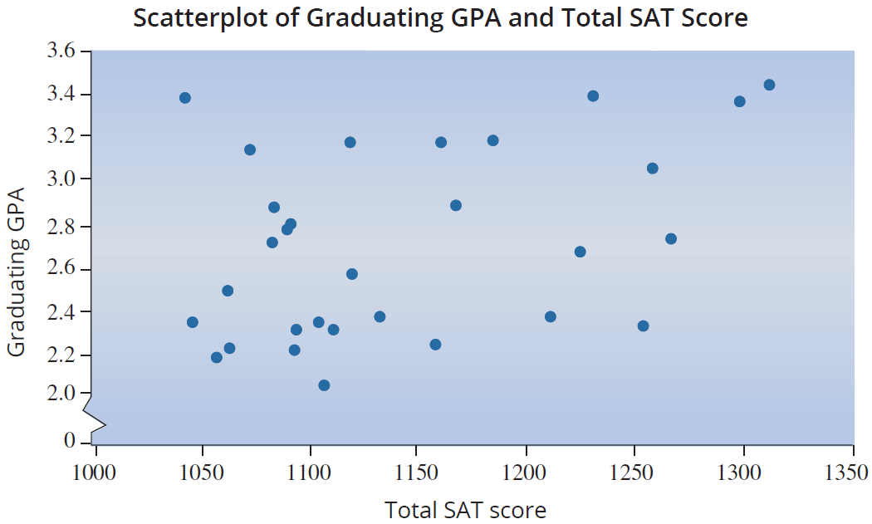
Example 5.3.1 (cont.)

Slide 14
Example 5.3.1 (cont.)
The scatterplot of the data suggests that as SAT scores increase the GPA tends to increase, although there is a substantial amount of variability in the relationship. The upward sloping pattern of the data suggests a linear model could be constructed. However, a great deal of variation in the model’s errors should be expected. What percent of the variation in final grade point average can be explained by the model relating total SAT score to graduating GPA?

Slide 15
Example 5.3.1 (cont.)
Solution
Using the least squares method, the estimated model is given by
Estimated Graduating GPA = 0.2733 + 0.0021 (Total SAT Score).

Slide 16
Example 5.3.1 (cont.)
SUMMARY OUTPUT
Regression Statistics
Multiple R | 0.3996
R Square | 0.1597
Adjusted R Square | 0.1297
Standard Error | 0.4008
Observations | 30
ANOVA
 | df | SS | MS | F
Regression | 1 | 0.8548 | 0.8548 | 5.3218
Residual | 28 | 4.4976 | 0.1606
Total | 29 | 5.3524
 | Coefficients | Standard Error | t Stat | P-value
Intercept | 0.2733 | 1.0677 | 0.2560 | 0.7998
SAT Total | 0.0021 | 0.0009 | 2.3069 | 0.0287

Slide 17
Example 5.3.1 (cont.)
When we studied the Honda Civic model, a list of predicted values and errors for each observed value was given. Instead of providing a list of the errors for each of the observed values, let’s summarize the errors from the model. In particular,

Slide 18
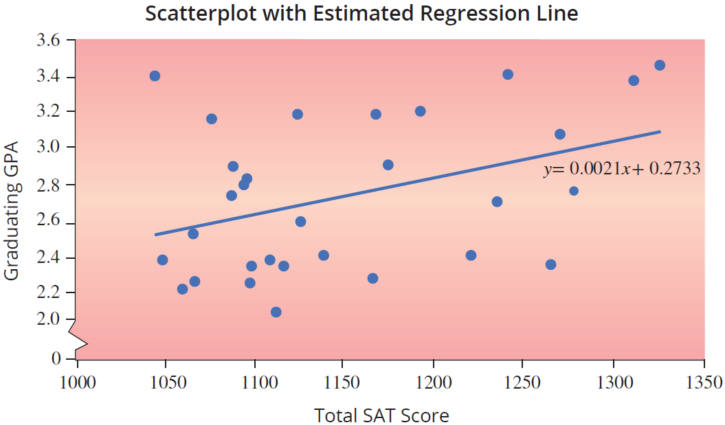
Example 5.3.1 (cont.)

Slide 19
Example 5.3.1 (cont.)
One of the differences in the Honda Civic model and the SAT/GPA model is the manner in which the models seem to fit the data. In the Honda Civic model, the data seemed to fit closely around the line, while in the SAT/GPA model the data is loosely clustered about the line. While tight and loose are interesting portrayals of the relative fit of the models to the data, it would be desirable to have a numerical measure to describe fit. R² is such a measure.

Slide 20
Example 5.3.1 (cont.)
Thus, approximately 16% of the variation in graduating GPA is explained by the linear model.

Slide 21
Coefficient of Determination
Formula
The coefficient of determination, R², can be calculated using the equation:

