Slide 1
Section 5.4
Fitting a Linear Time Trend

Slide 2
Linear Time Trend
How can you describe time series data that possess a trend? For some time series, a linear time trend is a useful model. A linear time trend is nothing but a line that is used to model the changes in some phenomenon measured over time. In a linear time trend model, the independent variable is always a time index.

Slide 3
Example 5.4.1
The following data is taken from the results of the 2013–2014 National Health and Nutrition Examination Survey (NHANES) of US adults age 20 and over who are above their recommended weight based on body mass index, or BMI. Body mass index, expressed as weight in kilograms divided by height in meters squared (kg/m²), is commonly used to classify people as overweight (BMI 25.0–29.9), obese (BMI greater than or equal to 30.0), and extremely obese (BMI greater than or equal to 40.0). Based on BMI, the percent of overweight Americans from 1999 to 2014 is shown in the following table.

Slide 4
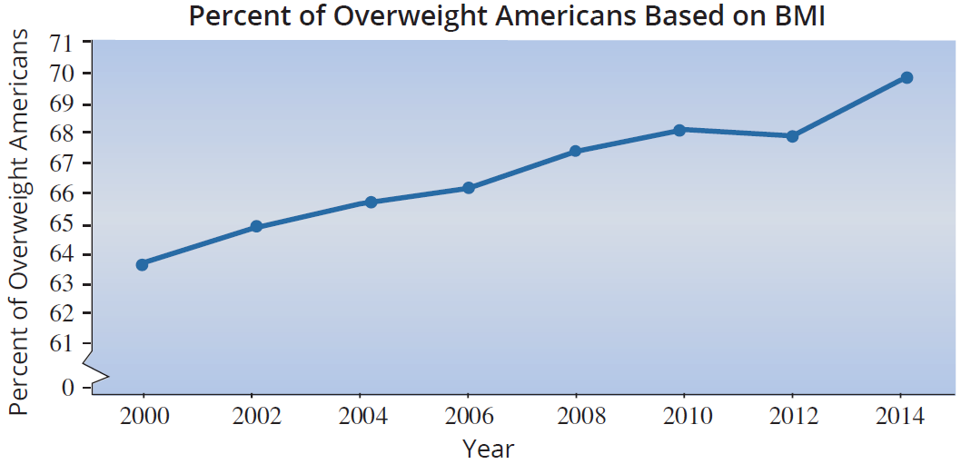
Example 5.4.1 (cont.)
Percent of Overweight American Adults
Year | 2000 | 2002 | 2004 | 2006 | 2008 | 2010 | 2012 | 2014
Percent Overweight | 64.5 | 65.6 | 66.4 | 66.9 | 68.1 | 68.8 | 68.6 | 70.4

Slide 5
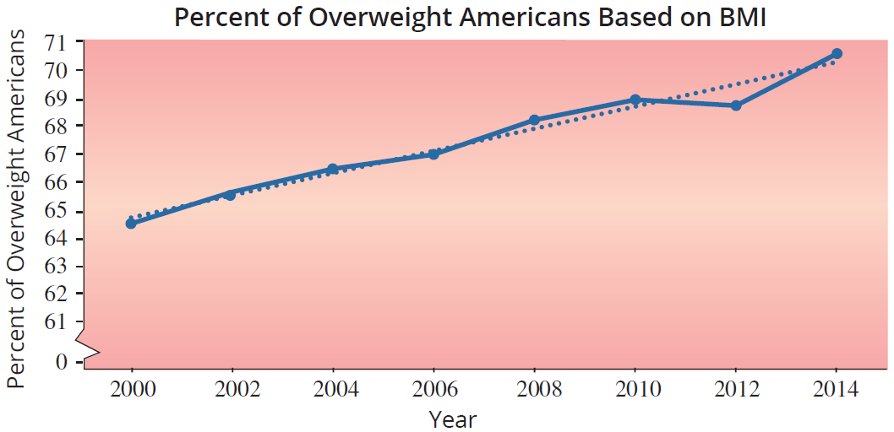
Example 5.4.1 (cont.)
A graph of the data reveals an upward trend in the percent of overweight Americans. The data appears to be a nonstationary time series with an upward trend.

Slide 6
Example 5.4.1 (cont.)
To describe the data we will model the trend by fitting a line through the data with the notion of capturing how fast (on average) the series is changing over time. Estimating the slope of the line will provide the average rate of change per year in the percent of overweight Americans. The line is fitted using least squares estimates in exactly the same way as the other regression models we studied have been constructed. The independent variable in a linear trend model is always time. In this case, the dependent variable is the percent of overweight Americans.

Slide 7
Example 5.4.1 (cont.)
The least squares equation is
Estimated % Overweight Americans = –705.5214 + 0.3851 (Year).
The computer output for the problem is given in the table on the next slide.

Slide 8
Example 5.4.1 (cont.)
Summary Output
Regression Statistics
Multiple R | 0.9830
R Square | 0.9660
Adjusted R Square | 0.9610
Standard Error | 0.3810
Observations | 8
ANOVA
 | df | SS | MS | F
Regression | 1 | 24.9172 | 24.9172 | 171.5380
Residual | 6 | 0.8715 | 0.1453
Total | 7 | 25.7889
 | Coefficients | Standard Error | t Stat | P-value
Intercept | –705.5214 | 59.0152 | –11.9550 | 0.00002
Year | 0.3851 | 0.0294 | 13.0972 | 0.00001

Slide 9
Example 5.4.1 (cont.)
Solution
The estimate of the slope of the line, 0.3851, tells us that on average the percent of overweight Americans is increasing at a rate of 0.3851 percent per year. Given how well the line fits the data (R² = 96.6%), the trend line is a good descriptor of the data.
The trend line can also be used for short-term prediction. Suppose you wished to estimate the percent of overweight Americans in 2015.

Slide 10
Example 5.4.1 (cont.)
If the data is not available, the trend model can be utilized by substituting the year, 2015, into the least squares equation.
–705.5214 + 0.3851 (2015) = 70.5%

