Slide 1
Section 6.2
Addition Rules for Probability

Slide 2
Probability Law 1
Definition
A probability of zero means the event cannot happen. (For example, the probability of observing three heads in two tosses of a coin is zero.)

Slide 3
Probability Law 2
Definition
A probability of one means the event must happen. (For example, if we toss a coin, the probability of getting either a head or tail is one.)

Slide 4
Probability Law 3
Definition
All probabilities must be between zero and one inclusively. The closer the probability is to 1, the more likely the event. The closer the probability is to 0, the less likely the event. For an event A this is expressed as follows.

Slide 5
Probability Law 4
Definition
The sum of the probabilities of all outcomes must equal one. That is, if P(A_{i}) is the probability of event A_{i}, and there are n such outcomes, then

Slide 6
Compound event
Definition
A compound event is an event that is defined by combining two or more events.

Slide 7
Union
Definition
The union of the events A and B is the set of outcomes that are included in event A or event B or both. Symbolically, the union of A and B is denoted A ∪ B and is read “A union B.”

Slide 8
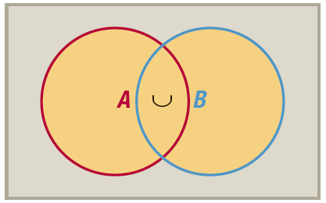
Union

Slide 9
Intersection
Definition
The intersection of the events A and B is the set of all outcomes that are included in both A and B. Symbolically, the intersection of A and B is denoted
A ∩ B and is read “A intersect B.”

Slide 10
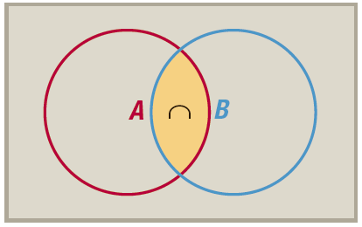
Intersection

Slide 11
Complement
Definition
The complement of an event A is the set of all outcomes in the sample space that are not in A. Symbolically, the complement of the set A will be written as A^{c}.

Slide 12
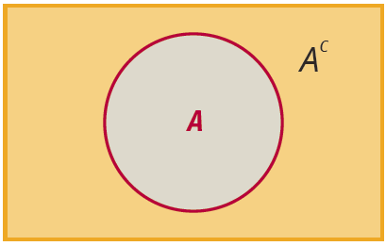
Complement

Slide 13
Probability Law 5: Complement of an Event
Definition
The probability of A^{c} is given by P( A^{c} ) = 1 − P(A).

Slide 14
Example 6.2.1
Consider the event A = {annual income is greater than $50,000}. Suppose the probability of A is 0.08. Determine the probability of observing someone whose income is less than or equal to $50,000.
Solution

Slide 15
Example 6.2.2
Consider an experiment to see how many tosses of a coin will be required to obtain the first head. The first head could be observed on the first toss or second toss, but there is no upper limit on the number of tosses that could be required. Therefore, the sample space for this experiment is the set of positive integers
{1, 2, 3, ... }. Not only is the sample space infinitely large, but there is another problem: the outcomes are not equally likely. This is a potentially ugly environment in which to compute a probability.

Slide 16
Example 6.2.2 (cont.)
But let’s make matters slightly worse. Suppose we want to know the probability that it will require at least two tosses (i.e., two or more tosses) to get the first head. This means that we must compute the probability of 2 tosses before the first head appears, the probability of 3 tosses to get the first head, and so on up to infinity and add them up in some way. The problem is rather insidious if approached directly.

Slide 17
Example 6.2.2 (cont.)
Solution
The problem becomes rather trivial by determining the complement of the event and computing its probability. The complement of obtaining the first head in two or more tosses is getting a head on the first toss. The probability of getting a head on the first toss is 0.5, assuming the coin is fair. Therefore, we have the following.

Slide 18
Odds
Definition
The odds in favor of an event A occurring is given by
The odds against an event A occurring is given by

Slide 19
Example 6.2.3
In the game of American roulette, the roulette wheel contains the numbers 1 through 36, alternating between red and black. There are two green spaces numbered 0 and 00.
Calculate the probability of the roulette ball landing on a red pocket.
Solution
Since there are 18 red pockets and 38 possible pockets on which to land, the probability of landing on red is given by

Slide 20
Example 6.2.3 (cont.)
In the game of American roulette, the roulette wheel contains the numbers 1 through 36, alternating between red and black. There are two green spaces numbered 0 and 00.
Calculate the probability of the roulette ball not landing on a red pocket.
Solution
The probability of not landing on a red pocket is found by

Slide 21
Example 6.2.3 (cont.)
In the game of American roulette, the roulette wheel contains the numbers 1 through 36, alternating between red and black. There are two green spaces numbered 0 and 00.
Calculate the odds in favor of the roulette ball landing on red.
Solution
The odds in favor of the roulette ball landing on red is

Slide 22
Mutually Exclusive
Definition
Two events are mutually exclusive if they have no outcomes in common.

Slide 23
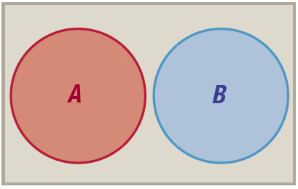
Mutually Exclusive

Slide 24
Probability Law 6: Union of Mutually Exclusive Events
Definition
If the events A and B are mutually exclusive, then

Slide 25
Probability Law 7: Intersection of Mutually Exclusive Events
Definition
If the events A and B are mutually exclusive, then

Slide 26
Example 6.2.4
Suppose that P(A) = 0.27 and the P(B) = 0.19. If A and B are mutually exclusive, what is the probability of A ∪ B?
Solution
Since these are mutually exclusive events,

Slide 27
Probability Law 8: The General Addition Rule
Definition
For any two events A and B,

Slide 28
Example 6.2.5
Suppose that a marketing manager believes that the probability that someone earns more than $50,000 is 0.2 and the probability that someone will subscribe to more than one sports magazine is 0.3. If the probability of finding someone in both categories is 0.08, what is the probability of finding someone who is earning over $50,000 or subscribes to more than one sports magazine?

Slide 29
Example 6.2.5 (cont.)
Solution
The problem involves the union of two events. Using the event names A and B, the desired probability is
Therefore, the probability of finding someone who is earning over $50,000 or subscribes to more than one sports magazine, or both is 0.42.

