Slide 1
Section 7.1
Types of Random Variables

Slide 2
Discrete Random Variable
Definition
A discrete random variable is a random variable which has a countable number of possible outcomes.
When describing a discrete random variable, you should do the following.
State the variable.
List all of the possible values of the variable.
Determine the probabilities of these values.

Slide 3
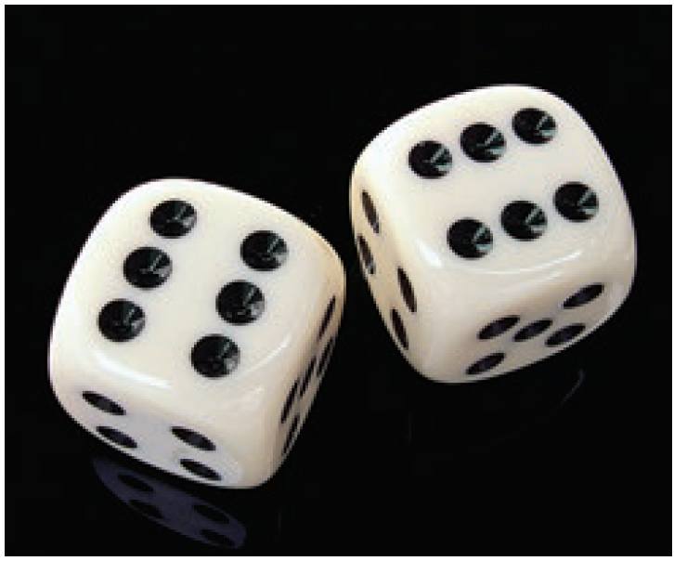
Example 7.1.1
Random Phenomenon: Toss a die and observe the outcome of the toss.
Identify the random variable:
X = the outcome of the toss of a die.
Range of values:
Integers between 1 and 6, inclusive.

Slide 4
Example 7.1.1 (cont.)
Probability distribution:
The outcomes of the toss of a die and their probabilities are given below. The probabilities are deduced using the classical method and the assumption of a fair die.
Tossing a Die
Value of X | 1 | 2 | 3 | 4 | 5 | 6
Probability | 1 6 | 1 6 | 1 6 | 1 6 | 1 6 | 1 6

Slide 5
Example 7.1.2
Random Phenomenon: The number of defective integrated circuits received in a batch of 1000. Each outcome of the random variable is a numerical measure whose range of values is given below.
Identify the random variable:
X = the number of defective integrated circuits in a batch of 1000.
Range of values:
Integers between 0 and 1000, inclusive, where N = 1000.
Probability distribution:
Unknown.

Slide 6
Example 7.1.3
Random Phenomenon: The head nurse of the pediatric division of the Sisters of Mercy Hospital is trying to determine the capacity requirement for the nursery. She realizes that the number of babies born at the hospital each day is a random variable. She will have to develop a description of the randomness in order to develop her plan.
Identify the random variable:
X = the number of babies born at Sisters of Mercy Hospital each day.

Slide 7
Example 7.1.3 (cont.)
Range of values:
Integers from 0 to some large positive number.
Probability distribution:
Unknown, but could be estimated using the relative frequency idea from Section 6.1 in conjunction with historical data on hospital births at Sisters of Mercy.

Slide 8
Continuous Random Variable
Definition
A continuous random variable is a random variable that can assume any value on a continuous segment(s) of the real number line.

Slide 9
Continuous Random Variable
Note
For continuous random variables, we specify probabilities with probability density functions.

Slide 10
Example 7.1.4
Random Phenomenon: A local restaurant has an express policy that states that lunch will be served within 15 minutes of ordering, or it will be free. Obviously, the restaurant is keenly interested in not giving away its product and in delivering on its promise of a timely lunch. But the length of time to prepare each meal varies because of the difference in preparation times of each dish, the load on the kitchen, and the experience of the chefs and waitresses.

Slide 11
Example 7.1.4 (cont.)
Identify the random variable:
X = the time between ordering a meal and receiving it.
Range of values:
From 0 to ∞ (infinity). Note that X is measured on a continuous scale.
Probability density:
Unknown, but could be approximated using historical data.

